Slide 1

MENTORA
AI Tutor for Personalized Learning
Noa Levy & Ben Garusi
The Academic College of Tel-Aviv – Yaffo
Github
github.com/bengarusi/Mentora

Slide 2





THE OPPORTUNITY
The Problem With Learning Today
One-size-fits-all
Classroom pacing rarely matches an individual student's gaps or speed.
Tutoring is expensive
Human tutors run $35–$100/hour — out of reach for consistent 1:1 support.
Passive digital content
Most online material informs but does not actively build understanding.
No real feedback loop
Students need immediate, adaptive guidance — not just answers.
2

Slide 3


WHO WE SERVE
Target Audience & Validated Need
Students, aged 6-15, learning independently or alongside a parent — anchored by two real use cases:
WHY NOW
$70–150B
global private-tutoring market, 2025
Learning a new topic
Solving a specific problem
25–35%
A structured, guided introduction to material the student hasn't studied yet.
Upload homework or class notes and get help tied directly to that content.
CAGR forecast for AI tutors through 2030
$35–$100/hr
Validation of demand
Market: global private tutoring is a $70–150B+ category already, growing 8–10% a year — families demonstrably pay for personalized support.
Competitors: well-funded products (Khanmigo, SchoolAI) already prove schools & families want an AI tutor, not just a chatbot.
typical cost of a human tutor
$0–$10/mo
Mentora's price to the family
3

Slide 4




THE PRODUCT
Meet Mentora
An AI tutor that explains, questions, and adapts — in real conversation, available 24/7.
Select Topic
Listen & Ask
Practice & Interact
Track Progress
Mentora replaces passive study with a dynamic, voice-driven tutoring loop — personalized to every student.
4

Slide 5
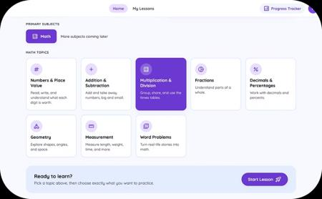
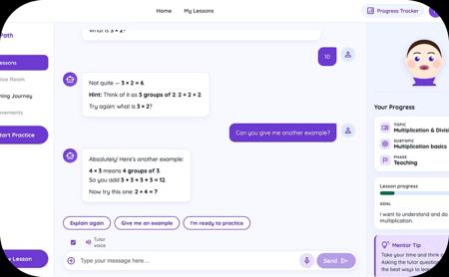
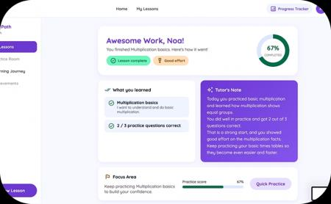
SEE IT IN ACTION
Product Walkthrough
Subject & Topic Selection
Conversational Tutor
Progress Tracking
Browse subjects and choose a lesson topic from a clean, card-based dashboard.
The AI tutor explains, asks follow-up questions, and evaluates answers — by voice or text.
Visual completion stats and a topic mastery map keep students motivated.
5

Slide 6




TECHNICAL FOUNDATION
System Architecture
FRONTEND
API LAYER
AGENT & LOGIC
AI LAYER
DATA LAYER
React / TypeScript / Vite
FastAPI + JWT auth
Tool-calling agent · state machine
OpenAI · Chat, STT, TTS
PostgreSQL · SQLAlchemy · Alembic
Streaming Voice Loop
State-Based Lesson Flow
Deterministic Math Grading
Engineering Depth
Speak → STT → chat LLM → TTS in 32KB chunks → avatar lip-sync, before full synthesis completes.
Teaching → Practice → Summary → Completed — each phase an isolated, testable state class.
Fraction · SymPy · normalization pipeline. The LLM never owns is_correct.
43 automated test suites · 10 versioned DB migrations · repository & strategy patterns.
6

Slide 7
THE LANDSCAPE
How Mentora Compares
Feature
Mentora
ChatGPT
Khanmigo
SchoolAI
Human Tutor
Deterministic answer grading
✓
✗
•
•
✓
Tutors from student's own material
✓
✓
✓
✓
✓
Real-time voice interaction
✓
✓
✓
✗
✓
Visual step-by-step explanations
✓
✗
•
•
✓
Progress tracking & analytics
✓
✗
✓
✓
✓
Price point
Low
Low
Low
Medium
High
• = partial capability, based on public product information
Mentora's edge: deterministic grading + document-grounded tutoring + a real voice loop, at a fraction of Khanmigo/SchoolAI's institutional price point.
7

Slide 8

MONETIZATION
Business Model
Free to start, simple to upgrade — built for ages 6–15.
MOST POPULAR
FREE
FOR FAMILIES
$10 / month
$0 forever
$10 + $5 / child
Unlimited tutoring sessions
Unlimited file uploads
Detailed progress reports
Limited guided lessons/day
Video tutoring
Basic progress tracking
Everything in Premium
Parent / teacher dashboard
Tiered pricing per child
Schools & Institutions: annual site license — every student gets full access. The real buyer is the educator; family & school tiers turn one happy learner into many seats.
8

Slide 9
THE PLAN
Go-to-Market Strategy
1
2
3
4
Consumer Beta
Subject Expansion
Family & Institutions
Scale
Launch free + premium on mathematics; validate retention & willingness to pay via schools, parenting groups, word of mouth.
Extend to English and Science, broadening the addressable student base and lengthening engagement.
Ship the parent/teacher dashboard; run pilot programs with individual schools.
Expand language coverage and subject depth; pursue broader institutional & multilingual markets.
Sequencing rationale: individual students feel the difference in a single session; institutional sales cycles are longer and lean on the roadmap items above.
9

Slide 10


PRODUCT ROADMAP
What's Next for Mentora
Smarter Memory
Upload Your Materials
Animated Avatar
Analytics Dashboard
More Subjects
Contextual memory across sessions so the tutor remembers each student's progress and gaps.
Already shipped for homework — expanding to full course syllabi and slide decks.
A fully expressive AI tutor avatar with lip-sync and emotion for a more human feel.
Deep insights — weak topics, session history, progress curves — for students and educators.
Expanding beyond math — Hebrew, English, and Science for broader learning support.
10

Slide 11




Mentora: A Tutor for Every Student
Truly Personalized
An AI tutor that explains, questions, and adapts to every student — 24/7.
Full Voice Loop
Speak or type — transcribe, reason, and speak back in seconds. Working today.
Built to Scale
A tested React + FastAPI + GPT stack, ready for new subjects and users.
Thank you!
Noa Levy & Ben Garusi

