Slide 1
Semi-Private Email Aliases
Beng Heng Ng, Alex Crowell, Atul Prakash
Department of Computer Science and Engineering
University of Michigan
May 4, AsiaCCS ’12, Seoul

Slide 2
Agenda
Introduction
Motivation
Related Work
Proposal
Design
Implementation
Evaluation
Conclusions

Slide 3
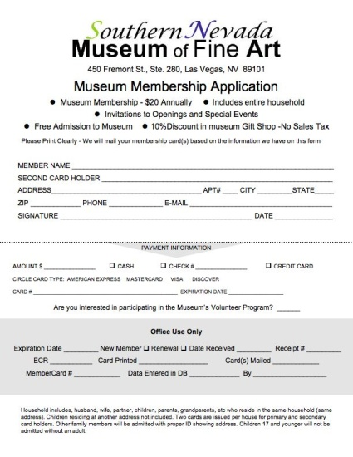
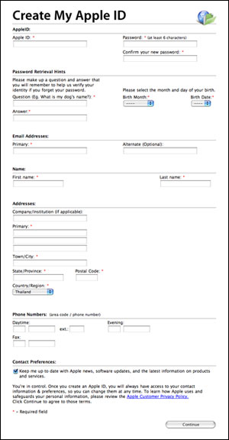
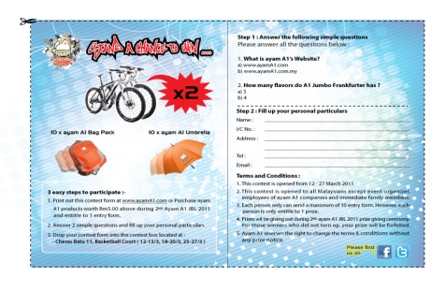




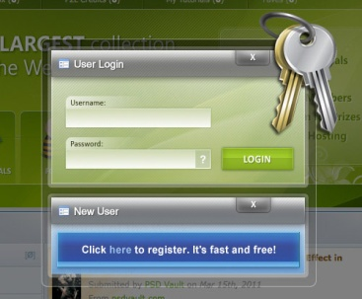






Email Addresses Distribution
Lucky Draws
Friends
Membership Forms
Product Registration
Websites
Affiliation Validation
Introduction ⇨ Motivation ⇨ Related Work ⇨ Proposal ⇨ Mechanism/Design ⇨ Implementation ⇨ Evaluation ⇨ Conclusions

Slide 4


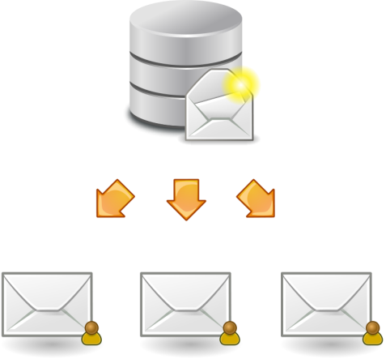
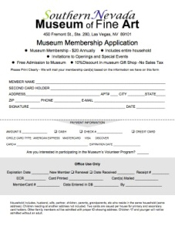
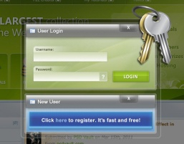
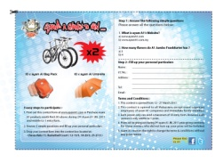




What is an Email Address Leak?
Sold on eBay
Affiliation validation
Email Marketing
bob@mail.com
Email Harvester
Product registration, lucky draws, membership forms, personal websites, forums
Sold on eBay
Relatives, Friends
Cracker
Introduction ⇨ Related Work ⇨ Proposal ⇨ Mechanism/Design ⇨ Implementation ⇨ Evaluation ⇨ Discussion ⇨ Conclusions
Notes:
How are your email addresses typically distributed?
Register for a new product, sign up for lucky draws, fill in membership forms, or register with certain websites, not uncommon that you provide your email address.
Relatives, friends, and fellow colleagues
Email addresses are also commonly used by businesses to validation your affiliation with an organization, so that they can provide you targeted services and product discounts. These include piazza, dropbox, Amazon Student, and mobile service providers.
When does your address get leaked?
When you handover your email address to any business, as postings on online forums, or on your own homepage, you no longer have any control over who can send you emails
Email marketers will of course be very interested in getting their hands on your email address. Expect this to get worse as email advertising becomes more targeted
Email harvesters crawl the web to collect email addresses, often unknown to the owner
Computers get hacked, or their email accounts are compromised, it is possible that your email address might be leaked too.

Slide 5
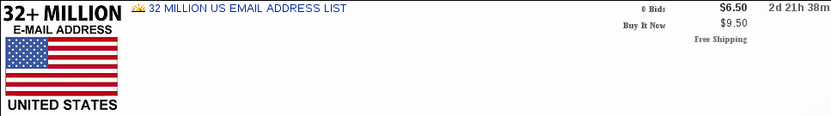
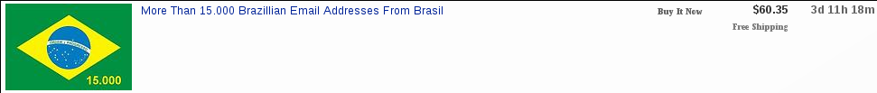

Email Addresses for Sale
Introduction ⇨ Related Work ⇨ Proposal ⇨ Mechanism/Design ⇨ Implementation ⇨ Evaluation ⇨ Discussion ⇨ Conclusions
Notes:
And of course, your email address could be sold cheaply online.
These are actual postings on eBay selling email addresses.

Slide 6
Current Solutions
bob_friends@mail.com
bob_colleagues@mail.com
bob_shopping@mail.com
bob_membership@mail.com
bob@mail.com.edu
Introduction ⇨ Motivation ⇨ Related Work ⇨ Proposal ⇨ Mechanism/Design ⇨ Implementation ⇨ Evaluation ⇨ Discussion ⇨ Conclusions
Notes:
Go to slide 4, 8, 10, 9
Mitigation/limit leak extent
Group our contacts into different categories, and provide each of them a different email address created manually.
A troublesome process to create an email account to obtain an email address each time you require one.
Some current email providers do provide aliases.
However, the number of aliases that you can create is usually limited. While this is only a technical limitation, it still does not address the problem of email address leakages.
When that alias is leaked, you can still received unwanted emails in your inbox.

Slide 7

Motivation
Problems with Current Solutions
Addresses could be guessed
Manageability issues with multiple email addresses (state as goal)
Rolling new addresses a challenge
Still do not solve root of problem, i.e. leakages
Introduction ⇨ Related Work ⇨ Proposal ⇨ Mechanism/Design ⇨ Implementation ⇨ Evaluation ⇨ Discussion ⇨ Conclusions
Notes:
What are the problems with the current solutions?
Users generally only have a limited number of permanent email addresses, and these could often be guessed, which can lead to leakages.
And when you have multiple email accounts, manageability becomes an issue.
Rolling new addresses is also a challenge.
Of course, existing solutions still don’t solve the root of the problem, that is stopping the leakage itself.

Slide 8
Problem Statement
Pessimistically assume eventual leak of an email address to some party undesired by user
Research gap in mitigating impact of address leaks
Provides explicitly user control in allowing senders to email the user
Secondary goal: combine advantages of permanent and temporary email addresses
Low costs for good users
High costs for potentially bad users
Introduction ⇨ Related Work ⇨ Proposal ⇨ Mechanism/Design ⇨ Implementation ⇨ Evaluation ⇨ Discussion ⇨ Conclusions
Notes:
We pessimistically assume that your email address will eventually be leaked to undesired users.
There is a research gap in mitigating this leak. In other words, there is currently no good way for the address owner to control who might send emails to them.
Additionally, we have the secondary goal of making the usability costs low for good users (as in permanent email addresses), while making it high for potentially bad users (as in temporary email addresses).

Slide 9
Related Work – Spam Filtering
Effective in most cases, but still occurs
Spammers getting more targeted
Heuristical approach, false positives/negatives
User may need to check 'Spam' folder
Solves the symptoms of the problem rather than the root cause, i.e. leaks.
Introduction ⇨ Related Work ⇨ Proposal ⇨ Mechanism/Design ⇨ Implementation ⇨ Evaluation ⇨ Discussion ⇨ Conclusions
Notes:
Another huge area of work is concerned with identifying and filtering spam.
Spam filtering has improved in the recent years. However, spammers are getting more targeted. They are sending emails that appear personalized, thus evading heuristical approaches. Moreover, spam filters do not consider the temporal characteristics of some scammers, which we observe on Craigslists. Craigslists is a popular and free classified advertising site.
Spam filtering solves the symptoms, but not the root cause. While spam filtering is important, we argue that our work is complementary to it.

Slide 10
Related Work
Features | Disposable Email Addresses | Inexpensive Email Addresses^{1,2} | Single Purpose Addresses^{2,3} | Traditional Aliases | Semi-Private Aliases
Complete Functions |  | ✓ | ✓ | ✓ | ✓
Integrated |  | ✓ | ✓ | ✓ | ✓
Private Inbox |  | ✓ | ✓ | ✓ | ✓
Intelligible Addresses | ✓ |  |  | ✓ | Partly
Stateless Design |  | ✓ | ✓ | ✓
Embedded Policy |  |  | ✓
Progressive Restrictions |  |  |  |  | ✓
Aram Yegenian and Tassos Dimitriou. Inexpensive Email Addresses: An Email Spam-Combating System. Security and Privacy in Communication Networks, volume 50 of Lecture Notes of the Institute for Computer Sciences, Social Informatics and Telecommunications Engineering, pages 35–52. Springer Berlin Heidelberg, 2010.
John Ioannidis. Fighting spam by encapsulating policy in email addresses. NDSS 2003.
TMDA. Tagged Message Delivery Agent (TMDA). Online.
Introduction ⇨ Related Work ⇨ Proposal ⇨ Mechanism/Design ⇨ Implementation ⇨ Evaluation ⇨ Discussion ⇨ Conclusions
Notes:
So, if creating multiple email addresses does not work, what else can we do? This table compares the features of various possible methods. Note that a tick does not imply it is a better feature. It just mean that the feature is supported.
Disposable Email Addresses (DEA) allow users to create an email address very quickly without having to create an email account. The mechanism is extremely lightweight, and is the only one that does not provide complete email functionalities. However, DEA has some shortcomings.
Emails are consolidated in a single public inbox, i.e. anyone can read emails from others.
And often, you can only use the created email address for receiving but not sending.
User needs to know right from the start that this sender cannot be trusted.
Emails are short-lived. For mailinator, they are deleted within several hours.

Slide 11
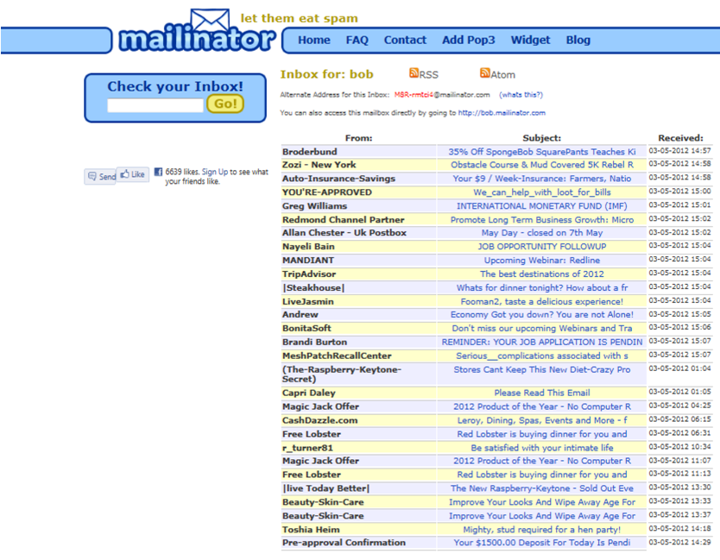

Slide 12
Related Work
Features | Short-term DEA | Inexpensive Email Addresses^{1,2} | Single Purpose Addresses^{2,3} | Traditional Aliases | Semi-Private Aliases
Complete Functions |  | ✓ | ✓ | ✓ | ✓
Integrated |  | ✓ | ✓ | ✓ | ✓
Private Inbox |  | ✓ | ✓ | ✓ | ✓
Intelligible Addresses | ✓ |  |  | ✓ | Partly
Stateless Design |  | ✓ | ✓ | ✓
Embedded Policy |  |  | ✓
Progressive Restrictions |  |  |  |  | ✓
Introduction ⇨ Related Work ⇨ Proposal ⇨ Mechanism/Design ⇨ Implementation ⇨ Evaluation ⇨ Discussion ⇨ Conclusions
Notes:
Inexpensive Email Address (IEA), proposed by Yegenian et al, uses a CAPTCHA to verify the sender. This makes it impossible to work with mailing lists, and newsletters.

Slide 13
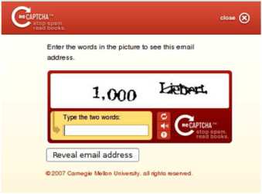
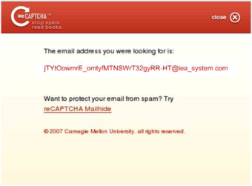
Related Work - IEA
From: "Alice" <alice@example.com>
To: "Bob" <bob@iea system.com>
From: "Alice" <alice@example.com>
To: "Bob" <jTYtOowmrE omtyfMTNSWrT32gyRR-HT@iea system.com>
Introduction ⇨ Related Work ⇨ Proposal ⇨ Mechanism/Design ⇨ Implementation ⇨ Evaluation ⇨ Discussion ⇨ Conclusions

Slide 14
Related Work
Features | Short-term DEA | Inexpensive Email Addresses^{1,2} | Tagged Email Addresses^{2,3} | Traditional Aliases | Semi-Private Aliases
Complete Functions |  | ✓ | ✓ | ✓ | ✓
Integrated |  | ✓ | ✓ | ✓ | ✓
Private Inbox |  | ✓ | ✓ | ✓ | ✓
Intelligible Addresses | ✓ |  |  | ✓ | Partly
Stateless Design |  | ✓ | ✓ | ✓
Embedded Policy |  |  | ✓
Progressive Restrictions |  |  |  |  | ✓
Single Purpose Address (SPA): ji+QQIV89O7OD2GDASIK2M1928IN6N8@fufutos.gr
TMDA: jason-dated-989108708.a17f80@mastaler.com
Introduction ⇨ Related Work ⇨ Proposal ⇨ Mechanism/Design ⇨ Implementation ⇨ Evaluation ⇨ Discussion ⇨ Conclusions
Notes:
Single Purpose Addresses (SPA) attempt to embed policies into the email addresses. In particular, the expiry date of the email address is encoded into the username. This has the shortcoming that once created, the only way for the email address to be decommissioned is to wait for them to expire. Moreover, they do not solve the leakage problem. As long as the sender knows an unexpired SPA, he can still send to that address.
Our work on Semi-Private Aliases attempts to retain the advantages of existing techniques without the shortcomings. An important feature in Semi-Private Aliases is that we allow progressive restrictions of who can send to an alias. We will describe this shortly.

Slide 15
Related Work
Features | Short-term DEA | Inexpensive Email Addresses^{1,2} | Tagged Email Addresses^{2,3} | Traditional Aliases | Semi-Private Aliases
Complete Functions |  | ✓ | ✓ | ✓ | ✓
Integrated |  | ✓ | ✓ | ✓ | ✓
Private Inbox |  | ✓ | ✓ | ✓ | ✓
Intelligible Addresses | ✓ |  |  | ✓ | Partly
Stateless Design |  | ✓ | ✓ | ✓
Embedded Policy |  |  | ✓
Progressive Restrictions |  |  |  |  | ✓
Introduction ⇨ Related Work ⇨ Proposal ⇨ Mechanism/Design ⇨ Implementation ⇨ Evaluation ⇨ Discussion ⇨ Conclusions
Notes:
Many modern email providers support creation of traditional aliases, although the implementations may differ. For example, in Gmail, an alias is created by appending a string to the username with a plus sign. The problem with traditional aliases is similar to permanent email addresses. It provides users the convenience of not having to create an account to get a new alias, but once the alias is leaked, the user will continue to receive spams on the alias.

Slide 16
Related Work
Features | Short-term DEA | Inexpensive Email Addresses^{1,2} | Tagged Email Addresses^{2,3} | Traditional Aliases | Semi-Private Aliases
Complete Functions |  | ✓ | ✓ | ✓ | ✓
Integrated |  | ✓ | ✓ | ✓ | ✓
Private Inbox |  | ✓ | ✓ | ✓ | ✓
Intelligible Addresses | ✓ |  |  | ✓ | Partly
Stateless Design |  | ✓ | ✓ | ✓
Embedded Policy |  |  | ✓
Progressive Restrictions |  |  |  |  | ✓
Introduction ⇨ Related Work ⇨ Proposal ⇨ Mechanism/Design ⇨ Implementation ⇨ Evaluation ⇨ Discussion ⇨ Conclusions
Notes:
Our work on Semi-Private Aliases attempts to retain the advantages of existing techniques without the shortcomings. An important feature in Semi-Private Aliases is that we allow progressive restrictions of who can send to an alias. We will describe this shortly.

Slide 17
Research Questions
Can we combine the advantages of permanent email addresses and disposable email addresses?
Is there a way to progressively limit the restrictions on the senders of an email address while providing a simple Mechanism/Design to rollover disposable addresses?
Introduction ⇨ Related Work ⇨ Proposal ⇨ Mechanism/Design ⇨ Implementation ⇨ Evaluation ⇨ Discussion ⇨ Conclusions
Notes:
So we want to know if we can combine the advantages of permanent email addresses and disposable ones.
And, is there a way to progressively limit the restrictions on the senders of an email address?

Slide 18
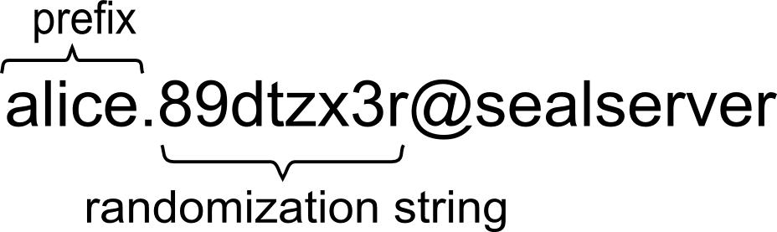
Contributions
Alias Lifecycles:
Paradigm for elegant degradation of aliases
Affiliation Validation
Provide control and design that make it easier to avert policy dilemma
Propose semi-randomized aliases
Low usage costs in the common cases
Introduction ⇨ Related Work ⇨ Proposal ⇨ Mechanism/Design ⇨ Implementation ⇨ Evaluation ⇨ Discussion ⇨ Conclusions
Notes:
We introduce the idea of alias lifecycles where aliases can be degraded gradually, from a state where we fully trust all senders to more restricted states where only a set of senders are allowed.
Secondly, our work enables users to create aliases to be distributed to businesses/organizations that uses email addresses for validating his/her affiliation.
We propose the use of semi-randomized aliases. Shown here is an example of a semi-private email alias. It has a prefix chosen by the user, and has a string that is automatically generated by SEAL. The purpose of the randomized string is to prevent brute-force attacks by senders.
Finally, we show how we can mitigate email address leaks with a solution that has low usage costs in the common cases, but high costs in the infrequent cases of bad senders.

Slide 19
Features
Semi-private Email Aliases
Stateful design
Reconfigurable policies; Fine grained permissions control
Lightweight – approximately 2000 lines of Python code
Semi-Randomization
Introduction ⇨ Related Work ⇨ Proposal ⇨ Mechanism/Design ⇨ Implementation ⇨ Evaluation ⇨ Discussion ⇨ Conclusions
Notes:
We propose SEAL, which has a stateful design. SEAL server stores state information about aliases, i.e. whether it is unrestricted, partly/fully restricted or disabled. It also has reconfigurable policies. Users can determine when to restrict an alias

Slide 20
What SEAL Doesn’t Do
Anonymity
User could reveal identity in email ID
Spam filtering
SEAL is a complementary approach
Email Storage Services
Introduction ⇨ Related Work ⇨ Proposal ⇨ Mechanism/Design ⇨ Implementation ⇨ Evaluation ⇨ Discussion ⇨ Conclusions
Notes:
SEAL does not enforce anonymity. If the user so chooses, she could use identifiable strings in the prefix. However, the randomized part prevents adversaries from easily guessing the complete alias.
SEAL does not do any spam filtering, although SEAL and spam filtering can be complementary.
SEAL does not store the emails. It is more like an email proxy service. However, we do store some information about the states of the aliases.

Slide 21

Unrestricted to Partly Restricted Alias
1
Trusted Sender
2
User
3
Introduction ⇨ Related Work ⇨ Proposal ⇨ Mechanism/Design ⇨ Implementation ⇨ Evaluation ⇨ Discussion ⇨ Conclusions
Notes:
[describe what is semi-restricted, partly restricted, use only 1 direction arrow]
I will now describe how semi-private email aliases work.
An alias starts from the fully trusted state, whereby it trusts all senders. This assumption here is that the email aliases are generally only distributed to trusted senders early in their lifecycle.
Suppose some time later, the user begins to receive unsolicited emails. This could be supported by existing spam filtering techniques.
The user can mark the alias as partly restricted. In this state, only senders prior to the first unsolicited email can continue sending to the alias, while new senders will need to solve CAPTCHAs, similar to Inexpensive Email Address by Yegenian et al. The user is also notified of the new senders.

Slide 22

Partly Restricted Alias
2
1
Introduction ⇨ Related Work ⇨ Proposal ⇨ Mechanism/Design ⇨ Implementation ⇨ Evaluation ⇨ Discussion ⇨ Conclusions
Notes:
If the CAPTCHAs are solved correctly, and the user allows the sender to continue sending, the new sender will be added to the group of trusted senders. Subsequently, the sender can send to the user without having to solve the CAPTCHA.

Slide 23
Partly Restricted to Fully Restricted Alias
Introduction ⇨ Related Work ⇨ Proposal ⇨ Mechanism/Design ⇨ Implementation ⇨ Evaluation ⇨ Discussion ⇨ Conclusions
Notes:
Over time, as the alias continues to leak, the user will receive more notifications for un-trusted senders. When the user feels that this is overwhelming him, he can mark the alias as fully restricted. In this state, SEAL does not issue any notification and CAPTCHAs. Mails from un-trusted senders are simply dropped. This way, we restrict only trusted senders to continue sending emails.

Slide 24
Disabled Alias
Introduction ⇨ Motivation ⇨ Related Work ⇨ Proposal ⇨ Mechanism/Design ⇨ Implementation ⇨ Evaluation ⇨ Conclusions
Notes:
The user may also completely disable the alias. In this state, even the trusted senders would not be able to send emails to the user. If the user chooses, he can create and send a new alias to the trusted senders, or a subset of them.
While we provide the ability to disable an alias, we feel that most users will keep their aliases in the fully restricted state.

Slide 25
System Overview
Introduction ⇨ Related Work ⇨ Proposal ⇨ Mechanism/Design ⇨ Implementation ⇨ Evaluation ⇨ Discussion ⇨ Conclusions
Notes:
[SEAL service, email provider, browser]
* Management vs email flow
Bob is a SEAL users, while Alice is a correspondent. The solid arrows represent the normal email flow, i.e. over SMTP, POP3, IMAP. The dashed arrows shows the flow of command emails, such as for creating and restricting the aliases. Bob can also issue commands over http. This is mostly for the user to manage his account.
We implemented SEAL as a proxy email service. This has advantages including consistent user interface. The user continues using his favorite email provider, as long as it supports authenticated SMTP. Also, this reduces attack surface, by not storing too much data that may be attractive to attackers.

Slide 26

System Overview
SEAL
Server
Internet
Forwarding
Mail Provider
Management flow
Email flow
Introduction ⇨ Related Work ⇨ Proposal ⇨ Mechanism/Design ⇨ Implementation ⇨ Evaluation ⇨ Discussion ⇨ Conclusions
Notes:
We implemented SEAL as a proxy email service. This has advantages including consistent user interface. The user continues using his favorite email provider, as long as it supports authenticated SMTP. Also, this reduces attack surface, by not storing too much data that may be attractive to attackers.
The orange normal email flow, i.e. over SMTP, POP3, IMAP. The dashed arrows shows the flow of command, such as for creating and restricting the aliases. The user can also issue commands over http. This is mostly for the user to manage his account.

Slide 27
Methods for Alias Creation
Many situations call for aliases
Both online and offline
Want many routes of access
Via Website
Via Email
Via Login Box
Future work: via Cell Phone
Introduction ⇨ Related Work ⇨ Proposal ⇨ Mechanism/Design ⇨ Implementation ⇨ Evaluation ⇨ Discussion ⇨ Conclusions
Notes:
SEAL provides online and offline alias creation, thus allowing the user to create aliases under different scenarios.
The website allows users to manage aliases using SEAL’s website.
The user may also send command emails to SEAL using emails.
For alias creation, it is also possible to request for a new alias by monitoring for keywords at login boxes, similar to the work PasswdHash.

Slide 28
Aliases and Affiliation
SEAL servers for organization domains
Validation done using aliases
Gives users power to enforce own policy
bengheng@eecs.umich.edu
bhwork.w7vv4b11@seal.eecs.umich.edu
Further extensions possible
Profile for each alias
User controls visible information
Avoids OpenID style auth. infrastructure
Introduction ⇨ Related Work ⇨ Proposal ⇨ Mechanism/Design ⇨ Implementation ⇨ Evaluation ⇨ Discussion ⇨ Conclusions
Notes:
SEAL servers for organization domains can be used for validating user affiliations. This provide users the ability to enforce their own policies.
It may also be possible to extend SEAL further by having a profile for each alias, whereby the user controls the visibility information. This avoids OpenID style authentication infrastructure.

Slide 29
SEAL Architecture
Introduction ⇨ Related Work ⇨ Proposal ⇨ Mechanism/Design ⇨ Implementation ⇨ Evaluation ⇨ Discussion ⇨ Conclusions

Slide 30
Implementation
Postfix
Content filter in Python
Dovecot SASL
SQLite database backend stores:
Account info
Aliases
History of correspondences
Introduction ⇨ Related Work ⇨ Proposal ⇨ Mechanism/Design ⇨ Implementation ⇨ Evaluation ⇨ Discussion ⇨ Conclusions
Notes:
We implemented SEAL, using Postfix and content filters in Python. We use Dovecot SASL for the authentication mechanism.
For our prototype, we use SQLite to store account information, aliases and correspondent histories. Of course, other databases could be used.

Slide 31
Evaluation
Affiliation Validation
Leakages by websites
Leakages by online postings/classifieds
Timing Performance
Introduction ⇨ Related Work ⇨ Proposal ⇨ Mechanism/Design ⇨ Implementation ⇨ Evaluation ⇨ Discussion ⇨ Conclusions
Notes:
For evaluation, we are interested in whether SEAL works in a real-life scenario for validating the affiliation of users.
Also, our evaluation examines the possibility of email address leakages by websites, online postings or classifieds.
Lastly, we are also interested in the timing performance of SEAL.

Slide 32
Evaluation (Affiliation Validation)
Objective: Applicability of SEAL in real-world affiliation validation
Piazza.com, an online classroom discussion forum, was used for a semester.
Need to reveal email to 3rd party site with different privacy policy from University
68 participants were offered the option of using SEAL.
Results
55 (80.9%) proceeded to create aliases and use SEAL actively for the whole semester.
Five users created two aliases, one created three and another created five.
Introduction ⇨ Related Work ⇨ Proposal ⇨ Mechanism/Design ⇨ Implementation ⇨ Evaluation ⇨ Discussion ⇨ Conclusions
Notes:
In this experiment, we are curious if SEAL could work in real world affiliation validations.
At the beginning of a semester for a class, we provide the students the option of using SEAL with Piazza. Piazza is an online classroom discussion forum.
There were 68 potential participants. 55 of them took up the option to use SEAL and remained using it actively for the whole semester.
We noticed five users who created two aliases, 1 created 3, and another created 5. However, for all these cases, only 1 of the alias is used actively. This is likely due to the user trying out the system.

Slide 33
Introduction ⇨ Motivation ⇨ Related Work ⇨ Proposal ⇨ Mechanism/Design ⇨ Implementation ⇨ Evaluation ⇨ Conclusions

Slide 34
Evaluation (Affiliation Validation)
Introduction ⇨ Related Work ⇨ Proposal ⇨ Mechanism/Design ⇨ Implementation ⇨ Evaluation ⇨ Conclusions
Notes:
These are two graphs showing the number of aliases and number of emails per day respectively, showing consistent usage of SEAL.
The dips correspond to weekends and public holidays.

Slide 35
Evaluation (Leakages By Websites)
Objectives: Measure whether leakages exists for site registrations, and whether semi-private email alias can mitigate impact of leakages
Registered with 56 popular websites found by searching keywords such as “shopping”, “fast cash”, “movies”, “music”, “cheap flights”, and “education”
Results
Two websites reject email IDs exceeding 30 characters
Three websites disallow period (.) in email IDs. We modified SEAL to support ‘_’ and ‘-’
Not a limitation since the RFC is not violated
Introduction ⇨ Related Work ⇨ Proposal ⇨ Mechanism/Design ⇨ Implementation ⇨ Evaluation ⇨ Conclusions
Notes:
Next, we want to evaluate leakages by websites. While laws mandate that if websites share information with their affiliates, they need to disclose the sharing in their privacy policy. However, as we all know, users often do not read everything in detail.
We registered with 56 popular websites by searching for certain keywords.
We found that two websites reject email IDs exceeding 30 characters.
3 websites disallow period. (Modified SEAL to support underscor and dash)
Note that this is not a limitation since the RFC is not violated.

Slide 36
Evaluation (Leakages By Websites)
Registered with another 101 websites from 15 categories ranked by Alexa: arts, business, computers, games, health, home, kids and teens, news, recreation, reference, regional, science, shopping, society, and sports
Subscribed to 15 mailing lists ranked as having most subscribers by L-Soft
Introduction ⇨ Related Work ⇨ Proposal ⇨ Mechanism/Design ⇨ Implementation ⇨ Evaluation ⇨ Conclusions
Notes:
In addition, we registered with another 101 websites from 15 categories ranked by Alexa.
We also subscribed to 15 mailing lists ranked by L-Soft as having the most number of subsribers.

Slide 37
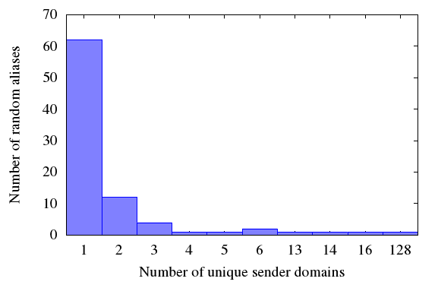
Evaluation (Leakages By Websites)
Introduction ⇨ Related Work ⇨ Proposal ⇨ Mechanism/Design ⇨ Implementation ⇨ Evaluation ⇨ Conclusions
Notes:
The histogram shows the number of random aliases versus unique sender domains. While most aliases received emails from 1 unique sender domains, there are some that received emails from multiple unique sender domains.
In an extreme case, there were 128 unique sender domains for the emails received by an alias. Clearly, this is not the case of a single website having multiple domains.

Slide 38
Introduction ⇨ Related Work ⇨ Proposal ⇨ Mechanism/Design ⇨ Implementation ⇨ Evaluation ⇨ Discussion ⇨ Conclusions

Slide 39
Evaluation (Leakages By Online Posts, Classifieds)
Objective: Measure whether leakages exists on online posts and classifieds
Posted messages on seven forums and one popular classified ads site using a new alias for each posting
Collected emails sent to aliases after 15 days
Results
Observed two leakages on two forums (tripadvisor.com, webmd.com)
Introduction ⇨ Related Work ⇨ Proposal ⇨ Mechanism/Design ⇨ Implementation ⇨ Evaluation ⇨ Discussion ⇨ Conclusions
Notes:
Next, we are curious about leakages by online posts and classifieds. This pertain mostly to email harvesters.
We posted messages on 7 public forums and 1 popular classified ads using a new alias for each posting.
The results are collected after 15 days.
We observed two leakages on two forums.
Additionally, there were 7 legitimate responses (verified manually) to the posting on the advertising site. 16 were illegitimate .
6 senders claimed to be admins of the classified ads site.
1 sender claimed to be from FBI and another from a reputable bank.
8 has links to suspicious sites.
While conducting this experiment, we found that the semi-private email aliases help us quickly identify sources of leakages.

Slide 40
Evaluation (Timing Performance)
Objective:
Email systems are store-and-forward (delay tolerable)
Still, any delay must be within reasonable bounds
Use arrival times in Received header field
Not ideal due to clock skew, incorrect time on some servers, and granularity of seconds
But sufficient
Only require approximation
Lack of access to other servers
Introduction ⇨ Related Work ⇨ Proposal ⇨ Mechanism/Design ⇨ Implementation ⇨ Evaluation ⇨ Discussion ⇨ Conclusions
Notes:
While email systems are store-and forward (and thus delay tolerable),
any delay should still be within reasonable bounds
We used the difference between the arrival times in the Received header field for the delays. While this is not ideal due to clock skew, incorrect times on some servers and includes network delays,
It is sufficient as an approximation.
Moreover we lack access to other servers.

Slide 41
Evaluation (Timing Performance)
(6) by 10.231.190.83
with SMTP id dh19csp37616ibb;
Sat, 25 Feb 2012 07:02:20 -0800 (PST)
(5) by 10.50.178.73
with SMTP id cw9mr7274127igc.23.1330182140761;
Sat, 25 Feb 2012 07:02:20 -0800 (PST)
(4) from seal.eecs.umich.edu
(d-110-235.eecs.umich.edu. [141.212.110.235])
by mx.google.com
with ESMTP id no10si2673927igc.10.2012.02.25.07.02.20;
Sat, 25 Feb 2012 07:02:20 -0800 (PST)
(3) from seal.eecs.umich.edu (localhost [127.0.0.1])
by seal.eecs.umich.edu (Postfix)
with ESMTP id EE11954C72F
for <johnsmith@gmail.com>;
Sat, 25 Feb 2012 10:05:12 -0500 (EST)
(2) from backend.www.inm.smartertravel.net
(backend.www.inm.smartertravel.net [75.98.73.172])
by seal.eecs.umich.edu (Postfix)
with ESMTPS id CA35354C722
for <ads.j1pdkqa5@seal.eecs.umich.edu>;
Sat, 25 Feb 2012 10:05:12 -0500 (EST)
(1) from smarter (helo=localhost)
by backend.www.inm.smartertravel.net
with local-bsmtp (Exim 4.76)
(envelope-from
<b-KEEXNPCTCQ-38936-2893808-AWDSubscriptionUtils
@lists.airfarewatchdog.com>)
id 1S1J8d-0007SB-QG
for ads.j1pdkqa5@seal.eecs.umich.edu;
Sat, 25 Feb 2012 10:02:19 -0500
Introduction ⇨ Related Work ⇨ Proposal ⇨ Mechanism/Design ⇨ Implementation ⇨ Evaluation ⇨ Discussion ⇨ Conclusions
Notes:
These are the Received headers from an actual email. The date/time information highlighted in red are the times we used for computing the delays.
Note that they only have a resolution of 1 second.

Slide 42
Evaluation (Timing Performance)
Delay (secs) | Percentage | Number
0 to 1 | 81.383 | 103, 189
1 to 2 | 9.465 | 12, 001
2 to 3 | 1.779 | 2, 255
3 to 4 | 0.900 | 1, 141
4 to 5 | 0.605 | 767
126, 794 delays
Mean: 105.116 secs
Standard Deviation: 21, 232.627 secs
SEAL mean: 0.274 secs
Introduction ⇨ Related Work ⇨ Proposal ⇨ Mechanism/Design ⇨ Implementation ⇨ Evaluation ⇨ Discussion ⇨ Conclusions
Notes:
In total, we collected 126, 794 delays, with a long tail distribution.
SEAL has a mean of 0.274 secs, well within 1 std deviation.
The results show that SEAL performs well within reasonable bounds.

Slide 43
Discussion – Security Analysis
Attack on SEAL servers
One-time intrusion: only email ID, all other email IDs are salted
Persistent: limited to the time the attack goes unnoticed
Misuse by spammers
May not be that advantageous to spammers since they can already create multiple email addresses using known technologies
Easy to detect, using stricter checks during user registration (similar to Gmail)
Email harvesters
Looking at generating “randomized” string based on IP address of HTTP request
Introduction ⇨ Related Work ⇨ Proposal ⇨ Mechanism/Design ⇨ Implementation ⇨ Evaluation ⇨ Discussion ⇨ Conclusions
Notes:
To limit the extent of the potential damage caused by a one-time intrusion, we hash all email IDs with the user salt, except for the forwarding email ID, which we need for redirection.
Spammers may think of misusing SEAL. But there may not be many advantages since using current technologies, they can already easily create multiple email addresses. Moreover, we can incorporate stricter checks during user registration, similar to Gmail.
Email harvesters crawl the web for emails. An idea could be to use Php to automatically generate an alias on the fly, where the randomized string is now based on the IP address of the HTTP request. This way, each email harvester from a unique IP will obtain a different alias, which can be disabled easily. For senders who are subsequently trusted, the user can add them to the list of trusted senders.

Slide 44
Discussion - Usability
Users prefer permanent email addresses because easy to remember, write down on business cards, etc.
Could pre-generate aliases and cached on mobile devices
Use mobile app to retrieve new alias
Multiple email aliases per user, may be confusing
SEAL compatible address books could automatically associate all aliases with same prefix
Introduction ⇨ Related Work ⇨ Proposal ⇨ Mechanism/Design ⇨ Implementation ⇨ Evaluation ⇨ Discussion ⇨ Conclusions

Slide 45
Conclusions
Traditional email addresses provide little permission control
Semi-private aliases extend DEAs
Alias Lifecycles
Easy-to-deploy affiliation validation
Practicality shown in lab, real-world tests
Introduction ⇨ Related Work ⇨ Proposal ⇨ Mechanism/Design ⇨ Implementation ⇨ Evaluation ⇨ Discussion ⇨ Conclusions
Notes:
To conclude, traditional addresses does not allow the user to control the permissions granted to the senders.
SEAL extends DEAs by having the concept of an alias lifecycle,
And it enables easy-to-deploy affiliation validation
Our experiments show that SEAL is practical in the real world.

