Slide 1
Power Converter Chain
USB-C Connector
USB Switch
5V -> 5.5V Boost Converter
5V -> +/-12V Conv
+/-10V LDO
+/-5V LDO
Toggle Switch
3.3VA LDO
3.3VDD LDO
1.8VDD LDO
5VDD LDO
3.0V LDO

Slide 2
Bypass
Toggle Switch
RCA Jack Input
1x toggle switch
4x rotary potentiometers
OPAxxxx
Input buffer and DC block
OPAxxxx
Bessel Low Pass Filter
ADAU1701 DSP
PCM5102A DAC
PGA2311 Volume Control
Output Stage
I2C, I2S
Headphone Jack
York Audio Module
EEPROM
OLED Display
I2C
ESP32
ADC
OPAxxxx
Unity Gain Non Inverting Input Buffer
SPI

Slide 3
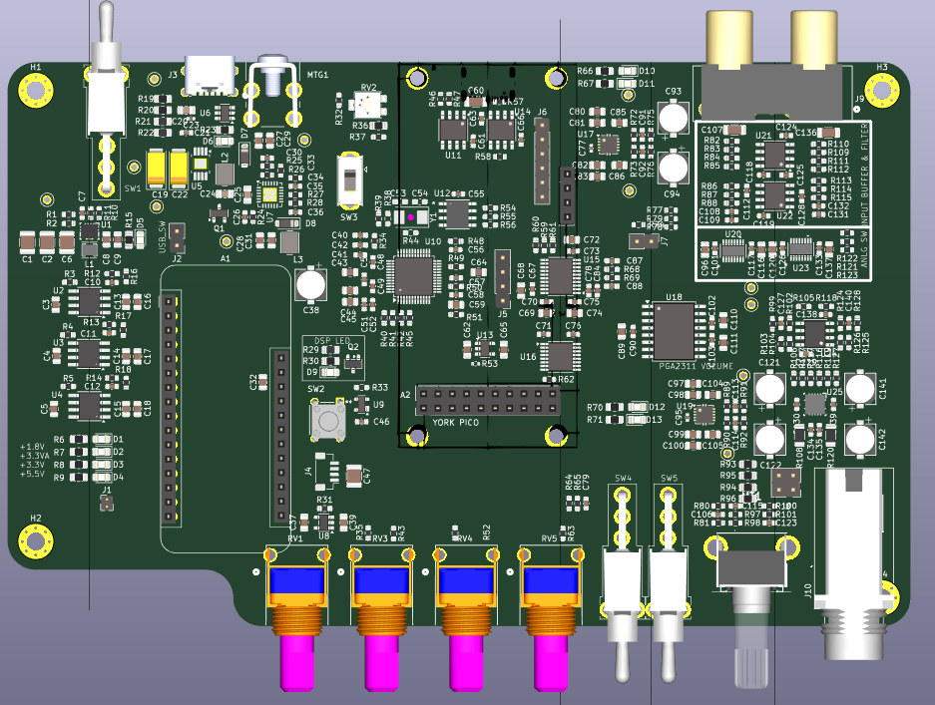
usbc
RCA Jack Input
+/-5V LDO
ON/OFF Switch
Input Stage
+/-12V Switcher
TPS65131
Boost Converter
ADAU1701 DSP
Analog Switches
PCM5102 DAC
5.0V LDO
ESP32 Module
PGA2311 Volume Control
Output Stage
3.3VA LDO
1.8V LDO
SPI Level Shifter
3.3V LDO
ADAU1701 Reset
York USB Module Connector
+/-10V LDO
3.0V LDO

