Slide 1
GradPlan Be on schedule
ECE 4564 Final Project
Team 22:
Bengi Sevil & Julian Davila

Slide 2


College is fast paced:
Once classes pick-up, it’s hard to keep track of deadlines that aren’t for the near future
Course request requires planning, comparing class times to create a schedule
You may not have time to meet with your advisor during course request week
As a freshman, you may not be familiar with different databases you can access: Timetable of classes, bursar’s office, academic calendar dates & deadlines, etc.

Slide 3
GradPlan: Students in ECE can plan their…
Schedule
Creates one or more schedules with desired classes
CRNs provided for each version per class
Finances
Tuition calculator with up-to-date costs
In-state, out-of-state, part-time and full-time
Deadlines
Course-Request
Drop/Add
Graduation
Checksheet by graduation year and major

Slide 4

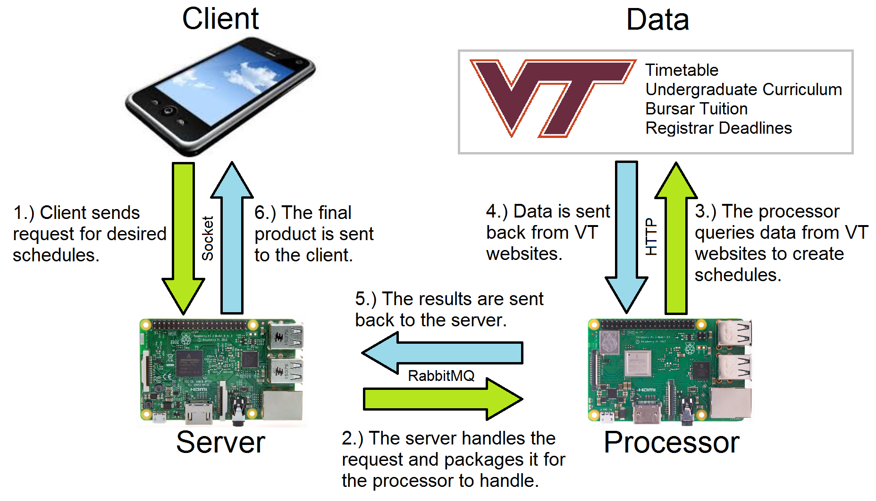
How it works: System Overview

Slide 5
Description of System Modules
Client
Send requests to retrieve class schedule.
Receives result from server with CRN numbers and costs.
Server
(Raspberry Pi)
Retrieves request from client and posts the data to a queue for the processor to retrieve.
Processor
(Raspberry Pi)
Consume from server queue.
Create schedules and send back to the server.
Receives the results from processor and send the result back to the client.
Makes requests to the Virginia Tech websites based on the information provided.
Sends request to retrieve check-sheet, receives result from Server.

Slide 6
Description of System Modules
Virginia Tech Servers
----
Timetable of Classes
Virginia Tech Servers
----
ECE Undergraduate Curriculum
Virginia Tech Servers
----
Bursar’s Tuition Page
Virginia Tech Servers
----
Registrar’s Dates and Deadlines
Virginia Tech Servers:
4 different VT websites are used to retrieve data, with the links provided in the specifications.
The timetable of Classes server is used to retrieve data to generate schedules.
The Curriculum and Tuition pages are used to provide check sheets and cost calculations.
The Registrar’s dates and deadlines page is used to obtain drop/add and course request deadlines.

Slide 7
Testable Requirements
1. Upon user input for classes and semester, one or more possible schedules generate with CRNs.
2. Based on user input, in-state and out-of-state tuitions are calculated for the given semester.
4. Based on system time, upcoming course-request and drop/add deadlines are displayed on the app.
3. The user can make a request to retrieve a major checksheet corresponding to their graduation year.

Slide 8


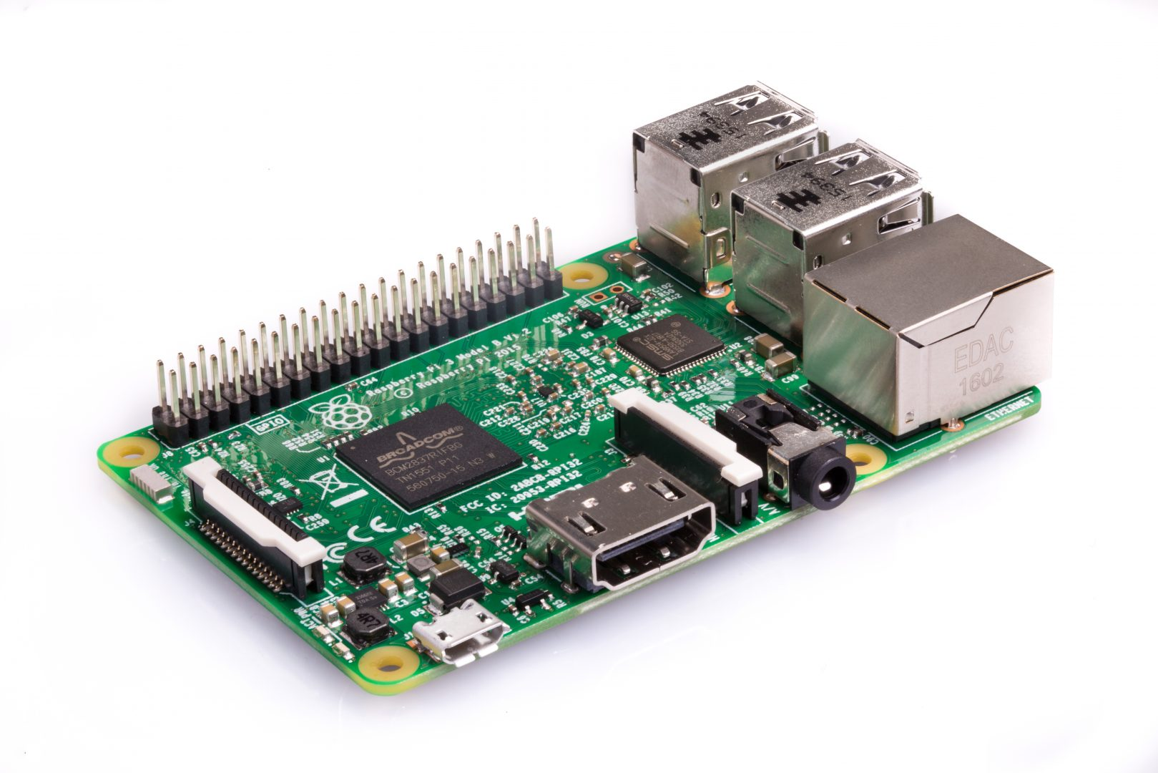


Hardware Requirements
2 of Raspberry Pi 3 Model B

Slide 9

Work Division
Bengi:
1. Create custom API for the client-server interaction.
2. Develop a flask app to make requests to the web servers, work on the processor and server.
3. Create a user-friendly interface.
4. Test Requirements, Fix bugs.
Julian:
1. Setup client to make requests to the server.
2. Develop the algorithm to analyze data retrieved from the timetable to create the schedules.
3. Display dates & deadlines.
4. Test Requirements, Fix bugs.

Slide 10
Schedule
 | Bengi Sevil | Julian Davila
March 25 | Create custom API for the client-server interaction. | Setup client to make requests to the server.
March 30 | Develop a flask app to make requests to the web servers, work on the processor and server. | Display dates & deadlines.
April 19 | Set-up client server model between the Rpi’s Create a user-friendly interface. Proposal Class Presentations | Develop the algorithm to analyze data retrieved from the timetable to create the schedules. Proposal Class Presentations
April 26 | Test requirements, Fix bugs Beta-Build Demonstrations | Test requirements, Fix bugs Beta-Build Demonstrations
May 7 | Final Project Demonstration | Final Project Demonstration

Slide 11

Downside of this service? It only works for ECE students! So we are good.

