Slide 1
DTI Predictions
CSE 484 Introduction to Bioinformatics
Selim Aybars Duran - 20190808019
Bengisu Şahin - 20180808052
Notes:
Hi everyone, I am Bengisu and my teammate is Aybars. We are presenting the drug target interaction prediction to you.

Slide 2
INTRODUCTION
Drug discovery and development is a complex and costly process that involves identifying potential drug candidates and understanding their interactions with target proteins. This method depends heavily on the precise prediction of drug-target interactions (DTIs), which also helps to identify prospective drug candidates, improve drug design, and cut down on expensive experimental trials. However, because there are so many possible interactions, experimentally determining DTIs is time-consuming, expensive, and frequently unfeasible.
Notes:
Drug discovery and development is a complex and costly process that involves identifying potential drug candidates and understanding their interactions with target proteins. This method depends heavily on the precise prediction of drug-target interactions (DTIs), which also helps to identify prospective drug candidates, improve drug design, and cut down on expensive experimental trials. However, because there are so many possible interactions, experimentally determining DTIs is time-consuming, expensive, and frequently unfeasible.

Slide 3
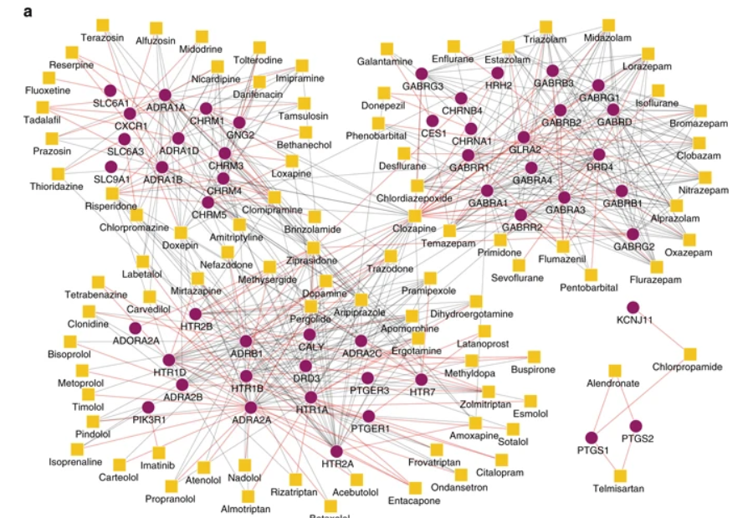
RELATED WORK / LITERATURE REVIEW
The numerous strategies used in DTI prediction are demonstrated in these studies. Wang et al. looked into the use of deep learning for the identification of inhibitors, while Zitnik et al. concentrated on GNNs and attention mechanisms. The ability of cutting-edge machine learning algorithms to increase DTI prediction accuracy and aid in drug development was established in both articles.
Fig. Visualization of the overall drug
Notes:
The numerous strategies used in DTI prediction are demonstrated in these studies. Wang et al. looked into the use of deep learning for the identification of inhibitors, while Zitnik et al. concentrated on GNNs and attention mechanisms.
It is important to note that these findings opened the door for further investigation in the area and sparked the creation of innovative models and algorithms. Deep learning methods, graph neural networks, and attention mechanisms have all been combined to advance DTI prediction, making predictions more precise and facilitating the development of fresh therapeutic approaches.

Slide 4
METHOD
We describe the process used to predict drug-target interactions (DTIs) using graph convolutional networks (GCNs) in this section. In our method, a drug-protein interaction graph is built, informative characteristics are extracted, and the GCN model architecture is designed.
Graph
Graph Construction
Feature
Feature Extraction
GCN
Graph Convolutional Network (GCN) Architecture
Model
Model Training and Evaluation
Notes:
We describe the process used to predict drug-target interactions (DTIs) using graph convolutional networks (GCNs). In our method, a drug-protein interaction graph is built, informative characteristics are extracted, and the GCN model architecture is designed.

Slide 5


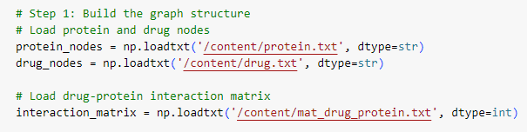




METHOD
Graph Construction and Feature Extraction
1) Building the Graph Structure:
To Protein and drug nodes are
loaded from separate files
(protein.txt and drug.txt).
The drug-protein interaction matrix is
loaded from mat_drug_protein.txt.
An empty graph is created using NetworkX.
Protein nodes are added to the graph with the type 'protein'.
Drug nodes are added to the graph with the type 'drug'.
Edges are added to the graph based on the drug-protein interaction matrix.
2) Creating Feature Inputs:
Similarity matrices for drugs and proteins
are loaded from Similarity_Matrix_Drugs.txt
and Similarity_Matrix_Proteins.txt.
Notes:
Graph Construction
We create a thorough drug-protein interaction graph to capture the complex interactions between drugs and proteins. Drug and protein nodes, which represent individual drugs and target proteins, are included in this network. The DTI landscape is represented as a network by the interactions between drugs and proteins, which are encoded as edges. Our approach allows the GCN model to take advantage of the connection patterns and dependencies within the network to exploit the underlying graph structure for precise DTI prediction.
Feature Extraction
We extract feature representations from similarity matrices of drugs and proteins in order to enrich the graph with useful characteristics. These matrices record several traits including protein sequence similarity and chemical structure. We give the GCN model a rich feature space by converting these similarity matrices into feature matrices, which enables it to learn patterns and representations for DTI prediction. The addition of feature extraction improves our method's ability to discriminate between different situations and makes it easier to model complex drug-protein interactions.

Slide 6
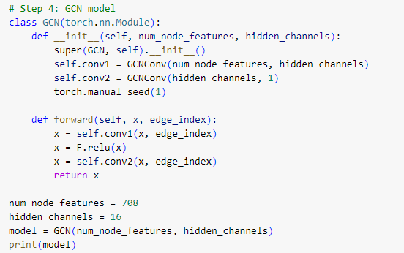
METHOD
Graph Convolutional Network (GCN) Architecture
3) Graph Convolutional Network (GCN) Architecture
For DTI prediction, our method makes use of graph convolutional networks (GCNs). The GCN successfully learns and makes use of the high-order dependencies and interactions inside the drug-protein interaction graph by repeatedly applying graph convolutional procedures.
To capture complicated interactions and increase the expressiveness of learned representations, our method uses a two-layer GCN architecture. Each layer consists of a graph convolutional operation followed by an activation function that isn't linear, such as a rectified linear unit (ReLU). Our model can accurately predict DTI thanks to this design's ability to extract hierarchical characteristics and encode complex interactions between drugs and proteins.
Notes:
For DTI prediction, our method makes use of graph convolutional networks (GCNs). The GCN successfully learns and makes use of the high-order dependencies and interactions inside the drug-protein interaction graph by repeatedly applying graph convolutional procedures.
To capture complicated interactions and increase the expressiveness of learned representations, our method uses a two-layer GCN architecture. Each layer consists of a graph convolutional operation followed by an activation function that isn't linear, such as a rectified linear unit (ReLU). Our model can accurately predict DTI thanks to this design's ability to extract hierarchical characteristics and encode complex interactions between drugs and proteins.

Slide 7
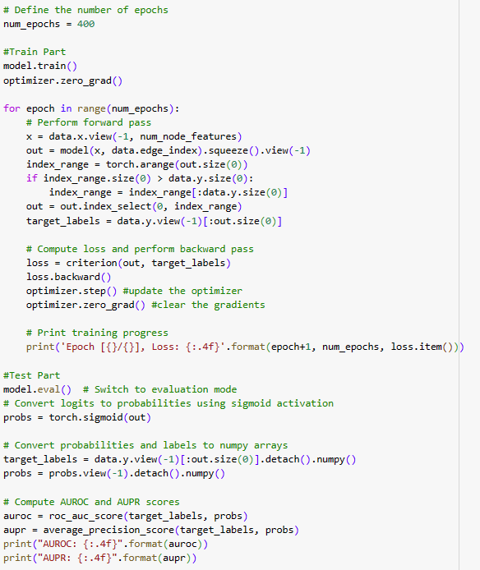
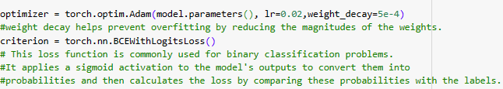
METHOD
Model Training and Evaluation
4) Model Training and Evaluation
A binary cross-entropy loss function, which gauges the difference between projected DTI probabilities and ground truth labels, is used to train the GCN model. With a learning rate of 0.02 and a weight decay of 5e-4, the Adam optimizer is used to find the best model parameters. The model gains the ability to predict events accurately and generalize well to new drug-target combinations by reducing the loss function.
Notes:
A binary cross-entropy loss function, which gauges the difference between projected DTI probabilities and ground truth labels, is used to train the GCN model. With a learning rate of 0.01 and a weight decay of 0.0005, the Adam optimizer is used to find the best model parameters. The model gains the ability to predict events accurately and generalize well to new drug-target combinations by reducing the loss function.

Slide 8
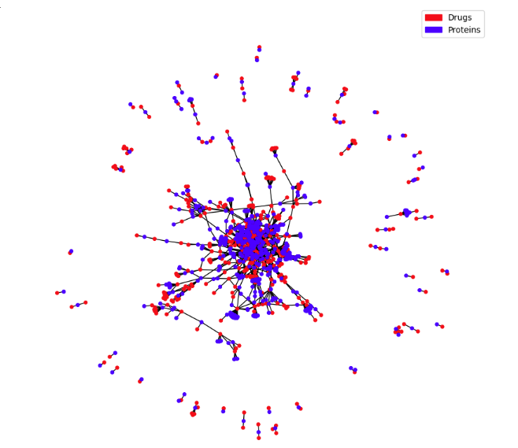
DTI GRAPH STRUCTURE
The graph consists of nodes representing drugs and target proteins, with edges indicating the interactions between them.
Notes:
The graph consists of nodes representing drugs and target proteins, with edges indicating the interactions between them. The figure illustrates the graph, where drugs are represented by red nodes and target proteins by blue nodes. The edges capture the connections between drugs and target proteins based on the underlying interactions.

Slide 9
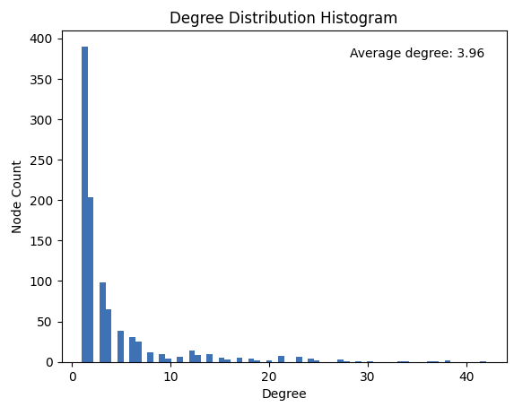
DEGREE DISTRIBUTION HISTOGRAM
The figure displays the histogram of node degrees in the graph, where the x-axis represents the degree values, and the y-axis represents the frequency of nodes with each degree. The degree distribution provides valuable insights into the connectivity patterns within the graph.
Notes:
The figure displays the histogram of node degrees in the graph, where the x-axis represents the degree values, and the y-axis represents the frequency of nodes with each degree. The degree distribution provides valuable insights into the connectivity patterns within the graph. And average degree is 3.96.

Slide 10
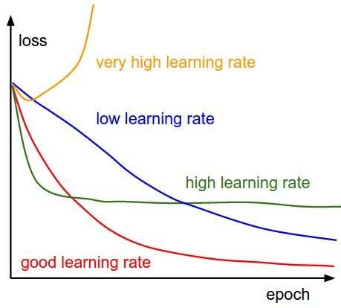
CONTRIBUTION
1) Learning Rate
The learning rate is a crucial hyperparameter that determines the step size during the optimization process. To select an optimal learning rate for our model, we conducted a parameter search by evaluating the performance of the model on a validation set.
2) Weight Decay
Weight decay, also known as L2 regularization, helps prevent overfitting by adding a penalty term to the loss function.
3) Epochs
The number of epochs determines the number of times the model iterates over the entire training dataset. We conducted experiments to determine the appropriate number of epochs for our model.
Notes:
1) Learning Rate
The learning rate is a crucial hyperparameter that determines the step size during the optimization process. To select an optimal learning rate for our model, we conducted a parameter search by evaluating the performance of the model on a validation set.
2) Weight Decay
Weight decay, also known as L2 regularization, helps prevent overfitting by adding a penalty term to the loss function.
3) Epochs
The number of epochs determines the number of times the model iterates over the entire training dataset. We conducted experiments to determine the appropriate number of epochs for our model.

Slide 11
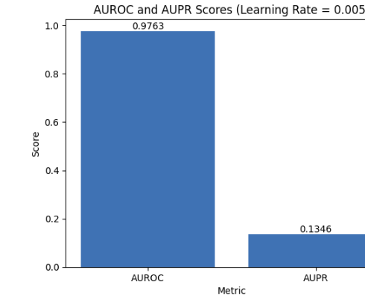
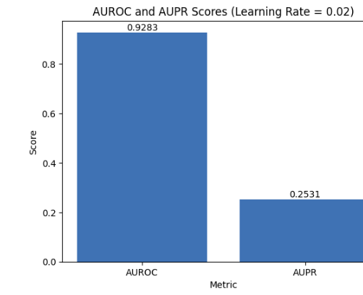
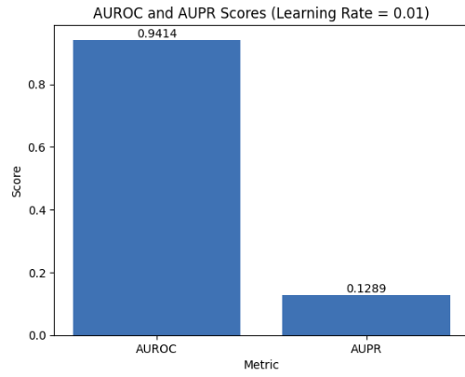
RESULTS
To investigate the impact of different learning rates on the performance of our model, we conducted experiments using three distinct learning rates: 0.01, 0.02, and 0.005.
Based on these results, we can infer that the learning rate significantly affects the model's performance. A learning rate of 0.02 produced the best performance in terms of both AUROC and AUPR scores. Therefore, we selected a learning rate of 0.02 for further experiments and analysis.
Notes:
To investigate the impact of different learning rates on the performance of our model, we conducted experiments using three distinct learning rates: 0.01, 0.02, and 0.005.
Based on these results, we can infer that the learning rate significantly affects the model's performance. A learning rate of 0.02 produced the best performance in terms of both AUROC and AUPR scores. Therefore, we selected a learning rate of 0.02 for further experiments and analysis.

Slide 12
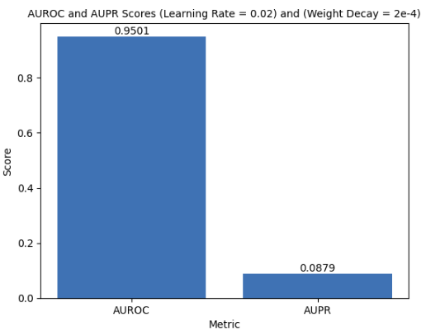
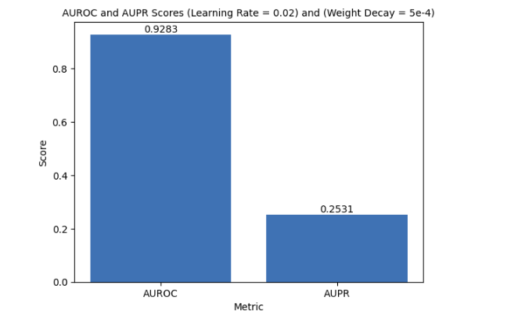
RESULTS
To explore the impact of different weight decay values on the performance of our model, we conducted experiments using two distinct weight decay values: 5e-4 and 2e-4.
Based on these results, we can infer that the weight decay value has an impact on the model's performance. Therefore, we selected a weight decay value of 5e-4 for further experiments and analysis.
Notes:
To explore the impact of different weight decay values on the performance of our model, we conducted experiments using two distinct weight decay values: 0.0005 and 0.0002.
Based on these results, we can infer that the weight decay value has an impact on the model's performance. Therefore, we selected a weight decay value of 0.0005 for further experiments and analysis.

Slide 13
CONCLUSION
In this study, we presented a novel methodology for drug-target interaction (DTI) prediction using graph convolutional networks (GCNs).
Our approach exhibited good results in properly predicting DTIs and showed potential for enhancing the field of drug development by utilizing the strength of graph-based representation and deep learning.
We visualized the intricate network of interactions between drugs and their target proteins by creating an extensive drug-protein interaction graph. The graph representation was enhanced by the addition of informative characteristics obtained from similarity matrices, which also gave the GCN model crucial data for forecasting. Our technology successfully learned and utilized the complex relationships and interactions inside the DTI network by fusing feature learning with graph structure.
Notes:
In this study, we presented a novel methodology for drug-target interaction (DTI) prediction using graph convolutional networks (GCNs).
Our approach exhibited good results in properly predicting DTIs and showed potential for enhancing the field of drug development by utilizing the strength of graph-based representation and deep learning.
We visualized the intricate network of interactions between drugs and their target proteins by creating an extensive drug-protein interaction graph. The graph representation was enhanced by the addition of informative characteristics obtained from similarity matrices, which also gave the GCN model crucial data for forecasting. Our technology successfully learned and utilized the complex relationships and interactions inside the DTI network by fusing feature learning with graph structure.

Slide 14
Thanks for listening ☺

