Slide 1
Otimização de Código

Slide 2
A compiler usually has many optimization settings (e.g. peephole, delayed-branch, etc)
  gcc 3.3 has 54 optimization options
  gcc 4 has over 100 possible settings
Compiler writers typically include switches that bundle together many optimization options
  gcc –O1, -O2, -O3
Optimizing compiler:
  Misnomer!
    Optimal compilation intractable
  Improves program performance

Slide 3
Compiler Code Optimizations
Introduction
  Optimized code
    Executes faster
    efficient memory usage
    yielding better performance.
  Compilers can be designed to provide code optimization.
  Users should only focus on optimizations not provided by the compiler such as choosing a faster and/or less memory intensive algorithm.

Slide 4
Why Compilers Matter
Key part of compiler’s job:
make the costs of abstraction reasonable
  Remove performance penalty for:
    Using objects
    Safety checks (e.g., array-bounds)
    Writing clean code (e.g., recursion)
Use program analysis to transform code

Slide 5
Analysis & The Holy Grail
Other great uses for program analysis:
  Static error-checking
    Detect information leaks
    Avoid security holes
  Informing runtime system (e.g., GC)
  Even better optimizations!
    E.g., locality-improving transformations (“memory wall”)
Holy Grail for compiler research:
  Programmer: writes simple but O(2^n) algorithm
  Compiler: changes it to O(n log n) (or O(1)!)

Slide 6
Levels of Analysis
(in order of increasing detail & complexity)
Local (single-block) [1960’s]
  Straight-line code
  Simple to analyze; limited impact
Intraprocedural [1970’s – today]
  Whole procedure
  Dataflow & dependence analysis
Interprocedural [late 1970’s – today]
  Whole-program analysis
  Tricky:
    Very time and space intensive
    Hard for some PL’s (e.g., Java)

Slide 7
Optimization = Analysis + Transformation
Key analyses:
  Control-flow
    if-statements, branches, loops, procedure calls
  Data-flow
    definitions and uses of variables
Representations:
  Control-flow graph
  Control-dependence graph
  Def/use, use/def chains
  SSA (Static Single Assignment)

Slide 8
Compiler Code Optimizations
A Code optimizer sits between the front end and the code generator.
  Works with intermediate code.
  Can do control flow analysis.
  Can do data flow analysis.
  Does transformations to improve the intermediate code.

Slide 9
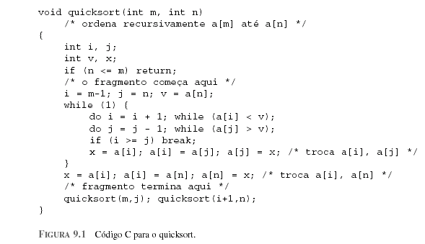
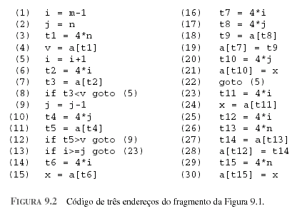

Slide 10
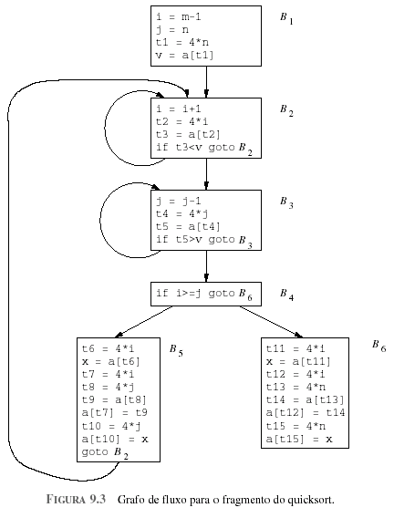
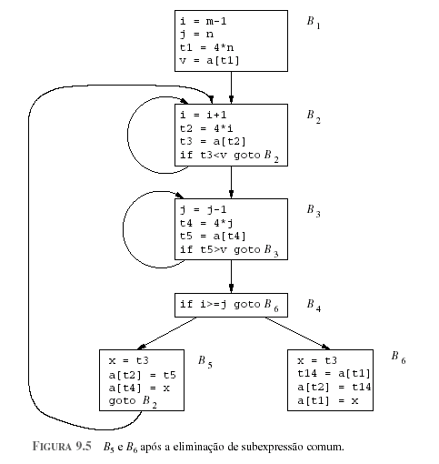

Slide 11
Compiler Code Optimizations
Optimizations provided by a compiler includes:
  Inlining small functions
  Code hoisting
  Dead store elimination
  Eliminating common sub-expressions
  Loop unrolling
  Loop optimizations: Code motion, Induction variable elimination, and Reduction in strength.

Slide 12
Compiler Code Optimizations
Inlining small functions
  Repeatedly inserting the function code instead of calling it, saves the calling overhead and enable further optimizations.
  Inlining large functions will make the executable too large.

Slide 13
Compiler Code Optimizations
Code hoisting
  Moving computations outside loops
  Saves computing time

Slide 14
Compiler Code Optimizations
Code hoisting
  In the following example (2.0 * PI) is an invariant expression there is no reason to recompute it 100 times.
    DO I = 1, 100
    ARRAY(I) = 2.0 * PI * I
    ENDDO
  By introducing a temporary variable 't' it can be transformed to:
    t = 2.0 * PI
    DO I = 1, 100
    ARRAY(I) = t * I
    END DO

Slide 15
Compiler Code Optimizations
Dead store elimination
  If the compiler detects variables that are never used, it may safely ignore many of the operations that compute their values.

Slide 16
Compiler Code Optimizations
Eliminating common sub-expressions
  Optimization compilers are able to perform quite well:
  X = A * LOG(Y) + (LOG(Y) ** 2)
  Introduce an explicit temporary variable t:
  t = LOG(Y)
  X = A * t + (t ** 2)
  Saves one 'heavy' function call, by an elimination of the common sub-expression LOG(Y), the exponentiation now is:
  X = (A + t) * t

Slide 17
Compiler Code Optimizations
Loop unrolling
  The loop exit checks cost CPU time.
  Loop unrolling tries to get rid of the checks completely or to reduce the number of checks.
  If you know a loop is only performed a certain number of times, or if you know the number of times it will be repeated is a multiple of a constant you can unroll this loop.

Slide 18
Compiler Code Optimizations
Loop unrolling
  Example:
  // old loop
  for(int i=0; i<3; i++) {
  color_map[n+i] = i;
  }
  // unrolled version
  int i = 0;
  colormap[n+i] = i;
  i++;
  colormap[n+i] = i;
  i++;
  colormap[n+i] = i;

Slide 19
Compiler Code Optimizations
Code Motion
  Any code inside a loop that always computes the same value can be moved before the loop.
  Example:
  while (i <= limit-2)
  do {loop code}
  where the loop code doesn't change the limit variable. The subtraction, limit-2, will be inside the loop. Code motion would substitute:
  t = limit-2;
  while (i <= t)
  do {loop code}

Slide 20
Compiler Code Optimizations
Conclusion
  Compilers can provide some code optimization.
  Programmers do have to worry about such optimizations.
  Program definition must be preserved.

