Slide 1

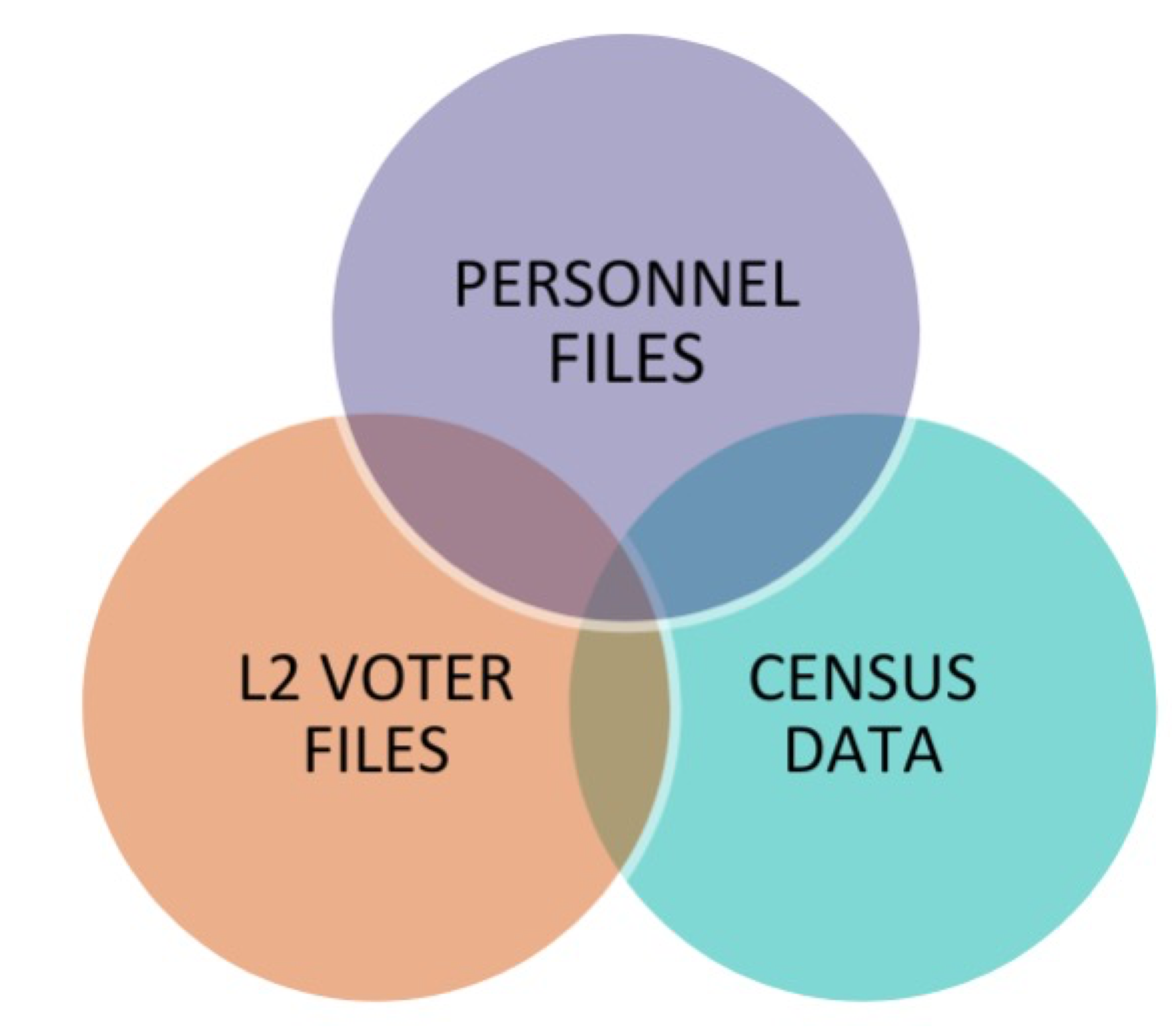
The Partisan and Racial Composition of State Prison Workforces
Daniel Chuang, Eleanor Schlick, Caroline Stafford, & Benjamin Goehring
BACKGROUND
DATA & METHODS
The United States has the second largest imprisoned population in the world with approximately half of incarcerated people housed in state-operated prisons.¹ᵃᵇ
Thus far, the literature on correctional officers has focused on organizational commitment and job stresses.²
We know relatively little about the partisan and social identities of the correctional officers (COs) that work in state prisons.
We fill this gap in the literature by examining:
1) The demographic and political composition of state COs in Mississippi (MS) and Arkansas (AR).
2) How CO promotion varies according to race and sex.
This analysis serves an important role in understanding why, across different states, people opt to work at correctional facilities, and provides a foundation for studying the impact of race, sex, and partisanship on the behavior of COs.
Data
We merge together the following datasets:
Monthly personnel files of all COs in MS (07/2017 to 06/2022) and AR (01/2015 to 07/2022), including their facility, full name, race, sex, salary, and job title.
MS and AR voter registration files from L2 that include each voter’s registered partisanship.
Census tract-level data on race and poverty.
Descriptives
Demographic Data
For MS and AR, shows the share of COs that are African American and female, respectively. Also shows the share of matched partisans that are registered Democrats.
H2: Promotion Across Groups
Shows the coefficients and 95% confidence intervals from six Cox regression models that regress promotion against COs race and sex. A coefficient greater than one indicates that a group is more likely to be promoted. For instance, male COs are almost 2.5 times more likely to be promoted from CO to lieutenant than their female counterparts. African American COs are almost twice as likely to be promoted from CO to lieutenant as their white counterparts.
RESEARCH QUESTIONS
KEY FINDINGS
What populations are more likely to become COs?
Does the race and sex of COs affect promotion?
Testing Hypothesis 1 | Testing Hypothesis 2
In order to understand who opts to work as a CO, we located COs home census tracts using the L2 voter files. With this merged dataset, we ran a negative binomial regression on the relationship between the number of COs in a census tract and tract-level demographic information. | We used a Cox regression analysis to investigate the “risk” of promotion based on COs race and sex. Limiting our analysis to COs in AR, we tested the likelihood of promotion from the lowest-rank CO position to the higher positions of, in order, Corporal, Sergeant, and Lieutenant.
COs are majority African American and Democratic.
COs are more likely to live in census tracts with more African Americans.
Male and African American COs are more likely to be promoted to the higher levels of management (lieutenant).
HYPOTHESES
H1: COs are more likely to live in census tracts near prisons that have higher percentages of African Americans and higher poverty rates:
Prisons are more commonly built in rural areas that, in MS and AR, are disproportionately African American and in poverty.³ᵃᵇ
Physical proximity to prisons can contribute to positive attitudes toward facilities and/or prison work.⁴ᵃᵇ
H2: COs that are members of marginalized groups (African Americans and/or females) are less likely to be promoted than their counterparts:
Female employees are rarely promoted to upper-level management positions, even though middle management positions are attainable.⁵
Female COs report bias in the promotional process.⁶
African American workers in other settings report slower rates of promotion than their white counterparts.⁷
CONCLUSION
We are curious how factors such as performance, bias, and attrition impact promotional probabilities of COs. With further analysis, we could compare the attrition rates of different demographics to see if there is an inverse relationship with promotion. We could utilize an Oaxaca decomposition to analyze the effects of experience and biases on each group’s salary.
Moreover, we would be interested in investigating why, when proximity to prisons and poverty rate are held constant, African Americans are more likely to work in these facilities. Other census tract variables of economic disadvantage, such as unemployment, insecurity, and crime rate, could be analyzed.
RESULTS
H1: CO Demographics
Shows the coefficients and 95% confidence intervals from two negative binomial regression models that regress the number of COs living in a census tract on the tract’s poverty level, racial composition, and distance to the nearest prison. In both AR and MS, when distance to the nearest prison and the poverty rate are held constant, census tracts with a higher percentage of African Americans are more likely to produce a CO (p < .01).
REFERENCES
1a: World Prison Brief (2023)
1b: Prison Policy Initiative (2023)
2: Butler, D. H., Tasca, M., Zhang, Y., & Carpenter C. (2019)
3a: Eason, J. M. (2010)
3b. Eason, J. M. (2017)
4a: Robertson, C. T. & Ray, M. C. (1994)
4b: Morrison, K. & Maycock, M. (2021)
5: Cornish, A.R. (2000)
6: Matthews, C., Monk-Turner, E., & Sumter, M. (2010)
7: James, E.H. (2000)

