Slide 1
Experiences with
Visual Programming Languages for End-Users and Specific Domains
Philip T. Cox Trevor J. Smedley
Dalhousie University
Halifax, Canada

Slide 2
Introduction
Spreadsheets
  Domain - tabular arithmetic
  End-user - accountant
  Metaphor - paper ledger
Why are they successful?
  They employ a well-understood, concrete representation in a specific domain (“Closeness of Mapping” - Green & Petre ‘96)
General principles
  Rely on concepts/actions familiar to the intended user
  The more specific the domain, the more concrete the programming language
Three projects …

Slide 3
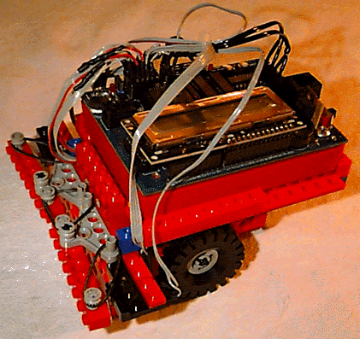
1. Autonomous Robots
Have sensors and effectors
React to changing conditions
Operate in partly unknown & changing environments
Require problem-solving abilities
Exhibit reactive behaviour
Programming
  Direct coding of sensor/effector feedback
  High-level planning - mechanical deduction (eg STRIPS)
  Logic programming based systems
  Layered control architectures (eg Brooks subsumption architecture)
Examples: Mars Rover; Lego car and Handyboard

Slide 4
Generality vs. Concreteness
Want “closeness of mapping” of language to domain
  include representation of robot and environment in the programming language
  programming involves realistic interaction with this representation
Also want generality
  applicable to a large class of robots (eg free-ranging, autonomous robots requiring reactive control mechanisms)
Apparently contradictory criteria
  generality vs. closeness to specific domain

Slide 5
Two-phase process
Specification phase
  Hardware Definition Module (HDM)
  editing environment for specifying “syntax and semantics” of target robot and environment
  builds visual representation of robot and environment
  specifies interactions between robot and environment
  specifies relationship between “software” robot and “hardware” robot
  outputs hardware specification structure
Realisation phase
  Software Definition Module (SDM)
  inputs hardware specification structure
  user builds control programs by interacting with “software” robot

Slide 6
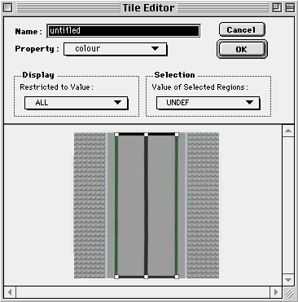
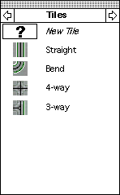
HDM - building the environment
Build “tiles”
  Region of any shape corresponding to specific value for a property
Combine tiles into components
Define classes from
components

Slide 7
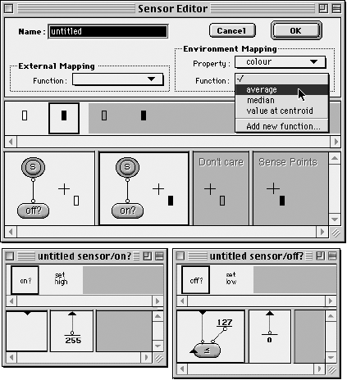
HDM - building the robot: sensors
Defines appearance of sensor in simulated world
Relates simulated sensor to real world sensor
Defines interaction between simulated sensor and simulated environment

Slide 8
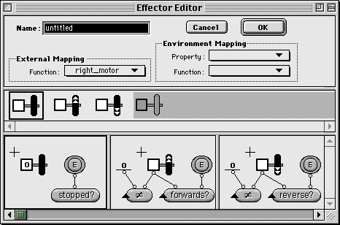
HDM - building the robot: effectors
Defines appearance of effector in simulated world
Relates simulated effector to real world effector
Defines effect of simulated effector on simulated environment

Slide 9

SDM - programming by demonstration
Build an environment from instances of environment components
Build a robot from sensors, effectors and inert pieces
Program behaviours (finite state machines) by running simulated robot in simulated environment

Slide 10
2. Design of Structured Objects
Electronic devices
Mechanical devices
Biological structures
Buildings
Software - a special case
  algorithms
  data structures

Slide 11
Design Activities
Building, editing
  software: coding, building data structures
  other: drafting, maybe coding
Testing, debugging
  software: interpreting
  other: simulation, trial assembly
Generating production model
  software: compilation
  other: generating such things as numerical control codes

Slide 12
Tools: Design vs Programming
Design environments
  Highly graphical
  Evolved from drawing applications
  Parametrisation requires programming - leads to dichotomy between design and coding
Programming languages
  Traditionally dominated by textual expression
  Evolved from machine-level coding
  Recent move toward visualisation
  Effectiveness of visual languages

Slide 13
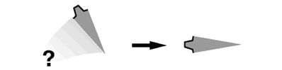
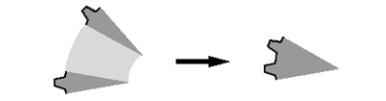
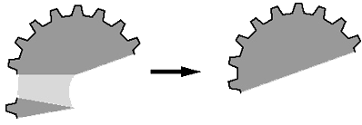

Parametrised Design
Build an elastic n-tooth partial cog from elastic teeth
  Build an elastic 1-tooth partial cog by adding a tooth to a 0-tooth partial cog (?)
  Build an elastic 2-tooth partial cog by adding a tooth to a 1-tooth partial cog
  Build an elastic n-tooth partial cog by adding a tooth to an (n-1)-tooth partial cog
Build an n-tooth cog by joining the open faces of the elastic n-tooth partial cog

Slide 14
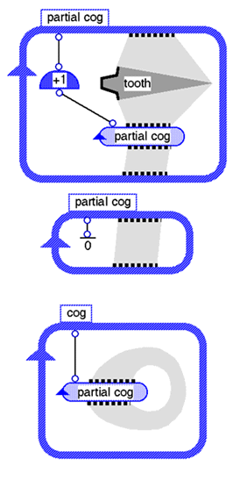
LSD - Language for Structured Design
Extension of visual logic programming language (Lograph)

Slide 15
3. Visual Scripting for Handhelds
Increasing power and widespread use of handheld computers
Expect an evolution parallel to that which we have seen with desktop computers, where end users increasingly want access to programming abilities
Significant challenges relating to relatively
low processing power, small screen size
and difficulty with textual input

Slide 16
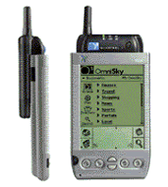
Component Model
Particularly interested in handheld computers with expansion capabilities, such as the Handspring Visor
Component-based approach to scripting
  Script components
    User defined scripts, created on the handheld
  User interface components
    Windows and menus, created on the handheld
  External components
    “Glue” to connect external devices and other software to scripting environment
    Defined using a desktop tool by a professional programmer and imported to the handheld

Slide 17
Execution Model
Triggers are used to cause the execution of scripts
  Button press, phone ring, etc.
Sources and sinks are used to extract information from and provide information to components
  Accessing text fields of windows, getting the caller id information of an incoming call, etc.
Specialised operations for conditional and repeated execution
Reusability of components

Slide 18
Demo
Very early in implementation
Currently have:
  Interface definition with a small number of interface elements
  Scripting environment with Sources, Sinks, Triggers and a small number of primitive operations
  No conditional or repeated execution
  No external components, and only very preliminary work on tool for their definition
  Undoubtedly lots of bugs, so bear with us!!

Slide 19
Concluding Remarks
The future of visual programming – application to specific domains.
Three example projects
  domains from concrete to more abstract.
Reduces cognitive load on users required to build structures from textual encodings.
No testable implementations yet.
  PDA project most abstract, so likely the first to be user-tested

