Slide 1

Car Purchase Predictor
Benjamin Griffis

Slide 2

Why I chose this dataset
I chose this dataset because I’m a business major who’s interested in sales
Thought it would be interesting to see decision-making from different backgrounded individuals

Slide 3
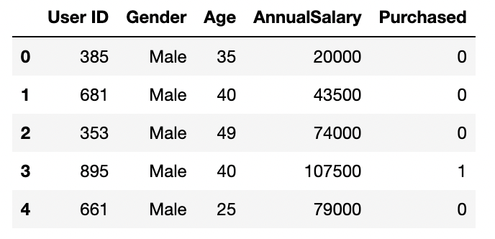
General Info
1,000 entries with 5 columns
Consisted of 3 continuous variables and 2 discrete variables
The goal was to create a model that could predict whether a customer would purchase a car or not.

Slide 4
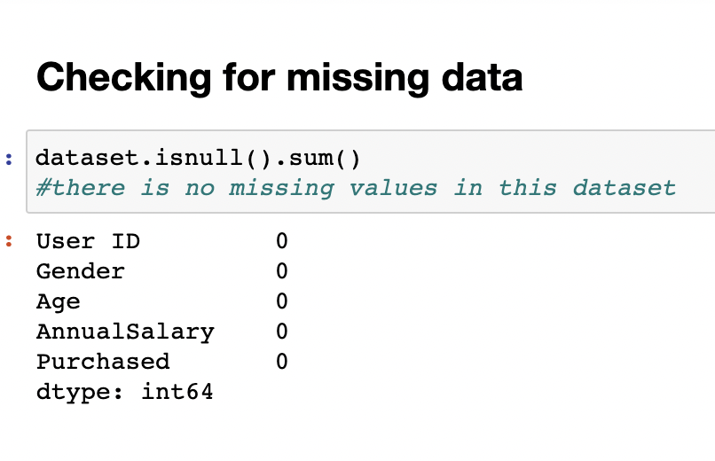
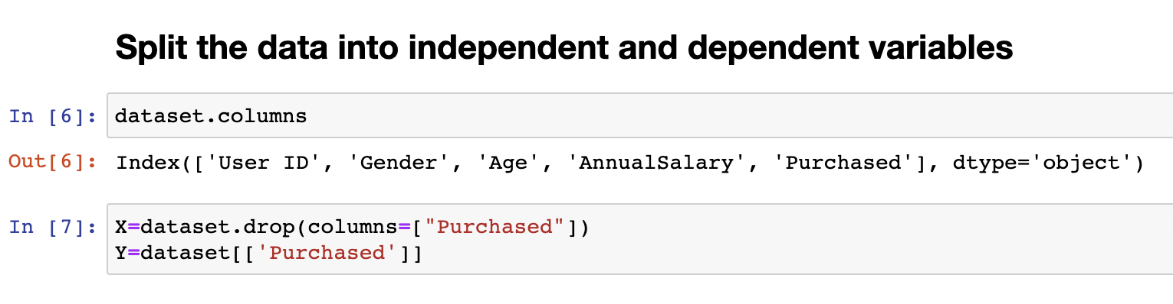
Preparing the data
- My dataset had no missing values
- No removing of columns, unique values, or outliers
Set all columns equal to X variable
Set “purchased” column to Y variable, as it’s the one that I would be predicting

Slide 5
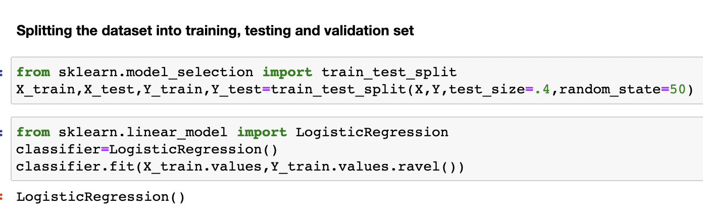
Training & Test Sets
3 Different Tests that used sklearn
60/40 split for train and test
80/20 split for train and test
90/10 split for train and test

Slide 6
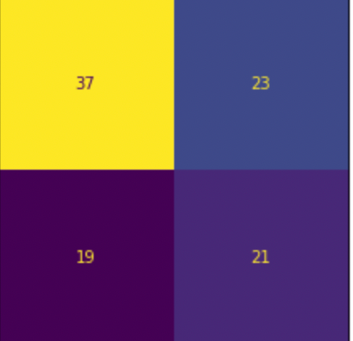
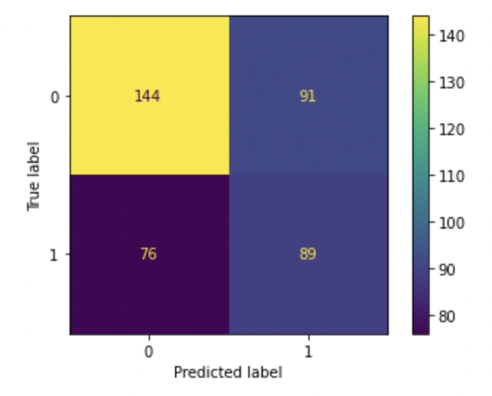
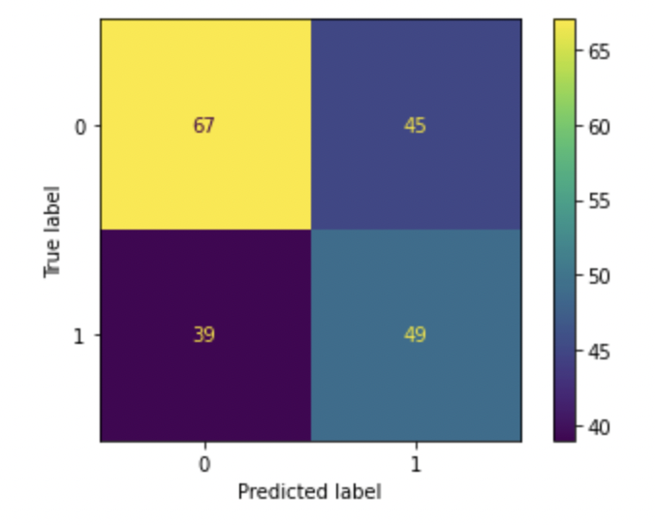

Results with confusion matrix
True
Negative
False
Negative
False
Positive
True Positive
60/40 Test
- 58% accuracy
80/20 Test
- 58% accuracy
90/10 Test
- 58% accuracy

Slide 7
Findings & Conclusion
The accuracy of the models were 58%
Wasn’t a very good model performing under the baseline accuracy of 60% (0.598 = 598/1000)
Still more True Negatives & True Positives then False Negatives & Positives
It generally indicates that the model is performing well in correctly identifying both positive and negative cases.

