Slide 1

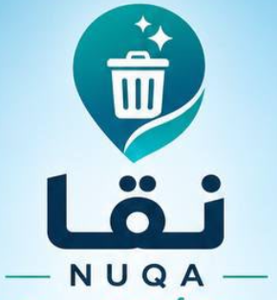
NUQA
INNOVATION PROJECT
NUQA
A Cleaner City,
Through Intelligence
Connect observation, response and verified action.
SMART CAMERAS + CONNECTED PEOPLE
Concept prototype • Illustrative scenes and fictional data
01
Notes:
NUQA is a concept prototype. The deck includes screenshots of the implemented demonstration and concept illustrations, not verified field deployment. Preserve the original NUQA brand and team attribution.

Slide 2
NUQA
THE PROBLEM
The problem NUQA is designed to address
Litter can harm the environment. NUQA connects detection to a coordinated response.
01
02
03
Environmental harm
Littering lacks context
Response is fragmented
Litter can contaminate soil and water, harm wildlife and degrade shared green spaces.
A sighting alone may not reliably establish when, where or from which vehicle waste was thrown.
Disconnected reports, assignments and updates make ownership and closure harder to follow.
Concept prototype • Illustrative scenes and fictional data
02
Notes:
These are operational problem hypotheses, not quantified findings from a NUQA deployment. Validate their frequency and impact with the pilot partner before setting targets.

Slide 3
NUQA
THE SOLUTION
The solution: one connected cleanliness platform
NUQA brings smart-camera alerts, citizen reports and field work into a shared case record.
01
02
03
Observe
Coordinate
Resolve
Camera signals + citizen reports
Location, time and event context.
Staff review + task assignment
A clear owner and next action.
Field response + verification
Citizens receive status updates.
The intended result: earlier awareness, clearer responsibility and traceable resolution.
Concept prototype • Illustrative scenes and fictional data
03
Notes:
NUQA concept presentation. Interface screenshots come from the current working prototype. All scenarios and data are illustrative.

Slide 4
NUQA
AI ANALYSIS
Artificial intelligence analyzes the scene
Proposed edge-AI processing turns camera frames into a structured event for review.
01
02
03
04
Video frames
Detect and track
Classify the event
Create an alert
Capture the approved road or public-space zone.
Locate waste, bins and relevant object movement.
Flag overflow, scattered litter or a potential throwing event.
Attach event type, time, location and selected evidence.
Roads: link a potential throwing event to the vehicle; read a visible plate when permitted.
Parks: analyze waste around bins, benches and paths, then route the event for staff review.
Concept prototype • Illustrative scenes and fictional data
04
Notes:
This is the proposed analysis architecture. The working website uses scripted visual simulations, not trained models or live video inference. Performance must be evaluated on authorized test data. Tracking an event does not require facial identification. Vehicle-to-event association and plate OCR require evidence review.

Slide 5
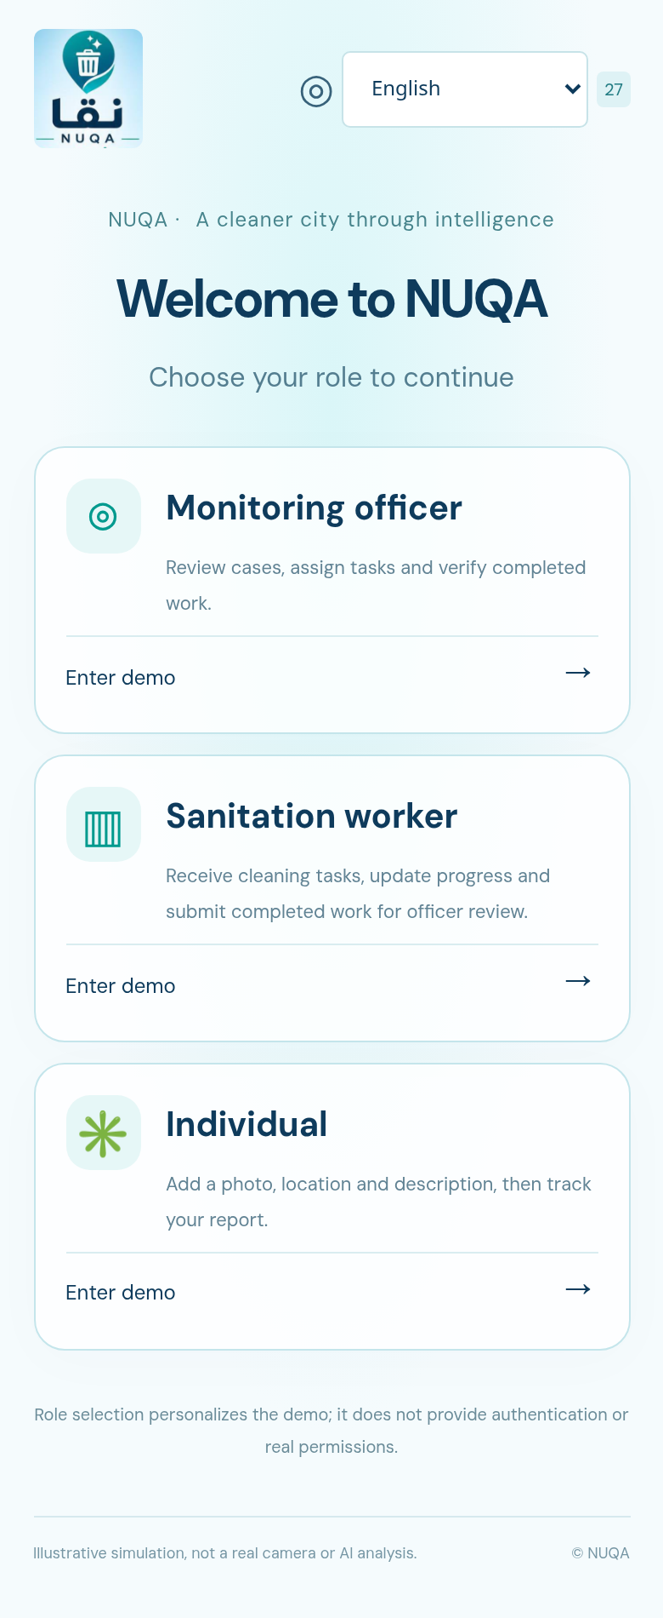
NUQA
APP EXPERIENCE
Three roles. A focused experience for each.
The working website starts with role selection and offers 27 interface languages.
9:41
Individual
01
Report a location and issue; follow its status.
02
Sanitation worker
Start assigned work and submit completion for review.
03
Monitoring officer
Review camera events, manage cases and verify closure.
Current NUQA prototype
Concept prototype • Illustrative scenes and fictional data
05
Notes:
Role selection personalizes this demo. It is not production authentication or access control. Screenshots show the current NUQA website, not a downloadable mobile application.

Slide 6
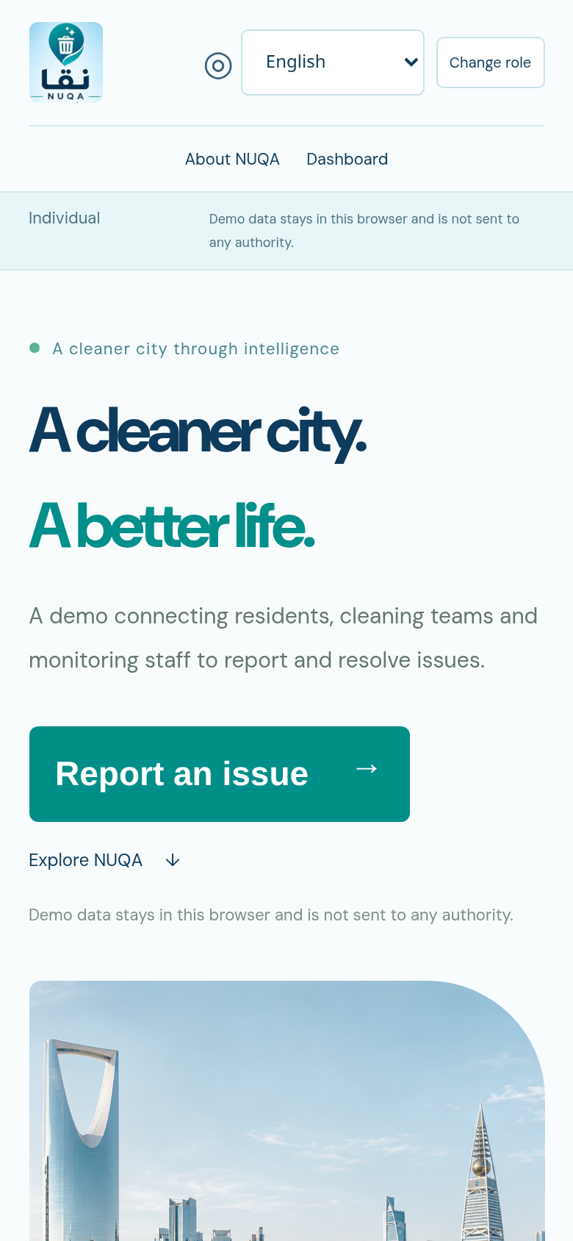
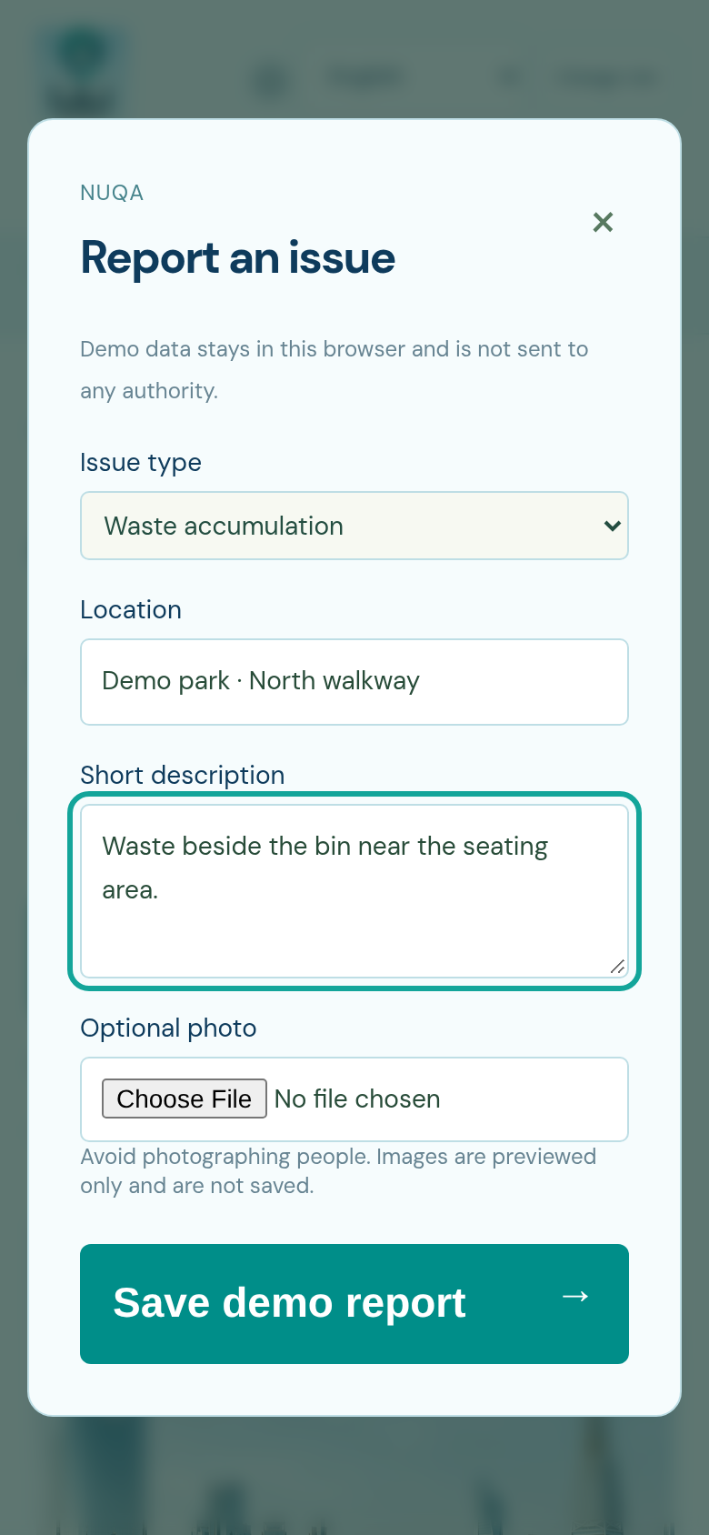
NUQA
CITIZEN INTERFACE
Citizen reporting: simple inputs, visible progress
A short report connects a local observation to the same operational case record.
9:41
9:41
01 Describe the issue
Choose the issue type, add a location and write a short description.
02 Preview, then submit
An optional photo adds context. Status updates keep the report trackable.
Current demo: reports stay in the browser; photos are previewed, not stored.
Home and reporting entry
Report form
Concept prototype • Illustrative scenes and fictional data
06
Notes:
NUQA concept presentation. Interface screenshots come from the current working prototype. All scenarios and data are illustrative.

Slide 7
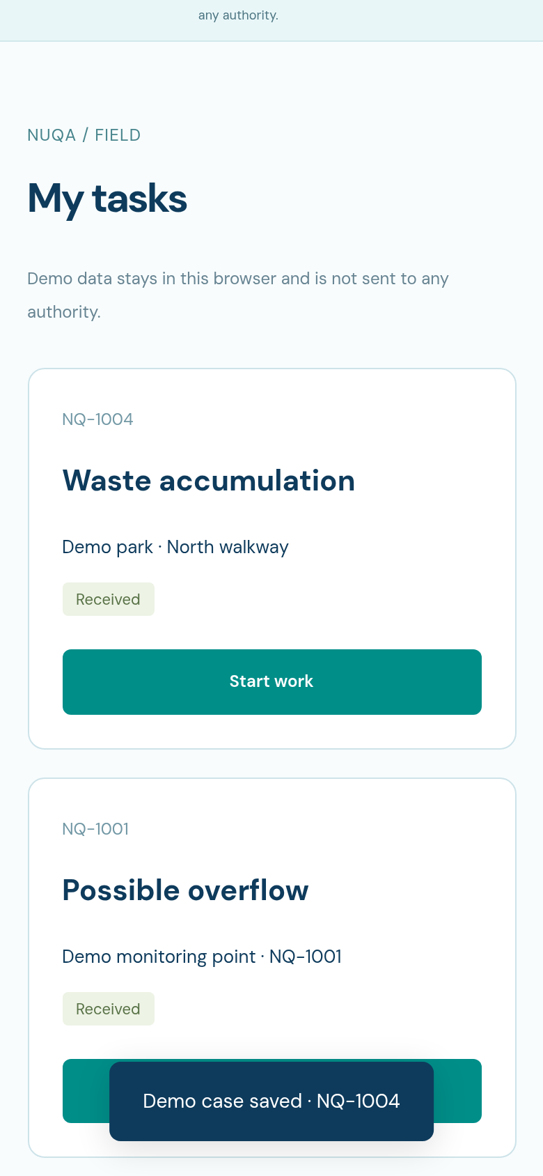
NUQA
WORKER INTERFACE
Sanitation teams: turn cases into accountable work
Tasks move forward with a defined completion handoff to monitoring staff.
9:41
01
Receive and start
A worker sees a task, issue type, location and current status.
02
Confirm completion
After cleanup, the worker submits the task for staff review.
03
Verify before closure
The officer checks the outcome and closes the case.
Current task-list screen
Concept prototype • Illustrative scenes and fictional data
07
Notes:
NUQA concept presentation. Interface screenshots come from the current working prototype. All scenarios and data are illustrative.

Slide 8
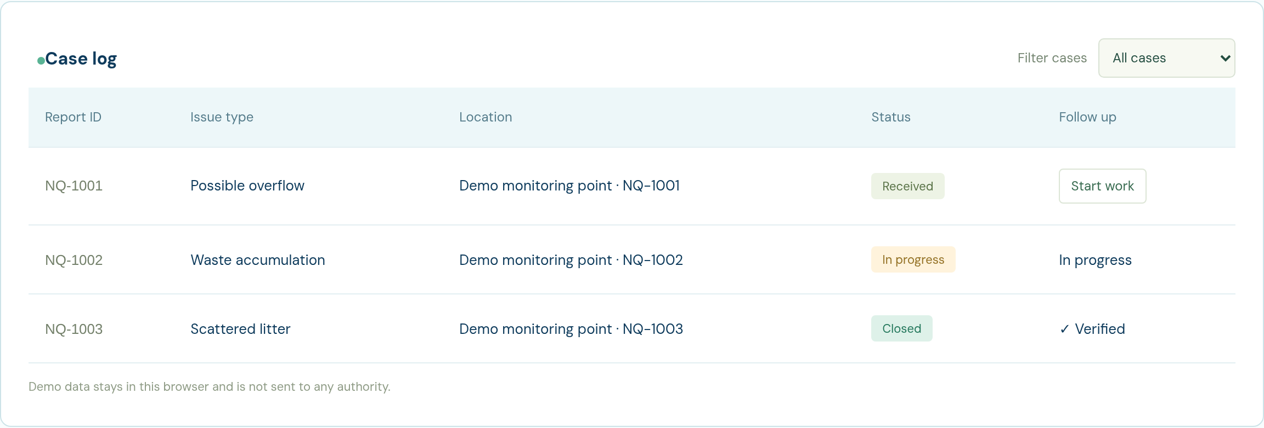
NUQA
MONITORING INTERFACE
Municipal view: one record from report to closure
Staff can inspect status, initiate work and verify completed tasks.
Unified cases
Reviewed transitions
Verified closure
Camera events and citizen reports
Received → In progress → Review
Officer confirmation before close
Concept prototype • Illustrative scenes and fictional data
08
Notes:
NUQA concept presentation. Interface screenshots come from the current working prototype. All scenarios and data are illustrative.

Slide 9
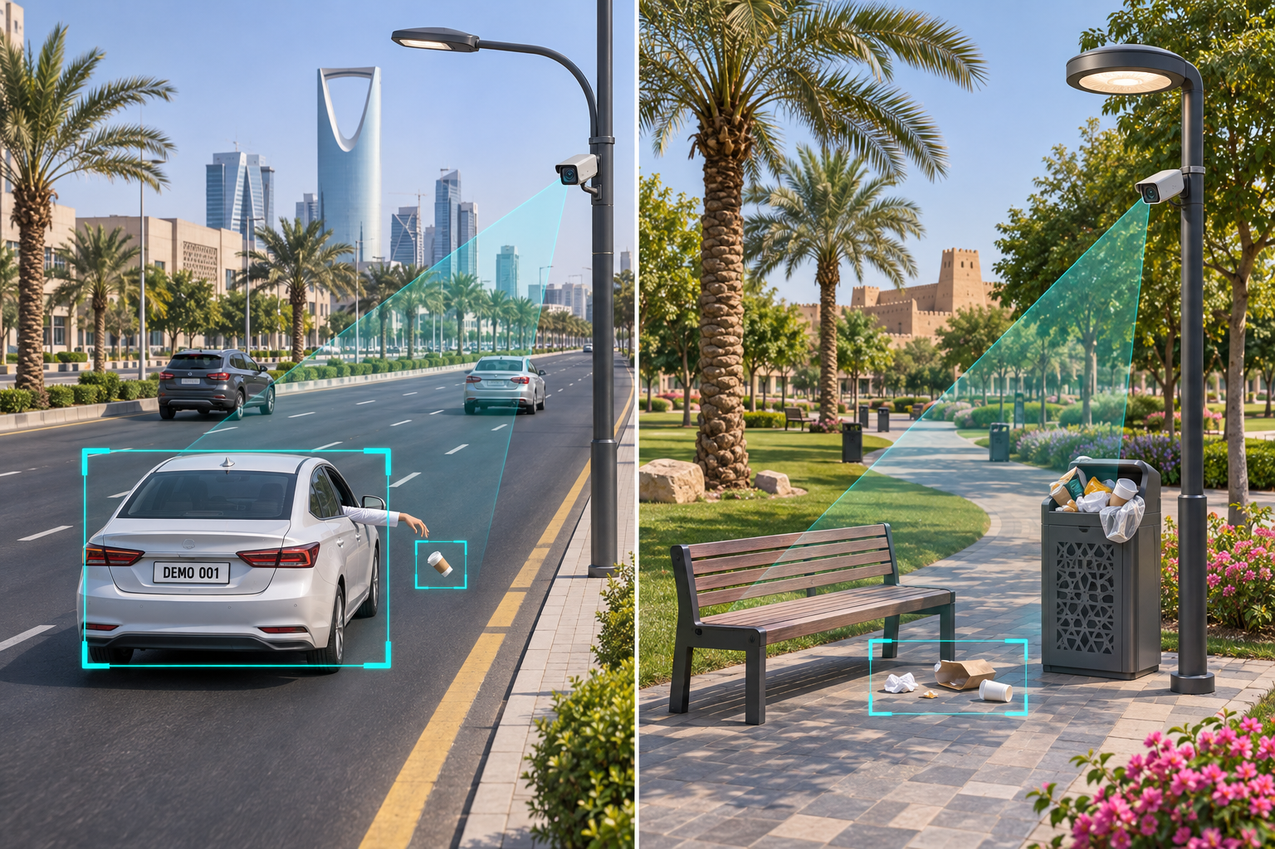
NUQA
ROADSIDE CAMERA CONCEPT
Public roads: detect a potential littering incident
AI analysis links a potential throwing event to a vehicle and a permitted plate snapshot.
01 AI detects the event
Track an object that may have been thrown from a vehicle.
02 Associate and read
Link the event to the vehicle and use plate OCR when the image is readable and capture is permitted.
03 Submit for review
Attach location, time and selected evidence to a candidate incident.
Illustrative scene • Fictional plate • Proposed capability
Concept prototype • Illustrative scenes and fictional data
09
Notes:
Concept visualization. Detecting a thrown object or associating it with a vehicle is uncertain. Plate capture/ALPR is a proposed future capability, not implemented in the website. No facial identification is required. Record the event context and allow an authorized officer to review before any real enforcement action.

Slide 10
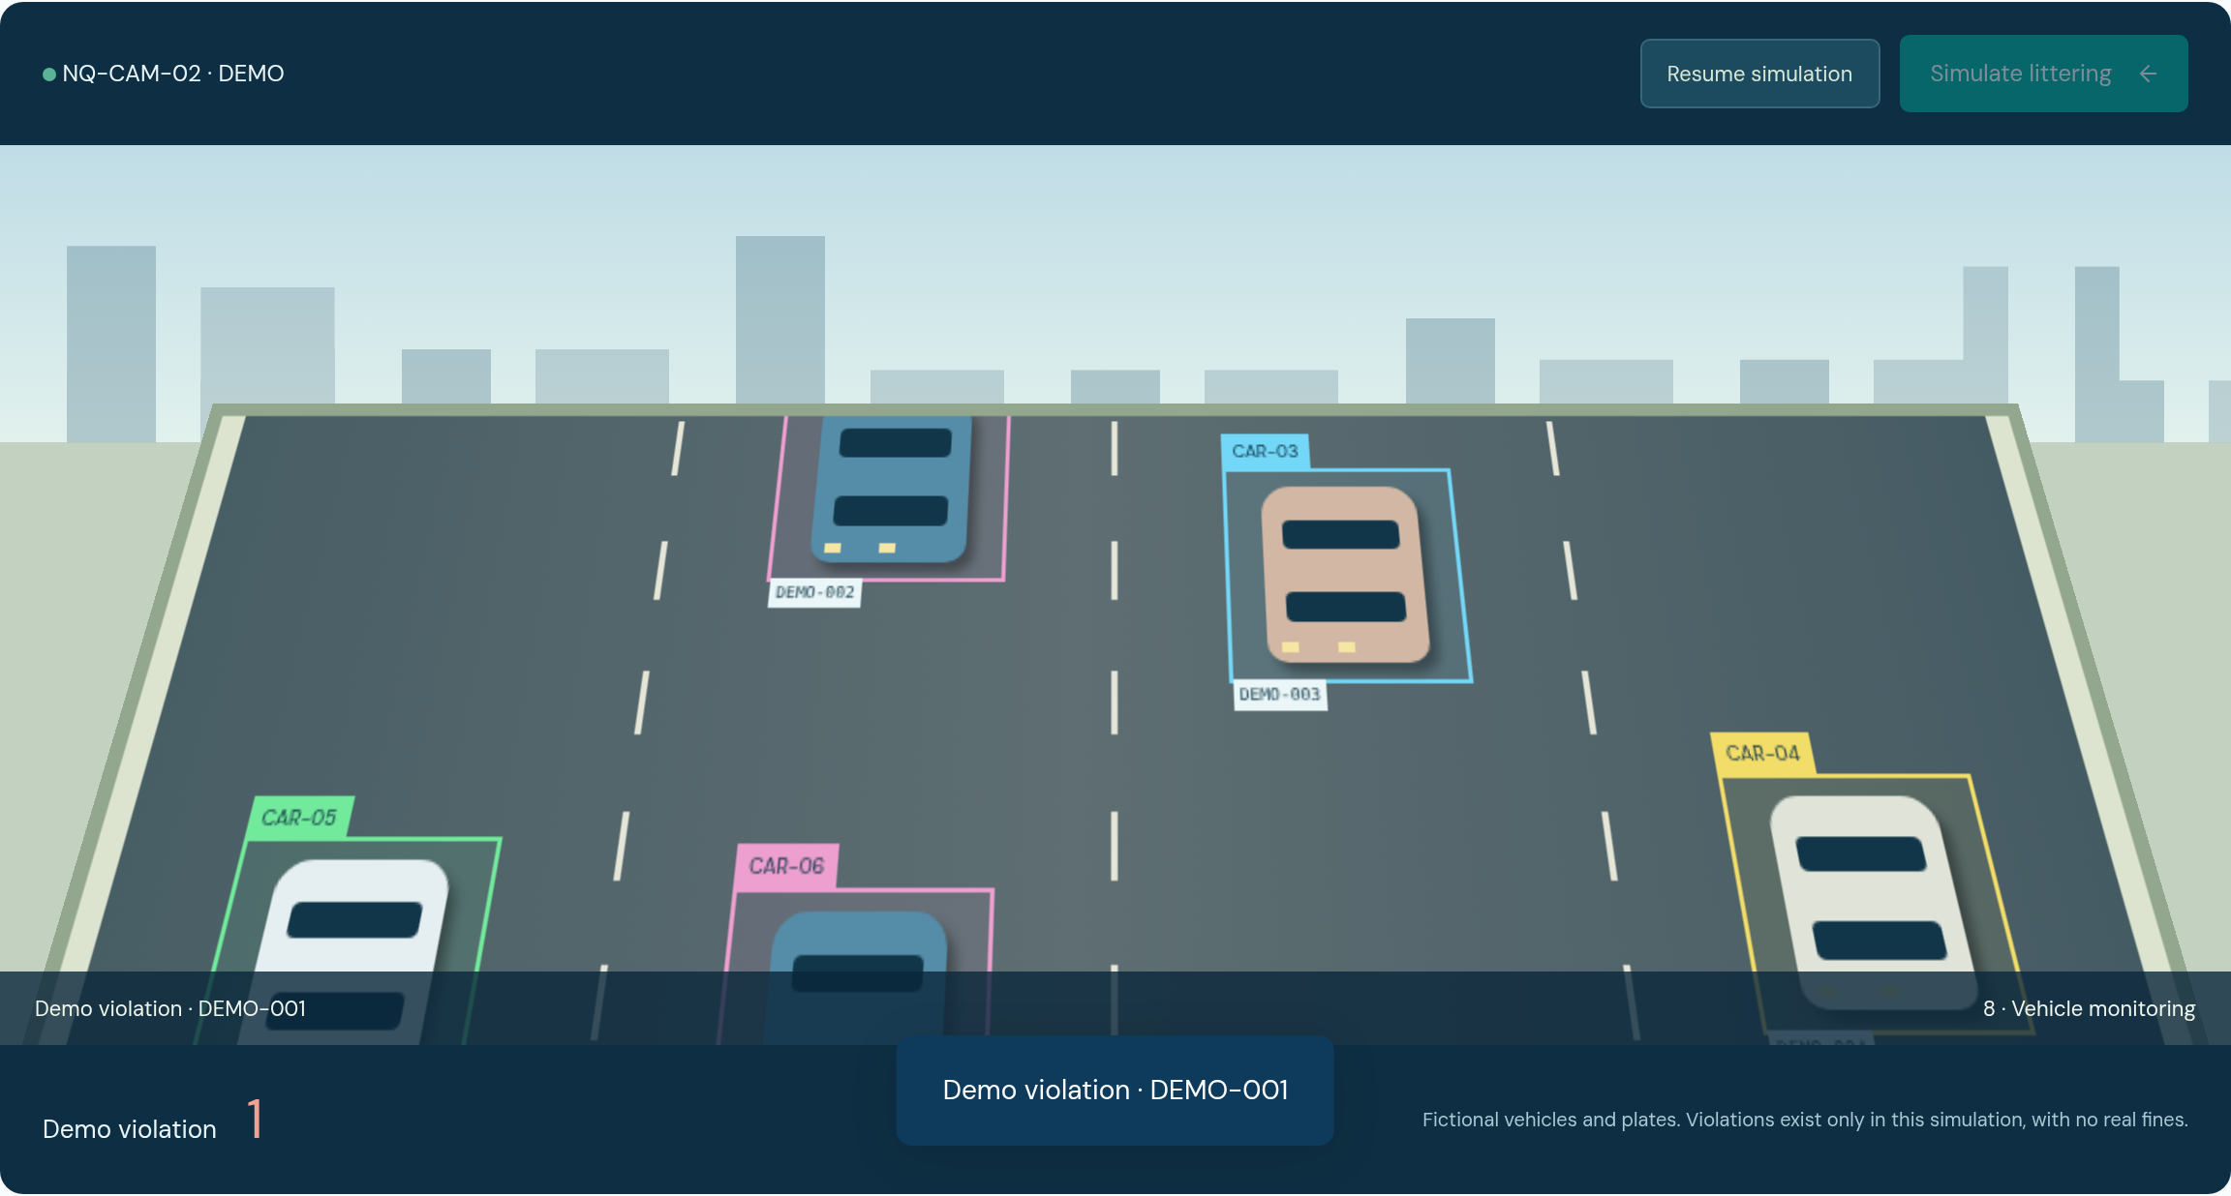
NUQA
IMPLEMENTED SIMULATION
Vehicle simulation: event → vehicle → demo record
The website illustrates the association using animated cars and fictional plates.
DEMO EVIDENCE
DEMO-001
Fictional vehicle plate
Demo violation record
Local record only.
No real fine is issued.
Implemented: a scripted event and local record. Proposed: real detection and authorized evidence review.
Concept prototype • Illustrative scenes and fictional data
10
Notes:
The simulated scene uses predefined cars DEMO-001 to DEMO-008 and a user-triggered littering animation. It creates local demonstration records only. The prototype does not analyze video, read real plates, identify people or issue real fines.

Slide 11
NUQA
PUBLIC-SPACE CAMERA CONCEPT
Parks and public spaces: cameras on lighting poles
Monitor waste hotspots around bins, paths and seating areas in an authorized pilot zone.
Use existing infrastructure
A proposed camera mounts below the lamp on an approved lighting pole.
AI analyzes the zone
Detect visible overflow, accumulated waste or a potential littering event near bins and benches.
Send a targeted response
Create a reviewed task with a clear location for the cleaning team.
Illustrative park and camera coverage
Concept prototype • Illustrative scenes and fictional data
11
Notes:
Concept illustration, not an installed camera or approved site. Mounting on lighting poles needs the asset owner’s permission, a coverage review and operational and privacy controls. The focus is waste conditions and events, not identifying park visitors.

Slide 12
NUQA
PUBLIC-SPACE SIMULATION
Park simulation: AI flags litter near a seating area
A visual walkthrough of the proposed analysis, event record and cleaning response.
PARK-DEMO-01 / LP-CAM-01
AI EVENT SIMULATION
Detected condition
Scattered litter beside a bench
LITTER-01
Event context
Camera zone + time + selected image
AI flag → Staff review → Cleaning task
Illustrative scene and simulated event
Concept prototype • Illustrative scenes and fictional data
12
Notes:
Staged concept simulation, not a live AI output. The scene and evidence region are illustrative, with a fictional location and camera ID. Proposed AI detects waste conditions and events; staff review determines the next action. No visitor is identified and no enforcement result is claimed.

Slide 13
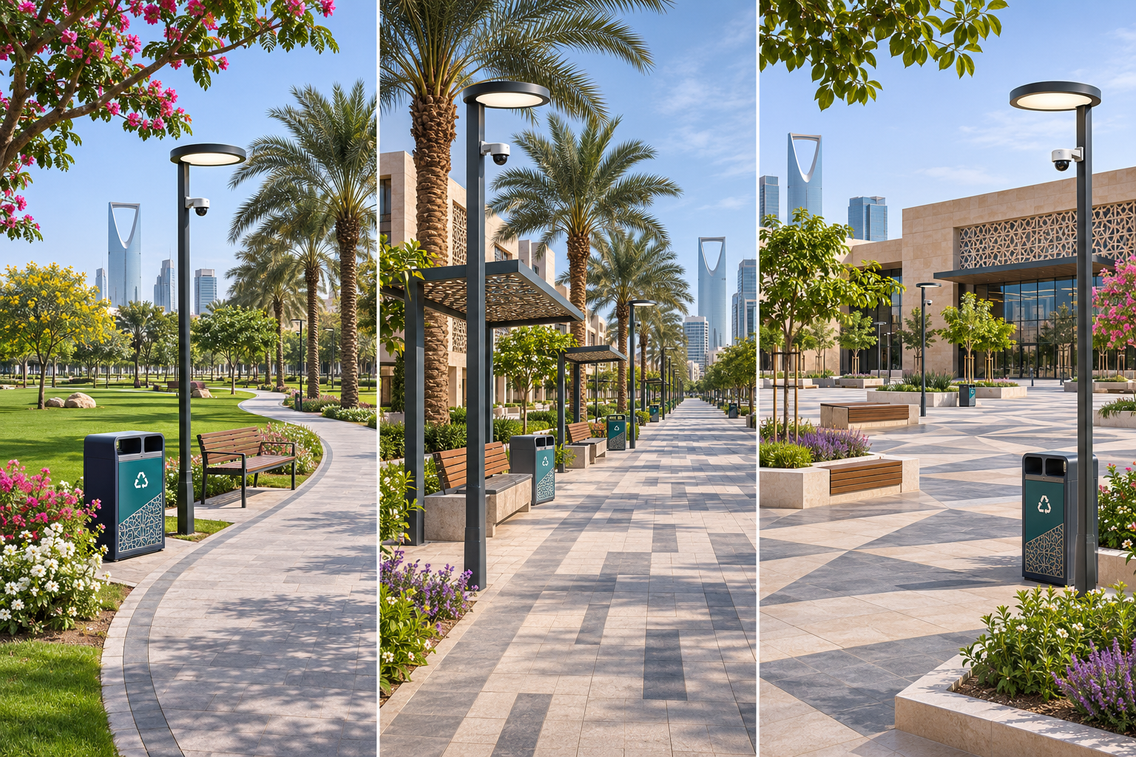
NUQA
LOCATION VISUALS
Designed for the places people share
Concept settings for an authorized pilot, using cameras on existing lighting poles.
Public parks
Walkways
Public plazas
Bins, lawns and seating areas
Paths and shared pedestrian zones
Gathering areas and planted edges
Concept prototype • Illustrative scenes and fictional data
13
Notes:
AI-generated concept location visuals. These are generic parks, walkways and plazas, not actual installation sites or approved partners. Camera coverage and physical mounting need site-owner review before deployment.

Slide 14
NUQA
OPERATIONAL MODEL
From camera alert to cleanup: a shared workflow
Different sources enter one process; responsibility is visible at each handoff.
01
02
03
04
05
→
→
→
→
Detect
Review
Assign
Resolve
Verify
Camera or citizen
Validate the event
Worker and task
Clean and submit
Officer closes case
Potential vehicle littering → Evidence review → Authorized decision
Concept prototype • Illustrative scenes and fictional data
14
Notes:
NUQA concept presentation. Interface screenshots come from the current working prototype. All scenarios and data are illustrative.

Slide 15
NUQA
DEPLOYMENT CONTROLS
Responsible evidence and human decisions
Design requirements for a future field pilot and any authority integration.
01
02
03
Purposeful capture
Protected evidence
Reviewed action
Focus on the incident. Avoid facial identification; mask unrelated people when appropriate.
Restrict access to plates and images. Define retention, permissions and an audit trail.
Check attribution and evidence quality. Allow correction before any real action.
Concept prototype • Illustrative scenes and fictional data
15
Notes:
NUQA concept presentation. Interface screenshots come from the current working prototype. All scenarios and data are illustrative.

Slide 16
NUQA
NEXT STEPS
Pilot plan: validate before deployment
Start with a small, authorized area and compare the system with field review.
01
02
03
Prepare
Test
Decide
Choose road and park test zones. Confirm permissions and define a baseline.
Evaluate events, vehicle association, plate visibility and usability.
Review false alerts, missed events, response times and verified cleanup.
Pilot measures
Detection quality • Attribution errors • Response time • Task completion
Concept prototype • Illustrative scenes and fictional data
16
Notes:
NUQA concept presentation. Interface screenshots come from the current working prototype. All scenarios and data are illustrative.

Slide 17
NUQA
INNOVATION PROJECT
The team
NUQA — A cleaner city through intelligence.
Manar Al-Nuqaydan
Tamadher
The next step
An authorized, controlled pilot that connects observation to a verified response.
Concept prototype • Illustrative scenes and fictional data
17
Notes:
NUQA concept presentation. Interface screenshots come from the current working prototype. All scenarios and data are illustrative.

