Slide 1

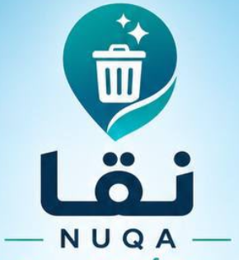
NUQA
INNOVATION PROJECT
NUQA
A Cleaner City,
Through Intelligence
Connect observation, response and verified action.
SMART CAMERAS + CONNECTED PEOPLE
Concept prototype • Illustrative scenes and fictional data
01
Notes:
NUQA is a concept prototype. The deck includes screenshots of the implemented demonstration and concept illustrations, not verified field deployment. Preserve the original NUQA brand and team attribution.

Slide 2
NUQA
THE PROBLEM
The problem NUQA is designed to address
Waste is visible. The path from a sighting to a verified response is often less clear.
01
02
03
Waste goes unnoticed
Littering lacks context
Response is fragmented
Overflowing bins and scattered litter can remain unreported or be reported late.
A sighting alone may not reliably establish when, where or from which vehicle waste was thrown.
Disconnected reports, assignments and updates make ownership and closure harder to follow.
Concept prototype • Illustrative scenes and fictional data
02
Notes:
These are operational problem hypotheses, not quantified findings from a NUQA deployment. Validate their frequency and impact with the pilot partner before setting targets.

Slide 3
NUQA
THE SOLUTION
The solution: one connected cleanliness platform
NUQA brings smart-camera alerts, citizen reports and field work into a shared case record.
01
02
03
Observe
Coordinate
Resolve
Camera signals + citizen reports
Location, time and event context.
Staff review + task assignment
A clear owner and next action.
Field response + verification
Citizens receive status updates.
The intended result: earlier awareness, clearer responsibility and traceable resolution.
Concept prototype • Illustrative scenes and fictional data
03
Notes:
NUQA concept presentation. Interface screenshots come from the current working prototype. All scenarios and data are illustrative.

Slide 4
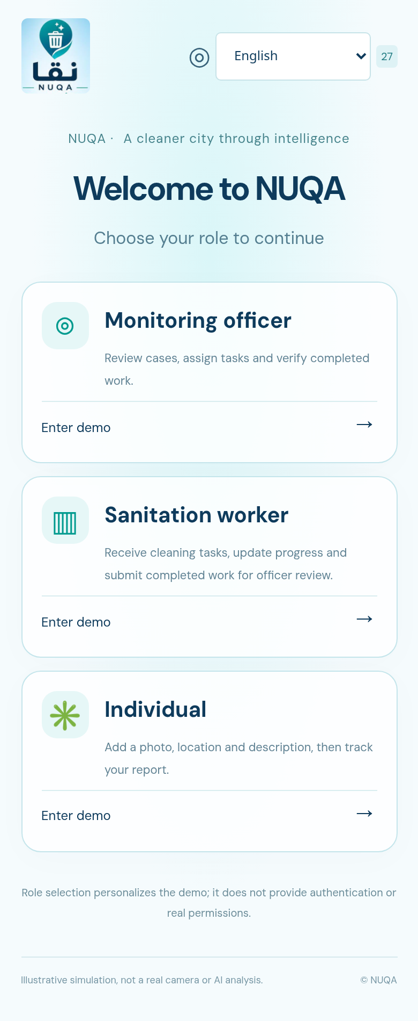
NUQA
APP EXPERIENCE
Three roles. A focused experience for each.
The working website starts with role selection and offers 27 interface languages.
9:41
Individual
01
Report a location and issue; follow its status.
02
Sanitation worker
Start assigned work and submit completion for review.
03
Monitoring officer
Review camera events, manage cases and verify closure.
Current NUQA prototype
Concept prototype • Illustrative scenes and fictional data
04
Notes:
Role selection personalizes this demo. It is not production authentication or access control. Screenshots show the current NUQA website, not a downloadable mobile application.

Slide 5
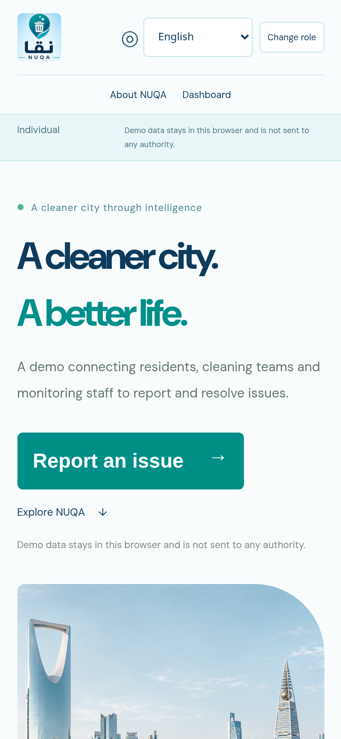
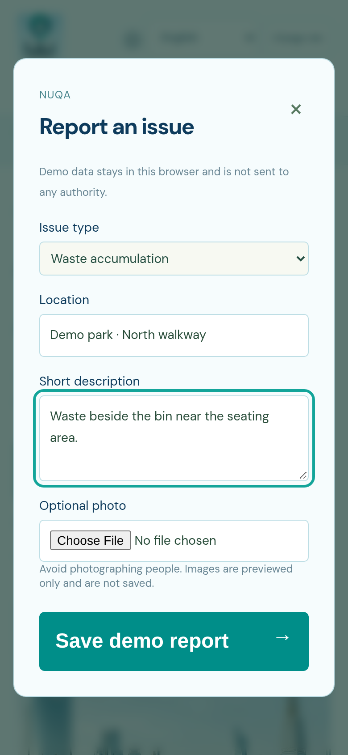
NUQA
CITIZEN INTERFACE
Citizen reporting: simple inputs, visible progress
A short report connects a local observation to the same operational case record.
9:41
9:41
01 Describe the issue
Choose the issue type, add a location and write a short description.
02 Preview, then submit
An optional photo adds context. Status updates keep the report trackable.
Current demo: reports stay in the browser; photos are previewed, not stored.
Home and reporting entry
Report form
Concept prototype • Illustrative scenes and fictional data
05
Notes:
NUQA concept presentation. Interface screenshots come from the current working prototype. All scenarios and data are illustrative.

Slide 6
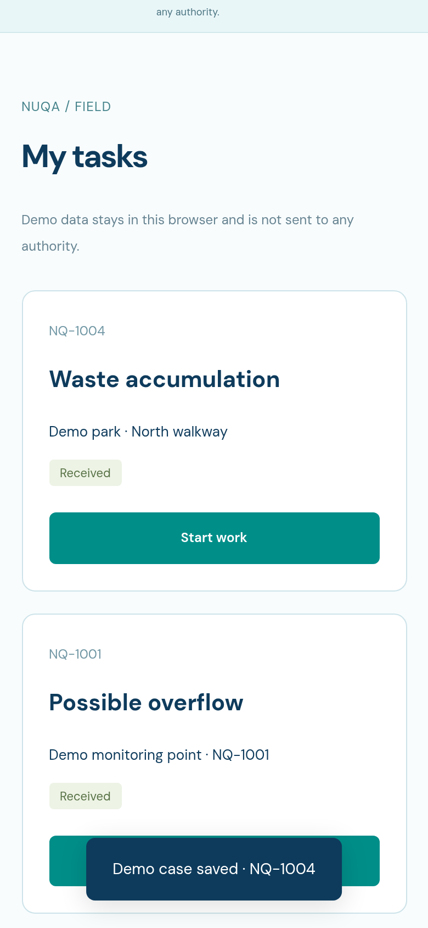
NUQA
WORKER INTERFACE
Sanitation teams: turn cases into accountable work
Tasks move forward with a defined completion handoff to monitoring staff.
9:41
01
Receive and start
A worker sees a task, issue type, location and current status.
02
Confirm completion
After cleanup, the worker submits the task for staff review.
03
Verify before closure
The officer checks the outcome and closes the case.
Current task-list screen
Concept prototype • Illustrative scenes and fictional data
06
Notes:
NUQA concept presentation. Interface screenshots come from the current working prototype. All scenarios and data are illustrative.

Slide 7
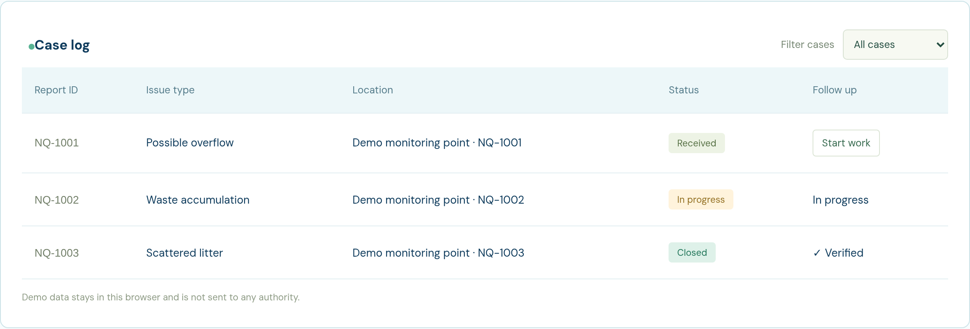
NUQA
MONITORING INTERFACE
Municipal view: one record from report to closure
Staff can inspect status, initiate work and verify completed tasks.
Unified cases
Reviewed transitions
Verified closure
Camera events and citizen reports
Received → In progress → Review
Officer confirmation before close
Concept prototype • Illustrative scenes and fictional data
07
Notes:
NUQA concept presentation. Interface screenshots come from the current working prototype. All scenarios and data are illustrative.

Slide 8
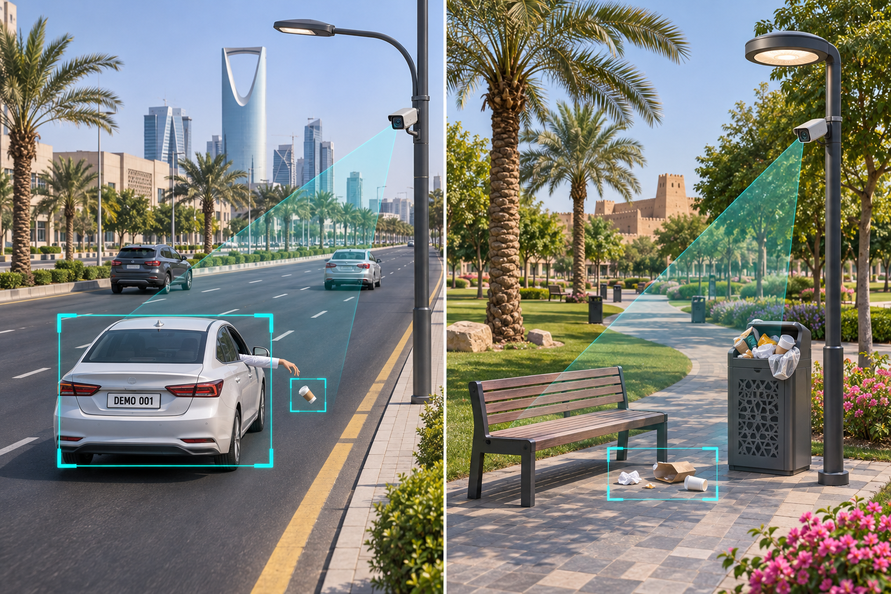
NUQA
ROADSIDE CAMERA CONCEPT
Public roads: detect a potential littering incident
Link the visible event to a vehicle and a permitted plate snapshot for authorized review.
01 Observe the event
Flag an object that may have been thrown from a vehicle.
02 Associate the vehicle
Retain scene context and the visible plate when capture is permitted.
03 Submit for review
Attach location, time and selected evidence to a candidate incident.
Illustrative scene • Fictional plate • Proposed capability
Concept prototype • Illustrative scenes and fictional data
08
Notes:
Concept visualization. Detecting a thrown object or associating it with a vehicle is uncertain. Plate capture/ALPR is a proposed future capability, not implemented in the website. No facial identification is required. Record the event context and allow an authorized officer to review before any real enforcement action.

Slide 9
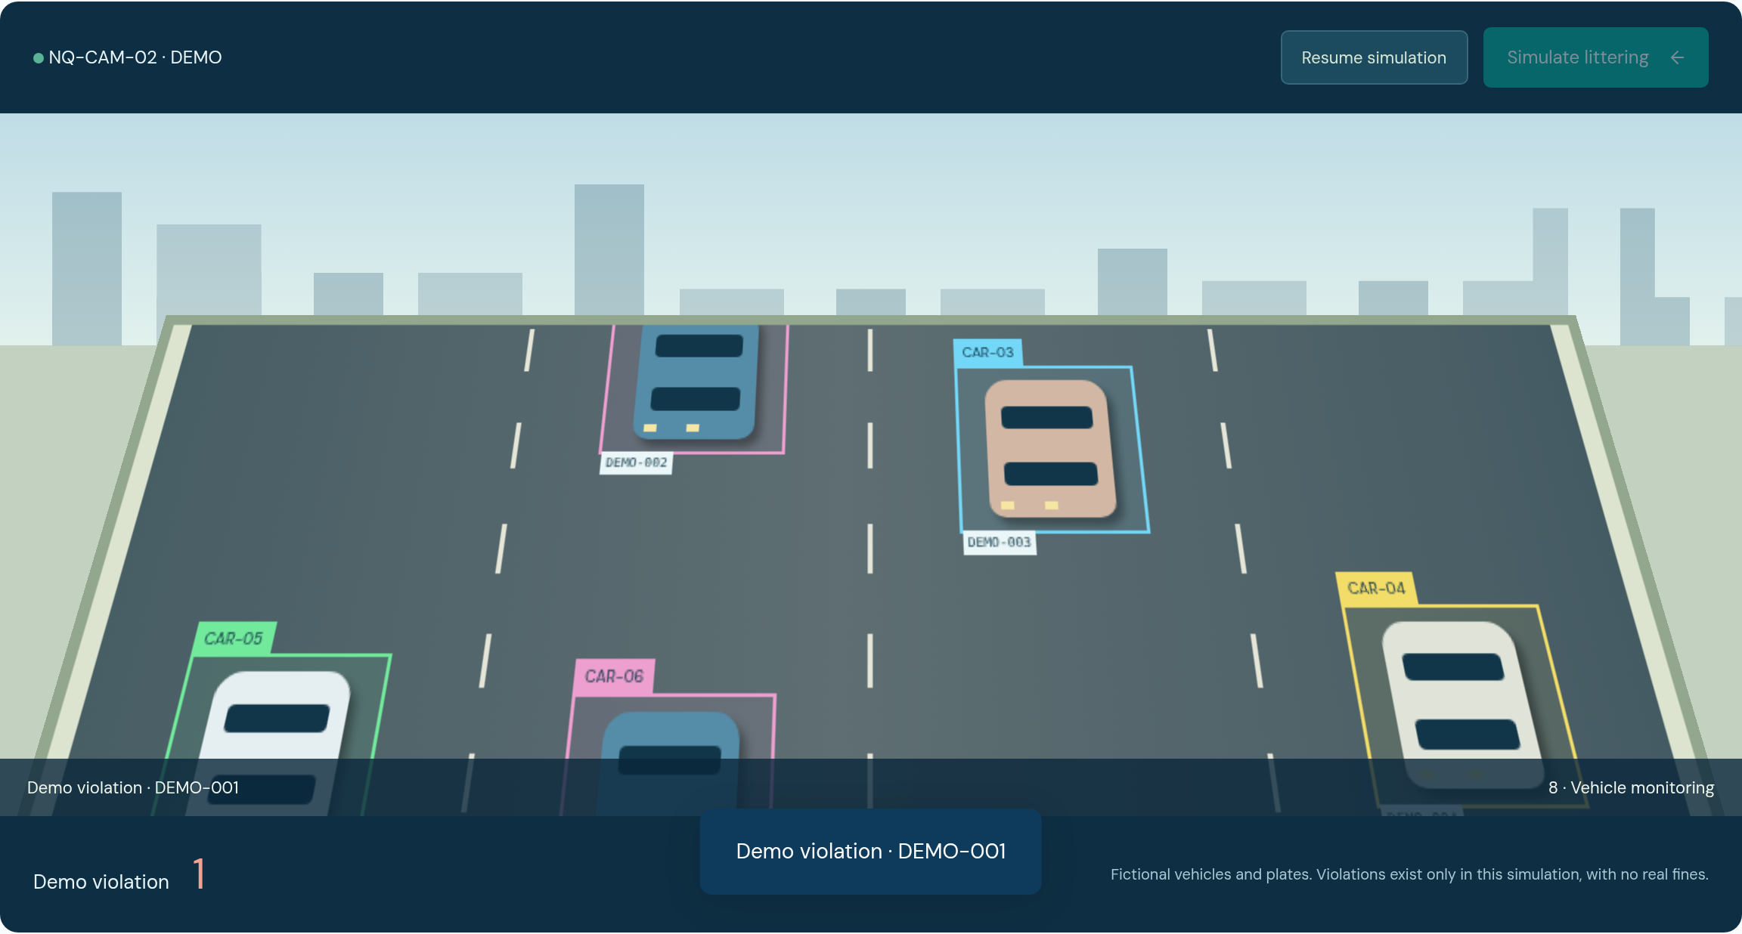
NUQA
IMPLEMENTED SIMULATION
Vehicle simulation: event → vehicle → demo record
The website illustrates the association using animated cars and fictional plates.
DEMO EVIDENCE
DEMO-001
Fictional vehicle plate
Demo violation record
Local record only.
No real fine is issued.
Implemented: a scripted event and local record. Proposed: real detection and authorized evidence review.
Concept prototype • Illustrative scenes and fictional data
09
Notes:
The simulated scene uses predefined cars DEMO-001 to DEMO-008 and a user-triggered littering animation. It creates local demonstration records only. The prototype does not analyze video, read real plates, identify people or issue real fines.

Slide 10
NUQA
PUBLIC-SPACE CAMERA CONCEPT
Parks and public spaces: cameras on lighting poles
Monitor waste hotspots around bins, paths and seating areas in an authorized pilot zone.
Use existing infrastructure
A proposed camera mounts below the lamp on an approved lighting pole.
Focus on waste conditions
Flag visible overflow, accumulated waste or a potential littering event.
Send a targeted response
Create a reviewed task with a clear location for the cleaning team.
Illustrative park and camera coverage
Concept prototype • Illustrative scenes and fictional data
10
Notes:
Concept illustration, not an installed camera or approved site. Mounting on lighting poles needs the asset owner’s permission, a coverage review and operational and privacy controls. The focus is waste conditions and events, not identifying park visitors.

Slide 11
NUQA
OPERATIONAL MODEL
From camera alert to cleanup: a shared workflow
Different sources enter one process; responsibility is visible at each handoff.
01
02
03
04
05
→
→
→
→
Detect
Review
Assign
Resolve
Verify
Camera or citizen
Validate the event
Worker and task
Clean and submit
Officer closes case
Potential vehicle littering → Evidence review → Authorized decision
Concept prototype • Illustrative scenes and fictional data
11
Notes:
NUQA concept presentation. Interface screenshots come from the current working prototype. All scenarios and data are illustrative.

Slide 12
NUQA
DEPLOYMENT CONTROLS
Responsible evidence and human decisions
Design requirements for a future field pilot and any authority integration.
01
02
03
Purposeful capture
Protected evidence
Reviewed action
Focus on the incident. Avoid facial identification; mask unrelated people when appropriate.
Restrict access to plates and images. Define retention, permissions and an audit trail.
Check attribution and evidence quality. Allow correction before any real action.
Concept prototype • Illustrative scenes and fictional data
12
Notes:
NUQA concept presentation. Interface screenshots come from the current working prototype. All scenarios and data are illustrative.

Slide 13
NUQA
NEXT STEPS
Pilot plan: validate before deployment
Start with a small, authorized area and compare the system with field review.
01
02
03
Prepare
Test
Decide
Choose road and park test zones. Confirm permissions and define a baseline.
Evaluate events, vehicle association, plate visibility and usability.
Review false alerts, missed events, response times and verified cleanup.
Pilot measures
Detection quality • Attribution errors • Response time • Task completion
Concept prototype • Illustrative scenes and fictional data
13
Notes:
NUQA concept presentation. Interface screenshots come from the current working prototype. All scenarios and data are illustrative.

Slide 14
NUQA
INNOVATION PROJECT
The team
NUQA — A cleaner city through intelligence.
Manar Al-Nuqaydan
Tamadher
The next step
An authorized, controlled pilot that connects observation to a verified response.
Concept prototype • Illustrative scenes and fictional data
14
Notes:
NUQA concept presentation. Interface screenshots come from the current working prototype. All scenarios and data are illustrative.

