Slide 1
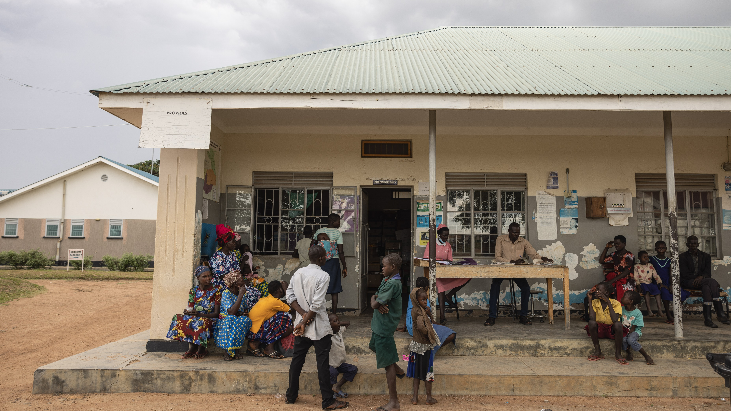
The Importance of integrating immunisation with PHC to achieve immunisation and SDG targets
Central Africa EPI manager meeting, Kinshasa, Sep 9 - 12
Dr. med. Katja Schemionek, Special Programme PHC, HQ/WHO
xyz
Notes:
Gavi’s HSS Strategy TAG workshop, 12 Feb 2024
Part 1: Using zero dose as a platform for integrated PHC services

Slide 2
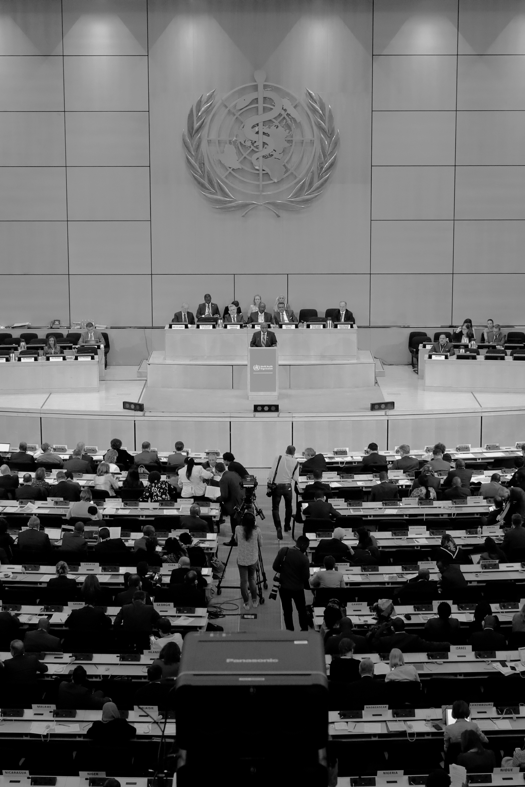
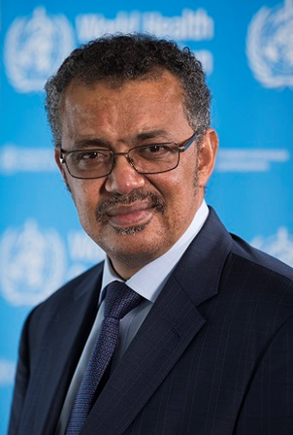
Dr Tedros
“A renewed commitment to Health Equity will be the key to addressing future health challenges”
“We must urgently reorient health systems towards Primary Health Care, as the foundation of universal health coverage”
«Health is a Political Choice»
Notes:
Role of parliamentarians to support the strategy: (1) Legislative; (2) funding support – allocate resources to the health sector; (3) accountability and monitoring progress

Slide 3
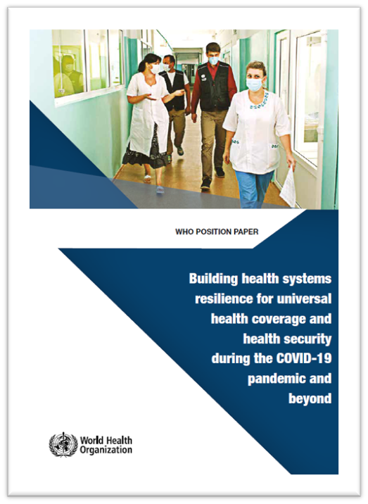
WHO POST COVID POSITION PAPER
Leverage the current response to strengthen health systems and preparedness
Invest in EPHFs including those for all-hazards emergency risk management
Strengthen PHC approach for health security and UHC
Invest in institutionalized mechanisms for whole-of-society engagement
Promote enabling environments for research, innovation and learning
Increase domestic and global investment in health system foundations and all-hazards emergency risk management
Address pre-existing inequities and the disproportionate impact of COVID 19 on marginalized and vulnerable populations

Slide 4
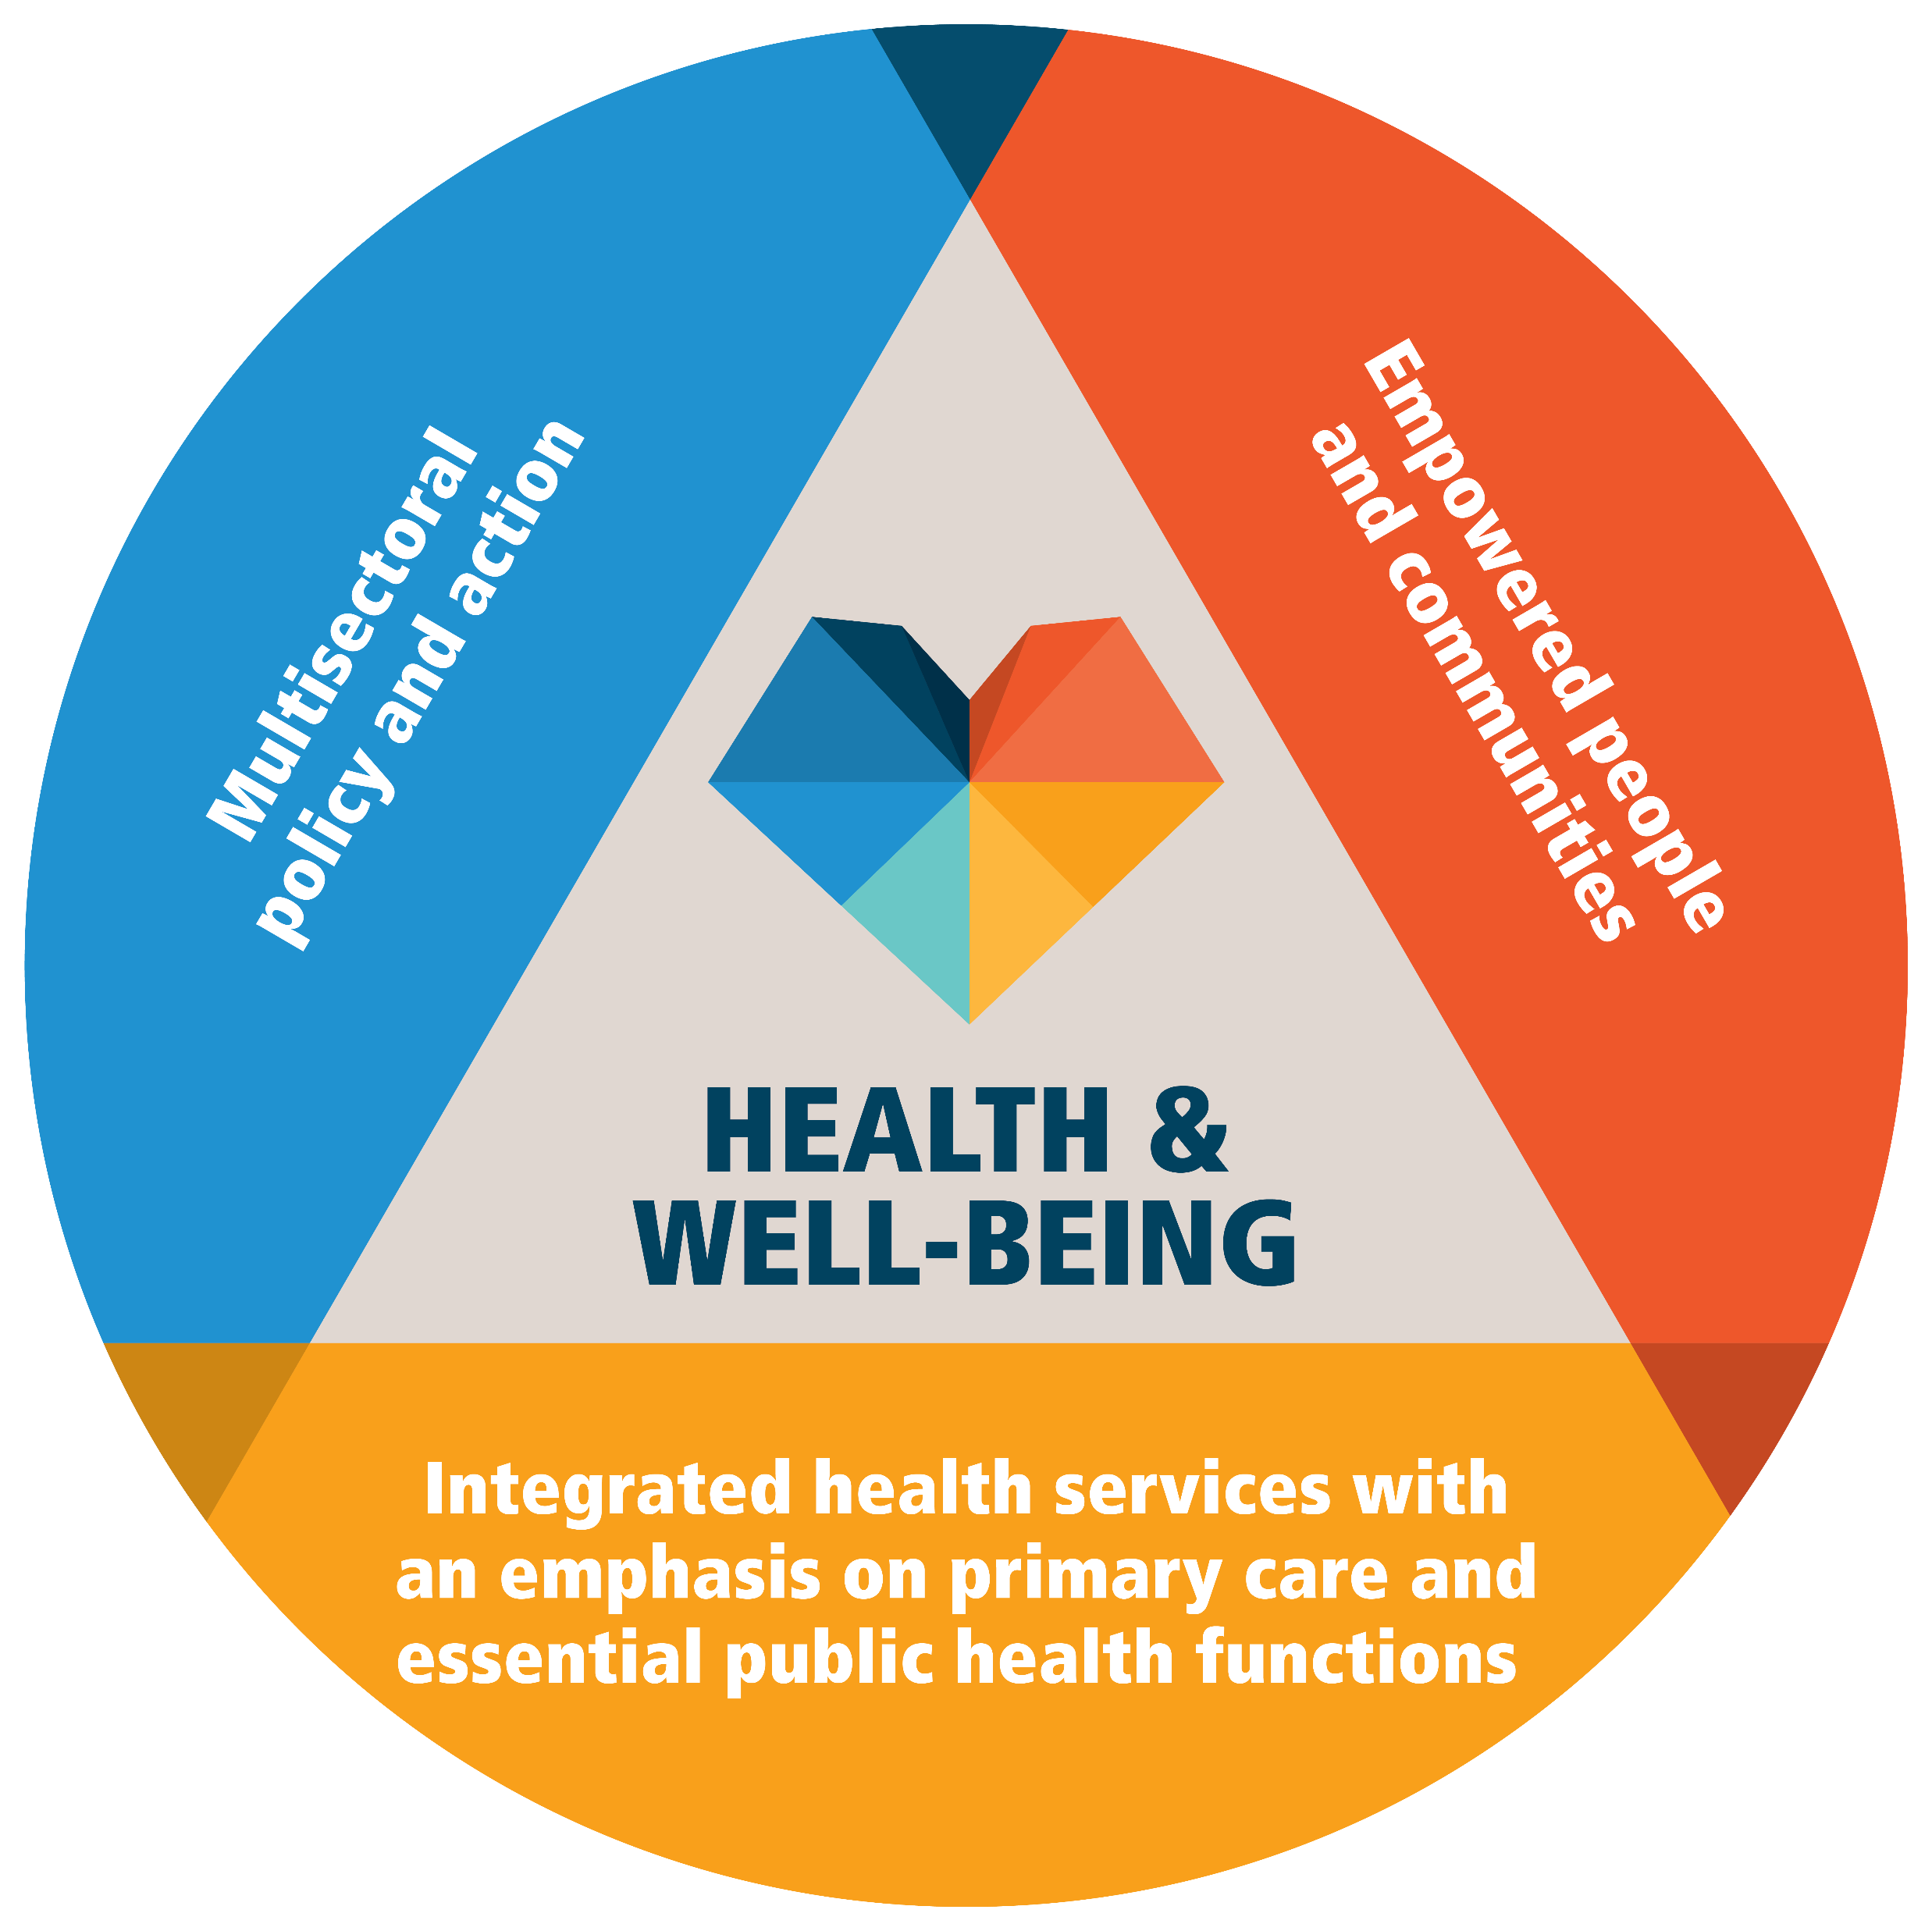
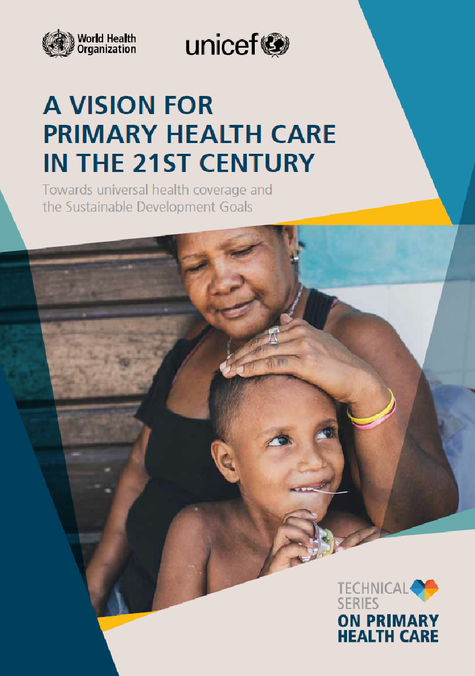
Remember the breadth of Primary Health Care
Multisectorality
Empowerment
Services
Source: World Health Organization & United Nations Children’s Fund (‎UNICEF)‎. (‎2018)‎. A vision for primary health care in the 21st century: towards universal health coverage and the Sustainable Development Goals.
https://apps.who.int/iris/handle/10665/328065.
Notes:
Primary health care and primary care are distinct but related concepts. PHC is more than just Primary Care, it is our broad intention for countries to move forward on the PHC approach.
Primary care (with essential public health functions) is the core and foundation of the service component of PHC. It delivers people-centred care with four characteristics: 1. first contact; 2. comprehensiveness; 3. continuity; 4. coordination.

Slide 5


Vaccination et SSP : pourquoi est-ce important ?
La vaccination est un volet essentiel des SSP et offre un point d'entrée clair pour les efforts multisectoriels visant à renforcer les SSP de manière plus générale. Étant donné les forces largement reconnues des programmes de vaccination, il est possible de s'appuyer sur cette expérience pour en faire bénéficier d'autres programmes de SSP.
De solides programmes de SSP sont nécessaires pour garantir l'adoption des vaccins tout au long de la vie. Cela est particulièrement évident pour les vaccins administrés en dehors de la période de l'enfance, comme le vaccin contre le papillomavirus (VPH).
Les responsables du PEV, qui reconnaissent et exploitent déjà les synergies entre le renforcement du système de vaccination et les SSP, sont des champions naturels des SSP, compte tenu de leur expérience du positionnement des personnes au centre des services de santé et de la promotion de l’action multisectorielle. Le cadre de SSP vise à montrer les possibilités de tirer parti de la vaccination pour contribuer à des SSP solides et renforcés.
Ces ressources peuvent être utilisées pour éclairer :
le plaidoyer auprès des responsables des programmes de vaccination et du ministère de la santé sur le rôle et la pertinence de la vaccination pour renforcer les programmes de SSP et auprès des programmes de SSP pour renforcer la vaccination ;
les processus d'élaboration de stratégies (y compris les stratégies nationales de vaccination et la planification du portefeuille complet de Gavi) pour s'assurer que ces processus soient exploités pour inclure des objectifs et des activités spécifiques susceptibles de renforcer mutuellement la vaccination et les SSP.
https://www.immunizationagenda2030.org/images/documents/BLS20116_IA_Visula-ID-DesignLayout_FR_WEB.pdf

Slide 6



Who Is The Framework for Action For?
Health system interventions, immunization touchpoints and PHC:
The way forward building on the Immunization for PHC Framework for Action
Three User-Friendly Tools
Practical Actions to Take
Includes country case studies and “Practical Actions You Can Take” including utilizing the National Immunization Strategy (NIS), National Health Plans/Strategies, and/or Gavi Full Portfolio Planning to propose objectives and specific activities that mutually strengthen immunization and PHC
Summary slide deck
IA2030 website SP 1
Interactive online version
IA2030 Immunization for PHC/UHC: Technical brief
EPI managers
PHC managers
National policymakers
Notes:
It translates the WHO/UNICEF Primary Health Care (PHC) Theory of Change to actions that can mutually benefit immunization and PHC on the road to achieving Universal Health Coverage

Slide 7
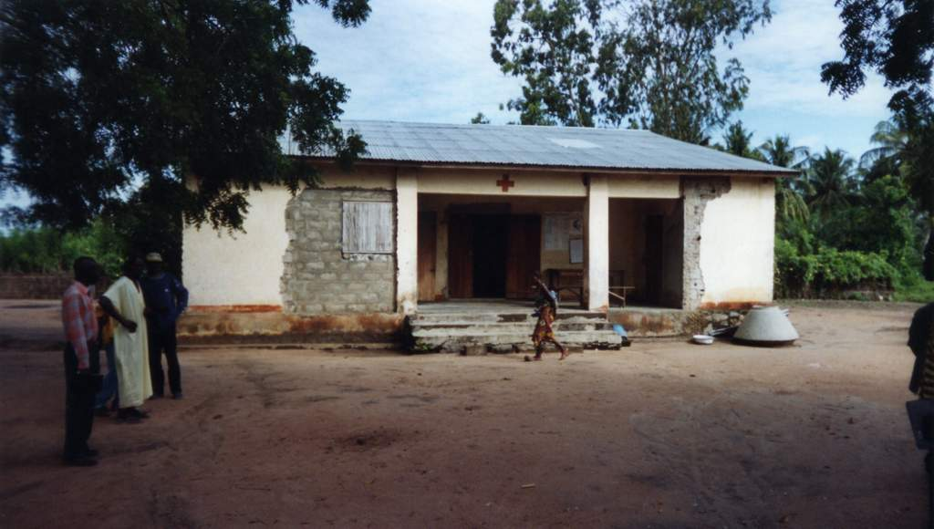
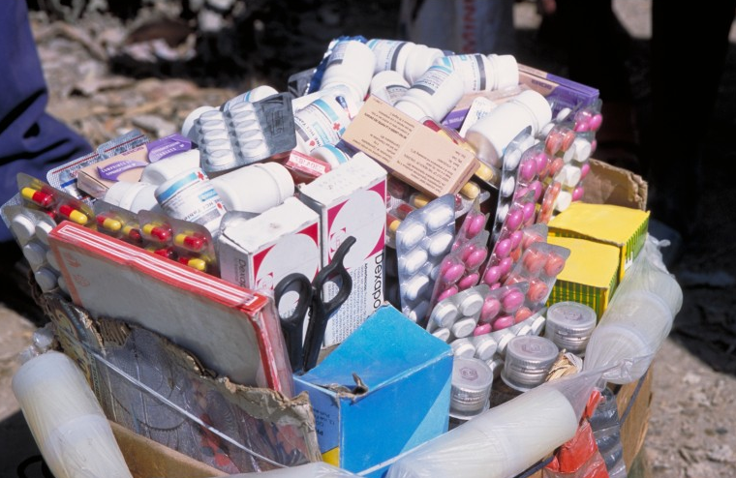
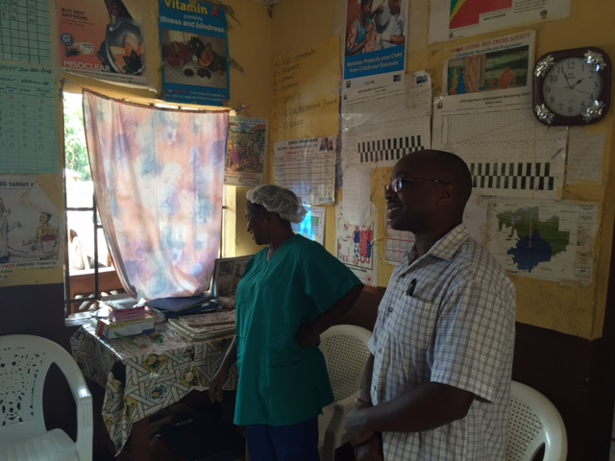
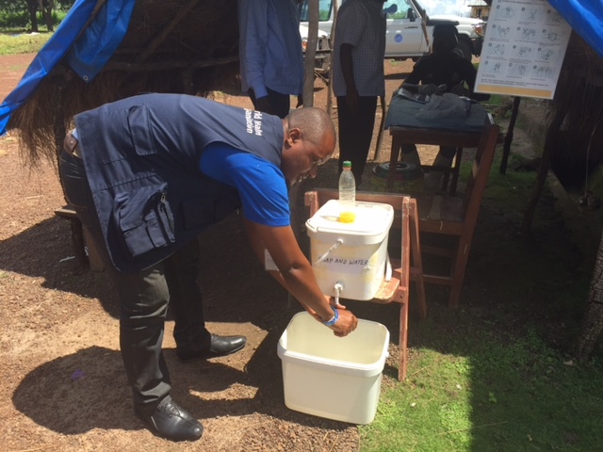
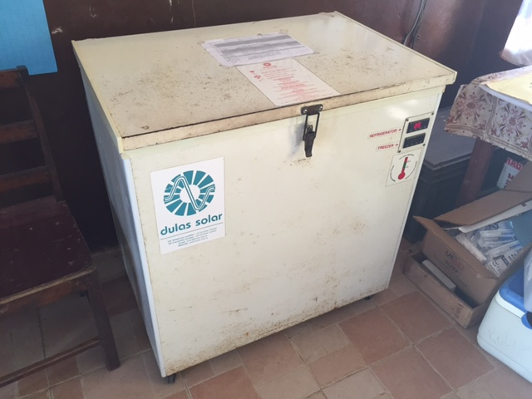
>50 countries lack PHC systems’ foundations

Slide 8
Integrating RI with PHC – the Gavi FPP process
Using Gavi FPP and other grant planning processes to target immunisation investments towards the PHC re-orientation of countries’ health systems
A ‘Zero Dose’ child is often lacking access to other PHC and social services and so is the child’s family and community
‘Zero Dose Children’ are also makers for ‘Zero PHC services’
Global immunisation targets cannot be reached without building strong health & PHC systems

Slide 9
Areas for integration of immunization & re-orientating health systems towards PHC
Governance and data
Use EPI data to inform PHC planning including at district level (EPI micro-plans) and resource allocation
Use ICC (or any existing coordination mechanism for EPI) to inform national /sub-national health sector coordination (standing agenda)
Stimulate dialogue with MoH/Gov to increase domestic financing for PHC when discussing e.g. Gavi HSS support
Use innovative approaches in EPI to scale-up across PHC (use of drones, GIS mapping to identify missed community)
Align NIS with national PHC priorities
Introduce innovative financing approaches that benefit vaccination AND PHC services (Direct Facility Financing)
Learn from immunisation research
Health Services & Health Workforce
Introduce quality of care improvement collaboratives (mentoring, supervision, rewarding) across PHC health worker teams
Utilise a ‘PHC multidisciplinary team approach’ (salary support and incentives!) rather than investing in vaccinators alone (reaching last mile, ZDC, deployment, retention, task shifting)
Make adequate infrastructure available, e.g. water & sanitation facilities, cold chain at PHC facilities
Ensure immunisation is included in pre-service curriculum
‘Service 'integration (planning & delivery) at sub-national levels
Community involvement and multi-sectorality
Use community members active in defaulter tracking for a ‘PHC approach’ (e.g. tracking pregnant women, people with NCD conditions)
Seek collaboration with other sectors that are critical for immunisation as well: education, youth, women, planning & vital statistics, water & sanitation)
Build on social mobilization activities used for vaccination campaigns / RI to mobilize using PHC services
Plan services with communities to meet their needs

Slide 10
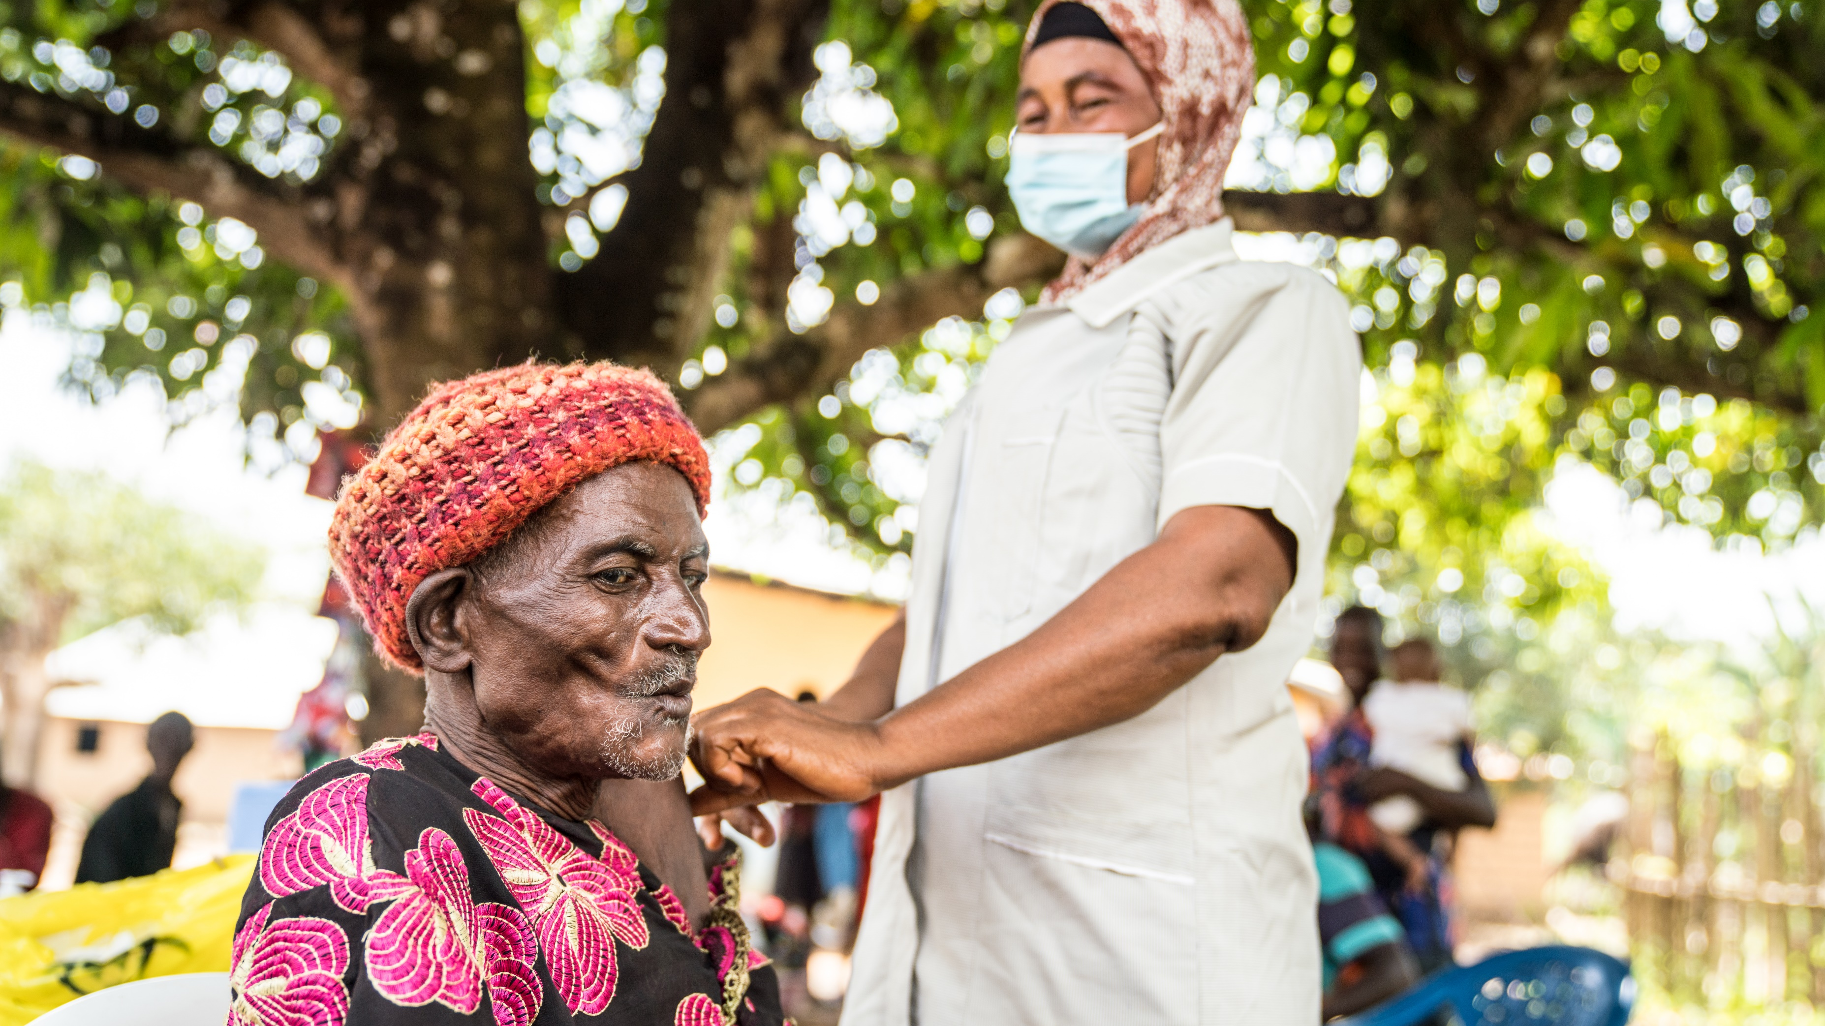
THANK YOU!

