Slide 1
Selective Sampling for Information Extraction with a Committee of Classifiers
Evaluating Machine Learning for Information Extraction, Track 2
Ben Hachey, Markus Becker, Claire Grover & Ewan Klein
University of Edinburgh

Slide 2
Overview
Introduction
  Approach & Results
Discussion
  Alternative Selection Metrics
  Costing Active Learning
  Error Analysis
Conclusions

Slide 3
Approaches to Active Learning
Uncertainty Sampling (Cohn et al., 1995)
Usefulness ≈ uncertainty of single learner
  Confidence: Label examples for which classifier is the least confident
  Entropy: Label examples for which output distribution from classifier has highest entropy
Query by Committee (Seung et al., 1992)
Usefulness ≈ disagreement of committee of learners
  Vote entropy: disagreement between winners
  KL-divergence: distance between class output distributions
  F-score: distance between tag structures

Slide 4
Committee
Creating a Committee
  Bagging or randomly perturbing event counts, random feature subspaces (Abe and Mamitsuka, 1998; Argamon-Engelson and Dagan, 1999; Chawla 2005)
    Automatic, but not ensured diversity…
  Hand-crafted feature split (Osborne & Baldridge, 2004)
    Can ensure diversity
    Can ensure some level of independence
We use a hand crafted feature split with a maximum entropy Markov model classifier
(Klein et al., 2003; Finkel et al., 2005)

Slide 5
Feature Split
Feature Set 1 |  | Feature Set 2
Word Features | w_{i}, w_{i-1}, w_{i+1} | TnT POS tags | POS_{i}, POS_{i-1}, POS_{i+1}
 | Disjunction of 5 prev words | Prev NE | NE_{i-1}, NE_{i-2} + NE_{i-1}
 | Disjunction of 5 next words | Prev NE + POS | NE_{i-1} + POS_{i-1} + POS_{i}
Word Shape | shape_{i}, shape_{i-1}, shape_{i+1} |  | NE_{i-2}+ NE_{i-1} + POS_{i-2} + POS_{i-1} + POS_{i}
 | shape_{i} + shape_{i+1} | Occurrence Patterns | Capture multiple references to NEs
 | shape_{i} + shape_{i-1} + shape_{i+1}
Prev NE | NE_{i-1}, NE_{i-2} + NE_{i-1}
 | NE_{i-3} + NE_{i-2} + NE_{i-1}
Prev NE + Word | NE_{i-1} + w_{i}
Prev NE + shape | NE_{i-1} + shape_{i}
 | NE_{i-1} + shape_{i+1}
 | NE_{i-1} + shape_{i-1} + shape_{i}
 | NE_{i-2} + NE_{i-1} + shape_{i-2} + shape_{i-1} + shape_{i}
Position | Document Position
Words, Word shapes, Document position | Parts-of-speech, Occurrence patterns of proper nouns

Slide 6
KL-divergence (McCallum & Nigam, 1998)
Quantifies degree of disagreement between distributions:
Document-level
  Average
Notes:
McCallum & Nigam: Document classification
Co-testing selects examples on which classifiers individually have high confidence but disagree with each other.
KL-divergence is a softer version of this.

Slide 7
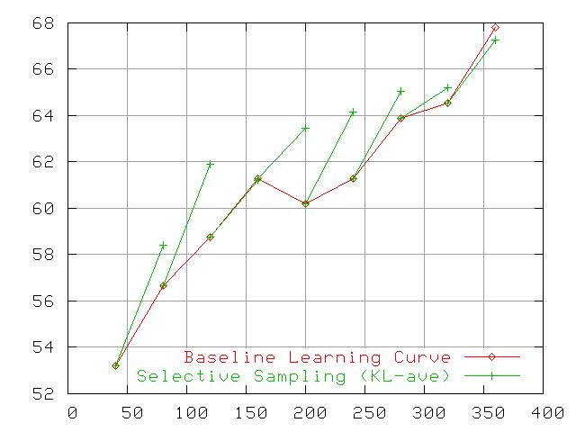
Evaluation Results
Notes:
* F-score against number of documents

Slide 8
Discussion
Best average improvement over baseline learning curve:
1.3 points f-score
Average % improvement:
2.1% f-score
Absolute scores middle of the pack

Slide 9
Overview
Introduction
  Approach & Results
Discussion
  Alternative Selection Metrics
  Costing Active Learning
  Error Analysis
Conclusions

Slide 10
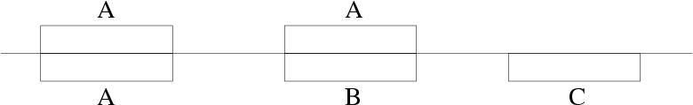
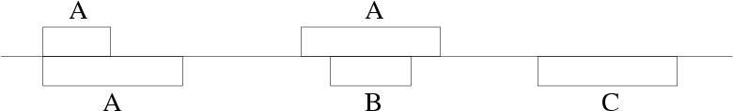
Other Selection Metrics
KL-max
  Maximum per-token KL-divergence
F-complement
(Ngai & Yarowsky, 2000)
  Structural comparison between analyses
  Pairwise f-score between phrase assignments:
Notes:
Don’t talk about these as optimisation

Slide 11
Related Work: BioNER
NER-annotated sub-set of GENIA corpus (Kim et al., 2003)
  Bio-medical abstracts
  5 entities:
  DNA, RNA, cell line, cell type, protein
Used 12,500 sentences for simulated AL experiments
  Seed: 500
  Pool: 10,000
  Test: 2,000

Slide 12
Costing Active Learning
Want to compare reduction in cost (annotator effort & pay)
Plot results with several different cost metrics
  # Sentence, # Tokens, # Entities
Notes:
Sentence level ~ document level

Slide 13
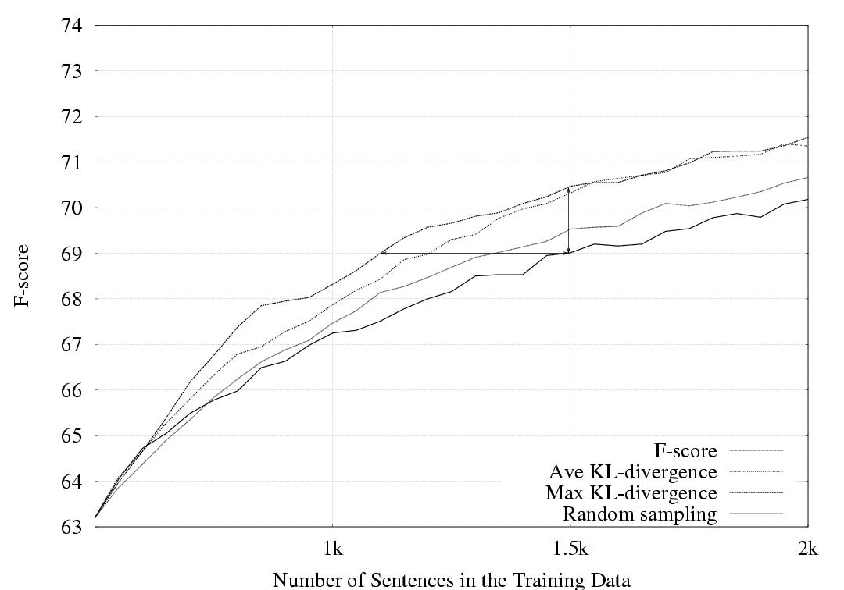
Simulation Results: Sentences
Cost: 10.0/19.3/26.7
Error: 1.6/4.9/4.9

Slide 14
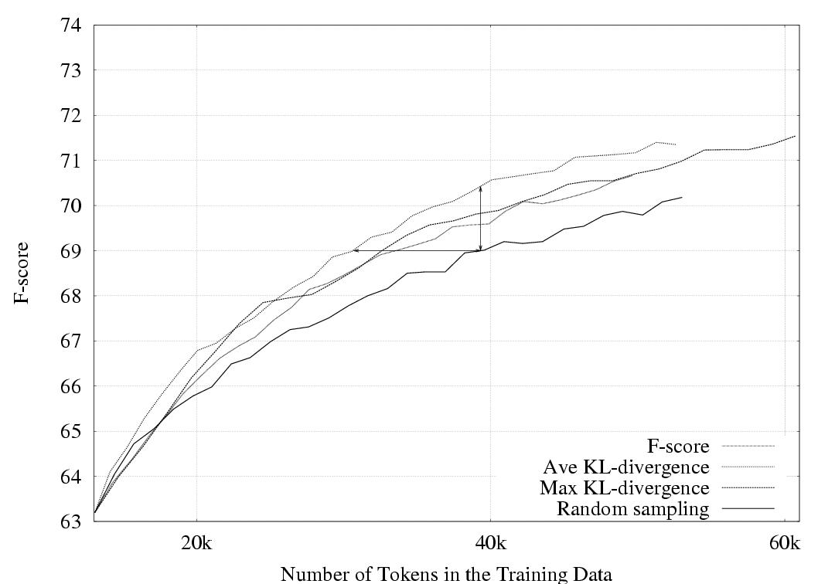
Simulation Results: Tokens
Cost: 14.5/23.5/16.8
Error: 1.8/4.9/2.6

Slide 15
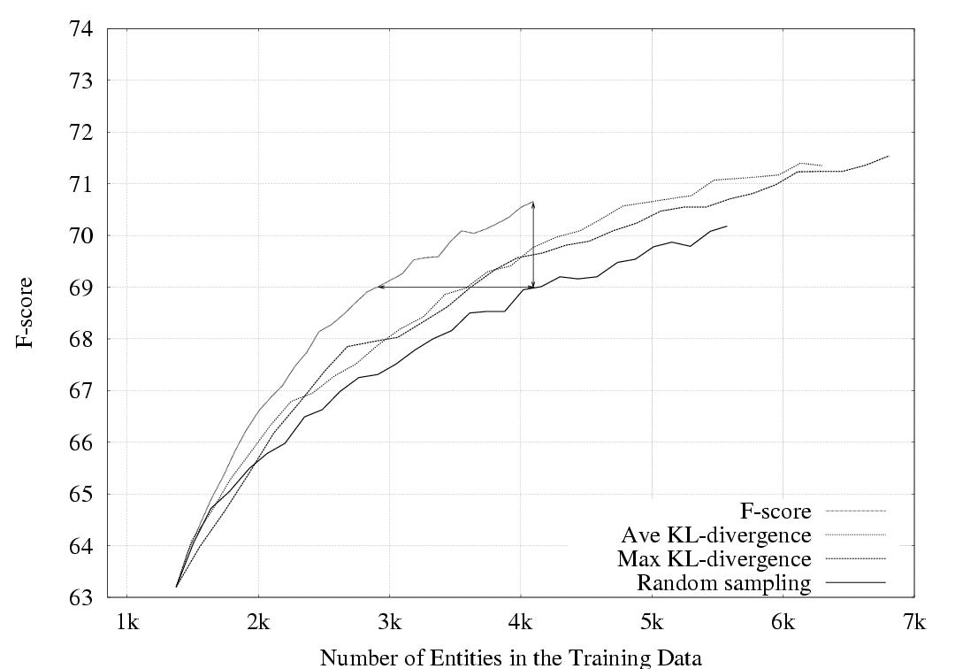
Simulation Results: Entities
Cost: 28.7/12.1/11.4
Error: 5.3/2.4/1.9

Slide 16
Costing AL Revisited (BioNLP data)
Metric | Tokens | Entities | Ent/Tok
Random | 26.7 (0.8) | 2.8 (0.1) | 10.5 %
F-comp | 25.8 (2.4) | 2.2 (0.7) | 8.5 %
MaxKL | 30.9 (1.5) | 3.3 (0.2) | 10.7 %
AveKL | 27.1 (1.8) | 3.3 (0.2) | 12.2 %
Averaged KL does not have a significant effect on sentence length
→ Expect shorter per sent annotation times.
Relatively high concentration of entities
→ Expect more positive examples for learning.
Notes:
Num tokens inappropriate: Does not account for the fact that more entities probably makes a sentence more difficult to annotate.
Num sentences too coarse: Gives same cost to very long and very short sentences.
Num entities inappropriate: Does not reflect fact that every sentence needs to be read from beginning to end regardless of number of entities.

Slide 17
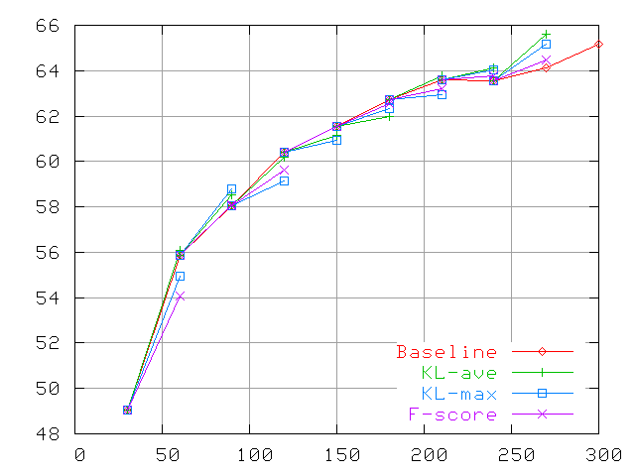
Document Cost Metric (Dev)
Notes:
Metrics give similar accuracy improvement
From previous work, we have a bias toward KL-ave…

Slide 18
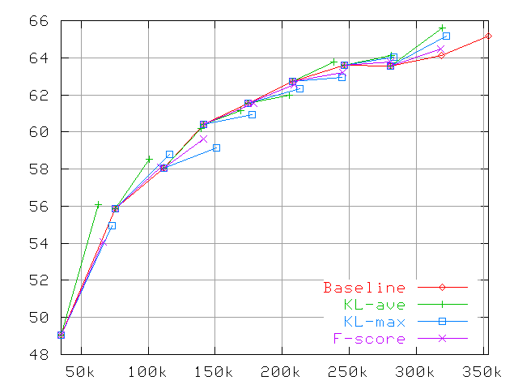
Token Cost Metric (Dev)

Slide 19
Discussion
Difficult to do comparison between metrics
  Document unit cost not necessarily realistic estimate real cost
Suggestion for future evaluation:
  Use corpus with measure of annotation cost at some level (document, sentence, token)

Slide 20
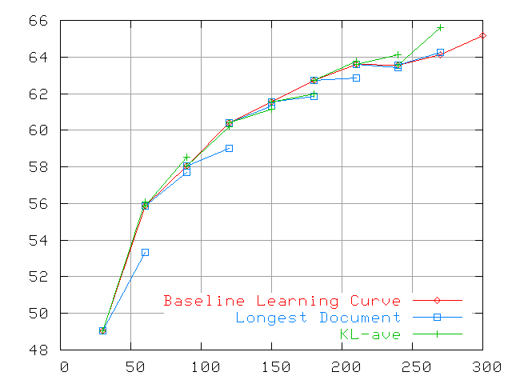
Longest Document Baseline
Notes:
Thought we might be able to prove costing point with a simple approach that just selects the longest documents…
Did not perform well
Longer documents seem to be noisier…

Slide 21
Confusion Matrix
Token-level
B-, I- removed
Random Baseline
  Trained on 320 documents
Selective Sampling
  Trained on 280+40 documents

Slide 22
random | O | wshm | wsnm | cfnm | wsac | wslo | cfac | wsdt | wssdt | wsndt | wscdt | cfhm
O | 94.82 | 0.37 | 0.14 | 0.07 | 0.04 | 0.04 | 0.05 | 0.04 | 0.02 | 0.01 | 0.01 | 0.03
wshm | 0.35 | 0.86 | 0 | 0 | 0 | 0 | 0 | 0 | 0 | 0 | 0 | 0.14
wsnm | 0.34 | 0 | 0.64 | 0 | 0 | 0 | 0 | 0 | 0 | 0 | 0 | 0
cfnm | 0.09 | 0 | 0.01 | 0.2 | 0 | 0 | 0 | 0 | 0 | 0 | 0 | 0
wsac | 0.1 | 0 | 0 | 0 | 0.19 | 0 | 0.04 | 0 | 0 | 0 | 0 | 0
wslo | 0.16 | 0 | 0 | 0 | 0 | 0.19 | 0 | 0 | 0 | 0 | 0 | 0
cfac | 0.05 | 0 | 0 | 0 | 0.03 | 0 | 0.15 | 0 | 0 | 0 | 0 | 0
wsdt | 0.07 | 0 | 0 | 0 | 0 | 0 | 0 | 0.13 | 0 | 0 | 0 | 0
wssdt | 0.03 | 0 | 0 | 0 | 0 | 0 | 0 | 0 | 0.1 | 0 | 0 | 0
sndt | 0.01 | 0 | 0 | 0 | 0 | 0 | 0 | 0 | 0.01 | 0.07 | 0 | 0
wscdt | 0.01 | 0 | 0 | 0 | 0 | 0 | 0 | 0 | 0 | 0 | 0.06 | 0
cfhm | 0.09 | 0.16 | 0 | 0 | 0 | 0 | 0 | 0 | 0 | 0 | 0 | 0.09
selective | O | wshm | wsnm | cfnm | wsac | wslo | cfac | wsdt | wssdt | wsndt | wscdt | cfhm
O | 94.88 | 0.34 | 0.11 | 0.06 | 0.04 | 0.05 | 0.05 | 0.03 | 0.02 | 0 | 0.01 | 0.03
wshm | 0.33 | 0.9 | 0 | 0 | 0 | 0 | 0 | 0 | 0 | 0 | 0 | 0.11
wsnm | 0.34 | 0 | 0.64 | 0 | 0 | 0 | 0 | 0 | 0 | 0 | 0 | 0
cfnm | 0.08 | 0 | 0.01 | 0.21 | 0 | 0 | 0 | 0 | 0 | 0 | 0 | 0
wsac | 0.08 | 0 | 0 | 0 | 0.22 | 0 | 0.03 | 0 | 0 | 0 | 0 | 0
wslo | 0.15 | 0 | 0 | 0 | 0 | 0.2 | 0 | 0 | 0 | 0 | 0 | 0
cfac | 0.06 | 0 | 0 | 0 | 0.03 | 0 | 0.13 | 0 | 0 | 0 | 0 | 0
wsdt | 0.07 | 0 | 0 | 0 | 0 | 0 | 0 | 0.13 | 0 | 0 | 0 | 0
wssdt | 0.03 | 0 | 0 | 0 | 0 | 0 | 0 | 0 | 0.1 | 0 | 0 | 0
wsndt | 0.01 | 0 | 0 | 0 | 0 | 0 | 0 | 0 | 0.01 | 0.07 | 0 | 0
wscdt | 0.01 | 0 | 0 | 0 | 0 | 0 | 0 | 0 | 0 | 0.01 | 0.06 | 0
cfhm | 0.09 | 0.18 | 0 | 0 | 0 | 0 | 0 | 0 | 0 | 0 | 0 | 0.07
Notes:
Motivate conf matrices
Main mass on diagonals
Some improvement for most but not necessarily all
+ e.g. O, workshophomepage, workshopacronym
- e.g. conference acronym, conferencehomepage

Slide 23
random | O | wshm | wsnm | cfnm | wsac | wslo | cfac | wsdt | wssdt | wsndt | wscdt | cfhm
O | 94.82 | 0.37 | 0.14 | 0.07 | 0.04 | 0.04 | 0.05 | 0.04 | 0.02 | 0.01 | 0.01 | 0.03
wshm | 0.35 | 0.86 | 0 | 0 | 0 | 0 | 0 | 0 | 0 | 0 | 0 | 0.14
wsnm | 0.34 | 0 | 0.64 | 0 | 0 | 0 | 0 | 0 | 0 | 0 | 0 | 0
cfnm | 0.09 | 0 | 0.01 | 0.2 | 0 | 0 | 0 | 0 | 0 | 0 | 0 | 0
wsac | 0.1 | 0 | 0 | 0 | 0.19 | 0 | 0.04 | 0 | 0 | 0 | 0 | 0
wslo | 0.16 | 0 | 0 | 0 | 0 | 0.19 | 0 | 0 | 0 | 0 | 0 | 0
cfac | 0.05 | 0 | 0 | 0 | 0.03 | 0 | 0.15 | 0 | 0 | 0 | 0 | 0
wsdt | 0.07 | 0 | 0 | 0 | 0 | 0 | 0 | 0.13 | 0 | 0 | 0 | 0
wssdt | 0.03 | 0 | 0 | 0 | 0 | 0 | 0 | 0 | 0.1 | 0 | 0 | 0
sndt | 0.01 | 0 | 0 | 0 | 0 | 0 | 0 | 0 | 0.01 | 0.07 | 0 | 0
wscdt | 0.01 | 0 | 0 | 0 | 0 | 0 | 0 | 0 | 0 | 0 | 0.06 | 0
cfhm | 0.09 | 0.16 | 0 | 0 | 0 | 0 | 0 | 0 | 0 | 0 | 0 | 0.09
selective | O | wshm | wsnm | cfnm | wsac | wslo | cfac | wsdt | wssdt | wsndt | wscdt | cfhm
O | 94.88 | 0.34 | 0.11 | 0.06 | 0.04 | 0.05 | 0.05 | 0.03 | 0.02 | 0 | 0.01 | 0.03
wshm | 0.33 | 0.9 | 0 | 0 | 0 | 0 | 0 | 0 | 0 | 0 | 0 | 0.11
wsnm | 0.34 | 0 | 0.64 | 0 | 0 | 0 | 0 | 0 | 0 | 0 | 0 | 0
cfnm | 0.08 | 0 | 0.01 | 0.21 | 0 | 0 | 0 | 0 | 0 | 0 | 0 | 0
wsac | 0.08 | 0 | 0 | 0 | 0.22 | 0 | 0.03 | 0 | 0 | 0 | 0 | 0
wslo | 0.15 | 0 | 0 | 0 | 0 | 0.2 | 0 | 0 | 0 | 0 | 0 | 0
cfac | 0.06 | 0 | 0 | 0 | 0.03 | 0 | 0.13 | 0 | 0 | 0 | 0 | 0
wsdt | 0.07 | 0 | 0 | 0 | 0 | 0 | 0 | 0.13 | 0 | 0 | 0 | 0
wssdt | 0.03 | 0 | 0 | 0 | 0 | 0 | 0 | 0 | 0.1 | 0 | 0 | 0
wsndt | 0.01 | 0 | 0 | 0 | 0 | 0 | 0 | 0 | 0.01 | 0.07 | 0 | 0
wscdt | 0.01 | 0 | 0 | 0 | 0 | 0 | 0 | 0 | 0 | 0.01 | 0.06 | 0
cfhm | 0.09 | 0.18 | 0 | 0 | 0 | 0 | 0 | 0 | 0 | 0 | 0 | 0.07
Notes:
Main source of errors due to entity detection not classification of type

Slide 24
random | O | wshm | wsnm | cfnm | wsac | wslo | cfac | wsdt | wssdt | wsndt | wscdt | cfhm
O | 94.82 | 0.37 | 0.14 | 0.07 | 0.04 | 0.04 | 0.05 | 0.04 | 0.02 | 0.01 | 0.01 | 0.03
wshm | 0.35 | 0.86 | 0 | 0 | 0 | 0 | 0 | 0 | 0 | 0 | 0 | 0.14
wsnm | 0.34 | 0 | 0.64 | 0 | 0 | 0 | 0 | 0 | 0 | 0 | 0 | 0
cfnm | 0.09 | 0 | 0.01 | 0.2 | 0 | 0 | 0 | 0 | 0 | 0 | 0 | 0
wsac | 0.1 | 0 | 0 | 0 | 0.19 | 0 | 0.04 | 0 | 0 | 0 | 0 | 0
wslo | 0.16 | 0 | 0 | 0 | 0 | 0.19 | 0 | 0 | 0 | 0 | 0 | 0
cfac | 0.05 | 0 | 0 | 0 | 0.03 | 0 | 0.15 | 0 | 0 | 0 | 0 | 0
wsdt | 0.07 | 0 | 0 | 0 | 0 | 0 | 0 | 0.13 | 0 | 0 | 0 | 0
wssdt | 0.03 | 0 | 0 | 0 | 0 | 0 | 0 | 0 | 0.1 | 0 | 0 | 0
sndt | 0.01 | 0 | 0 | 0 | 0 | 0 | 0 | 0 | 0.01 | 0.07 | 0 | 0
wscdt | 0.01 | 0 | 0 | 0 | 0 | 0 | 0 | 0 | 0 | 0 | 0.06 | 0
cfhm | 0.09 | 0.16 | 0 | 0 | 0 | 0 | 0 | 0 | 0 | 0 | 0 | 0.09
selective | O | wshm | wsnm | cfnm | wsac | wslo | cfac | wsdt | wssdt | wsndt | wscdt | cfhm
O | 94.88 | 0.34 | 0.11 | 0.06 | 0.04 | 0.05 | 0.05 | 0.03 | 0.02 | 0 | 0.01 | 0.03
wshm | 0.33 | 0.9 | 0 | 0 | 0 | 0 | 0 | 0 | 0 | 0 | 0 | 0.11
wsnm | 0.34 | 0 | 0.64 | 0 | 0 | 0 | 0 | 0 | 0 | 0 | 0 | 0
cfnm | 0.08 | 0 | 0.01 | 0.21 | 0 | 0 | 0 | 0 | 0 | 0 | 0 | 0
wsac | 0.08 | 0 | 0 | 0 | 0.22 | 0 | 0.03 | 0 | 0 | 0 | 0 | 0
wslo | 0.15 | 0 | 0 | 0 | 0 | 0.2 | 0 | 0 | 0 | 0 | 0 | 0
cfac | 0.06 | 0 | 0 | 0 | 0.03 | 0 | 0.13 | 0 | 0 | 0 | 0 | 0
wsdt | 0.07 | 0 | 0 | 0 | 0 | 0 | 0 | 0.13 | 0 | 0 | 0 | 0
wssdt | 0.03 | 0 | 0 | 0 | 0 | 0 | 0 | 0 | 0.1 | 0 | 0 | 0
wsndt | 0.01 | 0 | 0 | 0 | 0 | 0 | 0 | 0 | 0.01 | 0.07 | 0 | 0
wscdt | 0.01 | 0 | 0 | 0 | 0 | 0 | 0 | 0 | 0 | 0.01 | 0.06 | 0
cfhm | 0.09 | 0.18 | 0 | 0 | 0 | 0 | 0 | 0 | 0 | 0 | 0 | 0.07
Notes:
Conferencehomepage ⬄ workshophomepage
Error mass increases for selective sampling
AL may select difficult examples that classifier/feature set cannot learn
Conferencehompage most difficult (ave over all systems)

Slide 25
Overview
Introduction
  Approach & Results
Discussion
  Alternative Selection Metrics
  Costing Active Learning
  Error Analysis
Conclusions

Slide 26
Conclusions
AL for IE with a Committee of Classifiers:
Approach using KL-divergence to measure disagreement amongst MEMM classifiers
  Classification framework: simplification of IE task
Ave. Improvement: 1.3 absolute, 2.1 % f-score
Suggestions:
Interaction between AL methods and text-based cost estimates
  Comparison of methods will benefit from real cost information…
Full simulation?

Slide 27
Thank you

Slide 28


The SEER/EASIE Project Team
Bea Alex, Markus Becker, Shipra Dingare, Rachel Dowsett, Claire Grover, Ben Hachey, Olivia Johnson, Ewan Klein, Yuval Krymolowski, Jochen Leidner, Bob Mann, Malvina Nissim, Bonnie Webber
Edinburgh:
Stanford:
Chris Cox, Jenny Finkel, Chris Manning, Huy Nguyen, Jamie Nicolson

Slide 30
More Results

Slide 31
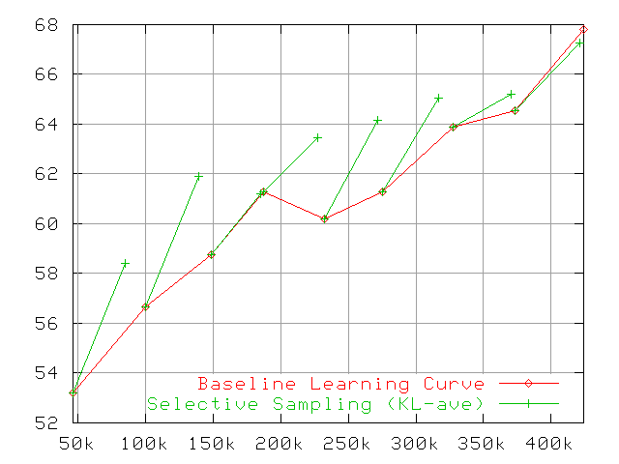
Evaluation Results: Tokens

Slide 32
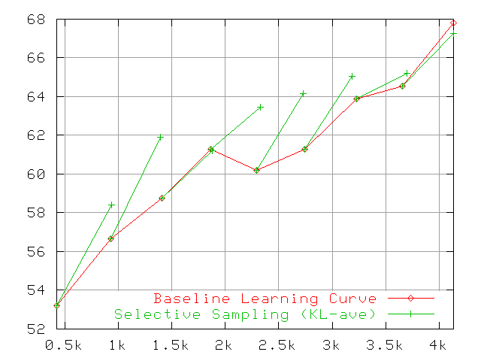
Evaluation Results: Entities

Slide 33
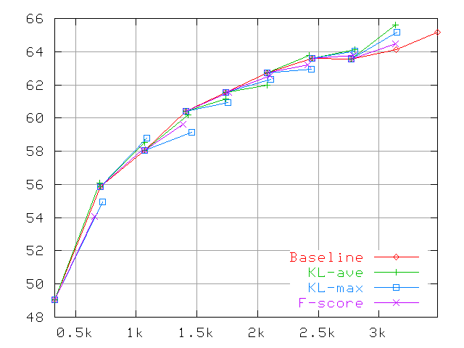
Entity Cost Metric (Dev)

Slide 34
More Analysis

Slide 35
Boundaries: Acc+class/Acc-class
Round | Random | Selective
1 | 0.974/0.970 | 0.975/0.970
4 | 0.977/0.971 | 0.977/0.972
8 | 0.978/0.973 | 0.979/0.975

Slide 36
Boundaries: Full/Left/Right F-score
Round | Random | Selective | ∆
1 | 0.564/0.593/0.588 | 0.568/0.594/0.593 | 0.004/0.001/0.018
4 | 0.623/0.648/0.647 | 0.619/0.643/0.643 | -.004/-.005/-.004
8 | 0.648/0.669/0.676 | 0.663/0.684/0.690 | 0.015/0.015/0.013

