Slide 1

COM-490
Lab in data science
ROBUST JOURNEY PLANNING
Présenté par:
A.Ben Haj Yahia - G.Karray
S.Ben Mustapha - M.Ben Hassen
Notes:
Hi, today, my colleagues and i will be presenting our final project of the course Lab in data science, which is about robust journey planning.

Slide 2
Overview
Introduction
Solution pipeline
Data engineering
Graph construction
Finding fastest paths
Risk attribution to paths
Interacting with users
Notes:
Our presentation will be divided into two parts.
First of all, we will start with a brief introduction of the project.
Then, we will discuss with you our full solution pipeline to come up with an optimized results, in which we will be talking about data engineering, graph construction, finding fastest paths associated with their risks and finishing with a very simple demonstration of how users might plan their journey.

Slide 3
Introduction
Journey planners are attracting more and more interest in research field.
Time is important and so is the way to travel from stations.
Finding the shortest path is not an easy task and requires a good risk comprehension for catching different line of means of transport.
Our project will englobe a study about these risks and will provide the shortest path with the best arrival probability .
Notes:
Journey planners are attracting more and more interest in research field considering the importance of time.
That’s why it is necessary to find, not only the shortest path for travelling but also the least risky one.
Our project will englobe an extended analysis about these risks and will provide the shortest path with the best arrival probability.
So, Let’s look at the way we managed data.

Slide 4
Data engineering
Wrangling with raw data
Yield tables representing the data in a structured way
RAW DATA ➡ STRUCTURED DATA (useful for following pipeline stages)
Outputs : Two data structures : Hypothetical data / Real data
Time table data :
Data sources : Timetable data collection (stops.txt, stop_times.txt, …)
Assumptions:
Only consider stations that are at radius of 15Km of Zurich HB.
Based on day 13-17-2019.
Output : useful for Graph construction stage.
Real data :
Data sources : ISTDATEN dataset
Assumptions:
Same assumptions
Output : useful for Risk attribution stage.
Notes:
After a good analysis of the data sources,consisting of time table data and real data,we tried to make some assumptions on each one of them that could help us process it and make it easier to handle,
Only stations at radius of 15km of Zurich HB were taken into account since our main interest is focused on this city.
And to optimize our implementation, we tried to add the possibility of switching lines by a 500m of walk with a reasonable speed rate 3km/h. This will help us reach more stations and as a result, avoid wasting time waiting for transport.

Slide 5
Graph construction
Problem definition (without risk attribution) : Given a source s (node), find the fastest paths (sequence of edges) possible to get to target t (node), before arrival_time.
We reduce the Journey Planning problem to : Finding all shortest paths in a Multi-Edged Directed Graph.
Assumptions :
Edge : 1-stop trip from node u to v, at time t, with a duration d, and transport mean TM.
Edge weights (cost) : The time cost of taking an edge.
Walking edge : Edge representing walking connection for nodes distant from each other at most 0,5km, assuming a speed of 50m/min.
Notes:
Using a graph to represent our data, we can define the problem at hand as follows Given a source node s (representing a station), find all possible fastest paths to get to target node t, before a certain arrival time.
Doing this gives us a another view of the Journey Planning problem. It becomes reducible to the problem of finding all shortest paths in a Multi-Edged Directed Graph.
An single edge, in this context, would represent a 1-stop trip from station u to station v, at a specific time t, with a duration d and transport mean TM.
The graph would be multi-edged as for a specific pair of nodes u and v, we could have multiple edge with same departure time and duration but different transport mean, or on the contrary multiple edges with same transport mean but at periodic departure times.
The edge weights in our problem would be the time cost of taking an edge. Basically, if you arrive at node at a certain time and have to wait several minutes before you take a follow an edge, the cost of that edge would be the duration of its corresponding trip + the waiting time.
Finally, we also model the possibility of walking between two stations that are not too far from each other (if it turns out to be relevant) by adding walking edges.

Slide 6
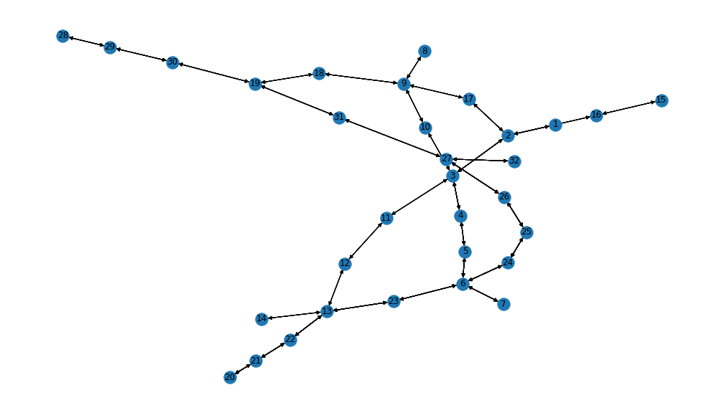
Graph construction
Multi-Edges :
(30 → 19)
type
departure_time
arrival_time
duration
trip_id
route_id
direction_id
Node : 25
stop_name
longitude
latitude
Notes:
Here’s a nice visualization summarizing the just described model.
A node in this graph has several attributes storing information about the station. A multi edge from node u to node v would be a collection of single edges, each single edge having several attributes such as the departure time, or information about the route etc ...

Slide 7
Finding fastest paths
Idea : Apply Dijkstra shortest path algorithm from s to t sequentially until no shortest path is found.
Challenges :
Adapting Dijkstra algorithm to work on Multi-Edged graphs.
Policy for discarding edges at the end of each iteration.
Edge costs depending on arrival_time at the source node.
Solutions :
Tweak “search” part of Dijkstra’s algorithm to account for multi-edges.
Use of a homebrewed heuristic to discard edges.
Computing costs dynamically.
Notes:
To find all shortest paths between two nodes, we made up an algorithm that drives inspiration from the following idea :
Iteratively apply Dijkstra’s shortest path algorithm to find one shortest path from s to t until no shortest path is found.
Implementing this idea proved to be harder than it seemed at the beginning. Some of the challenges we encountered are listed below :
First of all, we had to adapt Dijkstra’s algorithm to make it deal properly with multi-edges, as it was not initially conceived with multi-edged graphs in mind.
A second challenge we encountered was to know how to make the best choice for discarding edges at the end of each iteration. in order to make sure we do not get the same path over and over in the multiple Dijkstra passes. We constructed our own heuristic policy to deal with this.
Finally, whereas edge weights are typically fixed at the beginning of the search in classical shortest paths setups, in our case, the value of an edge weight depends on the actual time where the edge is considered. And we dealt with this by computing costs dynamically.

Slide 8
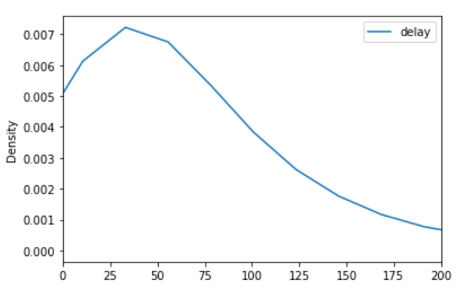
Risk attribution to paths
The delay in each station is calculated as the difference between the actual arrival time, and the scheduled arrival time
We first grouped our relations by transport type (Train or Bus)
Then, we decided to divide the day into 3 slots:
from 07:00 to 11:00
from 11:00 to 15:00
from 15:00 to 19:00
By plotting the different delays in each slot, we found that the best estimation of its distribution is the exponential distribution.

Slide 9
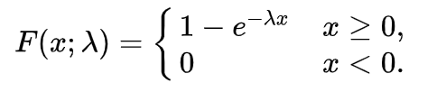
Risk attribution to paths
We used the mean delays of each slot and built a cumulative exponential distribution as below.
It will provide us with the probability of realizing X delay (seconds) in that specific line/relation
This probability is then used as follows:
For each change of lines, we calculate x as the difference in seconds between the arrival_time and the next departure time
Then F(X<=x) is the probability of success in reaching the next relation.
We assumed that if the relation is done walking, and the walking duration is less than x, the probability of success is one.

Slide 10
Interacting with users (1/2)
User Input : source station_id, target station_id, arrival time at target, confidence value.
Assumption : Discard all stops before arrival_time - 2H and after arrival_time.
Query the data tables : Only Edges within time bounds.
Construct the graph : Based on query result.
Find fastest paths : Ordered from latest to earliest departure time from source.
Risk attribution : Attribute a confidence value to each found path, keep only those with greatest confidence than the value provided.
Display the resulting paths : Human-readable table + Map visualization.
Notes:
So how does all this works?
The user has just to provide the nearest station to his position, the station he wants to go to, the time he want to be there and a confidence value.
Once we have these informations, we will start by querying our data tables by extracting all the necessary data , which will be used to construct the graph that will allow us to search the fastest paths to the destination by running the Dijkstra’s shortest path algorithm
on it. Then a confidence value will be attributed to each of the paths and only the ones with a value greater than the one desired by the user will be kept
And finally , the user will just have to choose a journey from the proposed ones that will be visualized on an interactive map.
So keep updated to see our demo which is coming in the next days and thank you for your attention.

Slide 11
THE END
Thank you for your attention!

