Slide 1



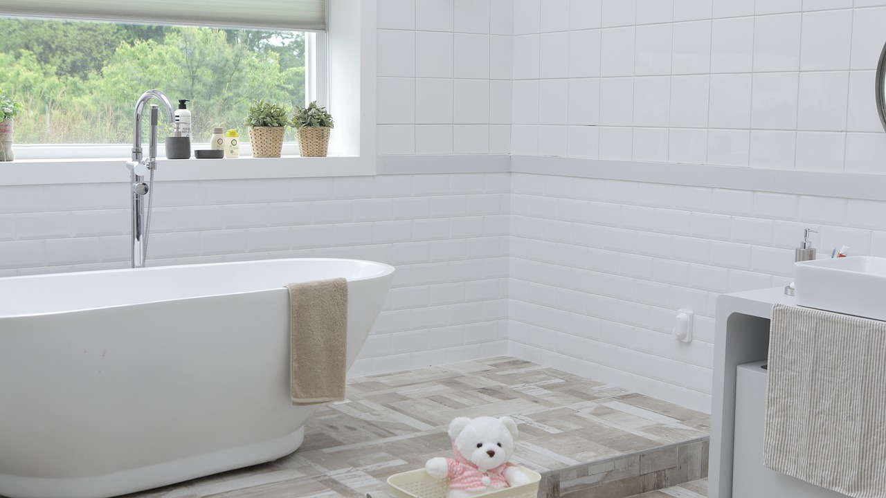
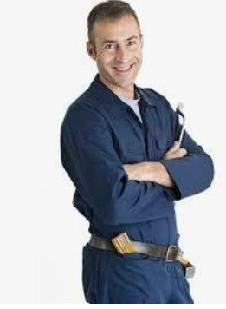

PT PLUMBING & HEATING
SOUTH EAST LONDON
07984 453 756
ptplumbing@gmail.com
5 STAR RATED ON FACEBOOK
EXPERIENCED, HIGHLY RATED PLUMBER
SOUTH EAST LONDON

Slide 2
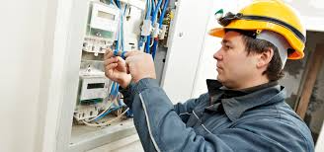
London Electrical
Services
ABOUT
SERVICES
OUR WORK
CONTACT
24/7 EMERGENCY CALL OUT IN LONDON
QUALIFIED EMERGENCY ELECTRICIANS
START FROM £75 + VAT
BOOK AN ELECTRICIAN

