Slide 1
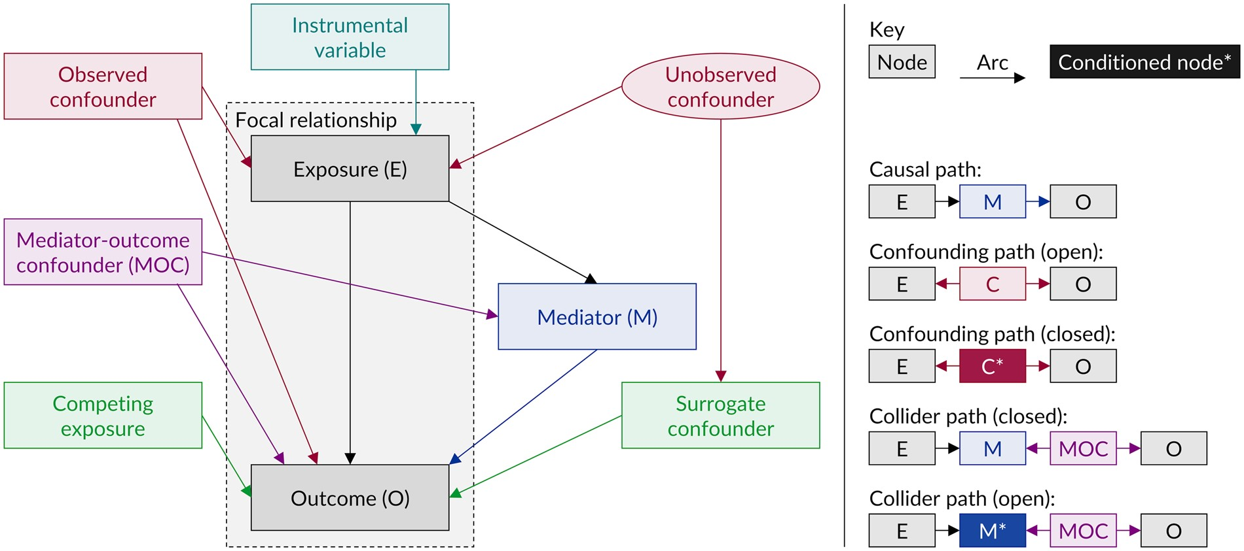

Figure 1 Illustration of the main components of a DAG, the most common types of contextual variables and the most ...
Notes:
Figure 1 Illustration of the main components of a DAG, the most common types of contextual variables and the most common types of paths. The DAG has been visually arranged so that all constituent arcs flow from top-to-bottom.
Unless provided in the caption above, the following copyright applies to the content of this slide: © The Author(s) 2020. Published by Oxford University Press on behalf of the International Epidemiological Association.This is an Open Access article distributed under the terms of the Creative Commons Attribution License (http://creativecommons.org/licenses/by/4.0/), which permits unrestricted reuse, distribution, and reproduction in any medium, provided the original work is properly cited.© The Author(s) 2020. Published by Oxford University Press on behalf of the International Epidemiological Association.

