Slide 1
Van Atta Exploration
Benjamin Herber :: Fall 2021

Slide 2




What’s Happening?
S
$$θ$$
$$θ$$
$$θ$$
$$θ$$
d
d
d
$${∴S}_{n}=n∗d∗cos\left(θ\right)$$

Slide 3
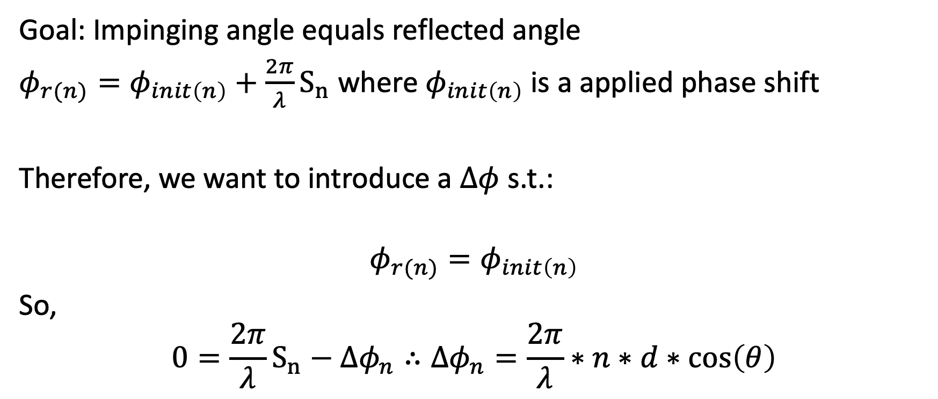
Phase Calculation
Goal: Impinging angle equals reflected angle
$φ_{r(n)}=φ_{init\left(n\right)}+\frac{2π}{λ}S_{n}$ where $φ_{init\left(n\right)}$ is a applied phase shift
Therefore, we want to introduce a $Δφ$ s.t.:
$$φ_{r(n)}=φ_{init\left(n\right)}$$
So,
$$0=\frac{2π}{λ}S_{n}−Δφ_{n}∴Δφ_{n}=\frac{2π}{λ}∗n∗d∗\cos\left(θ\right)$$

Slide 4
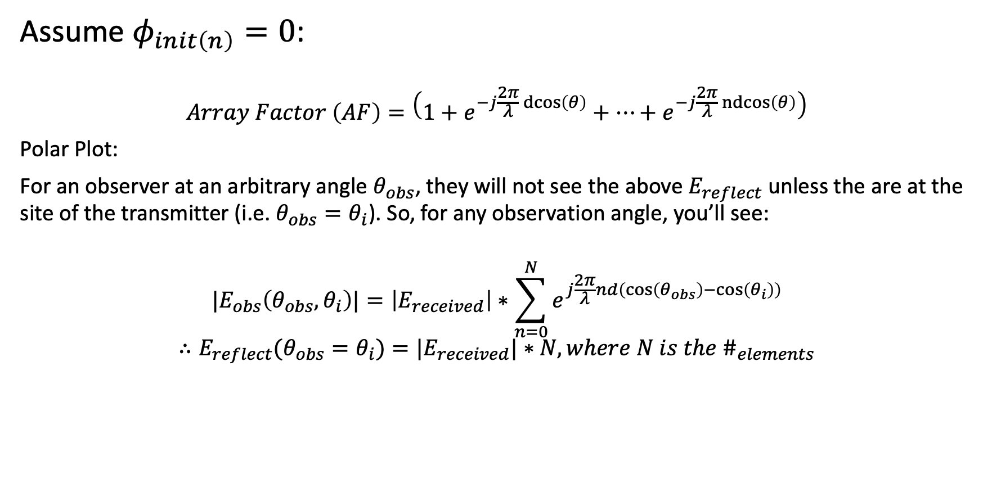
Radiated Response
Assume $φ_{init\left(n\right)}=0$:
$$Array Factor \left(AF\right)=\left(1+e^{−j\frac{2π}{λ}\operatorname{dcos}\left(θ\right)}+…+e^{−j\frac{2π}{λ}\operatorname{ndcos}\left(θ\right)}\right)$$
Polar Plot:
For an observer at an arbitrary angle $θ_{obs}$, they will not see the above $E_{reflect}$ unless the are at the site of the transmitter (i.e. $θ_{obs}=θ_{i}$). So, for any observation angle, you’ll see:
$${|E}_{obs}\left(θ_{obs},θ_{i}\right)|=\left|E_{received}\right|∗\sum_{n=0}^{N}{e^{j\frac{2π}{λ}nd\left(\cos\left(θ_{obs}\right)−\cos\left(θ_{i}\right)\right)}}$$
$$∴E_{reflect}(θ_{obs}=θ_{i})={|E}_{received}|∗N, where N is the \#_{elements}$$

Slide 5
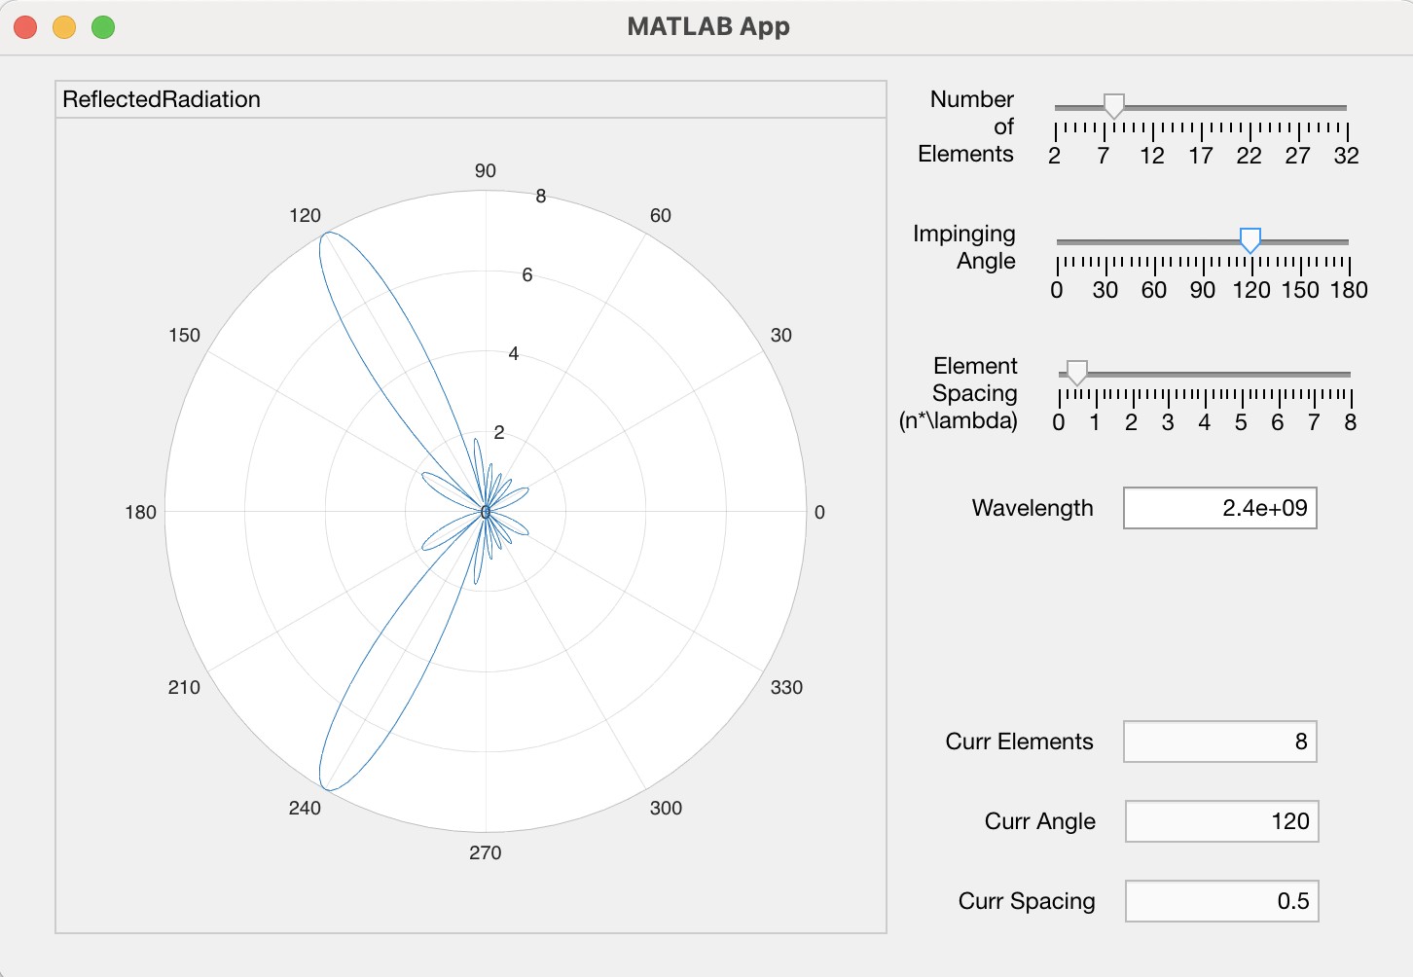
Now we can play with parameters!
Parameters:
Number of Elements in Array
Impinging Angle of Plane Wave
Spacing Between Array Elements
Note: You can interactively tune these in an interactive matlab app on Git.

Slide 6
Parameter: Number of Array Elements

Slide 7
Parameter: Impinging Angle

Slide 8
Parameter: Spacing of Array Elements

