Slide 1
Recent Developments in Difference in Differences Analysis
B520 Research Seminar on Marketing SS2024
B. Herzberger, J. Lympany, T. Matengu

Slide 2
Structure of the Presentation
1. Basic Model
Conditional
DiD
3. Staggered
Treatment
4. Synthetic
DiD

Slide 3
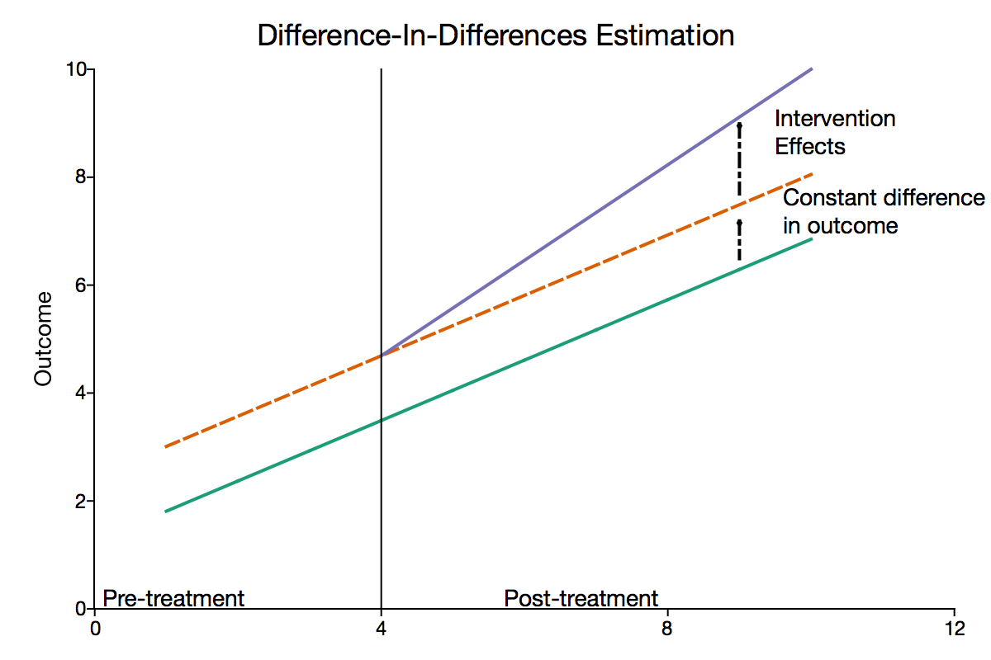
1. The Basic DiD Model
Assumptions
Parallel trends
Homogeneous treatment
No treatment anticipation
source : https://www.aptech.com/blog/introduction-to-difference-in-differences-estimation/

Slide 4
Structure of the Presentation
1. Basic Model
Conditional
DiD
3. Staggered
Treatment
4. Synthetic
DiD

Slide 5
2. Conditional DiD
Plan
Rambachan & Roth (2023):
A more credible approach to parallel trends
Sant’Anna & Zhao (2020):
Doubly robust difference-in-differences estimators
Bilinski & Hatfield (2018):
Nothing to see here? Non-inferiority approaches to parallel trends and other model assumptions
… parallel trends violations and points to consider …
… conditional DiD and how it can be leveraged …
… accounting for heterogeneous treatment effects …
?

Slide 6
2. Conditional DiD
Data-generating process
Input = heterogeneity, violation
7 time points 20 units
Trend over time
50 % of units assigned to treatment/control
external shock for some of the treated units
Heterogeneity, 0 -> all effects = 1 (Homogeneity)
Heterogeneity, not 0 -> varying effects mean = 1
Violation, 0 -> no violation
Violation, not 0 -> size of parallel trends violation
Process
y = trend + treat * 0.2 + post * treat * effect + post * external-shock * violation + random-change

Slide 7
2. Conditional DiD
Plan
Conduct simulations with varying input factors
Calculate ATTs using att_gt from Callaway (R) … both standard and conditional ...
Reveal impacts and biases from varying heterogeneity and violations
Research Hypotheses
?
1. Does the bias of ATT-estimates under violations of parallel trends decrease when conditioned on?
2. Does heterogeneity in treatment effects increase the bias of the ATT-estimates?

Slide 8
Structure of the Presentation
1. Basic Model
Conditional
DiD
3. Staggered
Treatment
4. Synthetic
DiD

Slide 9
3. Staggered DiD
Literature
Goodman-Bacon(2021)
Variance-weighted TWFE Regression
Sun & Abraham (2021)
Relative time periods
Cengiz et al. (2019)
Stacked regression
Research Questions
1. What assumptions must hold for a TWFE regression to be accurate?
2. Which alternative estimator works the best under violations of these assumptions
?

Slide 10
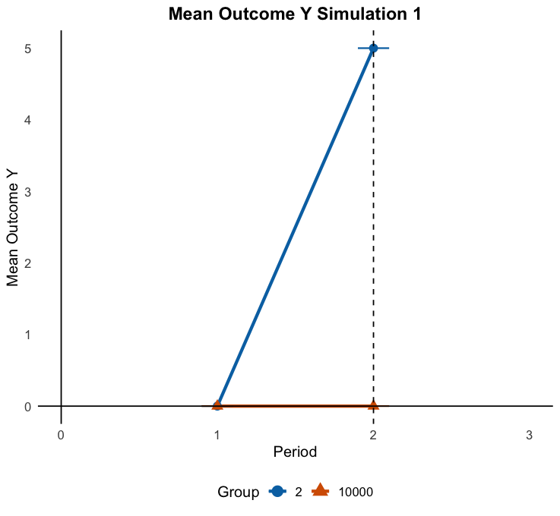
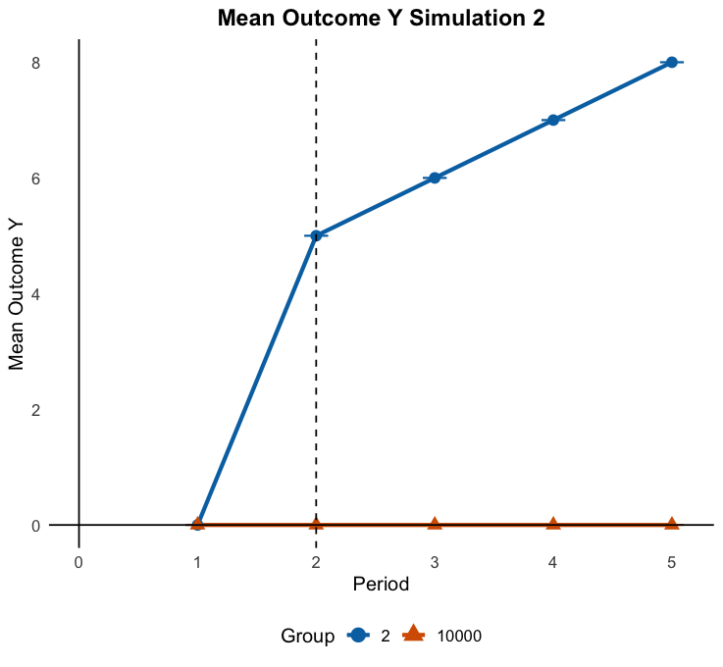
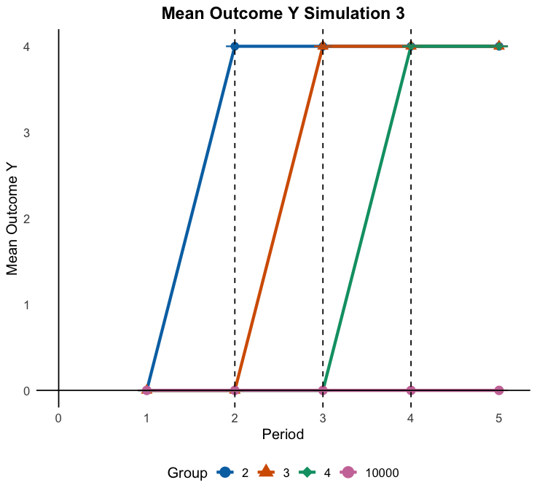
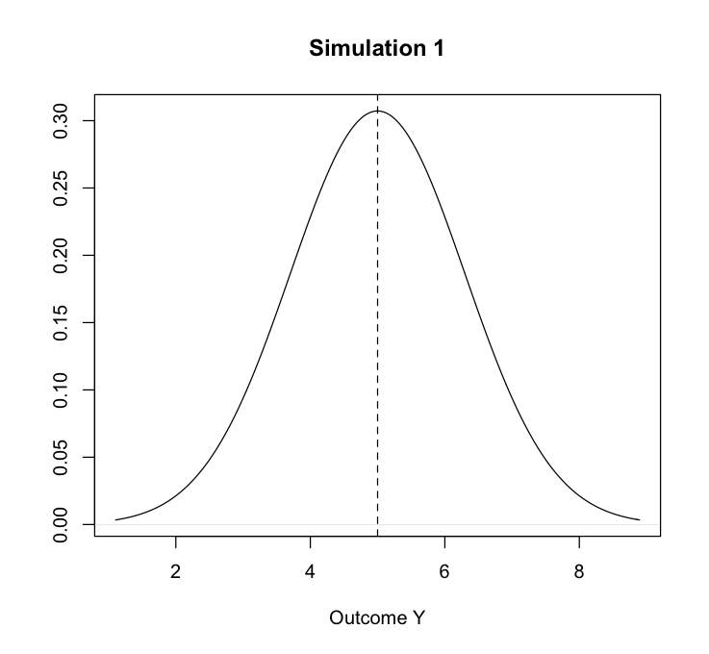
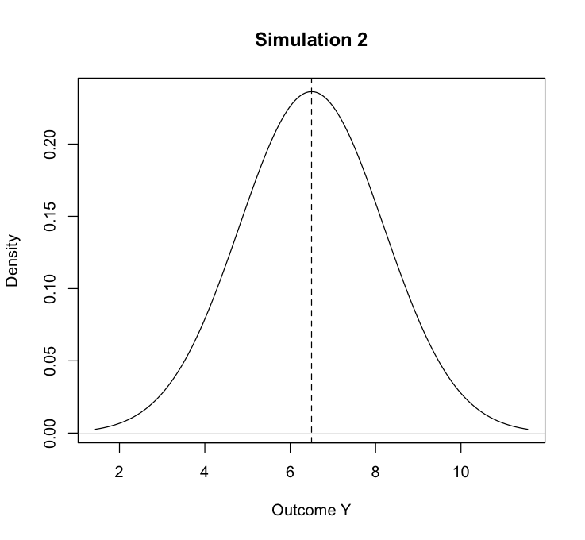
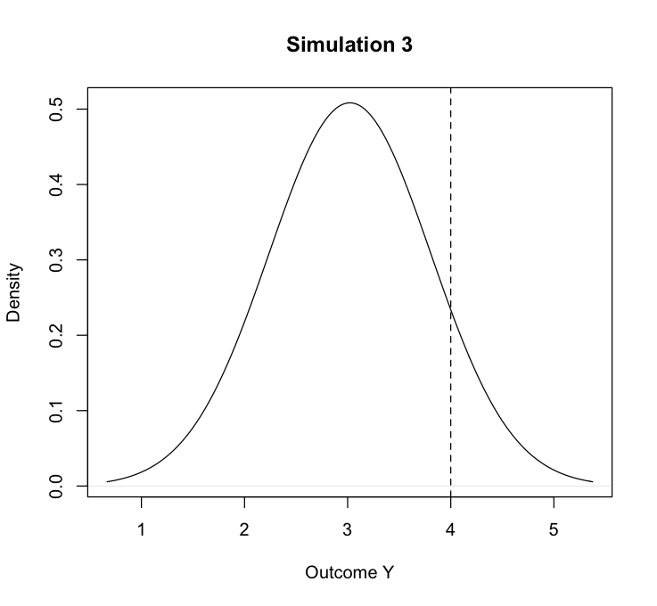
3. Staggered DiD

Slide 11
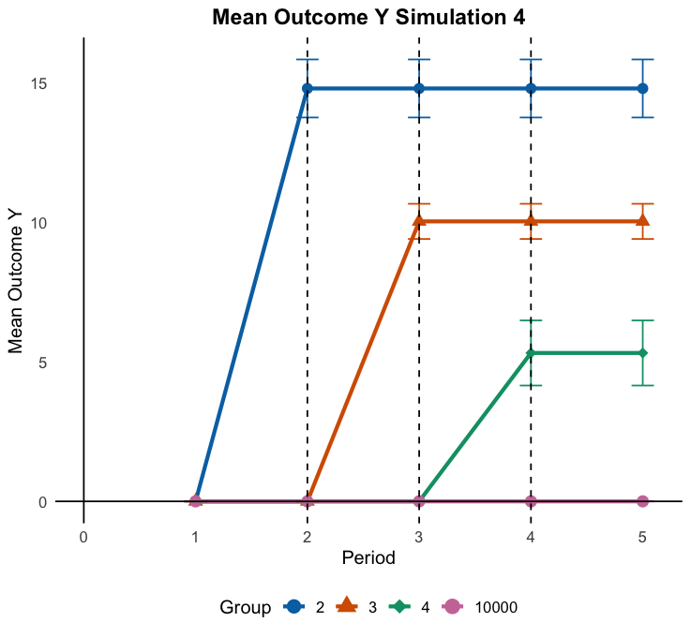
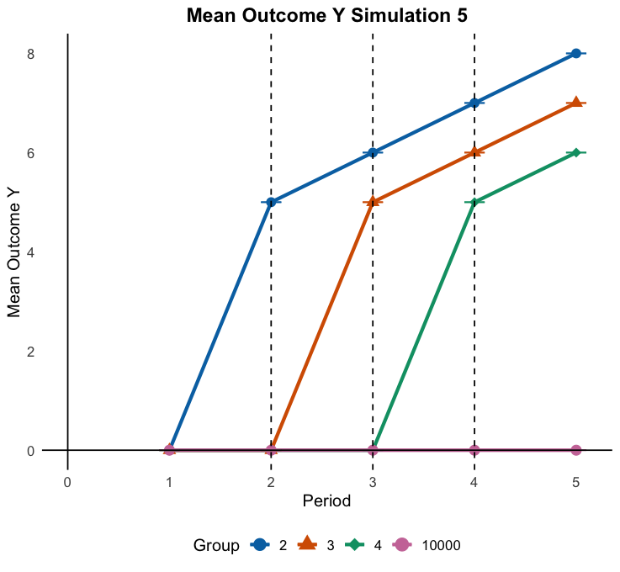
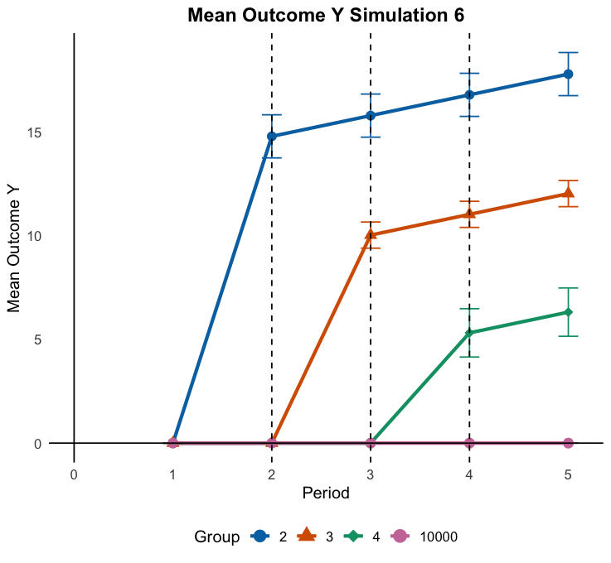
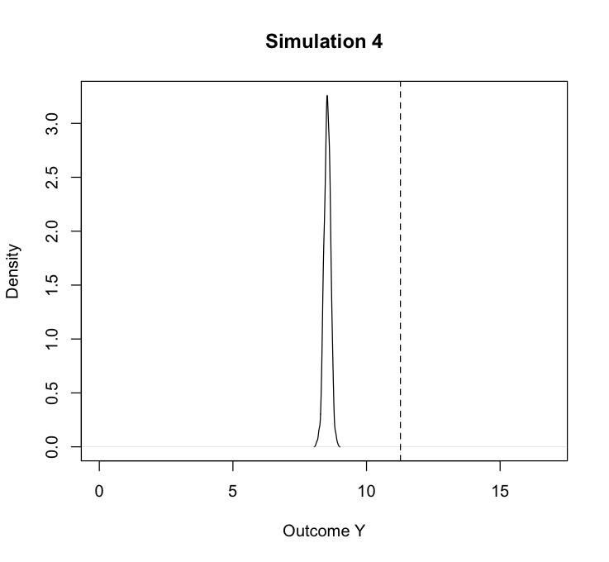
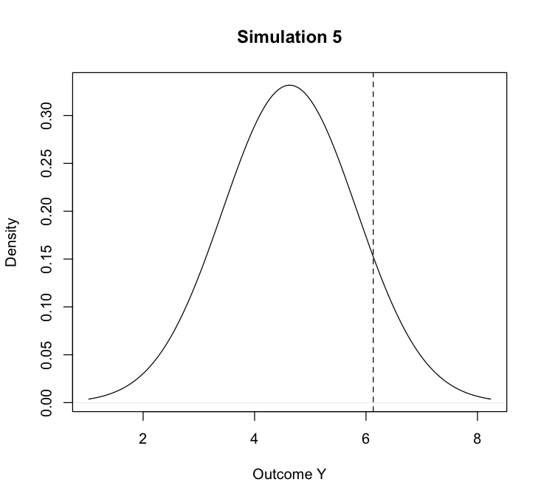
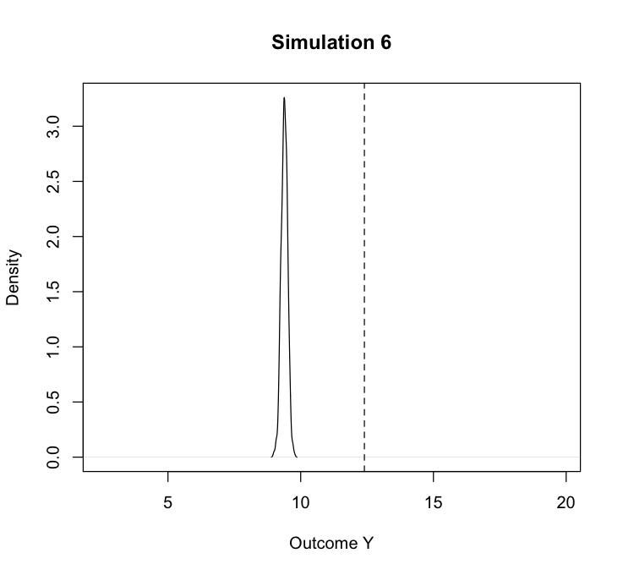
3. Staggered DiD

Slide 12
Structure of the Presentation
1. Basic Model
Conditional
DiD
3. Staggered
Treatment
4. Synthetic
DiD

Slide 13
4. Synthetic Difference in Differences
Approach
Comparison of Synthetic Difference-in-Differences (SDiD), Synthetic Control (SC) & standard DiD
Difference to standard DiD
Key problem: No counterfactual to use for estimation
SC (Abadie et al.): Reweighting of control units to construct an artificial control unit to most closely resemble the treated
SDiD (Arkhangelsky et al.): Combines and refines SC and DiD by also incorporating time-trends

Slide 14
4. Synthetic Difference in Differences
Approach
Data simulations varying in:
Sample size
Violation of parallel-trends (pre & post)
Treatment effect: Size, dynamic vs. static, heterogeneity, period
Estimation via {synthdid} package (Arkhangelsky et al.)
Research question
Under what conditions do the methods produce different/identical results?
Under what conditions do the respective methods work better/worse?
Is there a “best” method? If not, when to use which approach?
?

Slide 15
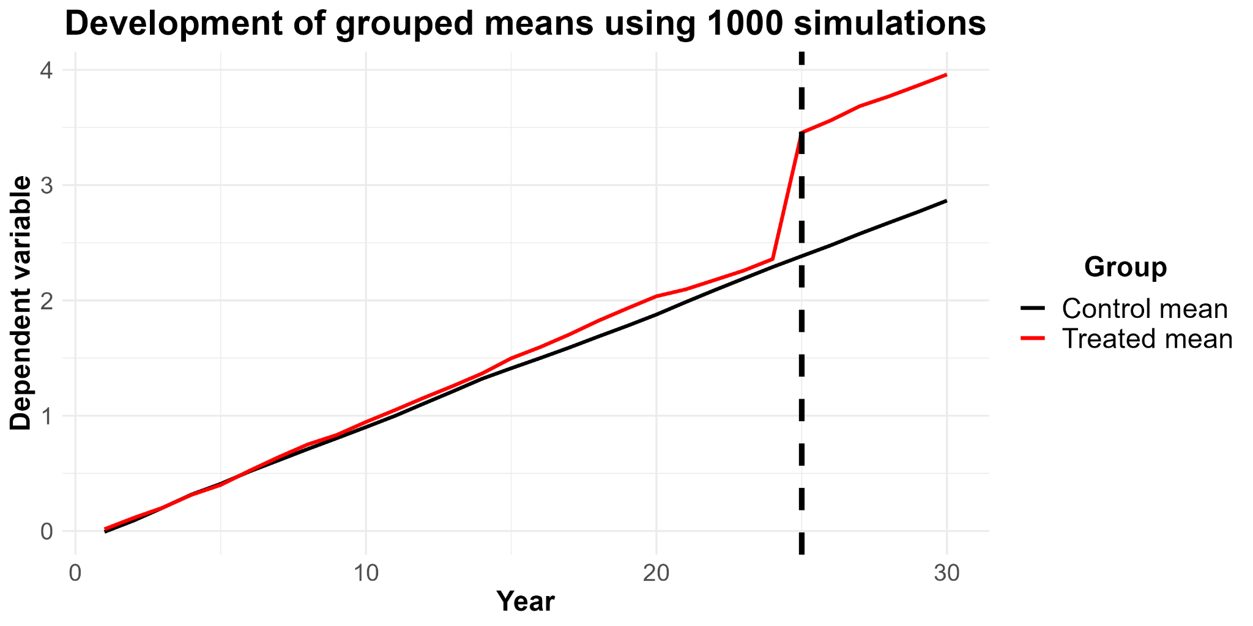
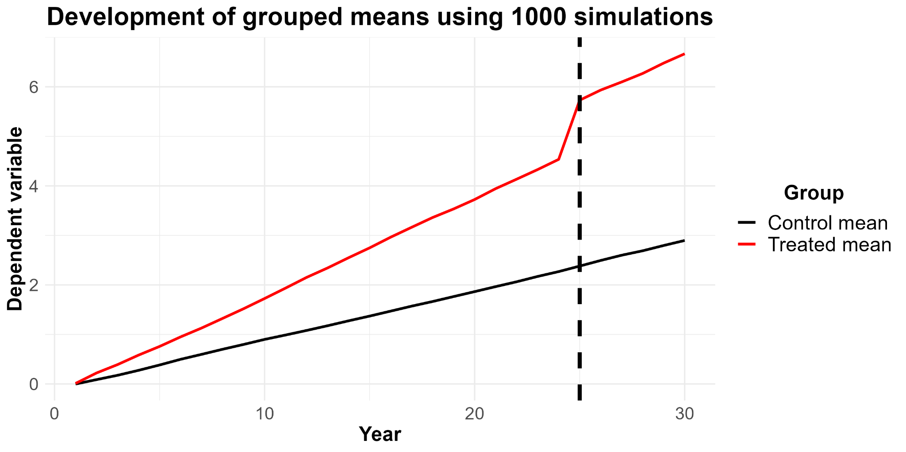
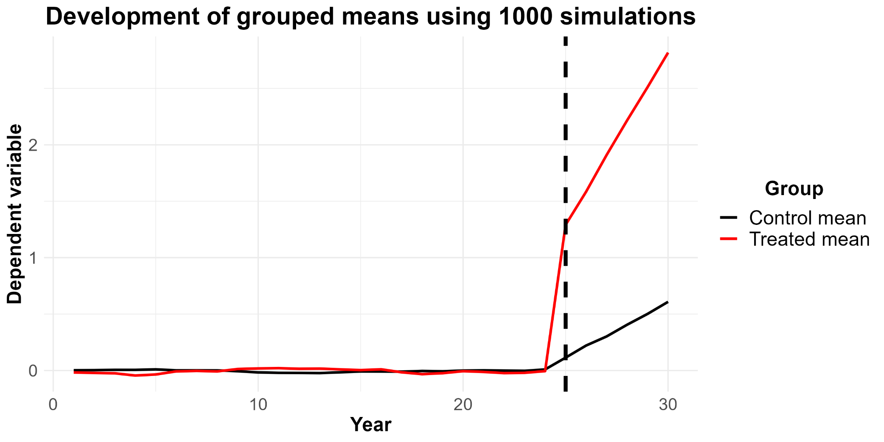
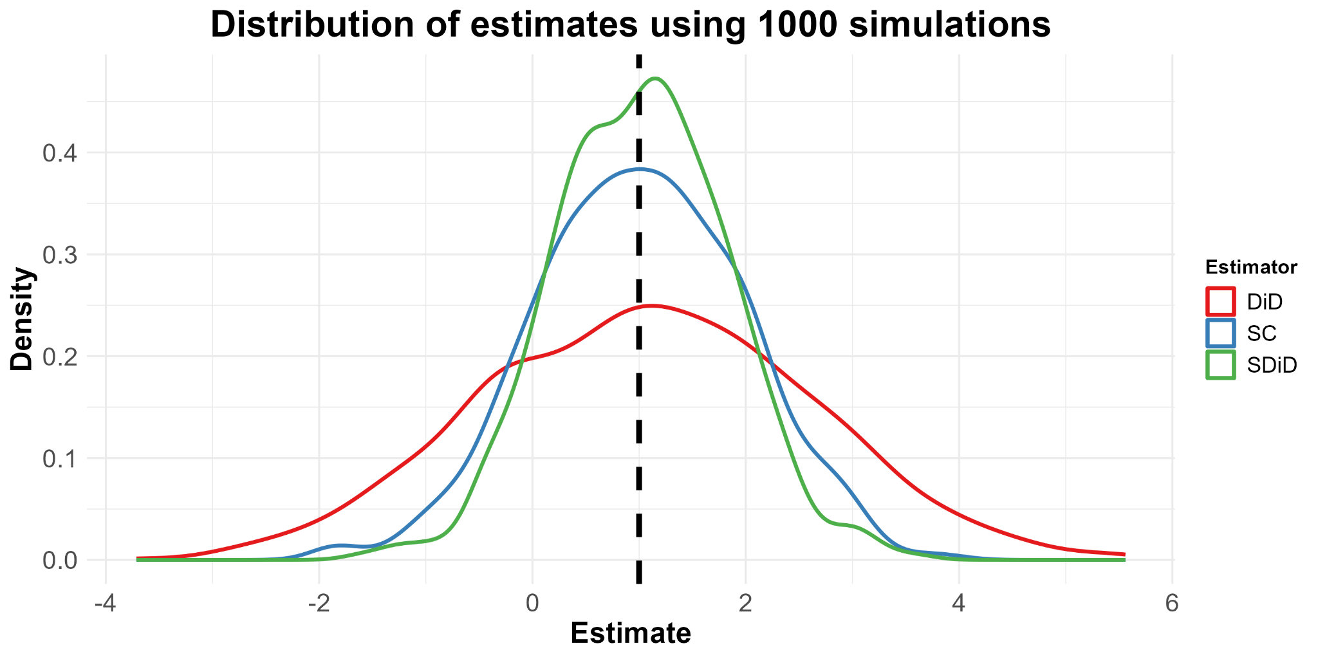
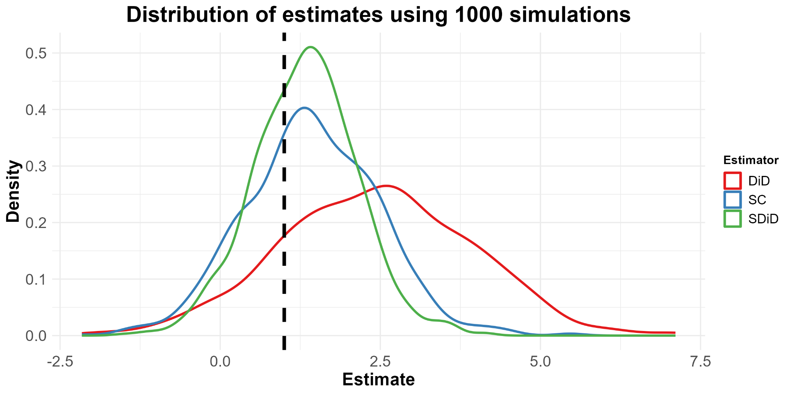
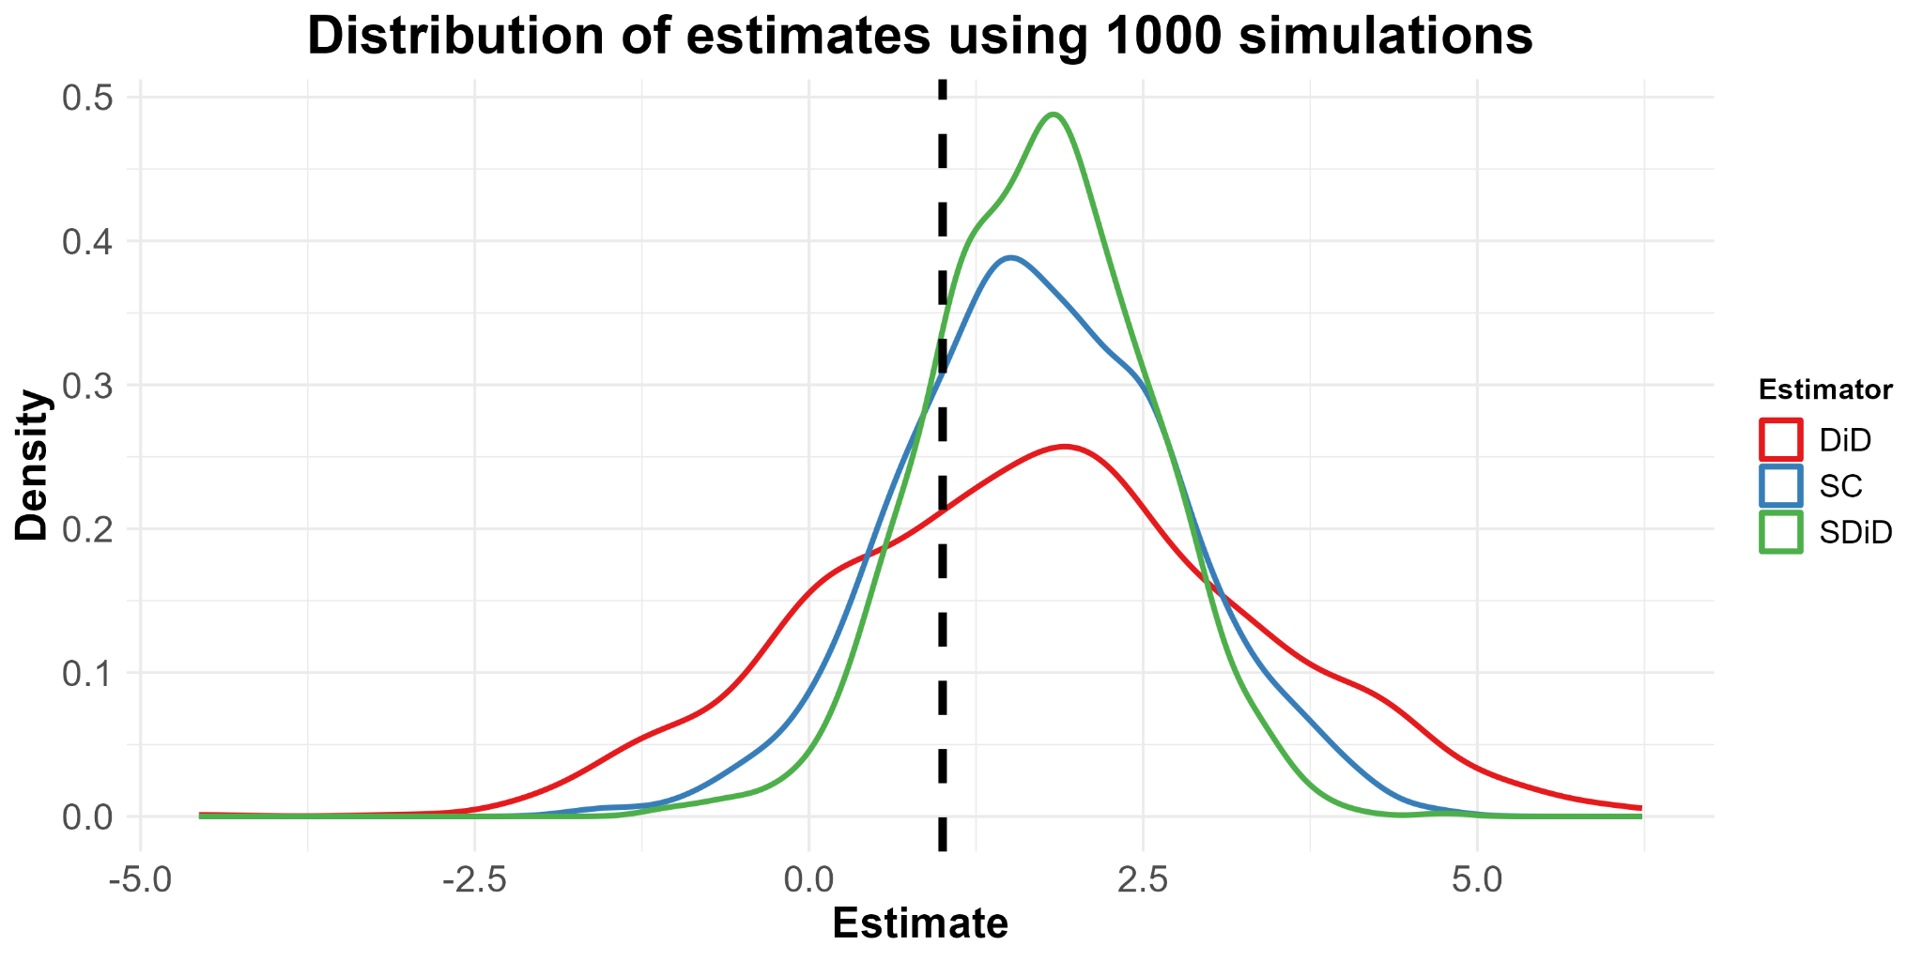
4. Synthetic Difference in Differences

