Slide 1
DS405 Mini project: Leveraging Machine Learning for Revenue Optimization via Strategic Couponing
Sahra Pfeifer, Benjamin Herzberger
Winter term 2023/2024
Eberhard Karls Universität Tübingen
School of Business and Economics

Slide 2
General approach of the estimation
Get an overview of the data
Missing values
Outliers
Visualization of feature distribution
Feature Selection
Delete
Modify
Add
Estimation process
Models used: RandomForest, AdaBoost, XGBoost
First RandomizedSearchCV() with broad parameter space
Second RandomizedSearchCV() around best parameters
Compute expected revenue
Select best-performing model

Slide 3
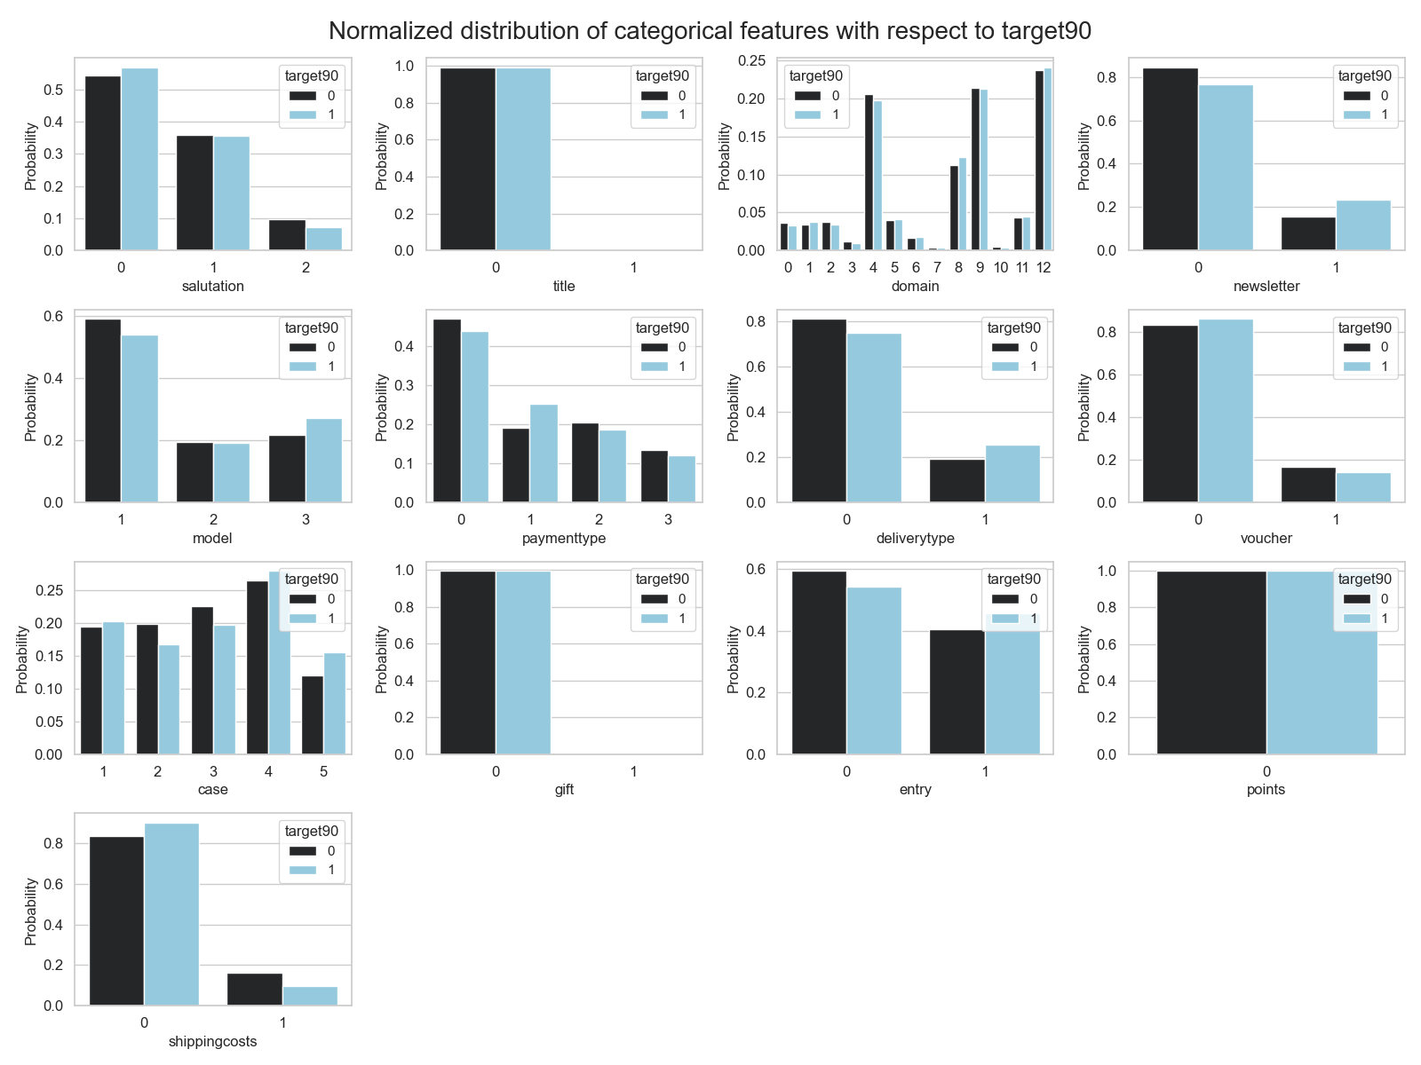
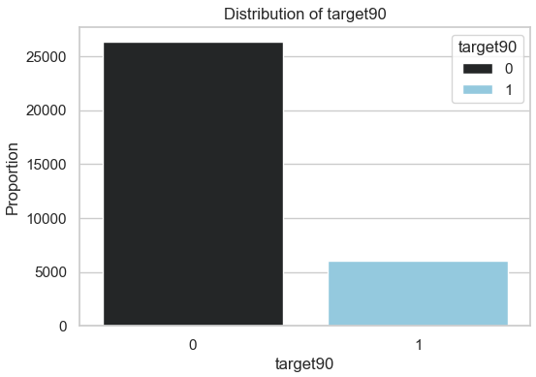
Visualization of target and feature distribution
Distribution of target variable
Normalized distribution of feature variables
Normalized feature distributions within target class
Consider changes in distributions to identify potentially impactful features
Repurchase rate: 18.66%
Imbalanced target class

Slide 4
Feature Selection
Customernumber: No systematic influence on repurchase.
Date: No systematic influence on repurchase.
Datecreated: No systematic influence on repurchase.
Delivpostcode: Too many missing values, use Invoicepostcode.
Advertisingdatacode: Too many missing values.
Deliverydatepromised: No systematic influence on repurchase.
Deliverydatereal: No systematic influence on repurchase.
Target90: Label, excluded from training.
Delivery_diff: Planned delay variable, too many missing values.
Adj_deliverydatepromised: Adjusted delivery dates for miscoding, not a training feature.

Slide 5
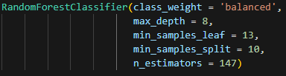

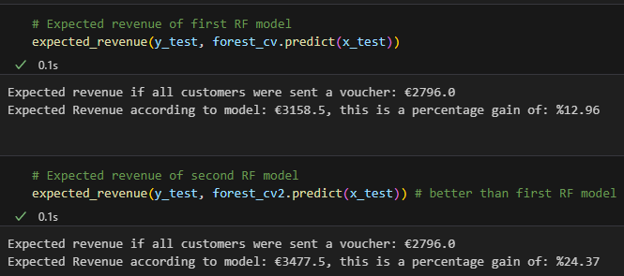
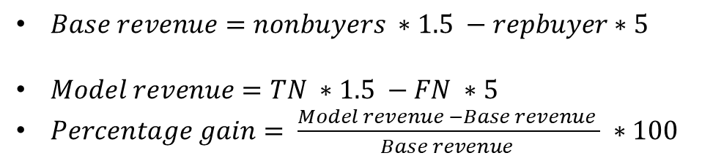
Best performing model: Random Forest
Best performing hyperparameters:
Performance of the model:
Revenue gain of the model:
Empirical analyses:
$Base revenue=nonbuyers ∗1.5 −repbuyer∗5$
$Model revenue=TN ∗1.5 −FN ∗5$
$Percentage gain= \frac{Model revenue −Base revenue }{Base revenue } ∗100$
Percentage gain: 24.37%

Slide 6
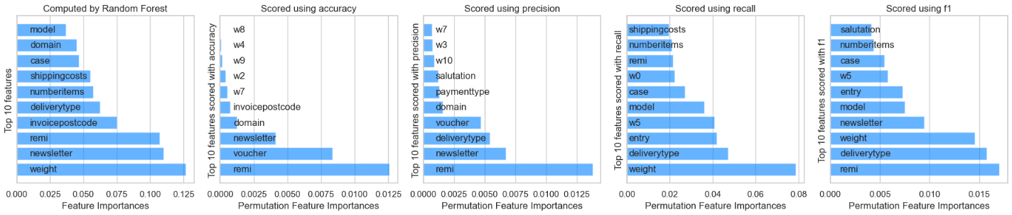
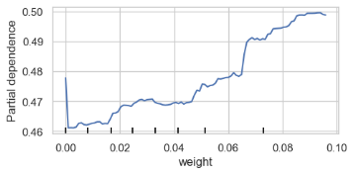
Global model interpretability
Permutation feature importance
Some important features: Weight, Remi, Newsletter, Voucher, Numberitems
Partial dependence plot for feature weight
Increasing the weight raises the probability of the target variable being 1

Slide 7
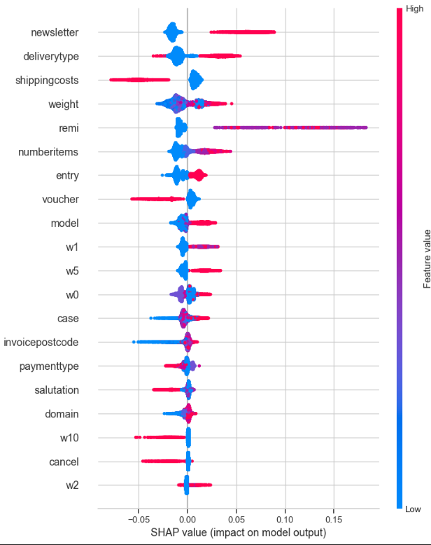
Local model interpretability: Shapley values
Shap value summary plot for label 1
Shapley values capture each variable's influence on prediction
Direct comparison of feature influences
Red symbolizes higher values in features
Placement on x-axis indicates direction of influence
Summary plot for label 1
For label 0 the visualization will be flipped
Higher Newsletter values increase label
Subscribed customers are more likely to repurchase
Higher Shippingscosts values decrease label
People who had to pay for shipping are less likely to repurchase

Slide 8

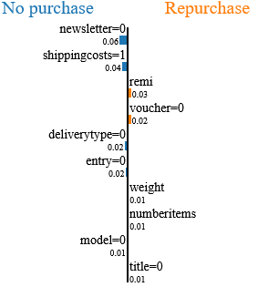
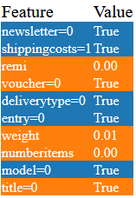
Local model interpretability: Local Surrogate
Results for observation 303
Explain individual predictions by approximating the black-box model locally with an easier model
Interpretable
Locally faithful
10 most influential features visualized
For observation 303 LIME predicts repurchase probability to only be 34%.
Not subscribed to newsletter -> no purchase
Shippingscosts paid -> no purchase
0 remitted items -> purchase

Slide 9
With the use of our Random Forest model revenue increases by as much as 25% can be achieved!

