Slide 1
DS405 Mini project: Leveraging Machine Learning for Revenue Optimization via Strategic Couponing
Sahra Pfeifer, Benjamin Herzberger
Winter term 2023/2024
Eberhard Karls Universität Tübingen
School of Business and Economics

Slide 2
General approach of the estimation
Get an overview of the data
Missing values
Outliers
Visualization of feature distribution
Feature Selection
Delete
Modify
Add
Estimation process
Models used: RandomForest, AdaBoost, XGBoost
First RandomizedSearchCV() with broad parameter space
Second RandomizedSearchCV() around best parameters
Compute expected revenue
Select best-performing model

Slide 3
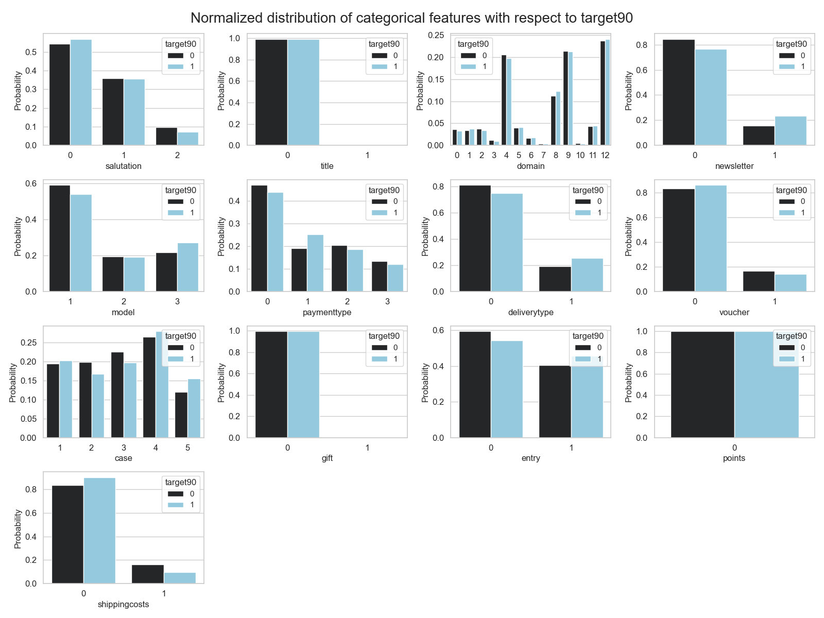
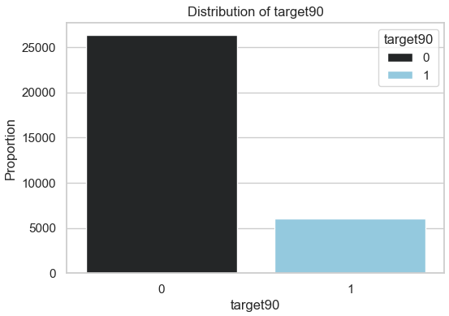
Visualization of target and feature distribution
Distribution of target variable
Normalized distribution of feature variables
Normalized feature distributions within target class
Consider changes in distributions to identify potentially impactful features
Repurchase rate: 18.66%
Imbalanced target class

Slide 4
Feature Selection
Customernumber: No systematic influence on repurchase.
Date: No systematic influence on repurchase.
Datecreated: No systematic influence on repurchase.
Delivpostcode: Too many missing values, use Invoicepostcode.
Advertisingdatacode: Too many missing values.
Deliverydatepromised: No systematic influence on repurchase.
Deliverydatereal: No systematic influence on repurchase.
Target90: Label, excluded from training.
Delivery_diff: Planned delay variable, too many missing values.
Adj_deliverydatepromised: Adjusted delivery dates for miscoding, not a training feature.

Slide 5
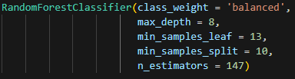

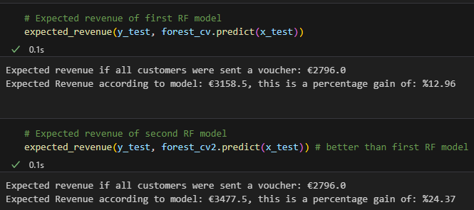
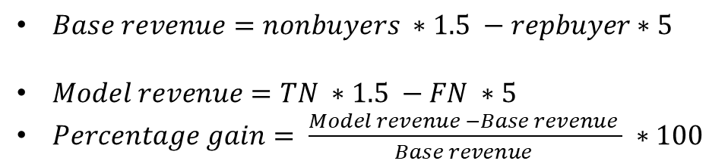
Best performing model: Random Forest
Best performing hyperparameters:
Performance of the model:
Revenue gain of the model:
Empirical analyses:
$Base revenue=nonbuyers ∗1.5 −repbuyer∗5$
$Model revenue=TN ∗1.5 −FN ∗5$
$Percentage gain= \frac{Model revenue −Base revenue }{Base revenue } ∗100$
Percentage gain: 24.37%

Slide 6
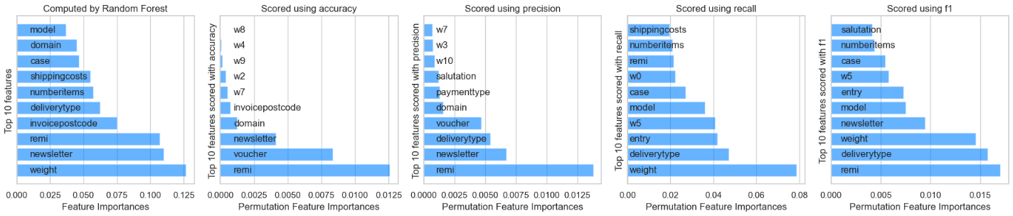
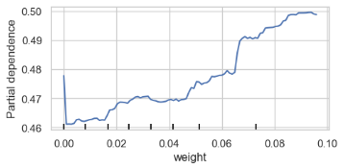
Global model interpretability
Permutation feature importance
Some important features: Weight, Remi, Newsletter, Voucher, Numberitems
Partial dependence plot for feature weight
Increasing the weight raises the probability of the target variable being 1

Slide 7
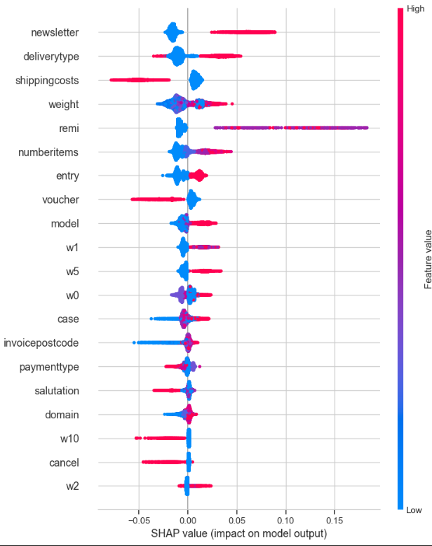
Local model interpretability: Shapley values
Shap value summary plot for label 1
Shapley values explain ML output via Game Theory.
Capture each variable's influence on prediction.
Direct comparison of feature influences.
Red symbolizes higher values in features.
Placement on x-axis indicates influence direction.
Summary plot for label 1.
Newsletter variable example.
Higher Newsletter values increase label.
Example: Subscribed customers more likely to repurchase.
For label 0 the visualization will be flipped.

Slide 8

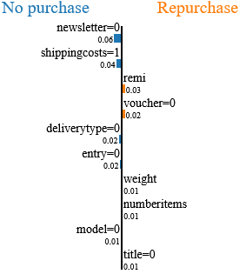
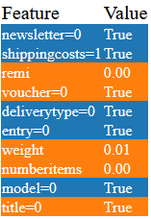
Local model interpretability
LIME
LIME interprets ML model predictions.
Locally faithful explanations.
Approximates behavior around instances.
Identifies top 10 influential features.
LIME predicts 34% repurchase for index 303.
Probability linked to not subscribing and shipping costs.

Slide 9
Summary

