Slide 1
DS405 Mini project: Leveraging Machine Learning for Revenue Optimization via Strategic Couponing
Sahra Pfeifer, Benjamin Herzberger
Winter term 2023/2024
Eberhard Karls Universität Tübingen
School of Business and Economics

Slide 2
General approach of the estimation
Get an overview of the data
Missing values (e.g. advertisingdatacode)
Outliers
Visualization of feature distribution
Delete/modify/add features
Delete: Customernumber, Date, Datecreated, …
Modify: Preprocessing pipelines: OrdinalEncoder(), MinMaxScaler()
Add: Delivery Delay
Estimation process
Models used: RandomForest, AdaBoost, XGBoost
First RandomizedSearchCV() with broad parameter space
Second RandomizedSearchCV() around best parameters
Compute expected revenue
Select best-performing model: RandomForest

Slide 3
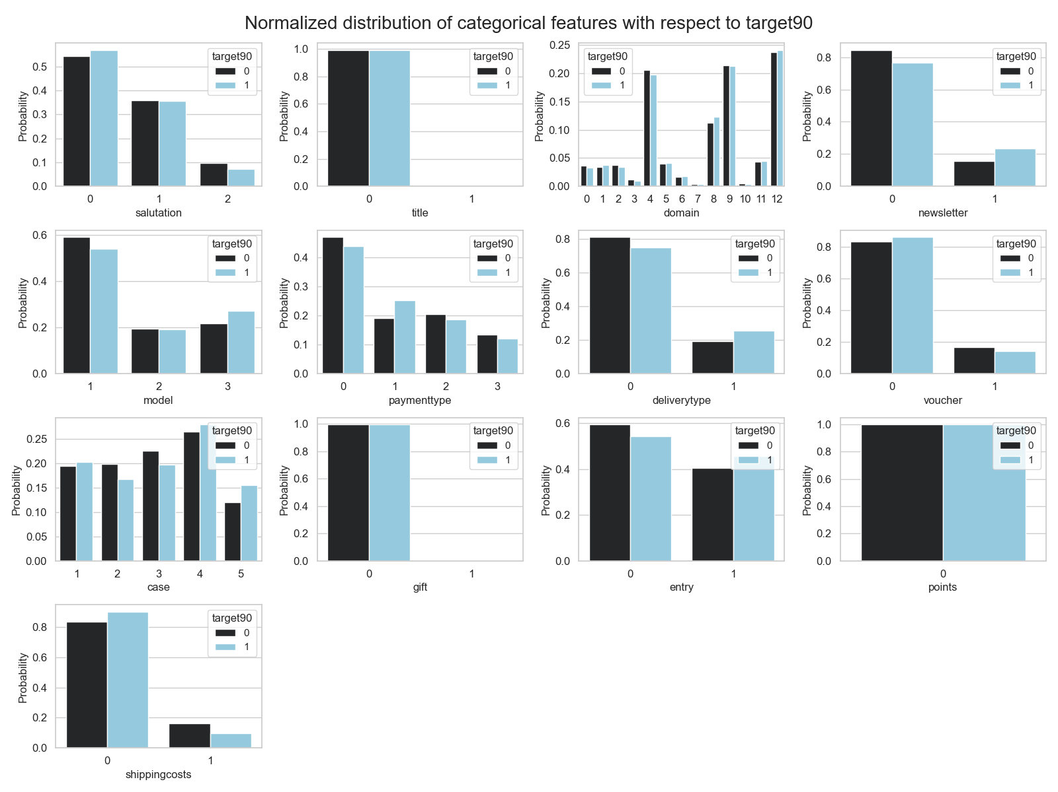
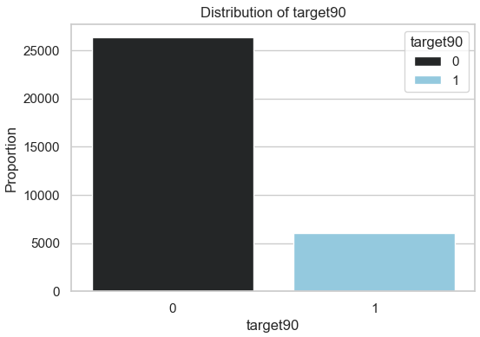
Visualization of feature distribution
Distribution of target variable

Slide 4
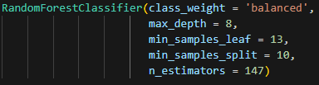

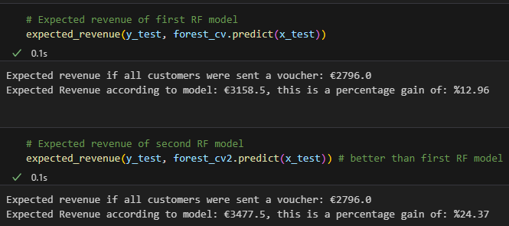
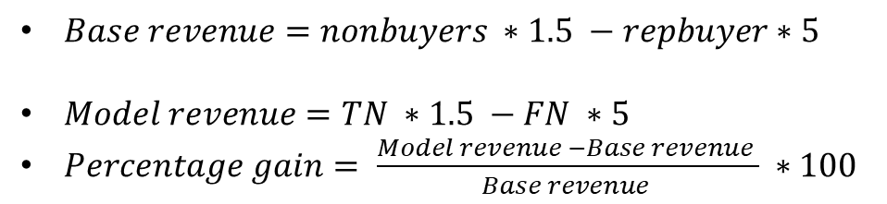
Best performing model: Random Forest
Best performing hyperparameters:
Performance of the model:
Revenue gain of the model:
Empirical analyses:
$Base revenue=nonbuyers ∗1.5 −repbuyer∗5$
$Model revenue=TN ∗1.5 −FN ∗5$
$Percentage gain= \frac{Model revenue −Base revenue }{Base revenue } ∗100$

Slide 5
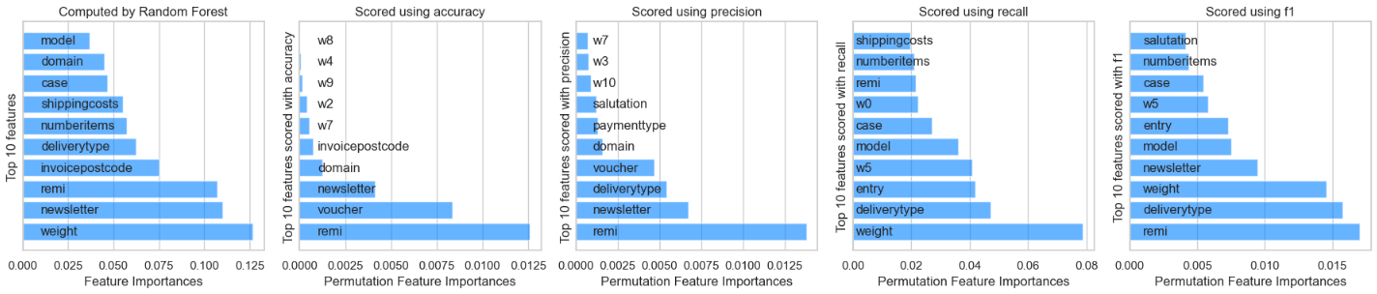
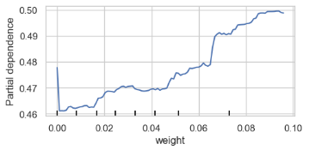
Global model interpretability
Permutation feature importance
Some important features: Weight, Remi, Newsletter, Voucher, Numberitems
Partial dependence plot for feature weight
Increasing the weight raises the probability of the target variable being 1

Slide 6
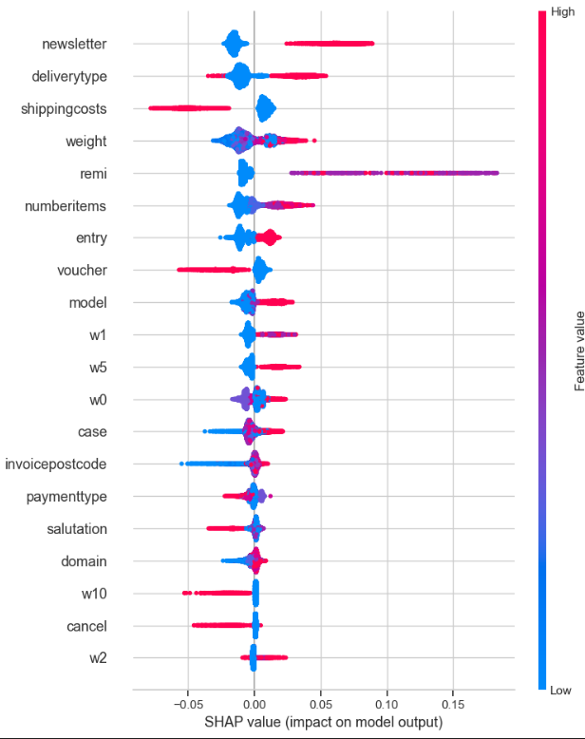
Local model interpretability: Shapley values
Shap value summary plot for label 1
f

Slide 7

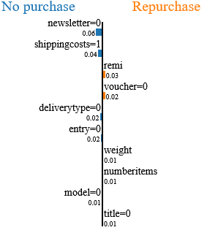
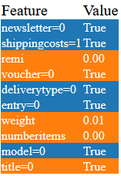
Local model interpretability
Shap value summary plot

Slide 8
Summary

