Slide 1
Frustratingly easy domain adaptation
Hal Daumé III
School of Computing, University of Utah
(now at University of Maryland)
Presented at ACL 2007
presented by Ben Hixon

Slide 2
Outline
Domain adaptation: train on one distribution, test on another
Examples and illustrations
Possible solutions (baselines)
Proposed “frustratingly easy” method: make multiple copies of each feature, feed augmented feature vector into learner
Intuition from its kernel function
Evaluation and results on sequence labeling tasks
Named entity recognition task weights with Hinton diagrams
Discussion and criticisms

Slide 3
Domain Adaptation
Typically we want to classify an unseen instance from same distribution as our training data
Domains are different datasets described by same features
What happens when we have lots of labeled training data in one domain and want to classify instances in a different domain?
This is domain adaptation: using labeled training data from one domain to classify instances in another
What is domain adaptation? • Baselines • Frustratingly easy • Sequence labeling results

Slide 4
Example: cell phone versus hotel reviews
Say we want to learn a binary classifier, e.g., that decides if a written review is thumbs up or thumbs down
We’ve got:
  Lots of labeled cell phone reviews (the ‘source’ domain)
  Some labeled hotel reviews (call it the ‘target’ domain)
  We want to classify instances of hotel reviews
Question: is it possible to use the cell phone reviews to say anything about hotel reviews, or is it a lost cause?
What is domain adaptation? • Baselines • Frustratingly easy • Sequence labeling results

Slide 5
Why we might not have to do domain adaptation
Sometimes we don’t have to…
Cell phone review | Hotel room review
“this phone is awesome, I highly recommend it” | “awesome hotel, had a great time”
<small, awesome,ugly> = <0,1,0> | <small, awesome,ugly> = <0,1,0>
Label = +1 (thumbs up) | Label = +1 (thumbs up)
Cell phone review | Hotel room review
“phone is really ugly and hard to use” | “the room was ugly and there was no room service ”
<small, awesome,ugly> = <0,0,1> | <small, awesome,ugly> = <0,0,1>
Label = -1 (thumbs down) | Label = -1 (thumbs down)
Same features, same label, different domain:
/ugly/ always means bad, /awesome/ always means good
What is domain adaptation? • Baselines • Frustratingly easy • Sequence labeling results

Slide 6
Why we need to do domain adaptation
But sometimes we should…
Cell phone review | Hotel room review
“this phone rulez i luv how small it is!” | “this hotel would have been okay, but the rooms were really small”
<small, awesome,ugly> = <1,0,0> | <small, awesome,ugly> = <1,0,0>
Label = +1 (thumbs up) | Label = -1 (thumbs down)
Same features, different label
Problem: “small” means different things in different domains!
What is domain adaptation? • Baselines • Frustratingly easy • Sequence labeling results

Slide 7
Formal problem statement
Let X be a feature space and Y = {+1,-1}, and
Given a large set of labeled data from distribution X_{s}⊆X and a small set of labeled data from distribution X_{t}⊆X,
We want to learn a classifier C:X→Y that has high accuracy on unseen instances from X_{t}
What is domain adaptation? • Baselines • Frustratingly easy • Sequence labeling results

Slide 8
Possible solution: Train only on source data
Train only on the source data and hope for the best
Hope that the source and target domains are enough alike that learning on the source data alone can tell us about the target data
If there’s not many features like /small/ and enough features like /awesome/ and /ugly/ then this should work pretty well
Implemented here as SRCONLY
What is domain adaptation? • Baselines • Frustratingly easy • Sequence labeling results

Slide 9
Train only on target data
Train only on target data and hope for the best
Training instances are in correct domain, but data is sparse
Lots of nicely labeled data for a similar domain: would be nice if we could use it
Pro: we know the training feature vectors belong to X_{t}
Cons: Sparse dataset might not be representative
Lose out on the training data we do have for a similar domain
Implemented here as TGTONLY
What is domain adaptation? • Baselines • Frustratingly easy • Sequence labeling results

Slide 10
Train using the union of target and source
Train on the two sets together
Might soften the blow of the suspect features, like /small/, and learner will learn to use only the features that are the same across both domains (/awesome/).
Problem: amount of training data in source domain is much larger than the target domain. Target data can get washed out and treated as outliers.
Implemented here as ALL
What is domain adaptation? • Baselines • Frustratingly easy • Sequence labeling results

Slide 11
More baselines
WEIGHTED: Avoid wash out by training on weighted union with target domain examples weighted higher
PRED: Use output of SRCONLY as a feature in TGTONLY: train on source only, use model to make predictions on target data, then train on target with these prediction as one extra feature
LININT: linear interpolation of SRCONLY and TGTONLY predictions using a held out development set
PRIOR: use SRCONLY predictions as a prior knowledge distribution (complicated, see Daumé III et al 2006)
What is domain adaptation? • Baselines • Frustratingly easy • Sequence labeling results

Slide 12
What we ideally want…
What we want is a learner that can somehow understand the difference between two types of features:
Constant indicators across both domains: e.g., /awesome/ always means +1
Features that vary across domains: e.g., /small/ means +1 in one domain but -1 in another domain
How do we get a learner to recognize the difference between /awesome/ and /small/?
What is domain adaptation? • Baselines • Frustratingly easy • Sequence labeling results

Slide 13
Intuition: general, source, and target-specific features
Key idea of this paper: there exist three kinds of features
General features: informative across all domains in the same way. /the/ always means determiner
Source-specific features: peculiarly informative for the source domain. /monitor/ usually means verb in WSJ
Target-specific features: peculiarly informative for the target domain. /monitor/ usually a noun in PCMagazine
We can let the learner identify these features for us!
What is domain adaptation? • Baselines • Frustratingly easy • Sequence labeling results

Slide 14
The ‘frustratingly easy’ trick: Triple the feature vector
The trick is to take every feature and triple it. This augmented triple vector is our new feature vector.
Make three copies of each feature:
  One copy for the general version
  One copy for the source-specific version
  One copy for the target-specific version
Map to new feature space:
<small, awesome, ugly> → <small_{g},awesome_{g},ugly_{g},small_{s},awesome_{s},ugly_{s},small_{t},awesome_{t},ugly_{t}>
What is domain adaptation? • Baselines • Frustratingly easy • Sequence labeling results

Slide 15
Map to new feature space: zero out the other domain
Need to map unaugmented examples from X_{s} and X_{t} into new feature space
Trick part 2: for each example keep only general and in-domain copies of the feature and zero out the out-of-domain copy
Φ^{s}(x) = <x,x,0> zero out target domain
Φ^{t}(x) = <x,0,x> zero out source domain
What is domain adaptation? • Baselines • Frustratingly easy • Sequence labeling results

Slide 16
Example augmentations
Cell phone review | Hotel room review
“this phone is awesome, I highly recommend it” | “awesome hotel, had a great time”
<small, awesome> = <0,1> | <small, awesome> = <0,1>
Label = +1 | Label = +1
augmented vector = <0,1,0,1,0,0> | augmented vector = <0,1,0,0,0,1>
Cell phone review | Hotel room review
“this phone rulez i luv how small it is!” | “this hotel would have been okay, but the rooms were really small”
<small, awesome> = <1,0> | <small, awesome> = <1,0>
Label = +1 | Label = -1
augmented vector = <1,0,1,0,0,0> | augmented vector = <1,0,0,0,1,0>
Feature vectors no longer same across domains!
Zero out
target
Zero out
source
Zero out
target
Zero out
source
What is domain adaptation? • Baselines • Frustratingly easy • Sequence labeling results

Slide 17
Why might this work? Intuition behind trick
We’re learning a weight vector that when dotted with the feature vector produces a + or a –
A linear discriminator puts high weights on distinguishing features (high information gain features):
  high positive for a feature that always goes to the +1 class
  high negative for a feature that always goes to the -1 class)
If we pool source and target together, discriminating features are lost: either source will wash out smaller set or the feature is no longer correlated with one label
Solution: special version of feature that remembers domain
What is domain adaptation? • Baselines • Frustratingly easy • Sequence labeling results

Slide 18

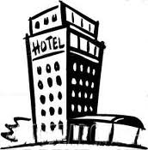
Distinguishing features should correlate
So if /small/ is a positive distinguishing feature only for cell phone reviews but not hotels …
… then it will be correlated with positive labels only and should get a high positive weight because the source examples and only the source examples have 1’s for that feature position (other domain zeroed out)
Small! ☺
Small! ☹
What is domain adaptation? • Baselines • Frustratingly easy • Sequence labeling results

Slide 19
What we expect to learn
Expect weights for feature vector </small/,/awesome/> to look like:
What happens if we use it to classify unseen instances?
< small_{g}, awesome_{g}, small_{s}, awesome_{s}, small_{t}, awesome_{t} >
< 0, +1, +1, +1, -1, +1 >
Cell phone review | Hotel room review
“I love small cell phones! I want this one for Christmas” | “The hotel room was so small that it felt like the walls were closing in. Try Motel 6 instead.”
<small, awesome> = <1,0> | <small, awesome> = <1,0>
True label = ☺ | True label = ☹
augmented vector = <1,0,1,0,0,0> | augmented vector = <1,0,0,0,1,0>
Predicted label = <1,0,1,0,0,0> • <0,1,1,1,-1,1 > = 0 + 0 + 1 + 0 + 0 + 0 = +1 = thumbs up! ☺ | Predicted label = <1,0,0,0,1,0> • <0,1,1,1,-1,1 > = 0 + 0 + 1 + 0 + 0 + 0 = -1 = thumbs down! ☹
What is domain adaptation? • Baselines • Frustratingly easy • Sequence labeling results

Slide 20
Multi-domain adaptation
For two domains: we triple each feature to get 1 general, 1 source, and 1 target version
For multiple domains, we need 1 general version and 1 version for each domain
So instead of 3 copies of each feature, need 1+K copies of each feature, where K=# of domains
Map examples to new feature space by zeroing out everything but in-domain and general versions
What is domain adaptation? • Baselines • Frustratingly easy • Sequence labeling results

Slide 21
Summary: Feature augmentation
Frustratingly easy feature augmentation:
  Trick part 1: multiple copies of each feature
  Trick part 2: get labeled examples to ignore out of domain copies
Why should it be an improvement?
  Linear models weight distinguishing features more highly
  If feature only stands out in one domain, might not be distinguishing when examples are pooled from different domains
  If the other domain’s copies of that feature are zeroed out: feature has chance to stand out again
Next: Kernel
intuitions…
What is domain adaptation? • Baselines • Frustratingly easy • Sequence labeling results

Slide 22
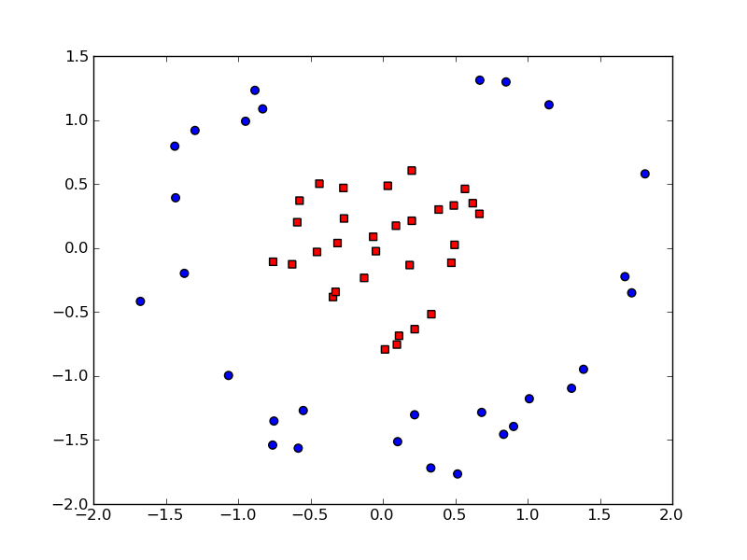
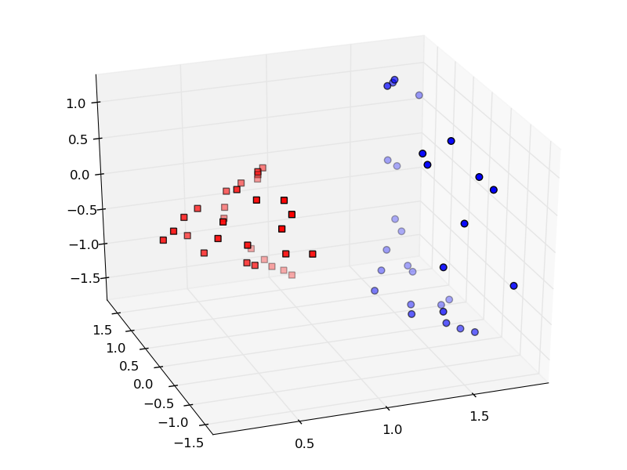
Intuition through its kernel
Linear models require linearly separable datasets
Can make data linearly separable with transformation to higher dimension
Computationally prohibitive: big feature vectors mean big dot products
What is domain adaptation? • Baselines • Frustratingly easy • Sequence labeling results

Slide 23
Kernel functions
The kernel function returns the dot product in high-dimensional space
Lets us take dot products in a high-dimensional space while staying in low-dimensional space!
For transformation from L to H with kernel function K:
x_{1H} • x_{2H} = K(x_{1L} , x_{2L} )
Can do regression in H (linearly separable but lots of dot products) without computationally complex trouble of actual transformation
Kernel functions are possible because transforming points from L to H doesn’t introduce any new information: dot product should be recoverable from original vectors
What is domain adaptation? • Baselines • Frustratingly easy • Sequence labeling results

Slide 24
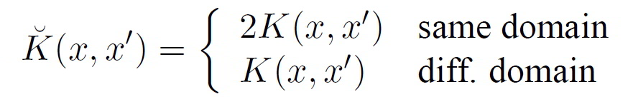
Augmented feature vector kernel
Let K(x,x’) be the kernel function for transformation T from L to H before augmentation, and Ǩ the kernel for T after augmentation
Turns out we can write new kernel in terms of old:
This means x and x’ have bigger dot product (closer together in feature space = more similar) if same domain
Weights gets bigger faster using same-domain vectors
What is domain adaptation? • Baselines • Frustratingly easy • Sequence labeling results

Slide 25
Experimental validation: Tasks
Sequence labeling tasks:
  Named entity recognition: is a word token part of a name?
  Part-of-speech tagging: assign each word token its part of speech
  Recapitalization: recover correct capitalization by assigning each lower-case word token its correctly capitalized form
  Shallow parsing (a.k.a. chunking): identify part-of-speech chunks
  [I begin] [with an intuition]: [when I read] [a sentence], [I read it] [a chunk] [at a time]
  (from “Parsing by chunks”, Steven Abney, 1994)
What is domain adaptation? • Baselines • Frustratingly easy • Sequence labeling results

Slide 26
Task Datasets
ACE-NER: named entity recognition between six domains (multi-domain adaptation)
CoNLL-NE: named entity recognition with ACE domains as source and CoNLL 2003 data as target
PubMed-POS: part-of-speech tagging with WSJ portion of Penn treebank as source, PubMed as target
CNN-Recap: recapitalization. Source: newswire (nw), Target: output of an ASR system
Treebank-Chunk: chunking with multi-domain adaptation
Treebank-Brown: chunking with Brown corpus as source, everything else in Treebank-Chunk as target
What is domain adaptation? • Baselines • Frustratingly easy • Sequence labeling results

Slide 27
Methodology
Features:
  Everything but CNN-Recap: use standard feature set that includes lexical information: words, stems, capitalizations, prefixes and suffixes
  CNN-Recap: use current, previous, and next word, and 1-3 letter prefixes and suffixes
Learning algorithm: SEARN with underlying averaged perceptron classifier (Daumé et al 2007)
For target domain: 75% train, 12.5% dev, 12.5% test
What is domain adaptation? • Baselines • Frustratingly easy • Sequence labeling results

Slide 28
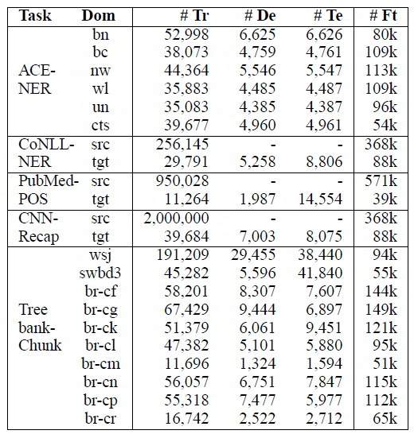
Task statistics
Tr = training set size
De = size of development set
Te = size of test set
Ft = number of unique features
What is domain adaptation? • Baselines • Frustratingly easy • Sequence labeling results

Slide 29
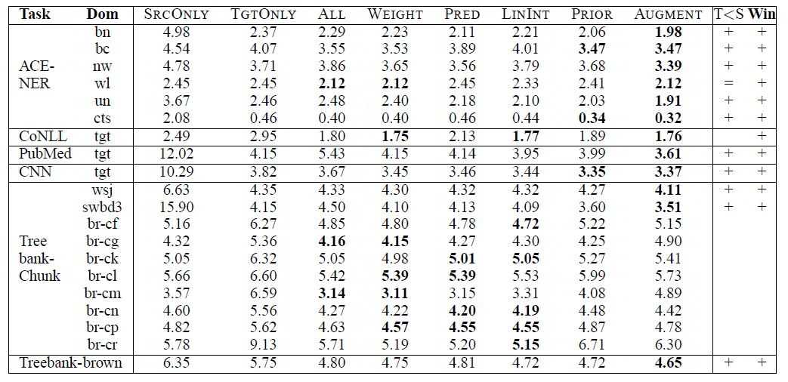
Results: task error rates
Error metric = hamming loss a.k.a. hamming distance
= number of mismatches between predicted and true sequence (standard metric for sequence labeling)
What is domain adaptation? • Baselines • Frustratingly easy • Sequence labeling results

Slide 30
Results
AUGMENT loses only when SrcOnly does better than TgtOnly (T<S == False): means source training data represents target domain better than target data
Makes sense: if the target data in that case is so bad (it can’t even represent its own domain!) and domains are so similar then not much benefit in ‘blowing up the feature space’
Interestingly: no clear winner on tasks that AUGMENT loses on (so no clear second place)
What is domain adaptation? • Baselines • Frustratingly easy • Sequence labeling results

Slide 31
ACE-NER Named entity recognition
Task: Given a sequence of words (tokens), label them as either a type of Named Entity or not
Different classifiers for each type of Named Entities:
  Person (PER),
  Geo-political Entity (GPE),
  Organization (ORG, or
  Location (LOC)
6 domains:
  Broadcast news (bn): no capitalization
  Broadcast conversations (bc)
  Newswire (nw)
  Weblog (wl)
  Usenet (un)
  Conversational telephone speech (cts)
What is domain adaptation? • Baselines • Frustratingly easy • Sequence labeling results

Slide 32
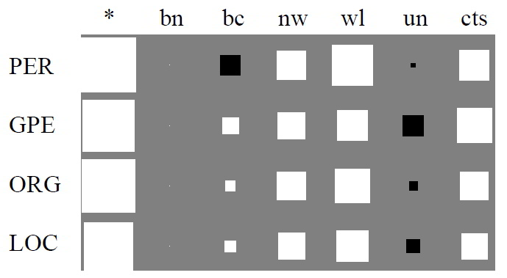
ACE-NER feature weights: /Aa+/ at current position
Iconical name feature. Great indicator in general. Slightly negative in usenet due to emails & URLs. Zero weights in bn: no capitalization!
What is domain adaptation? • Baselines • Frustratingly easy • Sequence labeling results

Slide 33
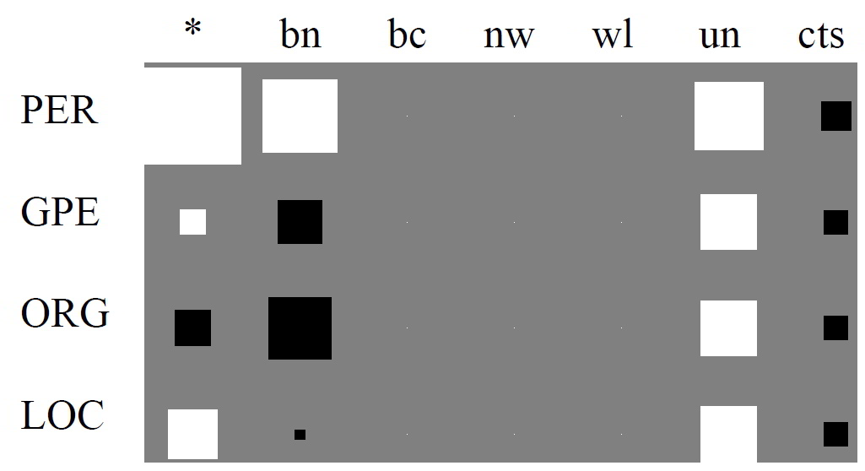
/bush/ at current position
Case sensitive! Almost always a person: bush as president >> bush as plant except in conversations. Extra high in usenet: nobody capitalizes him
What is domain adaptation? • Baselines • Frustratingly easy • Sequence labeling results

Slide 34
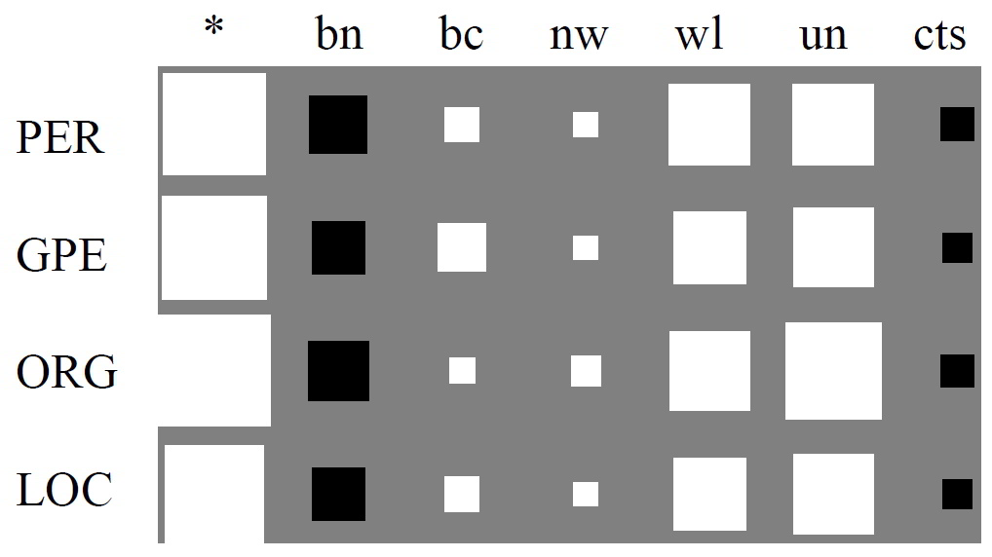
/the/ at current position
Common word in entities except broadcast news & conversational speech
What is domain adaptation? • Baselines • Frustratingly easy • Sequence labeling results

Slide 35
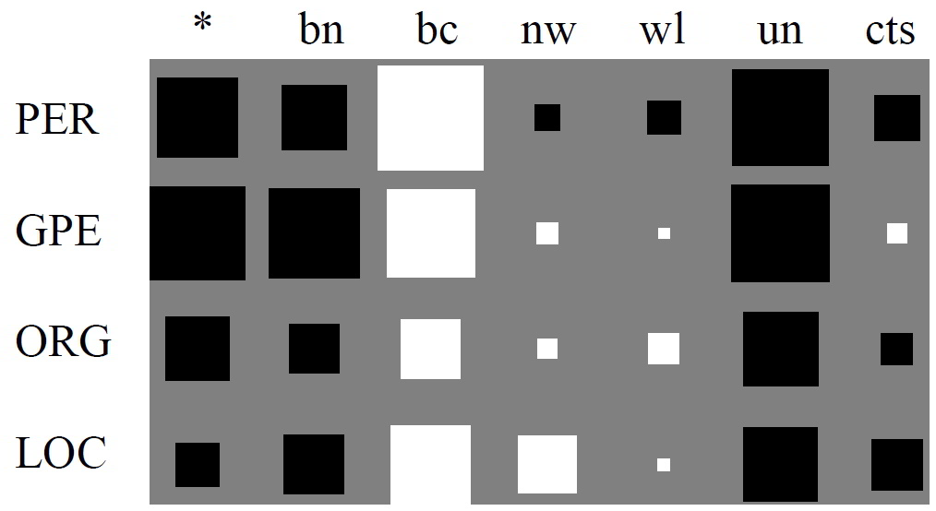
/the/ at previous position
Only indicative in bc: “the Iraqi people” (GPE), “the Pentagon” (ORG), “the Bush __” (PER), “the South” (LOC); otherwise counter-indicative
What is domain adaptation? • Baselines • Frustratingly easy • Sequence labeling results

Slide 36
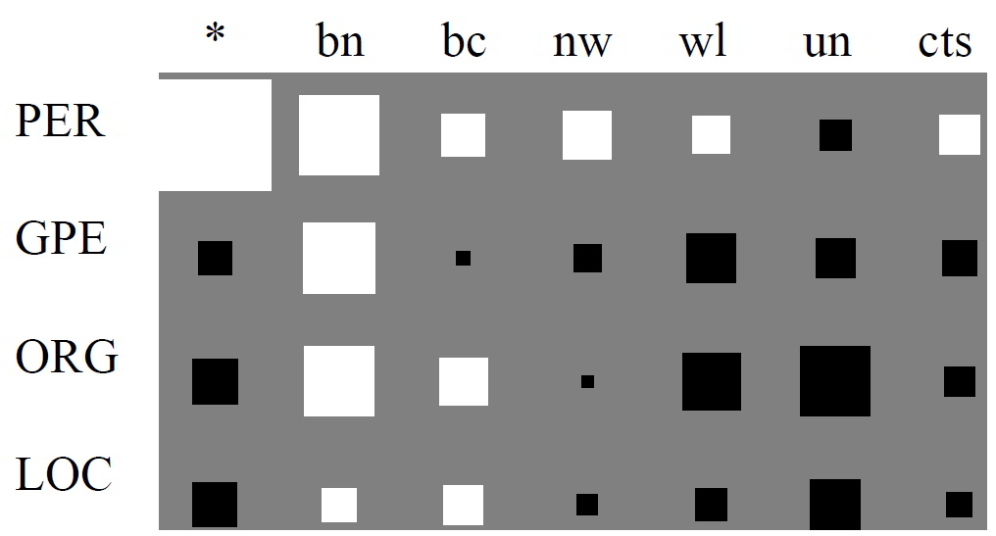
current position in list of common names
Usually only gets people. Except: (1) bn&bc describe GPE/ORG/LOC by name of leader. (2) usenet users have diverse names not on the list
What is domain adaptation? • Baselines • Frustratingly easy • Sequence labeling results

Slide 37
Conclusion
Domain adaptation is important: we have lots of training data to harness across domains with same features (text in particular is always describable by bag of words)
Some features indicate the same thing across all domains
Other features indicate different things in different domains
This method lets the learner decide which is which

Slide 38
Take home message
Feature augmentation is an easy and effective method to harness existing training data for classifying similar domains

Slide 39
Comments & Criticisms
Spell check
Shouldn’t have had to dig for error metric and train/test split
Cross-validation?
How similar do domains need to be?
But very clever

