Slide 1
Toward an Architecture for Never-Ending Language Learning
Andrew Carlson¹, Justin Betteridge¹, Bryan Kisiel¹, Burr Settles¹, Estevam Hruschka², and Tom Mitchell¹
¹School of Computer Science, Carnegie Mellon University
²Federal University of Sao Carlos, Brazil
AAAI 2010
presented by Ben Hixon

Slide 2
Outline
Problem: How to never-endingly learn facts from the web
Proposed solution: NELL architecture
Components of architecture
Experimental methodology
Evaluation and results
Discussion and Criticisms
Introduction • Architecture • Methodology • Results & Evaluation • Conclusion

Slide 3
Problem Statement
Never-ending language learning: run forever performing two tasks:
  Reading Task: extract facts from the web
  Learning Task: improve extraction ability over time
Implemented as NELL (Never-Ending Language Learner)
NELL starts with seed ontology and instantiates it with two types of facts:
  (1) categories
  (2) relations between those categories
Introduction • Architecture • Methodology • Results & Evaluation • Conclusion

Slide 4
Seed Ontology
Ontology = set of predicates defining categories and relations.
A category is a unary predicate, eg:
river(Fording River)
A relation is a binary predicate, eg:
tvStationInCity(WLS-TV, Chicago)
Can be coupled with constraints limiting possible categories and relations and used in coupled bootstrapped semi-supervised learning
Introduction • Architecture • Methodology • Results & Evaluation • Conclusion

Slide 5
Coupled bootstrapped semi-supervised learning
Unsupervised learning: uses no labeled examples (eg, clustering)
Semi-supervised learning: uses a small number of labeled examples
Bootstrapped semi-supervised learning: starts with a small number of labeled examples, but grows example set by incorporating new high-confidence instances
Coupled bootstrapped semi-supervised learning: constrains the high-confidence instances according to some a priori criteria
Introduction • Architecture • Methodology • Results & Evaluation • Conclusion

Slide 6
Why coupling? Semantic drift
Bootstrapped learning suffers from semantic drift: since new instances are incorporated into the labeled seed examples, errors will accumulate over time
Couple learning with constraints to minimize error accumulation
Constraints on categories and relations provided a priori:
  Mutual exclusion: a category instance isn’t promoted if it already belongs to a mutually exclusive category (eg, a sport can’t also be a person)
  Type checking: a relation instance isn’t promoted if it doesn’t satisfy type requirements
Introduction • Architecture • Methodology • Results & Evaluation • Conclusion

Slide 7
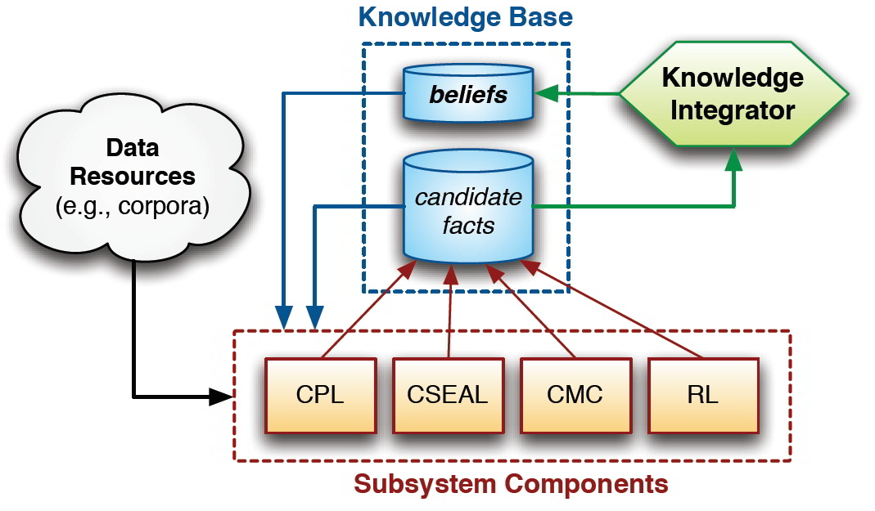
The NELL Architecture
Data, KB
↓
Extraction Components
↓
Candidate Facts
↓
Knowledge Integrator
↓
Beliefs
Introduction • Architecture • Methodology • Results & Evaluation • Conclusion

Slide 8
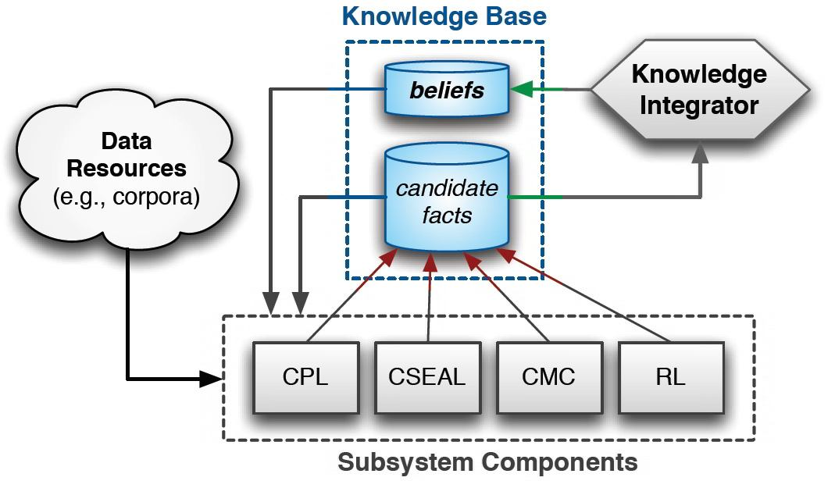
Knowledge Base (KB)
Instances divided into beliefs and candidate facts
Beliefs: output from KI, input to subsystem
Candidate facts: output from subsystem, input to KI
Introduction • Architecture • Methodology • Results & Evaluation • Conclusion

Slide 9
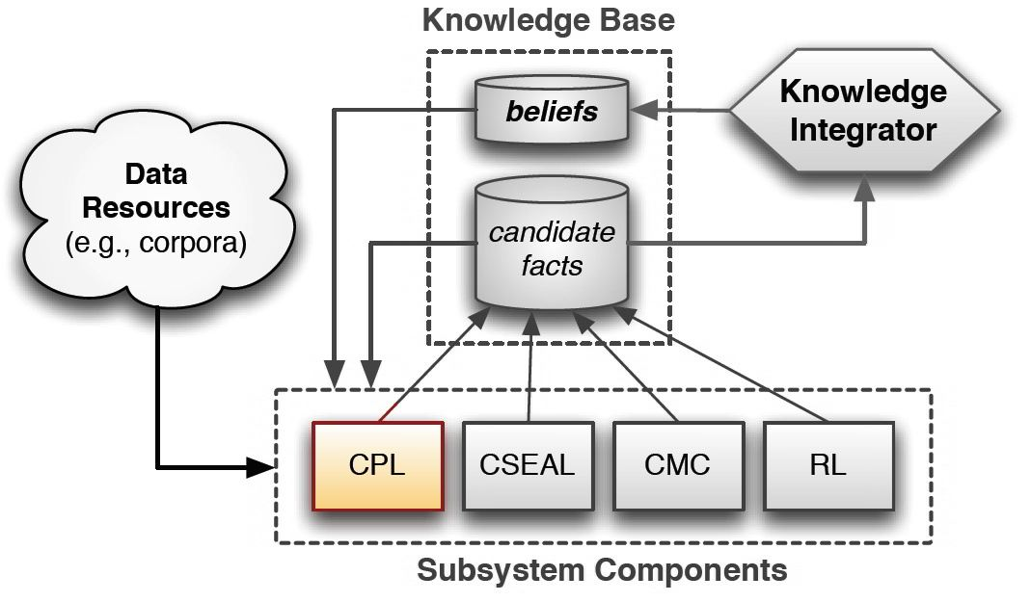
Coupled Pattern Learner (CPL)
Uses extraction patterns to identify instances.
Pattern is phrase with blanks, eg
“op-ed page of X” for X=newspaper
Starts with seed patterns, learns new ones
Introduction • Architecture • Methodology • Results & Evaluation • Conclusion

Slide 10
CPL learns patterns and instances from sentences
Preprocessing: Use OpenNLP package to process web pages into sentences. Extract, tokenize and POS-tag.
For each predicate:
  Given set of associated patterns
  Find all instances in data fitting those patterns. The same instance should identified by multiple patterns
  Rank candidates using confidence = 1 - 0.5^{c}, where c = # of patterns finding the candidate
  Promote top 100 scoring candidates
  For promoted candidates: extract phrases surrounding the candidate in every sentence it occurs. These are new extraction patterns for the predicate.
Introduction • Architecture • Methodology • Results & Evaluation • Conclusion

Slide 11
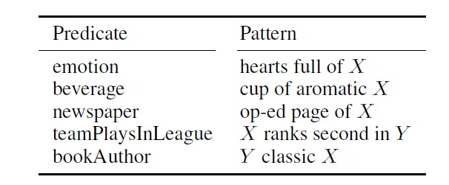
CPL Extraction Patterns
Example patterns learned by CPL
Introduction • Architecture • Methodology • Results & Evaluation • Conclusion

Slide 12
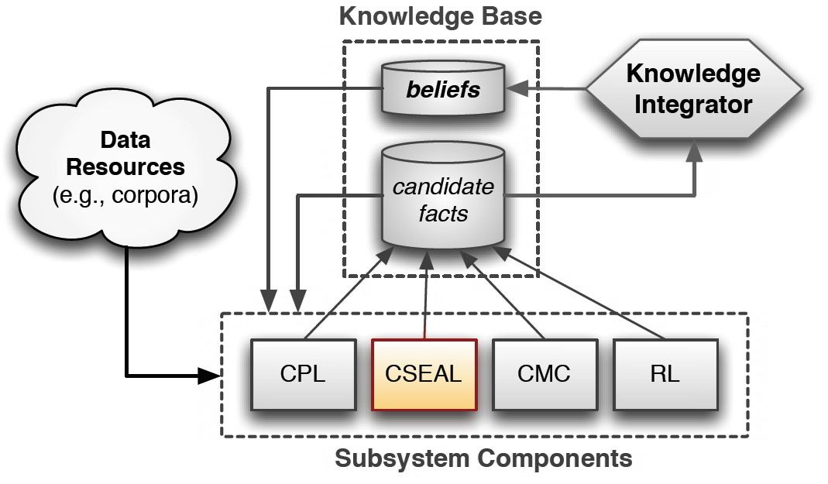
Coupled SEAL (CSEAL)
Uses subset of beliefs from KB for each predicate to query data for web page results
Mines results for instances using a pattern on the raw html called a wrapper
Introduction • Architecture • Methodology • Results & Evaluation • Conclusion

Slide 13
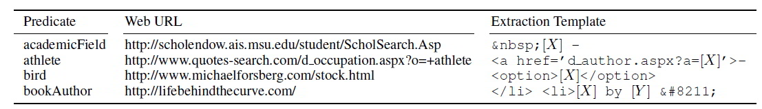
CSEAL uses wrappers: patterns on raw html
Preprocessing: “Subsamples” KB beliefs and uses them to query web data
  50 pages per query, 5 queries per category, 10 queries per relation
Wrappers are like CPL patterns for html
CSEAL works just like CPL except
  Wrappers instead of patterns
  Subsampled html pages instead of sentences
Example wrappers learned by CSEAL
Introduction • Architecture • Methodology • Results & Evaluation • Conclusion

Slide 14

Coupled Morphological Classifier (CMC)
Logistic regression classifier using parts of speech as features
Training data = beliefs from KB
Only classifies candidates from other components
Returns max of 30 results with P>0.75
Introduction • Architecture • Methodology • Results & Evaluation • Conclusion

Slide 15
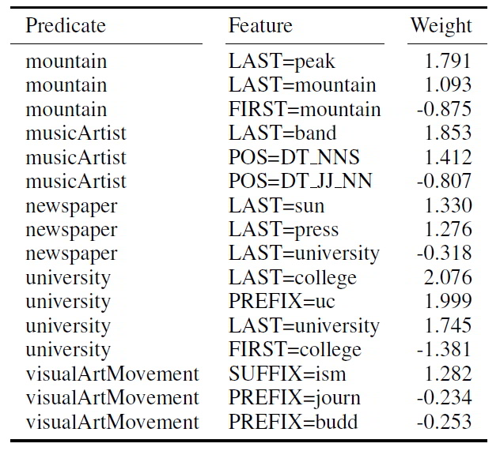
Example noun phrase rules learned by CMC
Noun phrases classified according to part-of-speech features
Same feature gets different weights depending on location in phrase: eg “Rocky mountain” versus “mountain climbing”
Introduction • Architecture • Methodology • Results & Evaluation • Conclusion

Slide 16
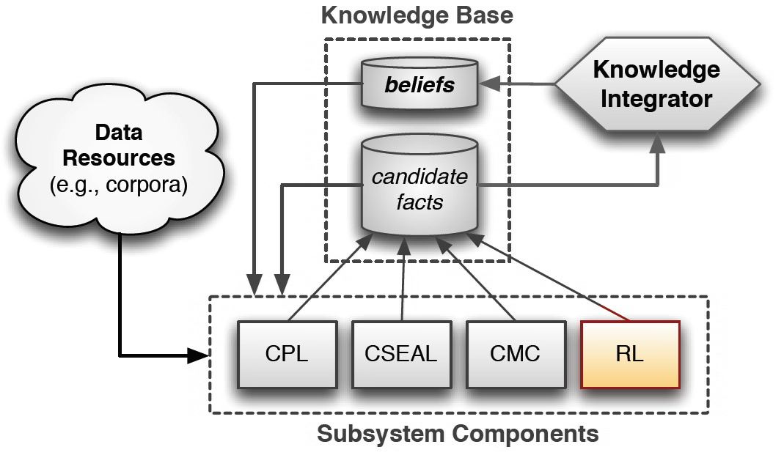
Rule Learner (RL)
Learns probabilistic horn clauses (defined next slide)
Implementation is based on FOIL algorithm by J.R. Quinlan
Introduction • Architecture • Methodology • Results & Evaluation • Conclusion

Slide 17
Horn Clauses
The rule learner learns probabilistic horn clauses
Horn clause: a logical disjunction where all but one of the disjuncts are negations. Has the form
    ~q₁ ∨ ~q₂ ∨ ~q₃ ∨ … ∨ ~q_{n} ∨ p
Can be converted to an inference rule by basic propositional logic (q∨p ≡ ~q⇒p), so that above becomes:
~( ~q₁ ∨ ~q₂ ∨ ~q₃ ∨ … ∨ ~q_{n} ) ⇒ p
    q₁ ∧ q₂ ∧ q₃ ∧ … ∧ q_{n} ⇒ p
Probabilistic Horn clause: has likelihoods assigned to disjunctions that can act as confidence values.
Introduction • Architecture • Methodology • Results & Evaluation • Conclusion

Slide 18
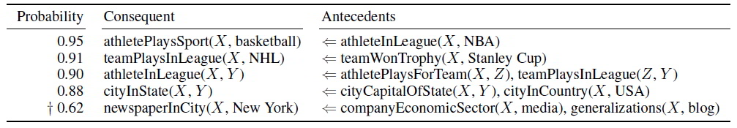
Horn clause examples
Example Horn clauses learned by RL
Introduction • Architecture • Methodology • Results & Evaluation • Conclusion

Slide 19
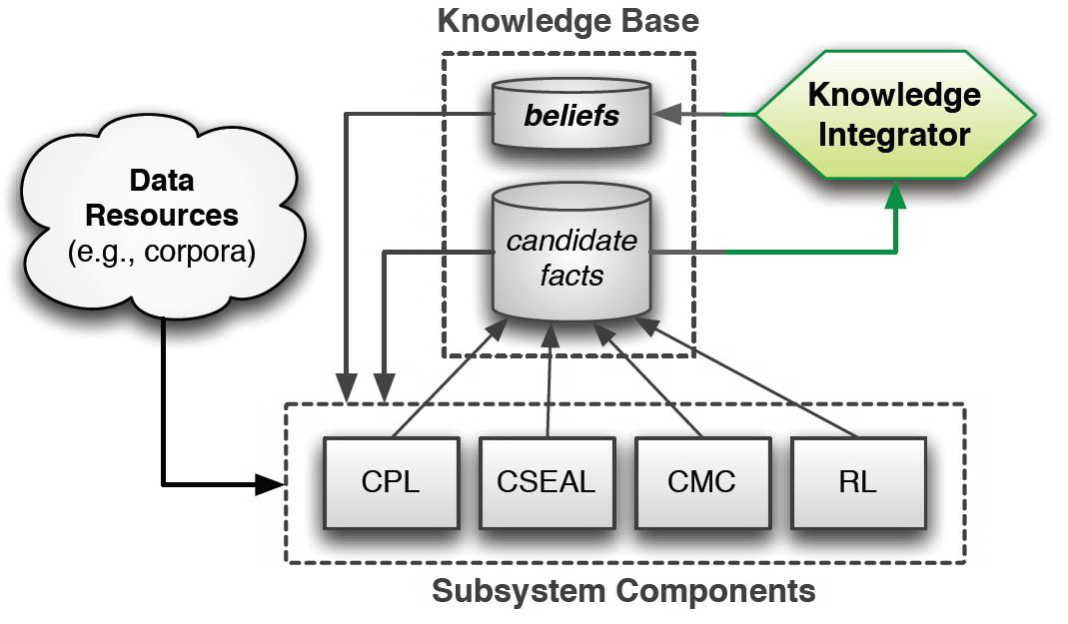
Knowledge Integrator (KI)
Promote candidate facts from subsystem components to beliefs
A promoted belief is never demoted
Max of 250 promotions per predicate per iteration
Introduction • Architecture • Methodology • Results & Evaluation • Conclusion

Slide 20
Promotion of candidates
A candidate fact is promoted on one of two conditions:
  A single component promotes it with high confidence (P>0.9)
  OR
  multiple extraction components promote it with low confidence
The new belief cannot break the following constraints:
Category instance: doesn’t already belong to a mutually exclusive category
Relation instance: its arguments obey type checking
Introduction • Architecture • Methodology • Results & Evaluation • Conclusion

Slide 21
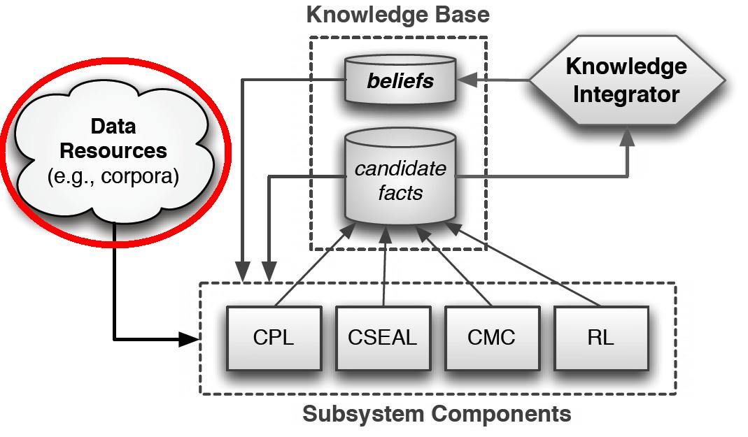
Input: ClueWeb09 Dataset
ClueWeb09 developed by LTI at CMU.
Total dataset is 1 billion web pages in 10 languages collected in Jan and Feb 2009.
5TB compressed, 25TB total
NELL uses the English language subset: 500 million web pages.
Introduction • Architecture • Methodology • Results & Evaluation • Conclusion

Slide 22
Experimental Methodology
Start with seed ontology:
  123 categories each with:
    10-15 seed instances
    5 seed patterns for CPL
  55 relations each with:
    10-15 seed instances
    5 negative instances (for mutual exclusion constraint)
CPL, CSEAL, and CMC run once per iteration
RL runs every 10 iterations. Output of RL filtered by humans (a few minutes only)
Introduction • Architecture • Methodology • Results & Evaluation • Conclusion

Slide 23
Iterative learning
For each iteration:
  Extraction components access web data and KB and return sets of candidate facts with confidence scores
  KI accesses candidate facts and promotes those facts that are given high confidence by one component or low confidence by more than one component
  Promoted facts are returns to KB as beliefs
Introduction • Architecture • Methodology • Results & Evaluation • Conclusion

Slide 24
Experimental Results
Experiment ran for 67 days and completed 66 iterations
242,453 beliefs promoted across all predicates
  95% category instances
  5% relation instances
Initial burst of 10,000 beliefs promoted in first iteration
A few thousand promoted each successive iteration
Introduction • Architecture • Methodology • Results & Evaluation • Conclusion

Slide 25
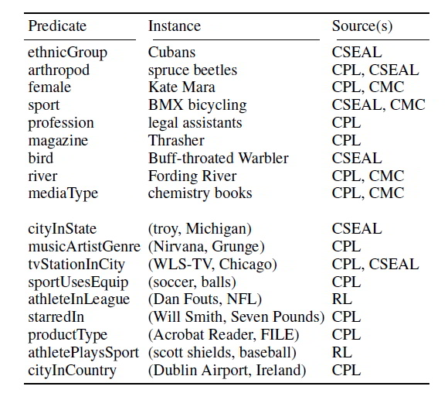
Example beliefs learned
Introduction • Architecture • Methodology • Results & Evaluation • Conclusion

Slide 26
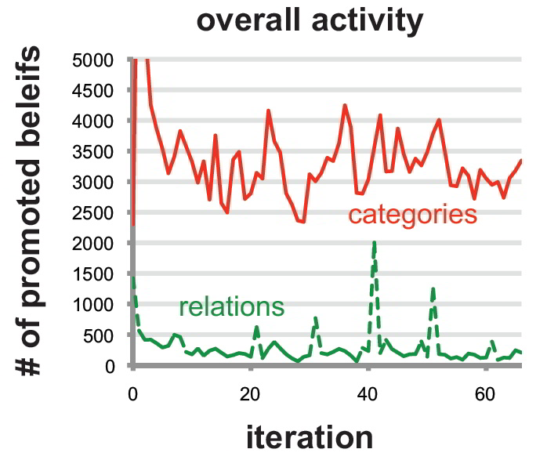
Overall activity
Number of category promotions seems to gradually decrease over time.
Note the spikes in the relations activity (green). These are from the RL, which only runs every 10 iterations.
Introduction • Architecture • Methodology • Results & Evaluation • Conclusion

Slide 27
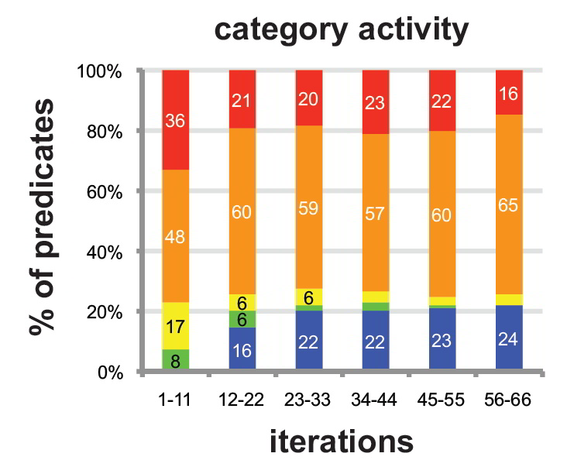
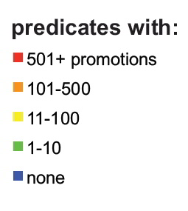
Category activity
Introduction • Architecture • Methodology • Results & Evaluation • Conclusion

Slide 28
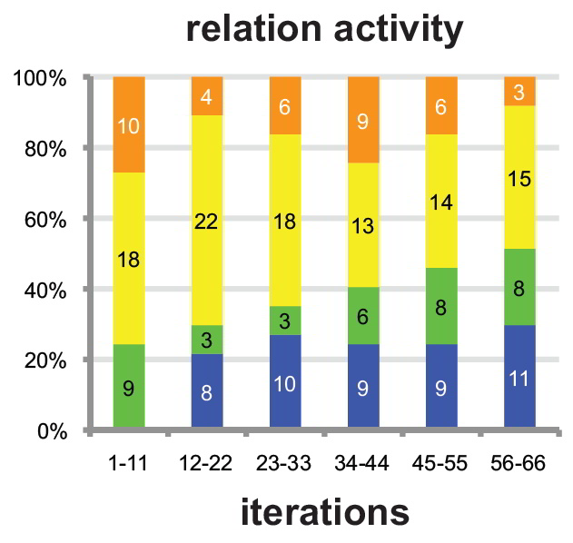
Relation activity
Introduction • Architecture • Methodology • Results & Evaluation • Conclusion

Slide 29
Evaluation of KB Precision
Estimate precision of KB by:
  randomly sample beliefs
  have several human judges decide correctness
Judges can discuss on disagreement
Facts that were once true but not anymore are considered correct
Introduction • Architecture • Methodology • Results & Evaluation • Conclusion

Slide 30
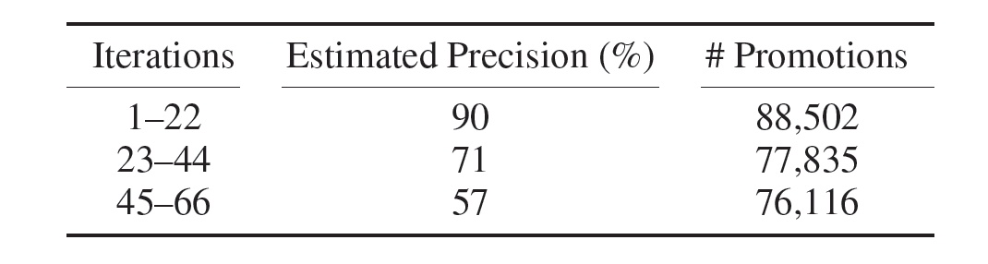
Precision estimates
Randomly sampled 100 beliefs from each set of 22 iterations; human judges decided correctness
Only a few debates between judges; eg “green leafy salad” judged correct as a kind of vegetable
Overall precision is 74%, but downward trend
Introduction • Architecture • Methodology • Results & Evaluation • Conclusion

Slide 31
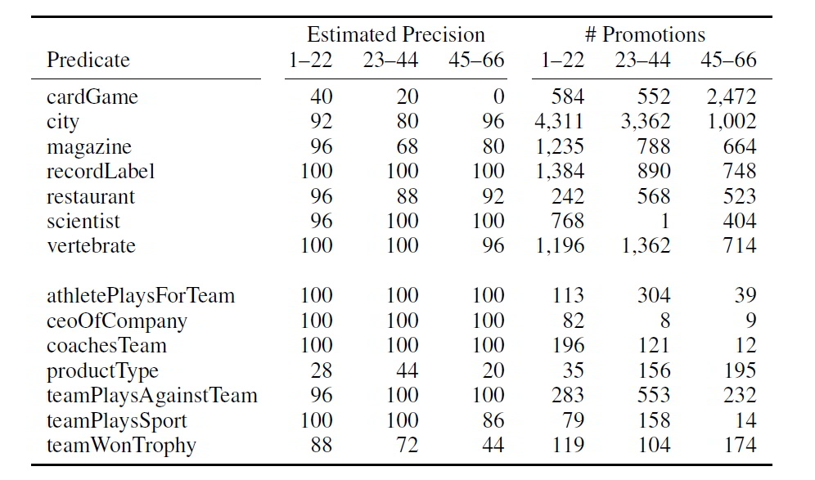
Predicate-level precision
Randomly choose 7 categories and 7 relations, 25 random beliefs from each
cardGame gets increasing promotions but decreasing precision over time because of online casino spam error accumulation (semantic drift).
Eg: “deposit casino bonuses free online list”
Introduction • Architecture • Methodology • Results & Evaluation • Conclusion

Slide 32
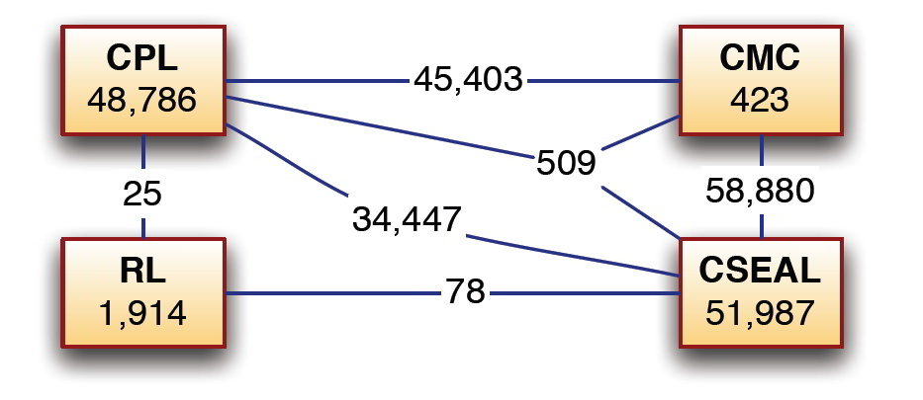
Multiple sources of belief
Node values are beliefs promoted by that source alone
Edge values are beliefs promoted by multiple sources together
242,453 beliefs total; 95% category instances, 5% relations
Introduction • Architecture • Methodology • Results & Evaluation • Conclusion

Slide 33
Conclusion
NELL learns facts from a huge dataset approaching the size of the web and requires little human guidance
Coupling bootstrap semi-supervised learning with a priori constraints is effective for maintaining reasonable precision over time but semantic drift still occurs
Introduction • Architecture • Methodology • Results & Evaluation • Conclusion

Slide 34
Take home message
Multiple-component architecture using bootstrapped semi-supervised learning coupled with ontological constraints shows promise for never-ending learning
Introduction • Architecture • Methodology • Results & Evaluation • Conclusion

Slide 35
Demonstration
NELL is still running! Read the Web at CMU
Introduction • Architecture • Methodology • Results & Evaluation • Conclusion

Slide 36
Criticisms
Method of evaluation (randomly sampled beliefs scored by a panel of human judges) is unsatisfactory; but 10-fold cross validation would take years!
Restricted by a priori ontology (set of possible predicates). Can’t these be learned too?
The scoring scheme for promoting candidates (‘yes’ if high confidence from one component or low confidence from 2+) is simplistic. FORR could do better by learning component weights!
I’d liked to have seen a single-component architecture running simultaneously for performance comparison
Introduction • Architecture • Methodology • Results & Evaluation • Conclusion

