Slide 1

Phonemic Similarity Metrics to Compare Pronunciation Methods
Ben Hixon¹, Eric Schneider¹, Susan L. Epstein^{1,2}
¹Department of Computer Science, Hunter College of
The City University of New York
²Department of Computer Science, The Graduate Center of The City University of New York

Slide 2
Outline of talk
Spoken Dialogue System with large vocabulary
Compare methods of producing a pronouncing dictionary
Bioinformatics-inspired weighted phonemic substitution matrix (WPSM)
Use this WPSM to compare pronouncing methods

Slide 3
The problem
Loqui project [http://www1.ccls.columbia.edu/~Loqui/]: spoken dialogue system for patron orders at the Andrew Heiskell Braille and Talking Book Library
Large vocabulary: 28,031 author names
71,166 book titles
ASR requires a pronouncing dictionary.
How do we get one this large? Answer: Automated G2P.
Background • G2P • Evaluation • WPSM • Results • Current Work

Slide 4
G2P: Graphemes to Phonemes
Grapheme-to-Phoneme (G2P) methods map words to phoneme strings
We need phoneme strings for all words in vocabulary
Automated G2P necessary to produce a pronouncing dictionary of this size
G2P is not an easy problem! Lots of proposed solutions
Background • G2P • Evaluation • WPSM • Results • Current Work

Slide 5
Comparing G2P methods
Logios: rule-based, using MITalk Letter-to-Sound rules [CMU Speech Group 2008]
Festival: decision trees [Black et al 1998]
Sequitur: joint sequence models [Bisani and Ney 2008]
How to gauge their performance?
Background • G2P • Evaluation • WPSM • Results • Current Work

Slide 6
Common G2P evaluation metrics
Word Error Rate (WER):
Phoneme Error Rate (PER):
Minimum # of insertions, deletions, substitutions known as Levenshtein Distance
incorrect pronunciations
total pronunciations
insertions + deletions + substitutions
total phonemes
“soda” | WER | Levenshtein Distance | PER
S OW D AH S OW D AA | 100% | 1 (one substitution) | 25%
Background • G2P • Evaluation • WPSM • Results • Current Work

Slide 7
Limitations of WER and PER
Under WER, following pronunciation pairs equally incorrect:
S OW D AH S OW D AH
S OW D AA T EY B L
PER better, but following pairs both have PER of 25%:
S OW D AH S OW D AH
S OW D AA S OW D N
We weren’t satisfied and wanted a more sensitive metric.
Background • G2P • Evaluation • WPSM • Results • Current Work

Slide 8
Weighted Levenshtein distance
Different phoneme substitutions should have different weights
Previous methods to determine these weights:
  Distance between articulatory feature vectors [Kessler 2005]
  ALINE [Kondrak 2000] gives phonemes 17-element vectors
  Confusion matrices based on listening tests [Cutler et al 2004; Pucher et al 2007]
  Require specialized knowledge about how phonemes are pronounced
Wanted: method that derives weights from corpora instead
Background • G2P • Evaluation • WPSM • Results • Current Work

Slide 9
BLOSUM
Amino acid substitution matrix used to align protein strings by maximizing string similarity
Biologists identified a set of protein alignments in which they had high confidence
From these, counted frequencies of individual amino acid substitutions
Final BLOSUM score is the log-odds of these frequencies
Background • G2P • Evaluation • WPSM • Results • Current Work

Slide 10
WPSM: Weighted Phonemic Substitution Matrix
Source of trusted alignments: CMU Pronouncing Dictionary
Procedure:
  Get headwords with multiple variant pronunciations (8,513 words)
  Align each pair of pronunciations using unweighted Levenshtein distance (10,159 alignments)
  Example: “Difficulty”
        D IH F AH K AH L T IY
        D IH F IH K AH L T IY
  Count frequency of each phoneme substitution
  Output: log odds of substitution frequencies in matrix
Background • G2P • Evaluation • WPSM • Results • Current Work

Slide 11
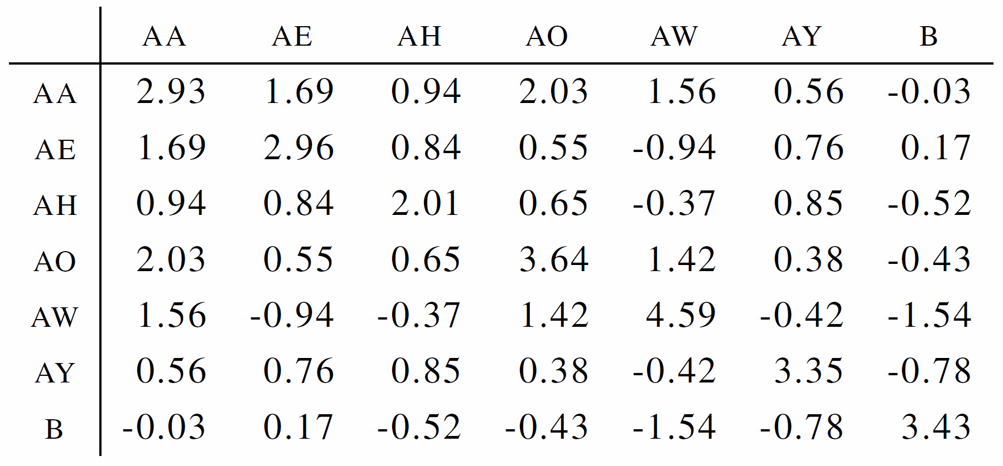
Excerpt from WPSM
Highest entries along diagonal ➔ phonemes most similar to themselves
Background • G2P • Evaluation • WPSM • Results • Current Work

Slide 12
Evaluation metrics with WPSM
WPSM similarity score = maximized Levenshtein distance between pronunciations using WPSM entries as weights
Mean Similarity Score (MSS)
WPSM similarity score(predicted, reference)
average length of predicted and reference
Mean Identity Ratio (MIR)
WPSM similarity score(predicted, reference)
WPSM similarity score(reference, reference)
Background • G2P • Evaluation • WPSM • Results • Current Work

Slide 13
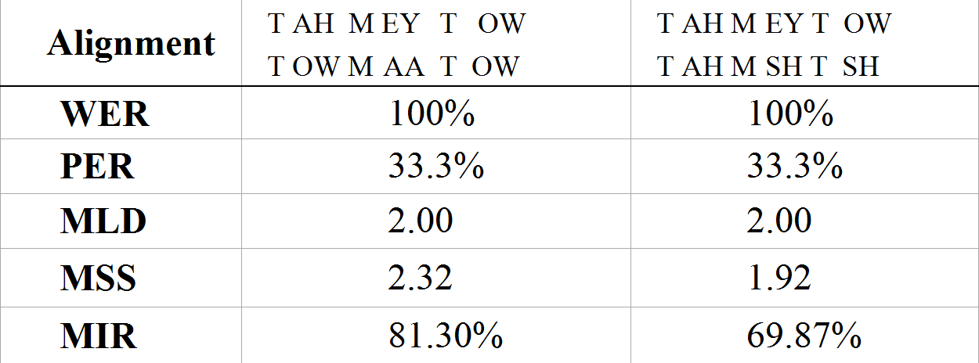
Illustrations of metrics
Realistic and unlikely pronunciations of “tomato”
Only MSS and MIR report different values
Background • G2P • Evaluation • WPSM • Results • Current Work

Slide 14
Experimental results
Festival and Sequitur trained on CMU Dictionary (10-fold cross-validation) Sequitur has lowest distance and highest similarity scores
 | WER(%) | PER(%) | MLD | MSS | MIR(%)
Festival | 40.10 ±0.40 | 9.06 ±0.11 | 0.57 ±0.01 | 2.683 ±0.003 | 94.22 ±0.09
Logios | 51.15 ±0.47 | 16.45 ±0.16 | 1.04 ±0.01 | 2.541 ±0.003 | 89.39 ±0.10
Sequitur | 27.94 ±0.45 | 6.75 ±0.14 | 0.43 ±0.01 | 2.727 ±0.003 | 95.73 ±0.09
95% confidence intervals
Background • G2P • Evaluation • WPSM • Results • Current Work

Slide 15
Discussion
CMU Pronouncing Dictionary used both to
  Provide training corpus for Festival and Sequitur
  Derive WPSM
Impact:
  Dictionary errors are perpetuated in the WPSM
  WPSM measures conformance with CMU Pronouncing Dictionary instead of “true” pronunciations
  Machine learning methods had advantage of training on same corpus as WPSM
Background • G2P • Evaluation • WPSM • Results • Current Work

Slide 16
Current work
Use sources of trusted alignments other than CMU Dictionary (e.g. UNILEX has dialect-specific pronouncing dictionaries)
Substitution matrices for non-English languages (method is language-independent). Are phoneme pairs substituted at different rates in different languages?
String matching metric in Voice Search, matching partial ASR hypotheses against a database.
Background • G2P • Evaluation • WPSM • Results • Current Work

Slide 17
Application
FORRSooth, an SDS architecture
  Learns to use multiple heuristics [Epstein et al. 2011]
  Uses approach and algorithms from FORR [Epstein 1994]
Advisors encapsulate heuristics to solve the problem
Build a voice search heuristic with WPSM
Background • G2P • Evaluation • WPSM • Results • Current Work

Slide 18
Conclusions
WPSM phoneme substitution weights are sensitive to the degree of mutability between phonemes
Automatically derived from large corpus of multiple pronunciations
WPSM creation requires no specialized speech knowledge
Language-independent, data-driven, and improved by richer training corpora

Slide 19
Take home message
Similarity metrics for phonemes can be derived automatically from pronunciation data using a language-independent method

Slide 20
Acknowledgements
This work is supported in part by the National Science Foundation.
Thanks to our colleagues at the Loqui Project:
Rebecca Passonneau
Tiziana Ligorio
Joshua Gordon
Eric Osisek

Slide 21
References
A. W. Black, P. Taylor, and R. Caley (1998, 3/1/2011), The Festival Speech Synthesis System. http://www.cstr.ed.ac.uk/ projects/festival/
M. Bisani and H. Ney, “Joint-sequence models for grapheme-to-phoneme conversion,” Speech Communication, vol. 50, pp. 434-451, 2008.
A. Cutler, A. Weber, R. Smits, and N. Cooper, “Patterns of English phoneme confusions by native and non-native listeners,” Journal of the Acoustical Society of America, vol. 116, pp. 3668-3678, 2004.
Carnegie Mellon University Speech Group (2008, 3/1/2011), The Logios Tool.: https://cmusphinx.svn.sourceforge.net/svnroot/ cmusphinx/trunk/logios/
S.L. Epstein, 1994. For the Right Reasons: The FORR Architecture for Learning in a Skill Domain. Cognitive Science, 18 (3): 479-511.
S.L. Epstein, R.J. Passonneau, J. Gordon, and T. Ligorio, “The Role of Knowledge and Certainty in Understanding for Dialogue,” Advances in Cognitive Systems, AAAI Fall Symposium.
B. Kessler, “Phonetic comparison algorithms,” Transactions of the Philological Society, vol. 103, pp. 243-260, 2005.
M. Pucher, A. Türk, J. Ajmera, and N. Fecher, “Phonetic distance measures for speech recognition vocabulary and grammar optimization,” in 3rd Congress of the Alps Adria Acoustics Association, Graz, Austria, 2007, pp. 2-5.

Slide 22
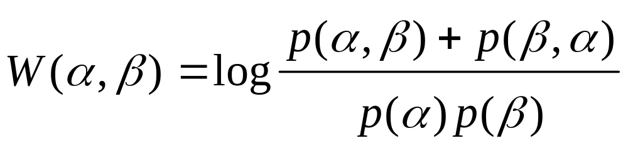
Log-odds
Log-odds: log of frequency with which α is substituted for β and vice versa divided by product of independent frequencies
Intuition: if a substitution is more likely to occur than the two phonemes independently, the log-odds is positive, and otherwise negative

Slide 23
Arpabet phonemes
Phoneme | E. g. | Phoneme | E. g. | Phoneme | E. g. | Phoneme | E. g.
AA | odd | EH | Ed | L | lee | T | tea
AE | at | ER | hurt | M | me | TH | theta
AH | hut | EY | ate | N | knee | UH | hood
AO | ought | F | fee | NH | ping | UW | two
AW | cow | G | green | OW | oat | V | vee
AY | hide | HH | he | OY | toy | W | we
B | be | IH | it | P | pee | Y | yield
CH | cheese | IY | eat | R | read | Z | zee
D | dee | JH | gee | S | sea | ZH | seizure
DH | thee | K | key | SH | she
From http://www.speech.cs.cmu.edu/cgi-bin/cmudict

Slide 24
Variant pronunciations in CMUDICT
ASSOCIATE AH S OW S IY AH T
ASSOCIATE(2) AH S OW S IY EY T
ASSOCIATE(3) AH S OW SH IY AH T
ASSOCIATE(4) AH S OW SH IY EY T
COUNTED K AW N T AH D
COUNTED(2) K AW N T IH D
COUNTED(3) K AW N IH D
COUNTED(4) K AW N AH D

Slide 25
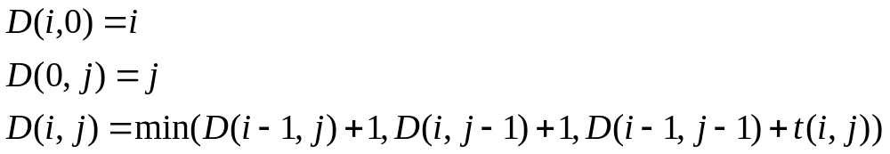
Levenshtein Distance
For strings S of length n and T of length m:
Def. D(i, j) is the edit distance between S[1..i] and T[1..j]
where t(i, j) = 1 if S(i) ≠ T(i), otherwise 0
The Levenshtein distance between S and T is D(n, m)
D(n, m) is typically computed using memoization

Slide 26
Levenshtein Distance: Example
S := T AH M EY T OW
T := T AH M SH T SH
 |  | T | AH | M | SH | T | SH
 | 0 | 1 | 2 | 3 | 4 | 5 | 6
T | 1 | 0 | 1 | 2 | 3 | 4 | 5
AH | 2 | 1 | 0 | 1 | 2 | 3 | 4
M | 3 | 2 | 1 | 0 | 1 | 2 | 3
EY | 4 | 3 | 2 | 1 | 1 | 2 | 3
T | 5 | 4 | 3 | 2 | 2 | 1 | 2
OW | 6 | 5 | 4 | 3 | 3 | 2 | 2
← D(n, m)

Slide 27
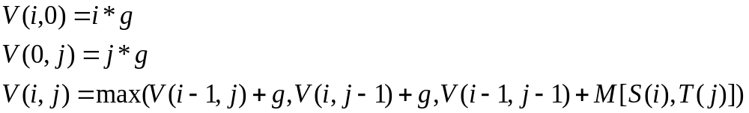
Needleman-Wunsch
Computes optimal global alignment and similarity score
Requires a substitution matrix M and a gap penalty g
Def. V(i, j) is the similarity score between S[1..i] and T[1..j]
Def. M[a, b] is the cost of substituting a for b
The similarity score between S and T is V(n, m)

Slide 28
Needleman-Wunsch: Example
S := T AH M EY T OW | g = -0.73
T := T AH M SH T SH | M is the WPSM
 |  | T | AH | M | SH | T | SH
 | 0 | -0.73 | -1.46 | -2.19 | -2.92 | -3.65 | -4.38
T | -0.73 | 2.367 | – | – | – | – | –
AH | -1.46 | – | 4.377 | – | – | – | –
M | -2.19 | – | – | 7.456 | – | – | –
EY | -2.92 | – | – | – | 8.314 | – | –
T | -3.65 | – | – | – | – | 10.681 | –
OW | -4.38 | – | – | – | – | – | 11.477
← V(n, m)

Slide 29
BLOSUM62 matrix excerpt
A R N D C Q E G H
A 4 -1 -2 -2 0 -1 -1 0 -2
R -1 5 0 -2 -3 1 0 -2 0
N -2 0 6 1 -3 0 0 0 1
D -2 -2 1 6 -3 0 2 -1 -1
C 0 -3 -3 -3 9 -3 -4 -3 -3
Q -1 1 0 0 -3 5 2 -2 0
E -1 0 0 2 -4 2 5 -2 0
G 0 -2 0 -1 -3 -2 -2 6 -2
H -2 0 1 -1 -3 0 0 -2 8
From http://www.ncbi.nlm.nih.gov/Class/FieldGuide/BLOSUM62.txt

