Slide 1
3-D Scene Analysis via Sequenced Predictions over Points and Regions
Xuehan Xiong, Daniel Munoz, J. Andrew Bagnell,
Martial Hebert
The Robotics Institute
Carnegie Mellon University
from the 2011 IEEE International Conference on Robotics and Automation (ICRA 2011)
presented by Ben Hixon

Slide 2
Outline
Problem: Semantic labeling of 3-D points
Base classifier: logistic regression
Proposed improvement: hierarchical segmentation with inter-level context and multi-round stacking
Stacked 3-D Parsing (S3DP)
Experimental set-up, evaluation and results on 3 data sets

Slide 3
Problem statement: Semantic labeling
Machine learning task is the object recognition problem:
Given a set of 3-D points, assign to each point a semantic label describing the object that the point belongs to
Introduction • Hierarchical Segmentation • Multi-round Stacking • S3DP • Results

Slide 4
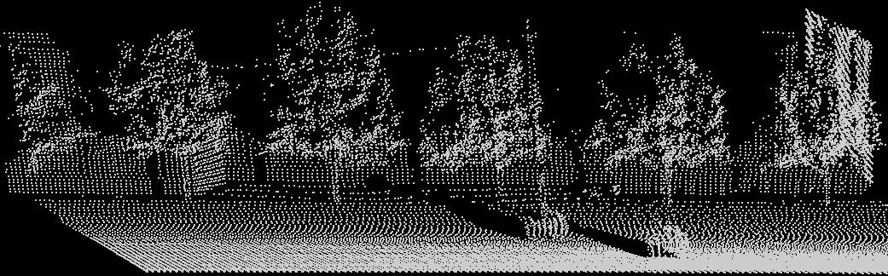
Semantic labeling
From
Introduction • Hierarchical Segmentation • Multi-round Stacking • S3DP • Results

Slide 5
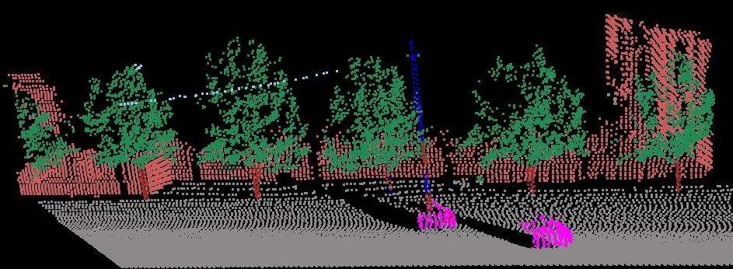
Semantic labeling
To
Building
Wire
Pole
Veg
Trunk
Car
Ground
( from slides by Xuehan Xiong )
Introduction • Hierarchical Segmentation • Multi-round Stacking • S3DP • Results

Slide 6
Some machine learning concepts
Start with a set of labeled data. Each label is a class.
Split your data into a training set and a test set
Train on the training set to build a classifier that predicts the label of unseen data
To see how good classifier is, try it out on test set
Compare predicted labels to true labels on the test set
Introduction • Hierarchical Segmentation • Multi-round Stacking • S3DP • Results

Slide 7
Base Classifer: Logistic Regression (LogR)
First consider linear regression:
  An instance (the thing you want to label) is described by a list of numerical attributes {a_{i}} or features
  We want to know what class the instance belongs to
  Can express class as weighted sum of attributes:
  x = w₁a₁ + w₂a₂ + … + w_{n}a_{n}
  How to get the weights? Minimize square error on the training data to get best-fitting line
Introduction • Hierarchical Segmentation • Multi-round Stacking • S3DP • Results

Slide 8
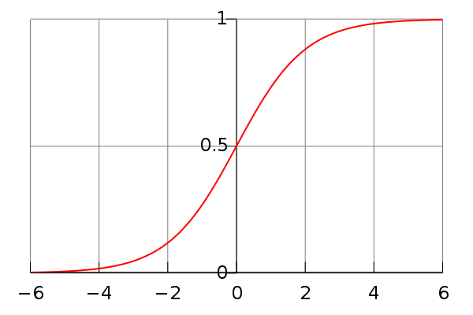
Logistic regression = extension of linear regression
Sometimes a line isn’t good enough, e.g., too sensitive to outliers
Instead, “squash” with a sigmoidal (S-shaped) function
from Wikipedia
Fit training data to this sigmoidal curve and maximize
log-likelihood (probability) instead of minimizing square error
K-class logistic regression returns a probability distribution
across all K labels
Introduction • Hierarchical Segmentation • Multi-round Stacking • S3DP • Results

Slide 9
K-class logistic regression
So for each point in
the K-class logistic regression classifier returns a 7-tuple that sums to 1, and the highest value is the predicted class
Building
Wire
Pole
Veg
Trunk
Car
Ground
Introduction • Hierarchical Segmentation • Multi-round Stacking • S3DP • Results

Slide 10
Hierarchical sequential classification with inter-level context
The key idea of this paper is to break the image into a hierarchy of coarse-to-fine levels and learn on each level
Top level: coarse regions of many points
Bottom level: fine regions of a single point each
Classify regions at each level but augment region’s features using inter-level context between levels
Can parse up and down this hierarchy in sequence until accuracy is good enough
Introduction • Hierarchical Segmentation • Multi-round Stacking • S3DP • Results

Slide 11
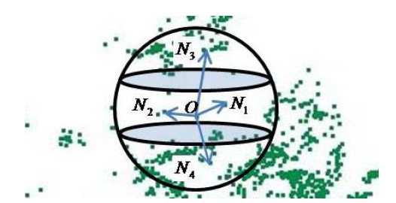
Contextual features
A region is described by a feature vector, e.g. centroid, spin, … (we’ll see a full list later)
But can also augment a region’s feature vector with info about its neighbors: contextual features.
Get info about neighboring regions above and below and just concatenate to end of feature vector
Introduction • Hierarchical Segmentation • Multi-round Stacking • S3DP • Results

Slide 12
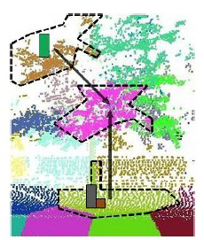
Contextual features
Augment a region’s feature vector with information about its neighbors
This info might be helpful! If so we’ll see performance improvement
Introduction • Hierarchical Segmentation • Multi-round Stacking • S3DP • Results

Slide 13
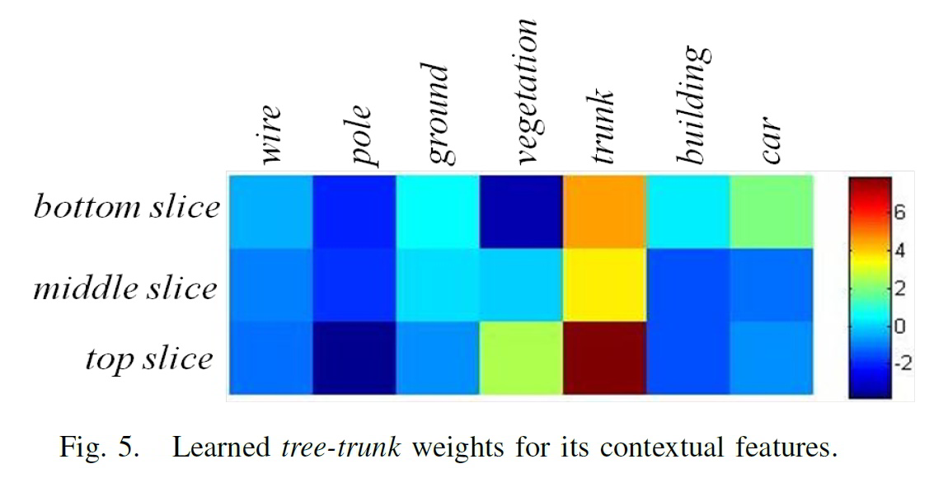
Learned meaningful context for tree-trunk
If region == tree-trunk, then:
- top neighbor more likely to be vegetation than bottom neighbor
- bottom neighbor more likely to be car than top neighbor
Introduction • Hierarchical Segmentation • Multi-round Stacking • S3DP • Results

Slide 14
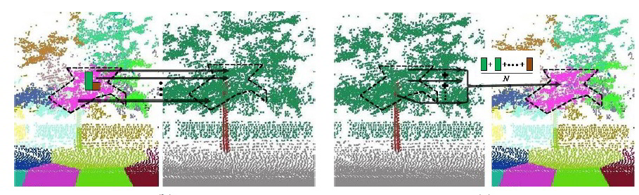
Example of inter-level context
high-to-low low-to-high
Introduction • Hierarchical Segmentation • Multi-round Stacking • S3DP • Results

Slide 15
Overfitting in sequential classification
Sequential classification: learning multiple classifiers in sequence where each new classifier corrects errors in previous
Problem: it’s possible for learner to learn too well
Overfitting: when the learner thinks that all data is just like the training set.
Get context that looks as much like unseen data as possible. Accomplished by multi-round stacking (MRS)
Introduction • Hierarchical Segmentation • Multi-round Stacking • S3DP • Results

Slide 16
Multi-Round Stacking (MRS)
Inuition: want context that is as noisy during training as it will be during testing
Stacking:
Partition training set into 5 disjoint subsets.
For each subset:
  Train on the other 4 to produce a temporary classifier
  Use that classifier to label the points in the holdout set
  Add these predictions to a context set Ŷ
  Use context set to augment features between levels
Stacking can be repeated multiple times: multi-round stacking

Slide 17
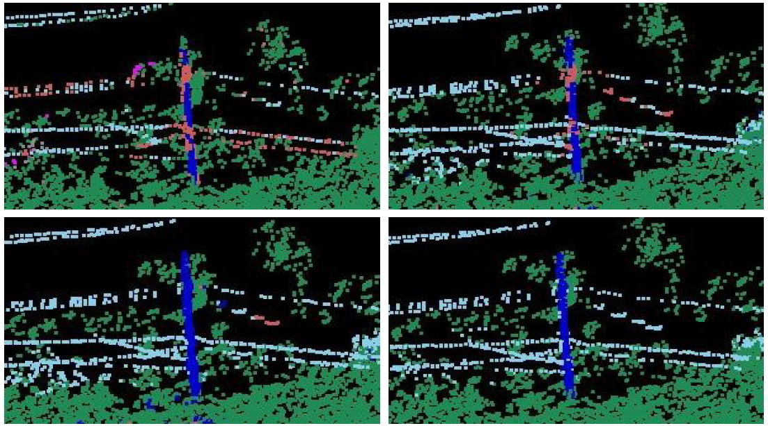
Effectiveness of MRS
pink = “Building”, white = “wires/power-lines”. MRS corrects pink to white
New rounds update context features from previous rounds.
Introduction • Hierarchical Segmentation • Multi-round Stacking • S3DP • Results

Slide 18
Putting it together: Stacked 3D Parsing (S3DP)
Set up 2-level hierarchy
bottom level: region (X_{b},Y_{b}) = 3D points
top level: region (X_{t},Y_{t}) = k-means-clusters
At each level, for each region, extract features
Parse up and down the hierarchy, using validation set to determine how often and in what order
When a level reached: perform multi-round stacking on region feature vectors augmented by context set Ŷ saved from previous level
Introduction • Hierarchical Segmentation • Multi-round Stacking • S3DP • Results

Slide 19

Set up 2-level hierarchy
Top level
K regions:
use K-means
clustering with
K=1% of total
points
Bottom level
regions = points
( pictures from slides by Xuehan Xiong )
Introduction • Hierarchical Segmentation • Multi-round Stacking • S3DP • Results

Slide 20
Feature extraction at each level
Bottom-level (Point) features:
  Scatter, linearity, planarity in local neighborhood
  Scalar projection of local tangent onto z-axis
  Scalar projection of local normal onto z-axis
Top-level features:
  Difference between region centroid and min/max elevation
  10-bin histogram averaging bottom-level features of all points in region
Features at both levels:
  Dimensions of bounding box enclosing points in region or neighborhood
  Spin images around z-axis
  Relative elevations for min and max elevation within the region or local neighborhood
Introduction • Hierarchical Segmentation • Multi-round Stacking • S3DP • Results

Slide 21
Parsing UP the hierarchy
Apply N rounds of MRS on bottom level (X_{b},Y_{b})
output: N+1 classifiers f_{(b)} and the Ŷ holdout predictions
For each region feature vector x_{i} in the top level:
Extend x_{i} with average of all its children’s label probabilities in Ŷ.
Apply N rounds of MRS to top level (X_{t},Y_{t})
output: f_{(t)} , N+1 classifiers for top level
Save f_{(b)} and f_{(t)} to be used for predictions on test set
Introduction • Hierarchical Segmentation • Multi-round Stacking • S3DP • Results

Slide 22
Use validation set to determine order
Can split labeled examples into three sets, training, testing, and validation, in order to tune parameters
They use validation set to determine how often to traverse hierarchy and in what order
Found that going from bottom to top and back down again worked well
Introduction • Hierarchical Segmentation • Multi-round Stacking • S3DP • Results

Slide 23
Experimental evaluation on 3 datasets
VMR-Oakland-v2
- 3.1M points scanned at ground level of CMU campus
- labels: wire,pole,ground,vegetation,tree-trunk,building,car
GML-PCV
- arial scans of Russian landscape – airborne LIDAR scans
- divided into two sets A and B, each with a training/testing split of 1M points each
- set A labels: ground, building, tree, low-vegetation
- set B labels: same as A plus car
RSE-RSS
- 10 scans at ground level of 65 thousand points each (sparse)
- labels: ground,streetsign,tree,building,fence,person,car,background
- noisy ground truth labeling (labeled examples sometimes wrong)
Introduction • Hierarchical Segmentation • Multi-round Stacking • S3DP • Results

Slide 24
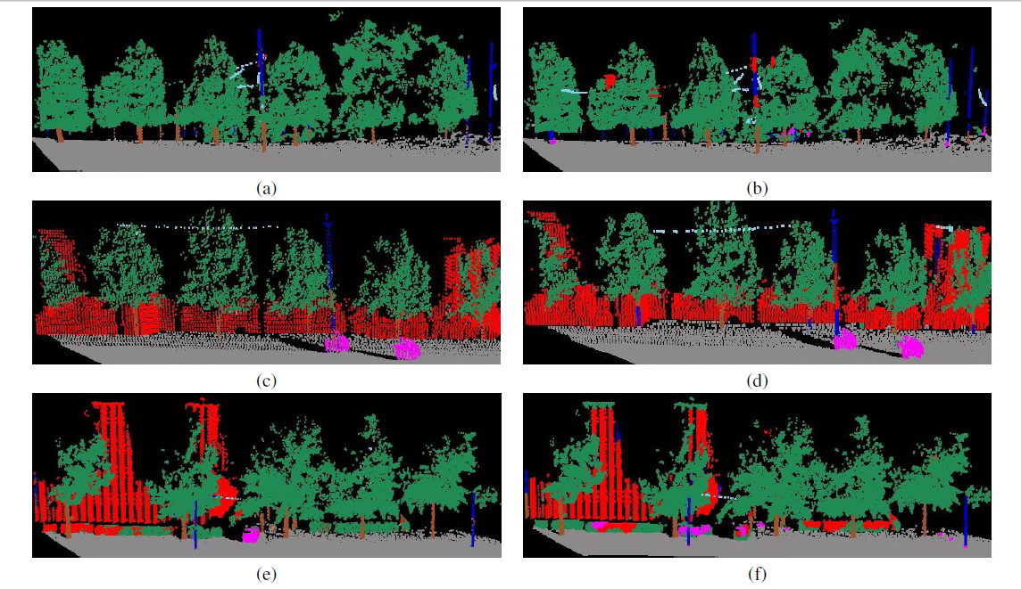
Dataset 1 example classifications
Introduction • Hierarchical Segmentation • Multi-round Stacking • S3DP • Results

Slide 25
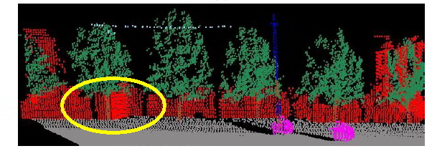
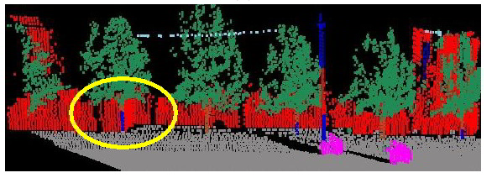
Context correctly labels tree
Top: S3DP
Bottom: M3N
S3DP better at tree trunks: in a 3D
point cloud without color,
only context can distinguish between
a pole and a tree trunk
Introduction • Hierarchical Segmentation • Multi-round Stacking • S3DP • Results

Slide 26
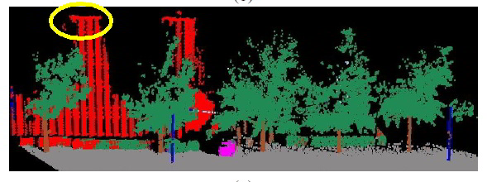
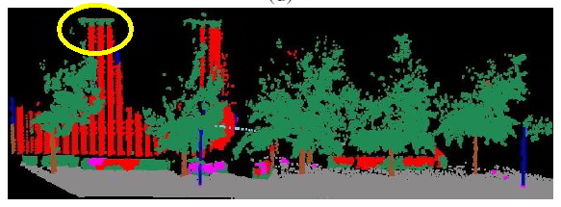
Context can also make mistakes
Top: S3DP
Bottom: M3N
S3DP “corrects” the vegetation on top of the building, because context tells it that what’s likely to be on top of a building is more building.
M3N that only uses local features gets it right.
Introduction • Hierarchical Segmentation • Multi-round Stacking • S3DP • Results

Slide 27
Evaluation metrics for classifiers
Precision = # true positives
# true positives + false positives
  how many positives are really true
Recall = # true positives
# true positives + false negatives
  how many trues are classified positive
F₁-measure
= harmonic mean of precision and recall
= 2 * precision * recall
precision + recall
Introduction • Hierarchical Segmentation • Multi-round Stacking • S3DP • Results

Slide 28
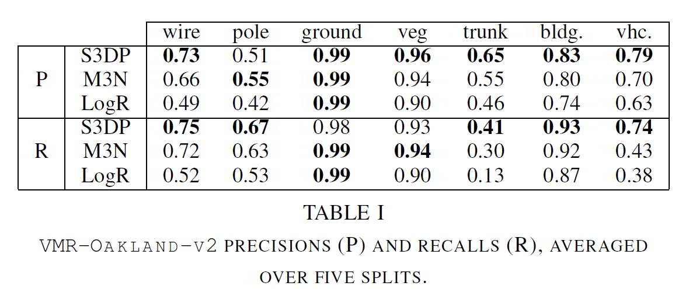
Dataset 1 per-label precision and recall
Precision: S3DP lower on pole but much higher on trunk
Recall: S3DP higher on pole and much higher on trunk
Introduction • Hierarchical Segmentation • Multi-round Stacking • S3DP • Results

Slide 29
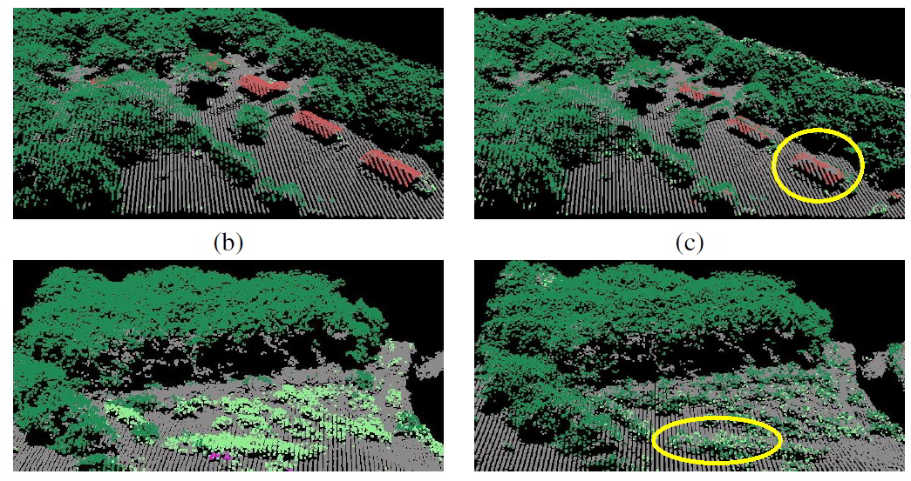
Dataset 2 example
S3DP LogR
LogR can’t distinguish low-veg from high-veg because they look the same locally
S3DP knows from context that low-vegetation more likely to be next to the ground
Introduction • Hierarchical Segmentation • Multi-round Stacking • S3DP • Results

Slide 30
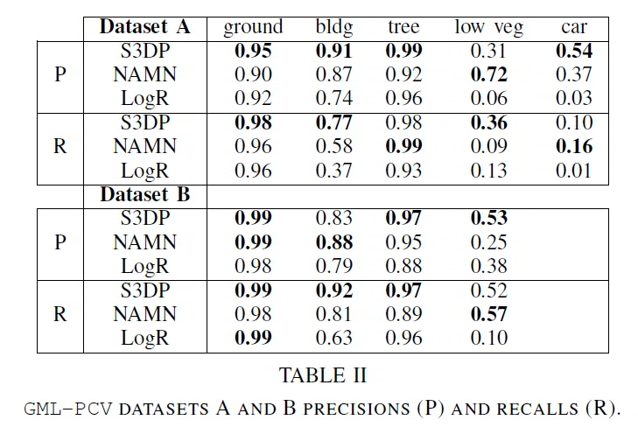
Dataset 2 Precision and Recall
Set A: car and low veg have similar local features and context: S3DP can’t distinguish
Set B: no car to throw it off so S3DP does better on low veg
Introduction • Hierarchical Segmentation • Multi-round Stacking • S3DP • Results

Slide 31
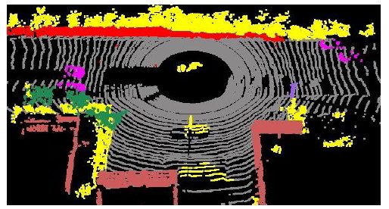
Dataset 3: Noisy ground truth destroys context
Yellow=background
Trees, ground, and house points get mislabeled as background
S3DP learns that background can appear anywhere.
Introduction • Hierarchical Segmentation • Multi-round Stacking • S3DP • Results

Slide 32
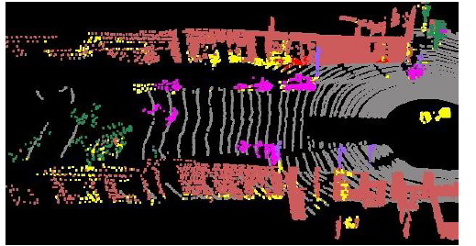
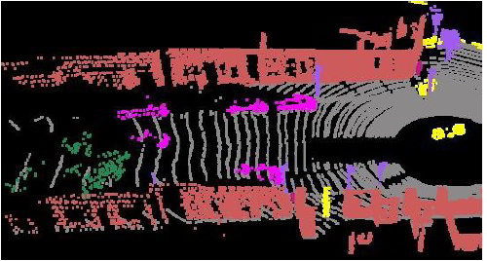
Dataset 3 examples
Top = S3DP
Bottom = Ground Truth
yellow = background
S3DP very poor on this data set because the ‘background’ label destroys contextual information
Introduction • Hierarchical Segmentation • Multi-round Stacking • S3DP • Results

Slide 33
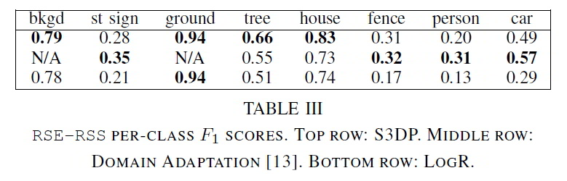
Dataset 3 Precision and Recall
Introduction • Hierarchical Segmentation • Multi-round Stacking • S3DP • Results

Slide 34
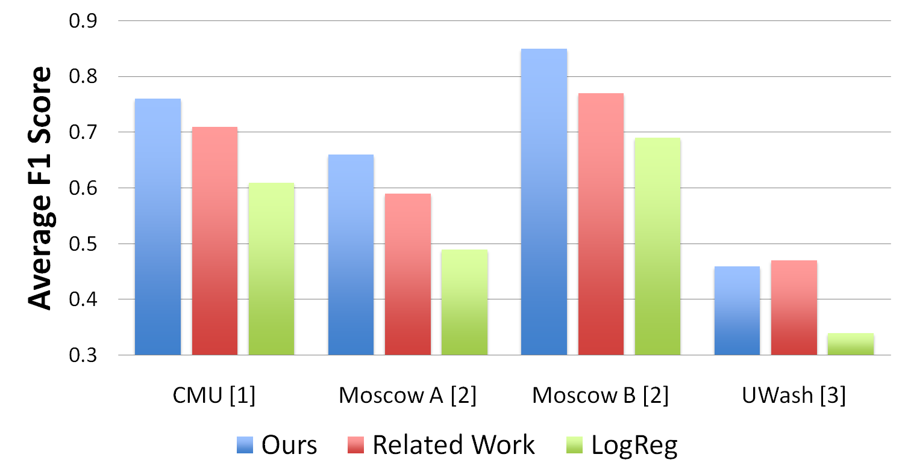
Overall F1 Scores on 3 datasets
( chart from slides by Xuehan Xiong )
Introduction • Hierarchical Segmentation • Multi-round Stacking • S3DP • Results

Slide 35
Conclusion
Authors have shown that they can use contextual information in a coarse-to-fine hierarchical structure to learn semantic labels
Demonstrate how context at the regional level can distinguish between otherwise similar points: e.g., ground foliage versus tree foliage
They demonstrate competitive precision and recall even in noisy sparse domains (dataset 3) but loss of context impairs the learner

Slide 36
Take home message
Semantic labeling of 3D point clouds can be improved by using contextual information between multiple levels of granularity

