Slide 1
GradGrub
Mobile food outlet in Oxford, England

Slide 2
Concept
Launch mobile food outlet called GradGrub targeted at uni students
Brand promise = cheap, healthy food
Focus on healthy hamburgers
Test first outlet in Oxford, England:
university city
small city (pop. ~ 150,000)
lots of university students

Slide 3
Key questions
Q1: What is the optimum location for the food truck?
Q2: What are the competitor hamburger outlets in Oxford?

Slide 4
Data
List of Oxford’s 45 colleges and halls (csv file)
Foursquare location database – GradGrub’s competitors

Slide 5
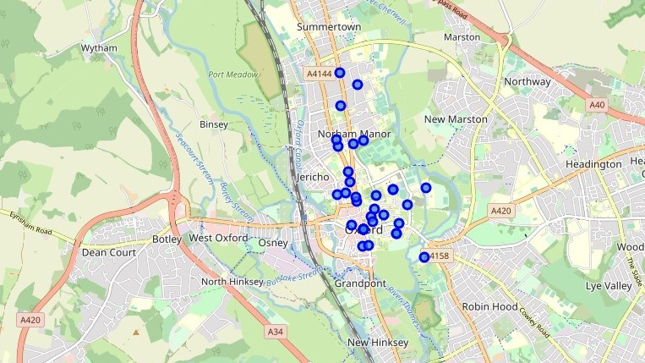
Oxford colleges

Slide 6
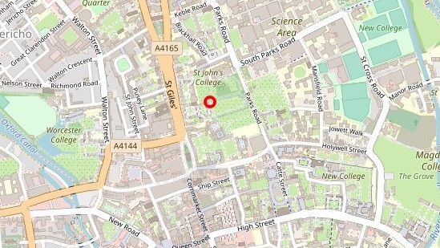
Optimum location
Directly outside St John’s College on St Giles road

Slide 7
Competitors
12 direct competitors that specialize in burgers
Several direct competitors that specialize in food trucks
Numerous indirect competitors that specialize in American food

Slide 8
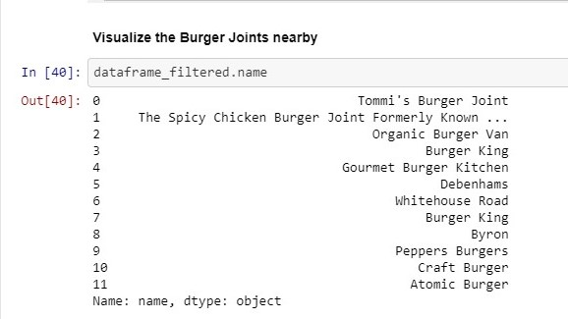
Burger Joints

Slide 9
Conclusion
GradGrub could carve out a niche as the only mobile food outlet offering hamburgers to students in Oxford
GradGrub has two distinct advantages:
1) centrally located to the colleges
2) carries lower overheads as a food truck

