Slide 1
Spring

Slide 2
Spring at the beginning
Created in 2003, Open Source
Lightweight container
  Spring container manage your application objects
  Use Dependency Injection to instantiate and assemble objects
Provide features for enterprise development
  high performing, easily testable and reusable code
Most popular framework in java community
Organized in modules

Slide 3
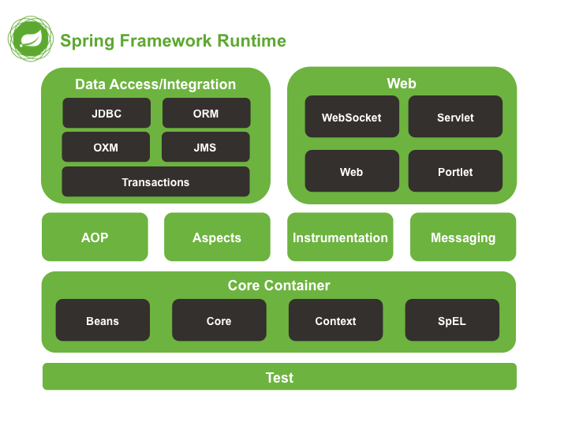
Spring Framework
More than a lightweight container
Spring Framework consists of features organized into about 20 modules
Modules are grouped into Core Container, Data Access/Integration, Web, AOP, Instrumentation, and Test

Slide 4
Spring Framework
Spring Core, the heart of Spring
The Core and Beans modules provide Dependency Injection features
The BeanFactory is a sophisticated implementation of the factory pattern
  Removes the need for programmatic singletons
Allows to decouple configuration and specification of dependencies from program logic

Slide 5
A word on Spring beans
A Spring bean is a Java bean managed by Spring container :
“A bean is an object that is instantiated, assembled, and otherwise managed by a Spring IoC container”
Beans are configured through XML files or a Java Code
This configuration is the definition of the bean, ie metadata used by Spring IoC container to create and manage bean lifecycle

Slide 6
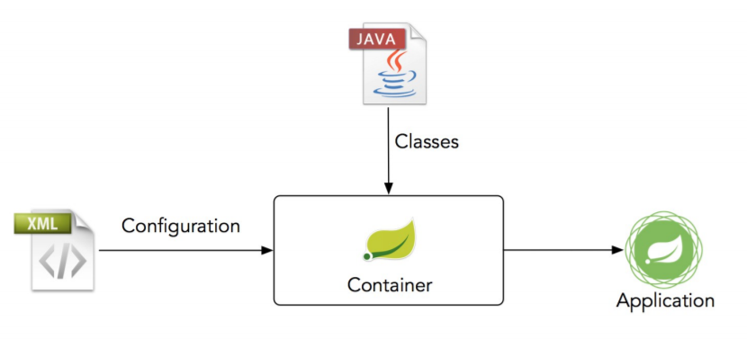

Spring IoC container
Spring IoC container and is responsible for instantiating, configuring, and assembling the beans

Slide 7
Spring IoC container : instantiation & use
ApplicationContext context = new ClassPathXmlApplicationContext("services.xml
// retrieve configured instance
PetStoreService service = context.getBean("petStore", PetStoreService.class);
// use configured instance
List<String> userList = service.getUsernameList();
<?xml version="1.0" encoding="UTF-8"?>
<beans xmlns="http://www.springframework.org/schema/beans" [...] >
<!-- services -->
<bean id="petStore" class="org.springframework.samples.jpetstore.services.PetStoreServiceImpl">
<property name="accountDao" ref="accountDao"/>
<property name="itemDao" ref="itemDao"/>
<!-- additional collaborators and configuration for this bean go here -->
</bean>
</beans>

Slide 8
Spring Injection : Constructor Based
Spring IoC container allows to inject a dependency through constructor
When no type conflict, Spring know how and what to inject
<beans>
<bean id="beanOne" class="x.y.ThingOne">
<constructor-arg ref="beanTwo"/>
<constructor-arg ref="beanThree"/>
</bean>
<bean id="beanTwo" class="x.y.ThingTwo"/>
<bean id="beanThree" class="x.y.ThingThree"/>
</beans>
public class ThingOne {
public ThingOne(ThingTwo thingTwo, ThingThree thingThree) {
// ...
}
}

Slide 9
Spring Injection : Constructor Based
When type conflict on constructor (ie multiple argument with the same type), Spring needs more information
public class ThingOne {
public ThingOne(ThingTwo thingTwo, ThingTwo thingTwoBis) {
// ...
}
}
With argument index
With argument name
<beans>
<bean id="beanOne" class="x.y.ThingOne">
<constructor-arg index="0" ref="beanTwo"/>
<constructor-arg index="1" ref="misterBean"/>
</bean>
<bean id="beanTwo" class="x.y.ThingTwo"/>
<bean id="misterBean" class="x.y.ThingTwo"/>
</beans>
<beans>
<bean id="beanOne" class="x.y.ThingOne">
<constructor-arg name="thingTwo" ref="beanTwo"/>
<constructor-arg name="thingTwoBis" ref="misterBean"/>
</bean>
<bean id="beanTwo" class="x.y.ThingTwo"/>
<bean id="misterBean" class="x.y.ThingTwo"/>
</beans>

Slide 10
Spring Injection : Constructor Based
When injecting a primitive type, Spring needs more information to inject
package x.y;
public class ThingOne {
public ThingOne(int years, String ultimateAnswer) {
// ...
}
}
<beans>
<bean id="beanOne" class="x.y.ThingOne">
<constructor-arg type="int" value="7500000"/>
<constructor-arg type="java.lang.String" value="42"/>
</bean>
</beans>

Slide 11
Spring Injection : Setter-based
Invoke no args constructor then call setters
Can mix constuctor based and setter based injection
Use constructor for mandatory dependencies and setters for optional ones
public class SimpleMovieLister {
private MovieFinder movieFinder;
public void setMovieFinder(MovieFinder movieFinder) {
this.movieFinder = movieFinder;
}
}
<beans>
<bean id="movieLister" class="x.y.SimpleMovieLister">
<property name="moviefinder" ref="awsMovieFinder"/>
</bean>
<bean id="awsMovieFinder" class="x.y.AwesomeMovieFinder"/>
</beans>

Slide 12

Spring problem...

Slide 13
Spring boot

Slide 14
Why Spring boot ?
Spring is hard to configure and time consuming
A simple Hello Word require XML configuration to works
Lot of XML configuration files to carefully configure your app (DB, Ldap, beans, web, security…)
Spring brings a high level of control on application configuration, but it has a cost on productivity
Solution ? Spring Boot

Slide 15
What is Spring boot ?
Spring Boot makes it easy to create stand-alone, production-grade Spring based Applications that you can “just run.”
Simplify, improve, accelerate Spring application creation
Use convention over configuration
Use default configuration based on the classpath
Oh a mysql dependency ? Maybe you want to connect to a MySQL database
Standalone app with embedded servlet container (Tomcat or Jetty)
Starters pom to quickly getting started

Slide 16
Spring Boot starters
Starters are a set of dependencies
They are skeleton of your project which brings all required dependencies with the right version
You want to build a Spring Boot application ? Use the spring-boot-starter
A web application ? Use spring-boot-starter-web
Need some security ? Use spring-boot-starter-security
You want a beautiful mustache ? Use spring-boot-starter-mustache
https://docs.spring.io/spring-boot/docs/current/reference/htmlsingle/#using-boot-starter

Slide 17
Spring Boot starters
<parent>
<groupId>org.springframework.boot</groupId>
<artifactId>spring-boot-starter-parent</artifactId>
<version>1.5.2.RELEASE</version>
<relativePath/>
</parent>
<dependency>
<groupId>org.springframework.boot</groupId>
<artifactId>spring-boot-starter-test</artifactId>
<scope>test</scope>
</dependency>
<dependency>
<groupId>org.springframework.boot</groupId>
<artifactId>spring-boot-starter-web</artifactId>
</dependency>
<dependencies>

Slide 18



Spring Boot : annotations

Slide 19
Spring Boot : First application
@SpringBootApplication
public class BillingserviceApplication {
public static void main(String[] args) {
SpringApplication.run(BillingserviceApplication.class, args);
}
}
@SpringBootApplication : Convenient annotation
  @EnableAutoConfiguration : Ask to Spring Boot to scan dependencies to guess the configuration required by your app
  @Configuration : Set class as a configuration class (can declare configuration items)
  @ComponentScan : Scan sub packages to discover configuration and components of your application. Spring will detect and register them

Slide 20
Spring stereotypes
Spring provides 4 stereotypes used to identified classes roles
Stereotypes are defined by annotations
Classes annotated with a stereotype are registered as beans in Spring container and are injectable
@Component
@Controller
@Service
@Repository

Slide 21
Spring stereotypes
@Service
public class BillingService {
@Autowired
MongoClient mongoClient;
}
@Controller
public class BillingController {
@Autowired
BillingService billingService;
}

Slide 22
Spring stereotypes
Allows to split your application in 3 layers
@Controller : presentation layer
@Service : business layer
@Repository : persistence layer

Slide 23
Spring Boot : Configure your app
@Configuration
public class Config {
@Value("${mongo.uri}")
private String mongoUri;
@Bean
public MongoClient mongoClient() {
MongoClientURI mongoClientURI = new MongoClientURI(mongoUri);
MongoClient mongoClient = new MongoClient(mongoClientURI);
return mongoClient;
}
@Bean
public FilterRegistrationBean corsFilter() {
CorsConfiguration config = new CorsConfiguration();
config.addAllowedOrigin("*");
FilterRegistrationBean bean = new FilterRegistrationBean(new CorsFilter(source));
return bean;
}
}
As we saw, @Configuration on class declare this class as a configuration class
You can configure your beans in these configuration classes
@Bean : create a Spring Bean with the name of the method

Slide 24
@Bean
Annotated method produces a bean to be managed by the Spring container
By default, bean’s name is the method’s name. Can be specified explicitly :
@bean(“myBean”)
@bean({“myBean”, “yourBean”})
@Bean
public MongoClient mongoMockClient() {
return new MongoClient(new MongoClientURI(mongoUri));
}

Slide 25
Injection with Spring boot : @Value
Used for injecting values (not instances) into fields in Spring beans
Can be applied at the field or constructor/method parameter level
@Value("An awesome value")
private String mongoUri;
Used to inject values from configuration file (properties, yaml) into a field or parameter by using a placeholder ${...}
@Value("${mongo.uri}")
private String mongoUri;
A default value can be provided
@Value("${mongo.uri:a_default value}")
private String mongoUri;
Notes:
@PropertySource

Slide 26
Injection with Spring boot : @Autowired
Injection with Spring Boot is an association of ComponentScan to find and register beans and @Autowired to inject these beans at the right place
@Autowired can used on fields, setters and constructors
A dependency can be declared optional with @Autowired(required=false)
public class BillingService {
@Autowired
MongoClient mongoClient;
}
public class BillingService {
MongoClient mongoClient;
@Autowired
public void setMongoClient(MongoClient mongoClient) {
this.mongoClient = mongoClient;
}
}
public class BillingService {
MongoClient mongoClient;
@Autowired
public BillingService(MongoClient mongoClient) {
this.mongoClient = mongoClient;
}
}

Slide 27
Injection with Spring boot : bean resolution
By default beans are resolved by type, so in our exemple Spring must find a bean of type MongoClient to inject it
When several beans of the same type are available, you have to provide additional information with @Qualifier
@Bean
public MongoClient mongoCloudClient() {
return new MongoClient(new MongoClientURI(mongoUri));
}
@Service
public class CustomerService {
@Autowired
@Qualifier("mongoCloudClient")
MongoClient mongoClient;
}
@Bean
public MongoClient mongoTestClient() {
return new MongoClient(new MongoClientURI(mongoTestUri));
}

Slide 28
Injection with Spring boot : bean resolution
If it can’t resolve by type or qualifier, Spring will try to resolve by name
If a bean with a name similar to the field annotated with @Autowired is found, Spring will inject this bean
It’s a kind of implicit injection
@Bean
public MongoClient mongoClient() {
return new MongoClient(new MongoClientURI(mongoUri));
}
@Service
public class CustomerService {
@Autowired
MongoClient mongoClient;
}
@Bean
public MongoClient mongoTestClient() {
return new MongoClient(new MongoClientURI(mongoTestUri));
}

Slide 29
Spring Boot : REST API
Presentation layer

Slide 30
RESTful API
<dependency>
<groupId>org.springframework.boot</groupId>
<artifactId>spring-boot-starter-web</artifactId>
</dependency>
Springs provide annotations to create a RESTful API
The presentation layer is where REST stuff is implemented
Controllers will be the classes responsible of communicating with clients following REST conventions

Slide 31
@RestController & @ResponseBody
Controllers are the main level of API definition
@RestController is a convenient annotation for @Controller and @ResponseBody
@ResponseBody indicate to Spring that return object of the method should be serialized (XML or JSON) and send in body of the response
All methods of the controller annotated with @RequestMapping will be automatically annotated with @ResponseBody

Slide 32
@RequestMapping
Indicate a mapping between an HTTP request and a method based on an URI and an HTTP method
Specific annotations for HTTP methods : @GetMapping, @PostMapping, @PutMapping, @DeleteMapping, @PatchMapping
@PathVariable and a placeholder in URI to bound a path element in a variable
@GetMapping("/resourceGroup/{resourceGroup}")
public ResponseEntity getResourceGroupTotalCost(@PathVariable String resourceGroup) {
CostResult result = billingService.getResourceGroupTotalCost(resourceGroup);
return ResponseEntity.ok(result);
}

Slide 33
@RequestMapping
It’s also possible to bound URL parameters to method parameters
A method can be mapped on multiple URI but an URI can’t be mapped on multiple methods
Can be set at class level to define a common URI prefix for all methods
// localhost/resourceGroup?rg=xxxx
@GetMapping("/resourceGroup")
public ResponseEntity getResourceGroupTotalCost(@RequestParam String rg) {
CostResult result = billingService.getResourceGroupTotalCost(rg);
return ResponseEntity.ok(result);
}
@RestController
@RequestMapping("/api/billing")
public class BillingController {
}

Slide 34
@RequestBody
Spring will automatically deserialize a request’s body to a Java Object
Mapping is done by HttpMessageConverter
You can create and register your own HttpMessageConverter for higher control on mapping
@PostMapping("/user")
public ResponseEntity postUser(@RequestBody User user) {
[...]
}

Slide 35
ResponseEntity
ResponseEntity represents the whole HTTP response: status code, headers, and body
Provide a full control on the response sent to the client unlike @ResponseBody
Can be useful to send a different status code according to some conditions or adapt it to your API specification
@RestController can be associated with ResponseEntity

Slide 36
@RestController
@RequestMapping("/api/billing")
public class BillingController {
@Autowired
private BillingService billingService;
@Autowired
UsageDetailsComputeService usageDetailsComputeService;
@GetMapping(value = "/resourceGroup/{resourceGroup}/billingPeriod/{billingPeriod}")
public ResponseEntity getResourceGroupCost(@PathVariable String resourceGroup, @PathVariable String billingPeriod) {
CostResult result = billingService.getResourceGroupCost(resourceGroup, billingPeriod);
return ResponseEntity.ok(result);
}
}

