Slide 1
3Nd_上機考
12/18

Slide 2
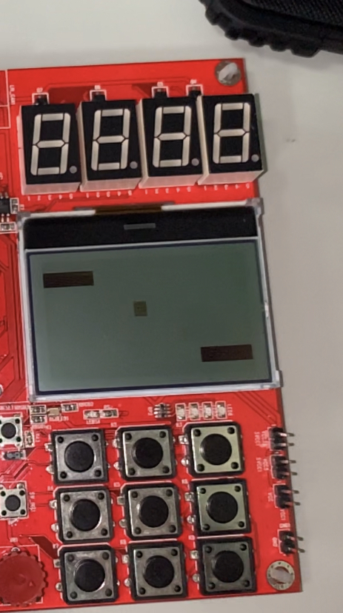
Q1. （70%）乒乓球對打機
操作流程：初始狀態類似右圖
(20%) 啟動時，
七段顯示器左2顆，顯示遊戲進行秒數SS(比正常快10倍， 00~59循環)
七段顯示器最右1顆，顯示下方球拍擊中球數(0~9循環，初始值=0)
七段顯示器最右的左邊1顆，顯示上方球拍擊中球數(0~9循環，初始值=0)
球在中心產生，並之後隨機（srand seed 使用自己學號後4碼)產生四個方向其中一個方向，開始以每0.1秒x, y軸各移動1個pixel速度移動， v=4，球邊緣碰到LCD四周邊界，球會以反射角反彈回。
(20%)轉動可變電阻，下方球拍做左右移動，
當球碰到下方球拍(球的下邊緣落在球拍下底的橫向範圍) 時，
蜂鳴器發出H1(Do f=1046)聲音0.1秒，七段顯示器最右1顆數值加一，
(5%)當球碰到上方球拍時(球的上邊緣在球拍上頂的橫向範圍) ，
蜂鳴器發出 C1(Do f=523聲音0.1秒，七段顯示器最右的左邊1顆數值加一，
(5%)當球碰到LCD四周邊緣時，
蜂鳴器發出C5(So f=784)聲音0.2秒
當按下 3X3 KEYPAD
(5%)鍵(5) 球，停住不動
(5%)鍵(2) 球，速度加快一倍， v++ 。
(5%)鍵(8) 球，速度減慢一半， v-- 。
(5%)鍵(4) 球，重新以每0.1秒速度， v=4 ，發球，七段顯示器內容不更變。
2
4
5
6
8

Slide 3
Q2. （30%）乒乓球機連線對打
連線對打流程：
使用為UART baud rate : 115200 並以\n作為字串結束位元
您的實驗板請寫一個程式當作Master ，經由UART傳送、接收資訊Slave的實驗板。
傳送
Q1.1啟動時， Q1.5 按下 3X3 KEYPAD時， Master傳您的球拍的位置， 球的速度，球的方向，球的X位置，球的Y位置，
Q1.2 轉動可變電阻，下方球拍做左右移動時， Master傳您的球拍的位置，球的速度=?，球的方向=? ，球的X位置=? ，球的Y位置=?
sprintf(Text, "%03d%01d%03d%02d\n",(u32ADCvalue/43),v,x,y);
UART_Write(UART0, Text, 10);
接收
Master 只會接收 Slave 的球拍位置

Slide 4
Q2. 乒乓球機連線對打
Slave傳送
sprintf(Text, "%03d\n",(u32ADCvalue/43));
UART_Write(UART0, Text, 4);
Slave接收
void UART02_IRQHandler(void)
{
uint8_t c, i;
uint32_t u32IntSts = UART0->ISR;
if(u32IntSts & UART_IS_RX_READY(UART0)) // check ISR on & RX is ready
{
while (!(UART0->FSR & UART_FSR_RX_EMPTY_Msk)){ // check RX is not empty
c = UART_READ(UART0); // read UART RX data
if (c!='\n') { // check line-end
PC12=0;
comRbuf[comRbytes] = c;
comRbytes++;
} else {
r = (comRbuf[0]-'0')*100+(comRbuf[1]-'0')*10+comRbuf[32]-'0';
v = (comRbuf[3]-'0');
x = (comRbuf[4]-'0')*100+(comRbuf[5]-'0')*10+comRbuf[6]-'0';
y = (comRbuf[7]-'0')*10+comRbuf[8]-'0';
comRbytes=0;
RX_Flag=1;
break;
}
}
}
}

Slide 5
Q1. （70%）Table tennis playing machine
Operation process: The initial state is similar to the picture on the right
(20%) When starting，
Seven-segment display, 2 digits on the left, showing game progress seconds SS (10 times faster than normal, 00~59 cycle)
The rightmost one of the seven-segment display shows the number of balls hit by the racket below (0~9 cycle, initial value = 0)
The second rightmost one of the seven-segment display shows the number of balls hit by the racket above (0~9 cycle, initial value = 0)
The ball is generated in the center, and then randomly (srand seed uses the last 4 digits of your student number) to generate one of four directions, and starts moving at a speed of 1 pixel on the x and y axes every 0.1 seconds, v=4, edge of the ball When it hits the border around the LCD, the ball will bounce back at a reflection angle.
(20%) Turn the variable resistor and then the racket below moves left or right. ，
When the ball hits the racket below (the lower edge of the ball falls within the lateral range of the bottom of the racket), ，
The buzzer sounds H1 (Do f=1046) for 0.1 seconds, and the value of the rightmost digit of the seven-segment display increases by one. ，
(5%) When the ball hits the racket above (the upper edge of the ball is within the horizontal range of the top of the racket) ，
The buzzer sounds C1(Do for 0.1 seconds, and the value of the rightmost left one of the seven-segment display is increased by one.
(5%) When the ball hits the edges around the LCD, and the buzzer sounds C5 (So f=784) sound for 0.2 seconds ，
When pressing 3X3 KEYPAD
(5%) key 5 presses, ball stops
(5%) key 2 presses, ball doubled speed, v++.
(5%) key 8 presses, ball slows down by half, v--.
(5%) key 4 presses, the ball return to the speed of every 0.1 seconds, v=4, and serves, and the content of the seven-segment display does not change.
2
4
5
6
8

Slide 6
Q2. （30%） Table tennis machine online play
Online fighting process: ：
Use UART baud rate: 115200 and use \n as the end bit of the string.
For your experimental board, please write a program to serve as the Master and send and receive information to/from the Slave experimental board via UART.
Send
Q1.1 starts, and Q1.5 presses the 3X3 KEYPAD, the Master transmits the position of your racket, the speed of the ball, the direction of the ball, the X position of the ball, and the Y position of the ball.
Q1.2 the variable resistor turns and the racket below moves left or right, the Master transmits the positin of the racket, the speed of the ball =?, the direction of the ball =?, the X position of the ball =?, the Y position of the ball
Send sprintf(Text, "%03d%01d%03d%02d\n",(u32ADCvalue/43),v,x,y);
UART_Write(UART0, Text, 10);
Receive
Master will only receive Slave's racket position

Slide 7
Q2. 乒乓球機連線對打
Slave Send
sprintf(Text, "%03d\n",(u32ADCvalue/43));
UART_Write(UART0, Text, 4);
Slave Receive
void UART02_IRQHandler(void)
{
uint8_t c, i;
uint32_t u32IntSts = UART0->ISR;
if(u32IntSts & UART_IS_RX_READY(UART0)) // check ISR on & RX is ready
{
while (!(UART0->FSR & UART_FSR_RX_EMPTY_Msk)){ // check RX is not empty
c = UART_READ(UART0); // read UART RX data
if (c!='\n') { // check line-end
PC12=0;
comRbuf[comRbytes] = c;
comRbytes++;
} else {
r = (comRbuf[0]-'0')*100+(comRbuf[1]-'0')*10+comRbuf[32]-'0';
v = (comRbuf[3]-'0');
x = (comRbuf[4]-'0')*100+(comRbuf[5]-'0')*10+comRbuf[6]-'0';
y = (comRbuf[7]-'0')*10+comRbuf[8]-'0';
comRbytes=0;
RX_Flag=1;
break;
}
}
}
}

