Slide 1
嵌入式系統設計與實務
授課教師：逢甲大學 資訊工程系 陳德生老師、王益文老師

Slide 2
第 13 週
ADC
- VR, ADC & LCD

Slide 3
ADC specification
Analog input voltage range: 0~Vref= 3.3V
12-bit SAR ADC (10-bit accuracy)
Input channel:
Up to 8 single-end analog input channels ADC0 ~ ADC7 = PA0 ~ PA7
4 pairs of differential analog input channel.
Up to 800KSPS
The maximum ADC operating frequency is 16M Hz
Three ADC operation modes
Single mode
Single-cycle mode
Continuous mode
Decimal | Binary | Voltage (Vref=3.3V)
0 | 0000_0000_0000 | 0/4096 * 3.3V
1 | 0000_0000_0001 | 1/4096 * 3.3V
2048 | 1000_0000_0000 | 2048/4096 * 3.3V
4095 | 1111_1111_1111 | 4095/4096 * 3.3V

Slide 4
SAR (Successive Approximation Register) ADC
SAR
End-Of-Conversion
clock
N-bit
DAC
Vref
Comparator
-
+
Sample
& Hold
Vin

Slide 5
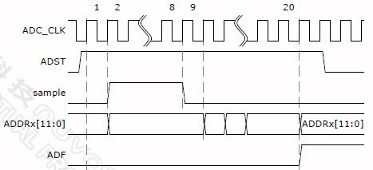
ADC Single mode

Slide 6
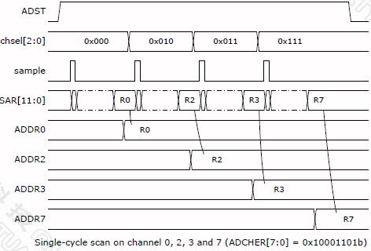
ADC Single-Cycle mode

Slide 7
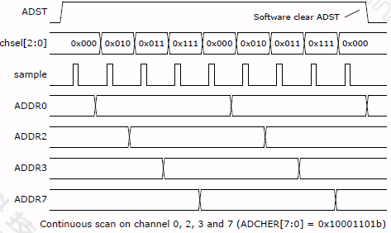
ADC Continuous mode

Slide 8
C Codes :
int32_t main()
{
//initialization
print_Line(0, "VR1 connect ADC7");
while(1){
u32ADCvalue = ADC_GET_CONVERSION_DATA(ADC, 7);
//convert ADC output binary code to ASSCII codes
//display ASSCII codes on LCD
}
void Init_ADC(void)
void ADC_IRQHandler(void)
8

Slide 9
Keil Demo
ADC VR1 & LCD
3

Slide 10
Practice VR1 connect ADC7 (GPA7)
VR1 connect ADC7
0.663V

Slide 11
版權聲明
素材內容 | 引用來源 | 授權說明
PPT | https://drive.google.com/drive/folders/1dwAL_a18o_VV9iBkfLwzhcTKHnRy5K9S?usp=sharing 郭子仁 MCU Interfaces & Driver Design 2020

Slide 12

有著作權，侵害必究©逢甲大學
Copyright@Feng Chia University

