Slide 1
Computer system
Pytorch scripts
(python data IO)
Pytorch API
Waveform data
Numpy array
Pytorch tensor
Raw data

Slide 2
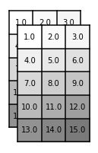
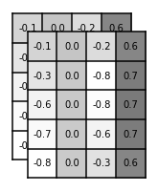
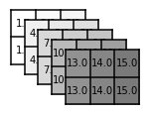
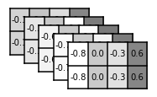
permute(1, 0, 2)
Pytorch
Bi-LSTM API
permute(1, 0, 2)
batch
length
length
length
feature
dimension
batch
batch
feature
dimension
feature
dimension’

Slide 3
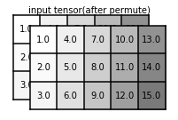
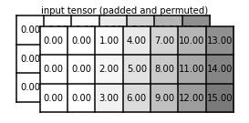
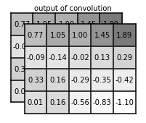
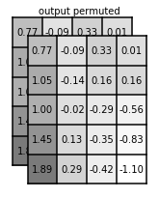
permute(0, 2, 1)
pad
feature
dimension
length
batch
length
batch
feature
dimension
permute(0, 2, 1)
length
batch
feature
dimension’

Slide 4

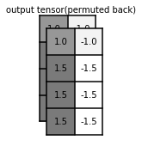
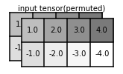
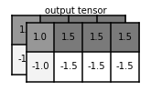



TimeInvariantFilter Wrapper
Conv1D wrapper
Permute
Pytorch conv1d
Permute
temporal
length
batch
2 signals in one batch
Flip and duplicate
Data (3)

Slide 5
Neural
network
Time Invariant
Filter
Input tensor
Output tensor
grad
Filter coefficients
tensor
Neural
network
Signal
convolution
Input tensor
Output tensor
Neural
network
Filter coefficients
tensor

Slide 6
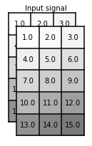
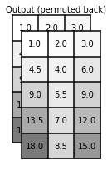
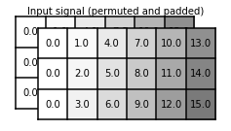
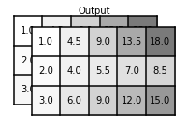




Data (2, 5, 2)
Permute, pad
Signal convolution
Permute
length
batch
3 signals in one batch
Data (2, 3)
Permute, flip
Kernel size
for 3 signals

Slide 7


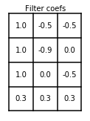







Data (1, 4, 1)
pad
Circular-shift (down)
Take first 4 elements
temporal
length
batch size=1
1 signal
Data (1, 4, 3)
+
+
temporal
length
batch size=1
filter order
(filter length)

Slide 8






x₀
x₁
x₂
x₃
Time variant filter
h_{2,1}
h_{2,2}
h_{2,3}
h_{2,4}
h_{1,1}
h_{1,2}
h_{1,3}
h_{1,4}
x₀
x₁
x₂
x₃
h_{0,1}
h_{0,2}
h_{0,3}
h_{0,4}
y₀
y₁
y₂
y₃

