Slide 1
Web Routing

Slide 2
Agenda
Basic Web-Routing concept
Routing in Node.js
MVC Architecture and commonly Node.js implementation of MVC
Magic-router
Hand-on with magic router

Slide 3
Routing
One of the most important aspects of your website or web service
Mechanism by which requests (as specified by a URL and HTTP method) are routed to the code that handles them
Simple => foo/about.html (HTML in the URL is being scoped out to avoid technically related information)

Slide 4
Information Architecture (IA)
Structural design of shared information environments; the art and science of organizing and labelling websites, intranets, online communities and software to support usability and findability; and an emerging community of practice focused on bringing principles of design and architecture to the digital landscape.
One of the most intelligent and timeless essays on IA is by Tim Berners-Lee, who practically invented the Internet (http://www.w3.org/Provider/Style/URI.html)
“It is the duty of a Webmaster to allocate URIs which you will be able to stand by in 2 years, in 20 years, in 200 years. This needs thought, and organization, and commitment.” — Tim Berners-Lee

Slide 5
Some suggestions to achieve a lasting IA in URL
Never expose technical details
Avoid meaningless information
Avoid needlessly long URLs
Be consistent with word separators
Never use whitespace or untypable characters
Use lowercase

Slide 6
Node.js Routing
Express - A minimal and flexible Node.js web application framework that provides a robust set of features to develop web and mobile applications. It facilitates the rapid development of Node based Web applications
Example :
var express = require('express');
var app = express();
app.get('/', function (req, res) {
res.send('Hello World');
})
var server = app.listen(8081, function () {
var host = server.address().address
var port = server.address().port
console.log("Example app listening at http://%s:%s", host, port)
})

Slide 7
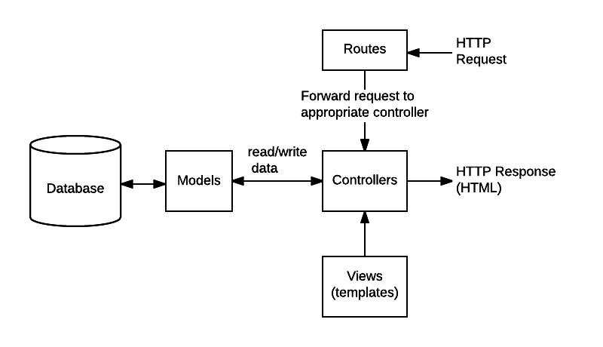
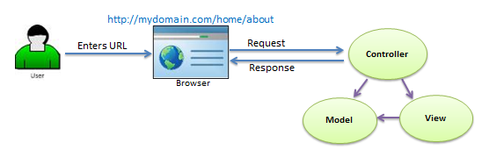


MVC Architecture
Mostly used MVC structure followed in Node.js
(https://developer.mozilla.org/en-US/docs/Learn/Server-side/Express_Nodejs/routes)

Slide 8
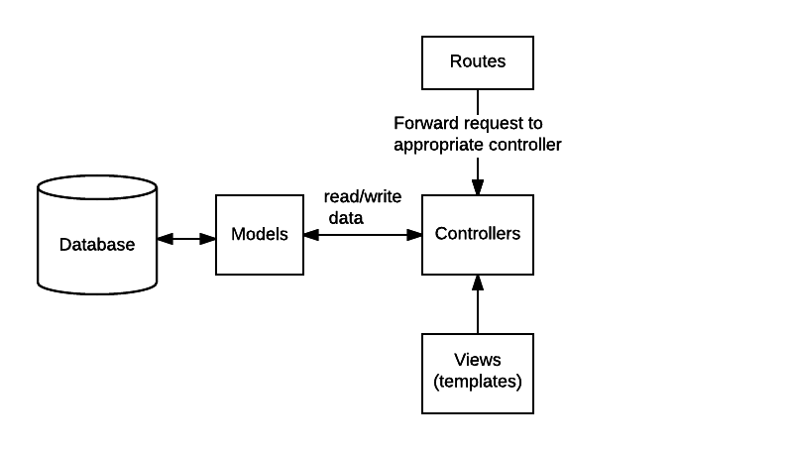
“magic-router” Approach
magic-router handle to tie router & controller

Slide 9
What/Why - magic-router?
It is a npm package (npm install --save magic-router).
It can be use for MVC-applications and api-applications.
It gives routing controls to controllers.
Have automatic/default routing.
Will increase productivity and code readability.
Have powerful custom routing features.
Give consistence to the source code IA.
It catch all errors from actions and give to global error handler.

Slide 10
How to use “magic-router”
Controllers should be in directory (“controllers”).
magicRouter.addAll(app, options); (app => instance of Express.js)
magicRouter.addAll(app, { dirPath: './controllers' });
Controller should be an Object.
Documents => (https://github.com/benhurdavies/magic-router)

Slide 11
Controller example =>

Slide 12
Hands on “magic-router”

