Slide 1

Quantum Enhanced Machine Learning:
Algorithmic Approach and Implementation
Project Guide: Prof. K Vedavathi, HoD,
Dept. of Computer Science
V BENHUR PRADEEP
MSc DS 2019-21
Reg. No. 121922502037
Date: 23-02-2021
Project review I
Dept. of Computer Science

Slide 2
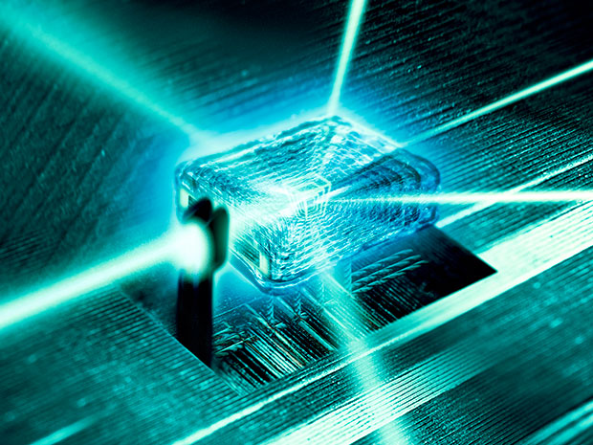
Quantum Mechanics
and
Machine Learning
?

Slide 3
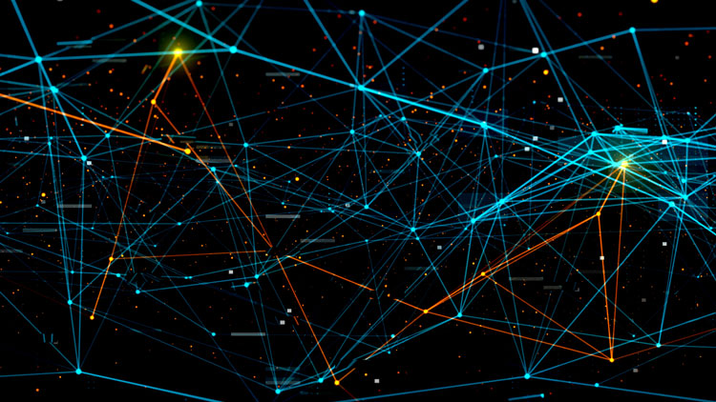

Classical Computing vs Quantum Computing

Slide 4

An example: Optimization
A picture taken in classroom of Gitam University

Slide 5
Another example of a molecule

Slide 6
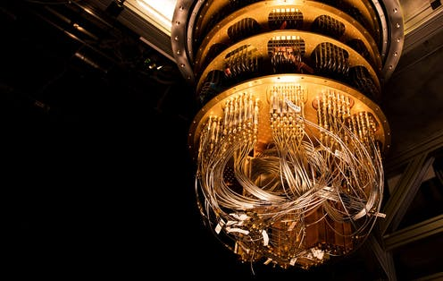
QUANTUM COMPUTER?
Performs calculations based on the laws of quantum mechanics, which is the behavior of particles at the sub-atomic level.

Slide 7
Classical Computing: (bit is the basic unit) | Quantum Computing: (Qubit is the fundamental unit)
Information is stored in bits, which take the discrete values 0 and 1. | Information is stored in quantum bits, or qbits. A qbit can be in states labelled |0} and |1}, but it can also be in a superposition of these states, a|0} + b|1}, where a and b are complex numbers. If we think of the state of a qbit as a vector, then superposition of states is just vector addition.
If storing one number takes 64 bits, then storing N numbers takes N times 64 bits | For every extra qbit you get, you can store twice as many numbers. For example, with 3 qbits, you get coefficients for |000}, |001}, |010}, |011}, |100}, |101}, |110} and |111}.

Slide 8
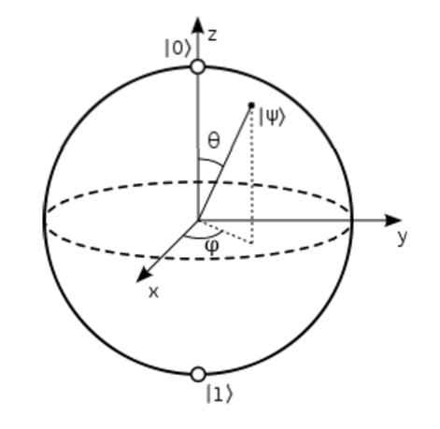
Qubit(Quantum bit)
A basic unit of memory that uses superposition of "quantum" effect to store the probability of information. It represents both "1" and "0" at the same time.

Slide 9
Fundamental Quantum effects :
Superposition
The number of computations that a quantum computer could undertake is 2^{n}, where n is the number of qubits used
Entanglement
Quantum entanglement allows qubits that are separated by incredible distances to interact with each other instantaneously

Slide 10
Qubit
Is very Faster
Can solve mathematical problems or ML algorithms in seconds which that take hundreds/ thousands of years to solve if we use our conventional computing
Hard to create
May face Decoherence
Stored in colder environment.(at -273 ºC)

Slide 11

Is it possible to demonstrate?

Slide 12
Recent work in quantum computing
Google quantum lab's paper(2019)
“QUANTUM SUPREMACY”
Claim of 100,000,000x speed up

Slide 13
Now, Amazon is preparing a service that will allow to use Quantum hardware and do simulated quantum computing

Slide 14
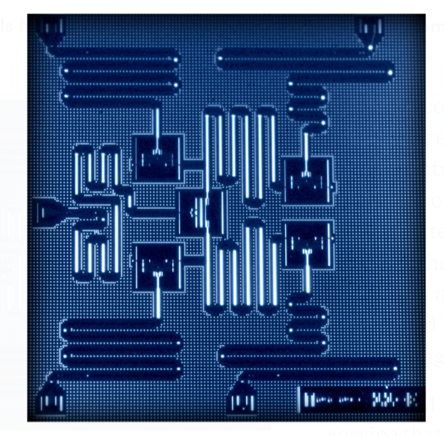
IBM 5 qubits processor

Slide 15
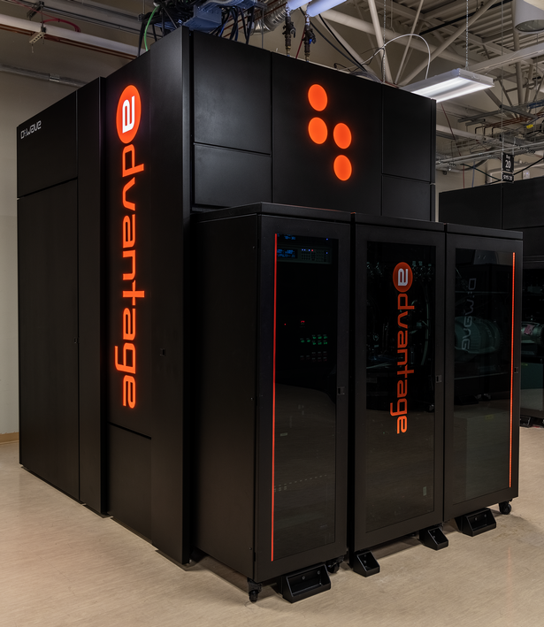
D-Wave 2x machine
D wave is the largest and most powerful quantum computer in existence.
“ADVANTAGE”, It’s a 5000+ qubit quantum computer!
Just imagine 2⁵⁰⁰⁰ computations!!

Slide 16
Developing a Quantum machine learning model
(QUBIT DEMONSTRATION)
https://github.com/benhurpradeep1/QML-PROJECT-MS-DS/blob/main/Quantum_model.ipynb

Slide 17
Installing and Importing tensorflow-quantum
pip install -q tensorflow==2.3.1
pip install -q tensorflow-quantum
import tensorflow as tf
import tensorflow_quantum as tfq
import cirq
import sympy
import numpy as np
# visualization tools
%matplotlib inline
import matplotlib.pyplot as plt
from cirq.contrib.svg import SVGCircuit

Slide 18
Quantum versions of machine learning algorithms
Before proceeding to the discussion of classical machine learning algorithms and their quantum counterparts, we have to take a look on the actual problems these methods intend to solve, as well as introduce the formalism used throughout this article. Probably the most important application is the task of pattern classification, and there are many different classical algorithms tackling this problem. Based on a set of training examples consisting of feature vectors4 and their respective class attributes, the computer has to correctly classify an unknown feature vector. For example, the feature vector 4A feature vector has entries that refer to information on a specific case, in other words a datapoint. could contain preprocessed information on patients and their correctly diagnosed disease. A machine learning algorithm then has to find the correct disease of a new patient. More precisely, given a training set T = {~vp , cp}p=1,...,N of N n-dimensional feature vectors ~v and their respective class c p , as well as a new n-dimensional input vector ~x, we have to find the class c x of vector ~x. Closely related to pattern classification are other tasks such as pattern completion (adding missing information to an incomplete input), associative memory (retrieving one of a number of stored memory vectors upon an input) or pattern recognition (including finding and examining the shape of patterns; this term is often used as a synonym to pattern classification). The central problem of unsupervised learning is clustering data. Given a set of feature vectors {~vp}, the goal is to assign each vector to one out of k different clusters so that similar inputs share the same assignment. Other problems of machine learning concern optimal strategies in terms of an unknown reward function, given a set of consecutive observations of choices and consequences. As stated above we will not concentrate on the learning of strategies here

Slide 19
Implementations include:
Quantum versions of k-nearest neighbor methods
Quantum computing for support vector machines
Quantum algorithms for clustering
Searching for a quantum neural network model
Towards a quantum decision tree
Quantum state classification with Bayesian methods
Hidden quantum Markov models

Slide 20
Algorithms for QML implementation:
Grover based algorithms:
To measure min/max/mean distance or other metrics between data points.
Exam: Clustering, K-NN, etc.
Quadratically faster.
Quantum basic linear algebra subroutines :
Exponentially faster.
Adiabatic Quantum Computing (Quantum Annealing):
For optimization.
Speed up unknown

Slide 21
THANK YOU

