Slide 1
Milestones:
Ben Hutchison
Melbourne Scala, 2014

Slide 2
Milestones
Melbourne Scala turns 5
First meeting April 2009 at Internet Business Systems
Special thanks to all our presenters
Thanks to everyone who has come along over the years
Scala turns 2.11.0
2003: 1.0.0
…
Feb 2008: 2.7.0
August 2010: 2.8.0
May 2011: 2.9.0
Jan 2013: 2.10._
April 2014: 2.11.0

Slide 3
Scala Macros
Ben Hutchison
Melbourne Scala, 2014

Slide 4
Macros: Code that runs during compilation
Code generation
eg generate assert statements that capture and log variables in scope if the assert fails
Code customisation
eg Performance: loop over generic Array[T] using unboxed primitives, if T is an Int or Double
Static Analysis & Checks
eg Strongly typed printf
Domain Specific Languages
eg async (SIP-22) - Similar to C#/.NET await keyword, it uses continuations to eliminate callbacks

Slide 5
Macros are convenient
More lightweight way to extend the compiler than plugins
Macros live in the application codebase
Invoked automatically
No passing extra flags to scala compiler

Slide 6
Macros: Consuming > Writing
Writing macros is not, and probably will never be, super-easy
It’s not something the average Scala developer is going to do often
But you will benefit (a lot!) from macros even if you never write one
Enable better APIs, libraries and tools
ScalaMock
Scala Pickling serialisation library
uTest macro-powered smart asserts

Slide 7
Macros in 2.10.0
“Def Macros”
The first flavor of macro to come out
Transforms the body of a def expression
def log(severity: Severity, msg: String): Unit = macro impl
def impl(c: Context)
(severity: c.Expr[Severity], msg: c.Expr[String]): c.Expr[Unit] = {
import c.universe._
reify {
if (Config.loggingEnabled)
Config.logger.log(severity.splice, msg.splice)
}
}

Slide 8
Macros in 2.10.0
“Def Macros”
The first flavor of macro to come out
Transforms the body of a def expression
Example: uTest smart asserts
assert(areEqual(expected, actual))
[info] utest.AssertionError: (assert(areEqual(expected, actual))
[info] expected: P = {"foo":"bar","#id":"1","person":{"#id":"2","name":"Ben"},"starsign":null…}
[info] actual: P = {"#id":"1","person":{"#id":"2","name":"Ben"},"starsign":null…}

Slide 9
Def Macros
The macro returns the implementation of the def
The signature of the def cannot be changed by the macro, but the internals can be
eg Seq[Boolean] => Unit
Runs once at each code site where the macro is invoked
Can read the AST (ie code) at the invocation site
assert(areEqual(expected, actual))
def assert(exprs: Boolean*): Unit = macro Asserts.assertProxy
def assertProxy(c: Context)(exprs: c.Expr[Boolean]*): c.Expr[Unit] = {
import c.universe._
TraceLogger(c)(q"utest.asserts.Asserts.assertImpl", exprs:_*)
}

Slide 10
Scala Reflection API
Scala 2.10 introduced a far more extensive reflection API than that exposed by Java, including eg
Universe: The root of a reflection API
Context: described where a macro was invoked, and gateway to compile-time reflection API
Expr[T]: An abstract-syntax-tree (ie parsed & type-checked code) of an expression which at runtime evaluates to type T

Slide 11
Scala Reflection: Two Worlds
There are two Universes in reflection
Compile-time
Exposed to macros
Models the entire structure of Scala source code via massive ASTs

Slide 12
Scala Reflection: Two Worlds
There are two Universes in reflection
Compile-time
Exposed to macros
Models the entire structure of Scala source code via massive ASTs
Runtime
As Java, programs can introspect while running
Classes, Objects, Methods & Fields, but not ASTs
Work in terms of Types, rather than the Classes used by Java API
TypeTags replace Manifests in 2.10 as the way to preserve erased generic types at runtime

Slide 13
How best to work with ASTs?
A challenging problem for the Reflection & Macro designers
Option 1: Raw Reflection API
Staggeringly verbose
An small excerpt from the AST generated by the utest smart asserts:
Apply(Select(Select(Select(Ident(TermName("utest")), TermName("framework")), TermName("TestThunkTree")), TermName("create")), List(Block(List(ValDef(Modifiers(), TermName("$ret$macro$150"), TypeTree(), Apply(Select(Select(Select(Ident(utest), utest.asserts), utest.asserts.Asserts), TermName("assertImpl")), List(Apply(TypeApply(Select(Apply(TypeApply(Select(Select(This(TypeName("scala")), scala.Predef), TermName("ArrowAssoc")), List(TypeTree())), List(Literal(Constant(""no state during pickle"-{assert(pickleState.refs.isEmpty)}")))), TermName("$minus$greater")), List(TypeTree())), List(Function(List(ValDef(Modifiers(PARAM), TermName("$log$macro$120"), TypeTree(), EmptyTree)), Select(Select(Block(List(ValDef(Modifiers(), TermName("$temp$macro$121"), TypeTree(), Ident(TermName("pickleState"))), Apply(Select(Ident(TermName("$log$macro$120")), TermName("apply")), List(Apply(Select(Select(Ident(utest), utest.LoggedValue), TermName("apply")), List(Literal(Constant("pickleState")), Literal(Constant("prickle.PickleState")), Ident(TermName("$temp$macro$121"))))))), Ident(TermName("$temp$macro$121"))), TermName("refs")), TermName("isEmpty"))))))))), Apply(Select(Ident(scala), TermName("Tuple2")), List(Ident(TermName("$ret$macro$150")), Apply(Ident(TermName("Seq")), List())))))), Apply(Select(Select(Select(Ident(TermName("utest")), TermName("framework")), TermName("TestThunkTree")), TermName("create")),

Slide 14
How best to work with ASTs?
Option 2: Reify
Write code as normal Scala expression of type T
Pass it to the reify macro
Instead of running the code, reify returns an Expr[T]
scala> val expr = reify { 1 to 3 map (_+1) }
expr: reflect.runtime.universe.Expr[scala.collection.immutable.IndexedSeq[Int]]
scala> showRaw expr.tree
Apply(Apply(Select(Apply(Select(Apply(Select(Select(This(newTypeName("scala")), newTermName("Predef")), newTermName("intWrapper")), List(Literal(Constant(1)))), newTermName("to")), List(Literal(Constant(3)))), newTermName("map")), List(Function(List(ValDef(Modifiers(<param> <synthetic>), newTermName("x$1"), TypeTree(), EmptyTree)), Apply(Select(Ident(newTermName("x$1")), newTermName("$plus")), List(Literal(Constant(1))))))), List(Select(Select(This(newTypeName("immutable")), newTermName("IndexedSeq")), newTermName("canBuildFrom"))))

Slide 15
How best to work with ASTs?
Why not Reify?
After initial enthusiasm, people are finding that reify can be limited and brittle
“The main weakness of reify, the officially advertised way to compose trees, is that it only works with typechecked trees. Whenever one can't have a typechecked tree (e.g. a tree doesn't make sense on it's own but is fine in some context), then one has to resort to fully manual tree construction for code generation”

Slide 16
How best to work with ASTs?
Option 3: Quasiquotes
q"""val result = new $tpe(..$unpickledFields)”””
Write and splice together quasiquoted fragments of Scala code
Evaluate to parsed but not type-checked trees
q operator is actually a def macro itself
Part of Scala 2.11 core
Getting wide adoption

Slide 17
Implicit Macros
Hook def macros up to methods invoked implicitly
implicit def materializeUnpickler[T]: Unpickler[T] =
macro PicklerMaterializersImpl.materializeUnpickler[T]
One of the expanding set of macro flavors being developed
We won’t cover any others tonight

Slide 18
Implicit Macros Case Study
Lets look at a practical problem in more detail
Understand why implicit macros are useful

Slide 19
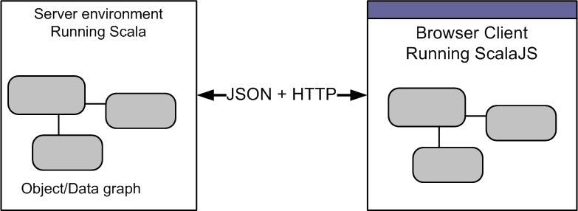
Implicit Macros Case Study
Problem
Communication between ScalaJS clients and Scala servers

Slide 20
Implicit Macros Case Study
Want to serialize (aka ‘Pickle’) objects between client and server
Without hand-maintaining JSON encoding

Slide 21
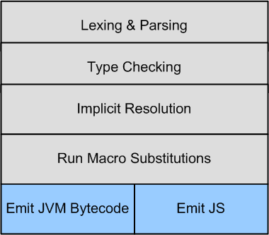
Implicit Macros Case Study
ScalaJS doesn’t support reflection
because Javascript doesn’t support reflection
But it does support macros!

Slide 22
Implicit Macros Case Study
De/Serialization without reflection can be achieved via typeclasses
Pickler[T] converts Ts into json
Unpickler[T] reconstitutes json into Ts
Implicit macros can generate Pickler/Unpickler typeclasses auto-magically
Dubbed materialization

Slide 23
Implicit Macros Case Study
Materialization is a recursive process
Types are queried for type of their fields
Then Picklers for these field are materialized
case class Address(street: String)
case class Person(name: String, address: Address)
case class Meeting(p1: Person, p2: Person)
val json = Pickle(
Meeting(
Person(“Ben”, Address(“Royal Crt”)),
Person(“Santa”, Address(“North Pole”))
))

Slide 24
Implicit Macros Case Study
Working code:
https://github.com/benhutchison/prickle

Slide 25
Debugging Macros
Debug Macro execution
Run SBT in debug mode
Remote debug from IDE and set breakpoint in macro
> cat ~/bin/sbt-debug
java -agentlib:jdwp=transport=dt_socket,server=y,suspend=n,address=5006
-server -jar sbt-launch.jar
Debug Code with Macro substituted
More difficult
In my build.sbt:
//scalacOptions ++= Seq("-Ymacro-debug-lite")
//scalacOptions ++= Seq("-Xlog-implicits")

Slide 26
Thank you

