Slide 1
REST Representational state transfer
Jeton Mustini

Slide 2
Rest – Representational state transfer
An architectural style for building web services that interact via HTTP protocol
The key elements of the REST API paradigm are
a client or software that runs on a user’s computer or smartphone and initiates communication;
a server that offers an API as a means of access to its data or features; and
a resource, which is any piece of content that the server can provide to the client (for example, a video or a text file).
To get access to a resource, the client sends an HTTP request. In return, the server generates an HTTP response with encoded data on the resource. Both types of REST messages are self-descriptive, meaning they contain information on how to interpret and process them.

Slide 3
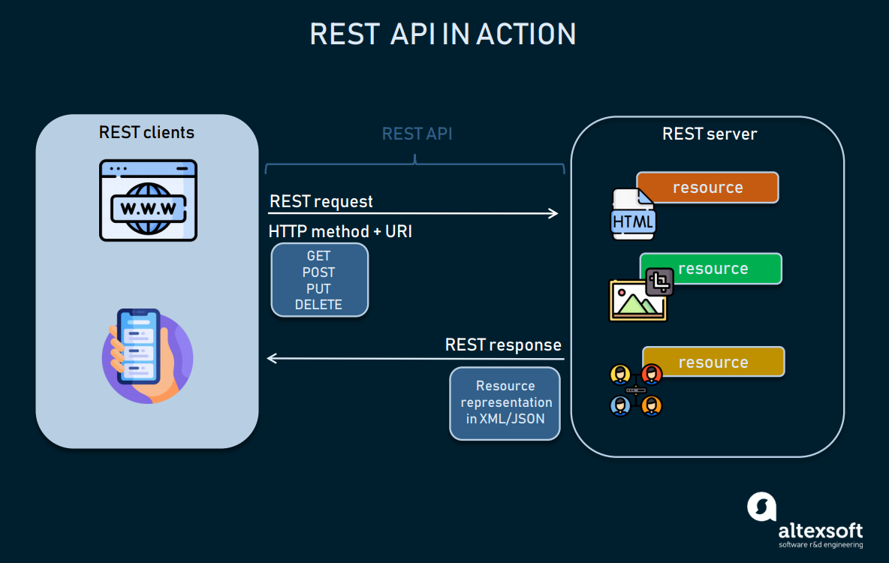
HTTP – hyper text transfer protocol Rest – Representational state transfer
https://www.altexsoft.com/blog/rest-api-design/

Slide 4
Rest request structure
Any REST request includes four essential parts: an HTTP method, an endpoint, headers, and a body.
An HTTP method describes what is to be done with a resource. There are four basic methods also named CRUD operations:
POST to Create a resource,
GET to Retrieve a resource,
PUT to Update a resource, and
DELETE to Delete a resource.

Slide 5
Rest request structure
An endpoint contains a Uniform Resource Identifier (URI) indicating where and how to find the resource on the Internet. The most common type of URI is a Unique Resource Location (URL), serving as a complete web address.
Headers store information relevant to both the client and server. Mainly, headers provide authentication data — such as an API key, the name or IP address of the computer where the server is installed, and the information about the response format.
A body is used to convey additional information to the server. For instance, it may be a piece of data you want to add or replace.

Slide 6
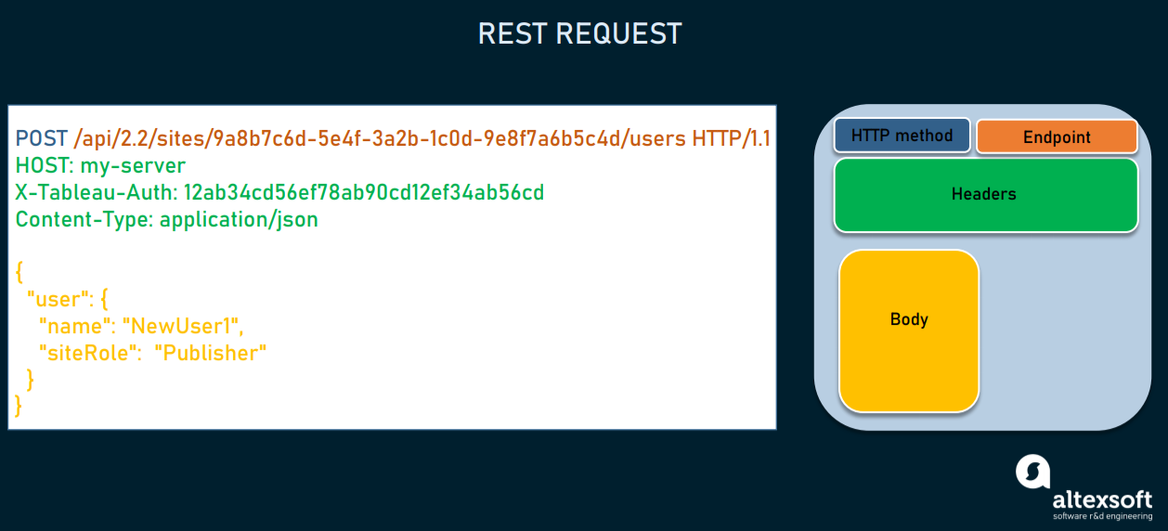
REST request for creating a new user where the response will return the ID of the created resource.

Slide 7
Rest response structure
In response, the server sends not the sought-for resource itself, but its representation — a machine-readable description of its current state. The same resource can be represented in different formats, but the most popular ones are XML and JSON.
Whenever relevant, a server includes in the response hyperlinks or hypermedia that links to other related resources. This way, the server gives instructions on what the client can do next and what further requests it can make.

Slide 8
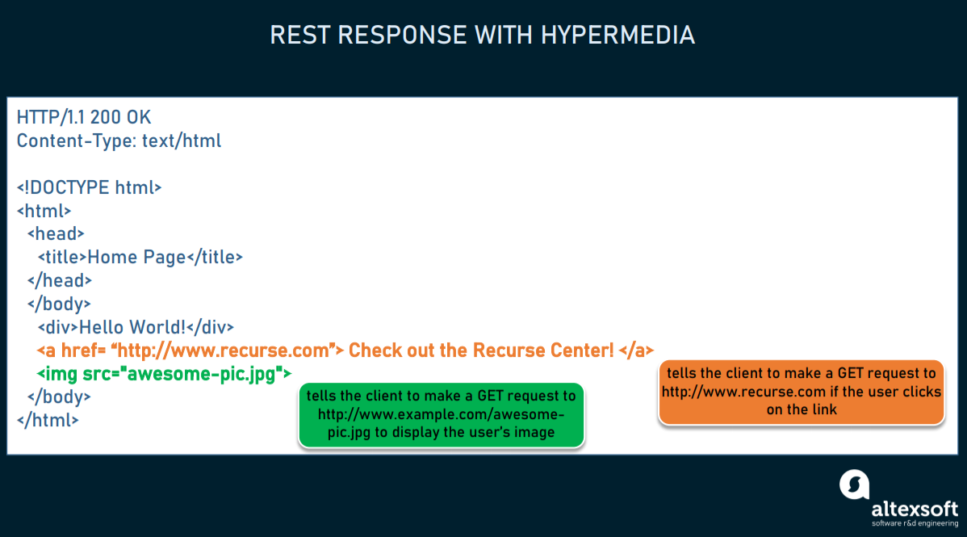
An example of a self-descriptive server response with hypermedia.

Slide 9
Slide Tite
Lets get this party started!

