Slide 2

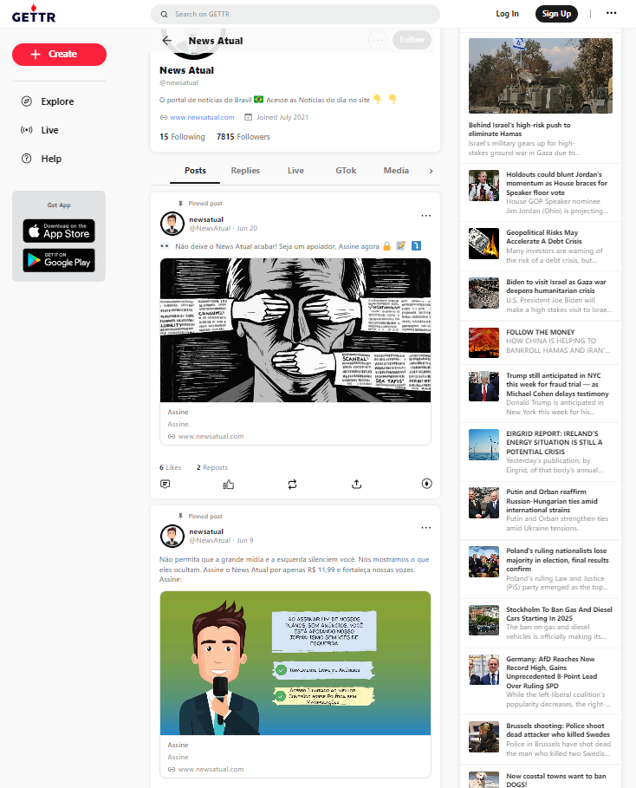
Images and texts to be extracted…

Slide 3
Hi, everyone. I hope you’re all doing well.
For the task at hand, and upon checking the websites, it is to my understanding that I will be extracting images and text from user posts as shown by the sample below.
As to how I can extract them, I’m thinking of ways on how I can access API calls in the XHR tab of the Network section of the development tools.

Slide 4
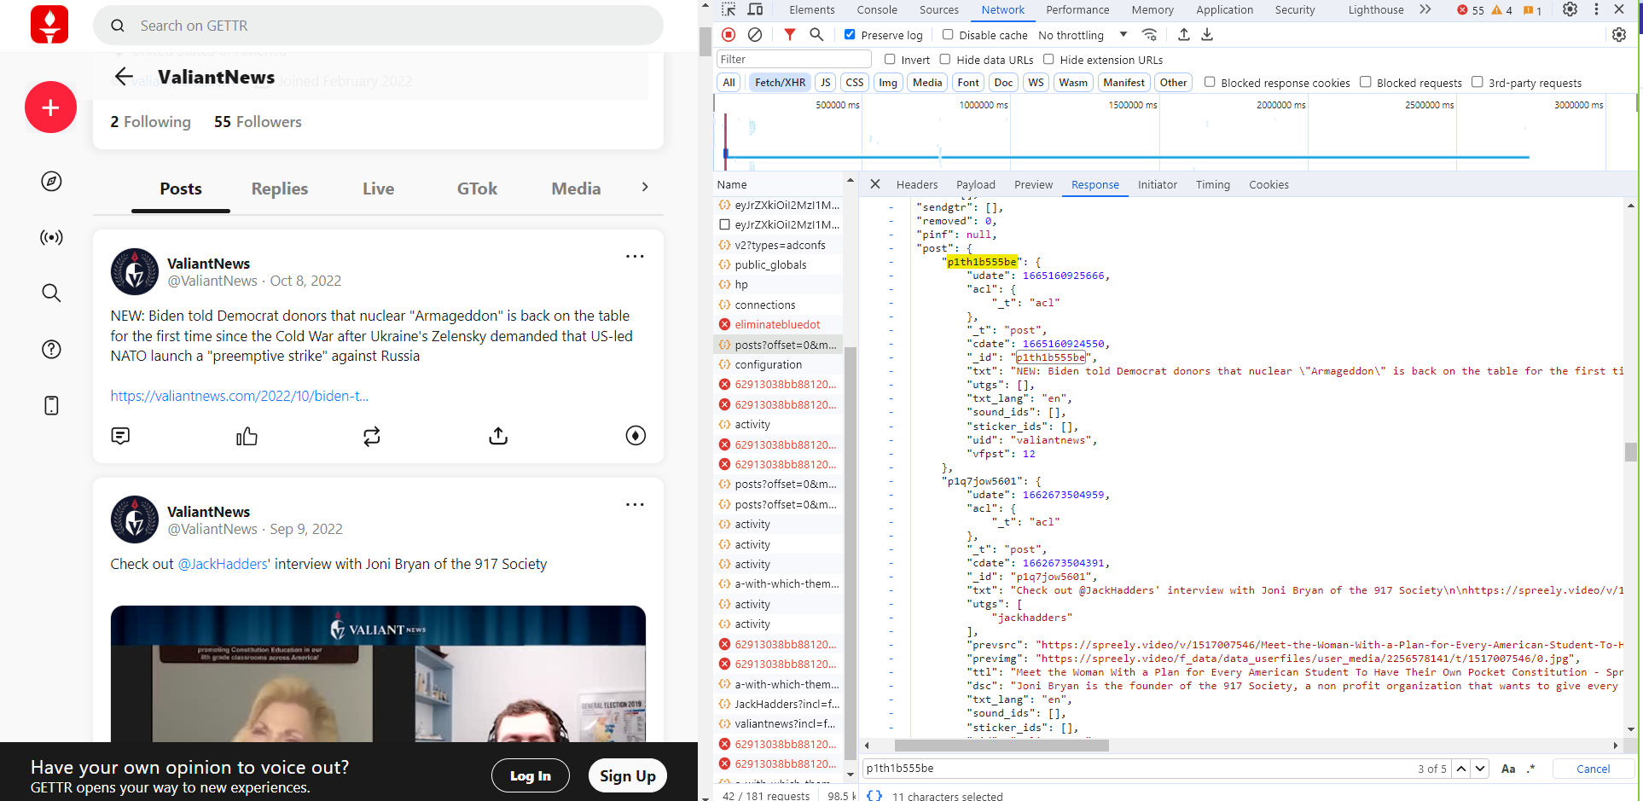

Slide 5
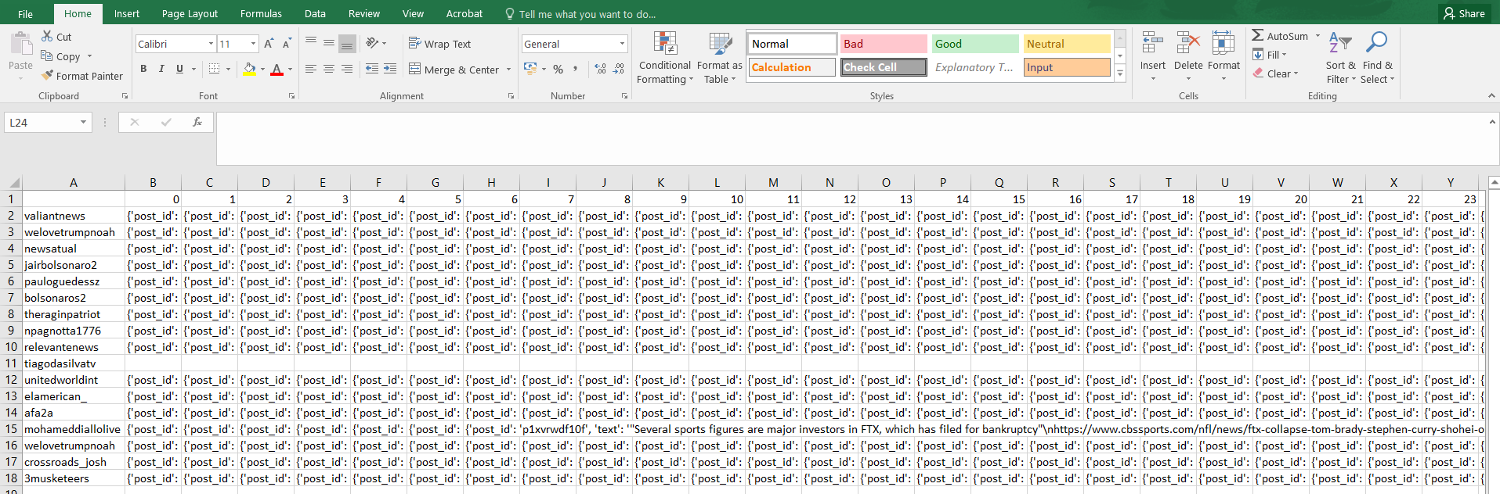

Slide 6
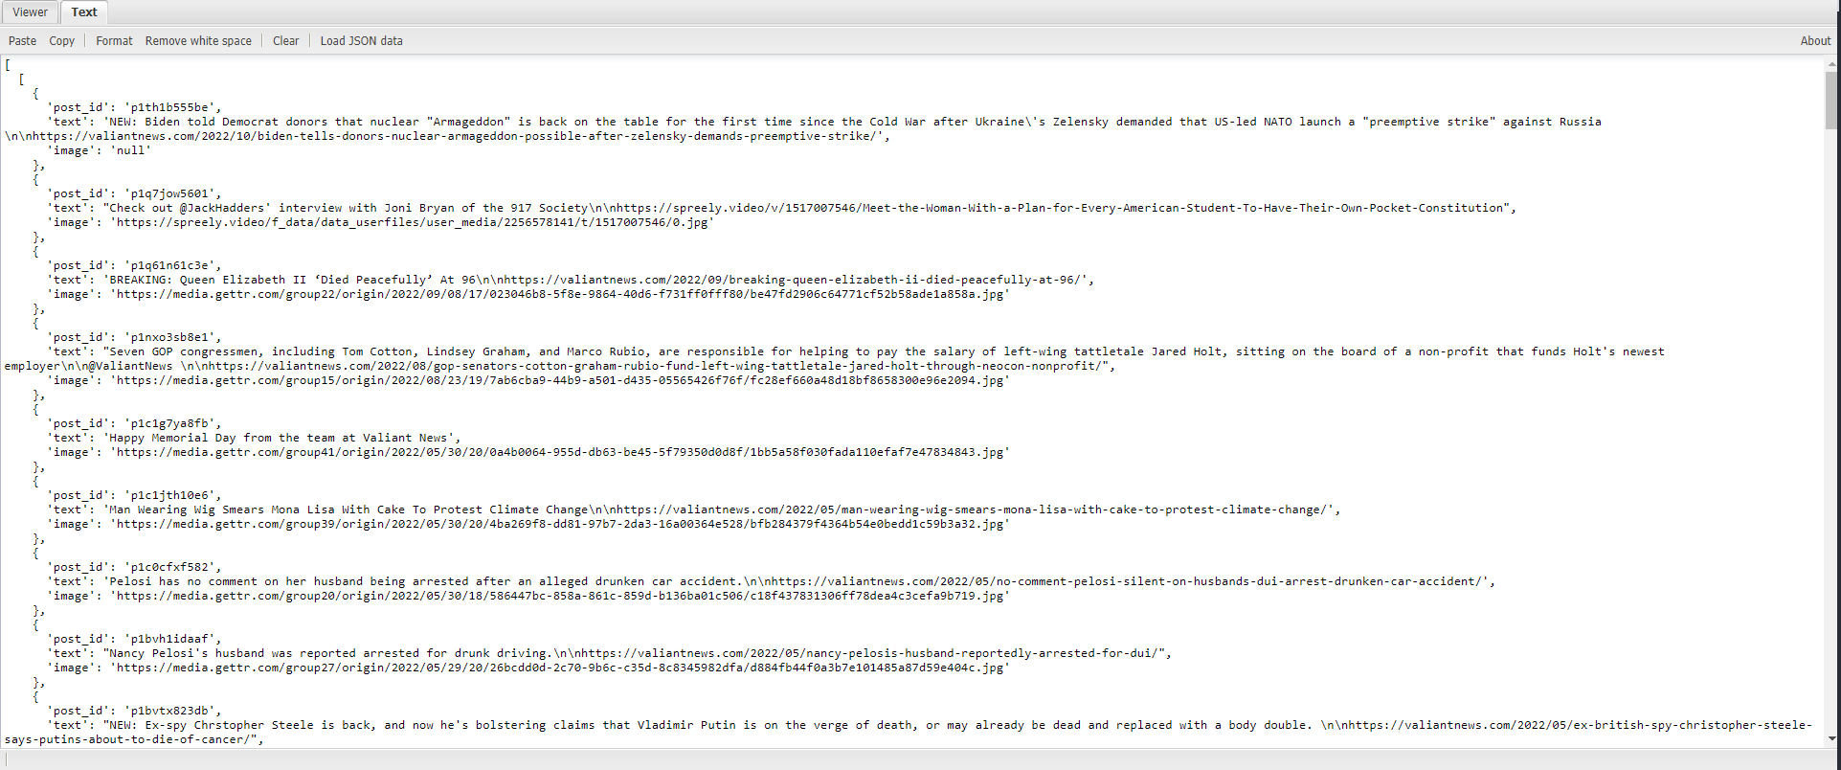

Slide 8
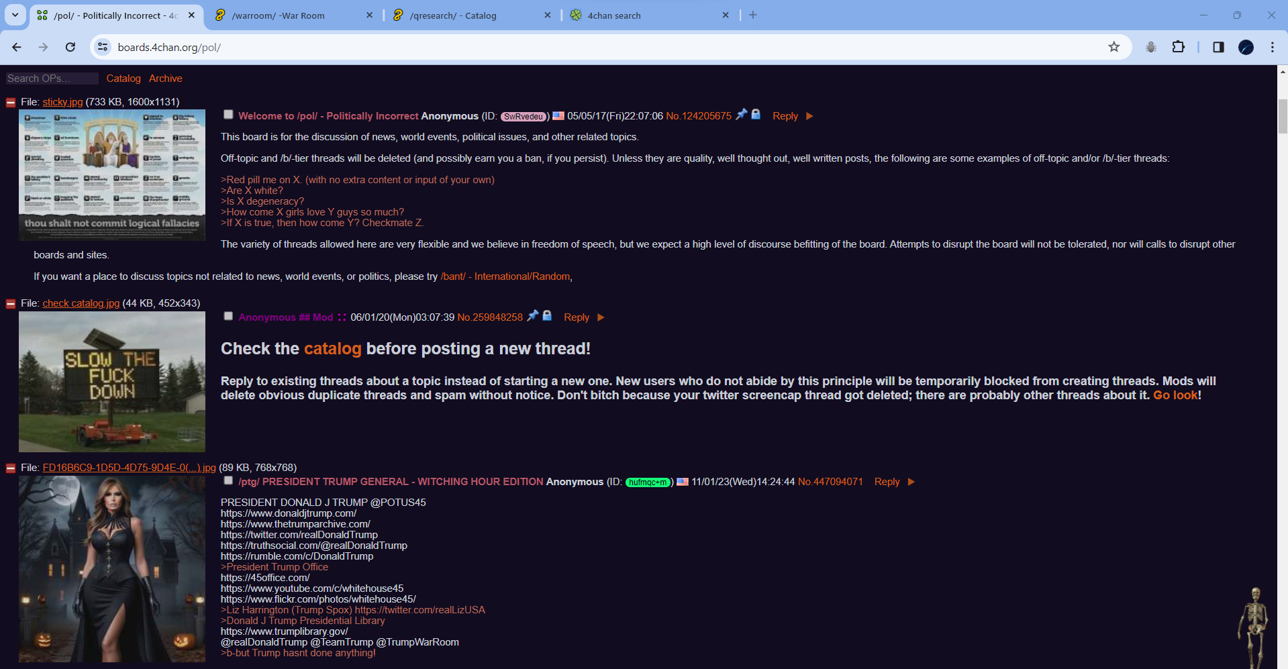
Images and texts to be extracted…

Slide 9
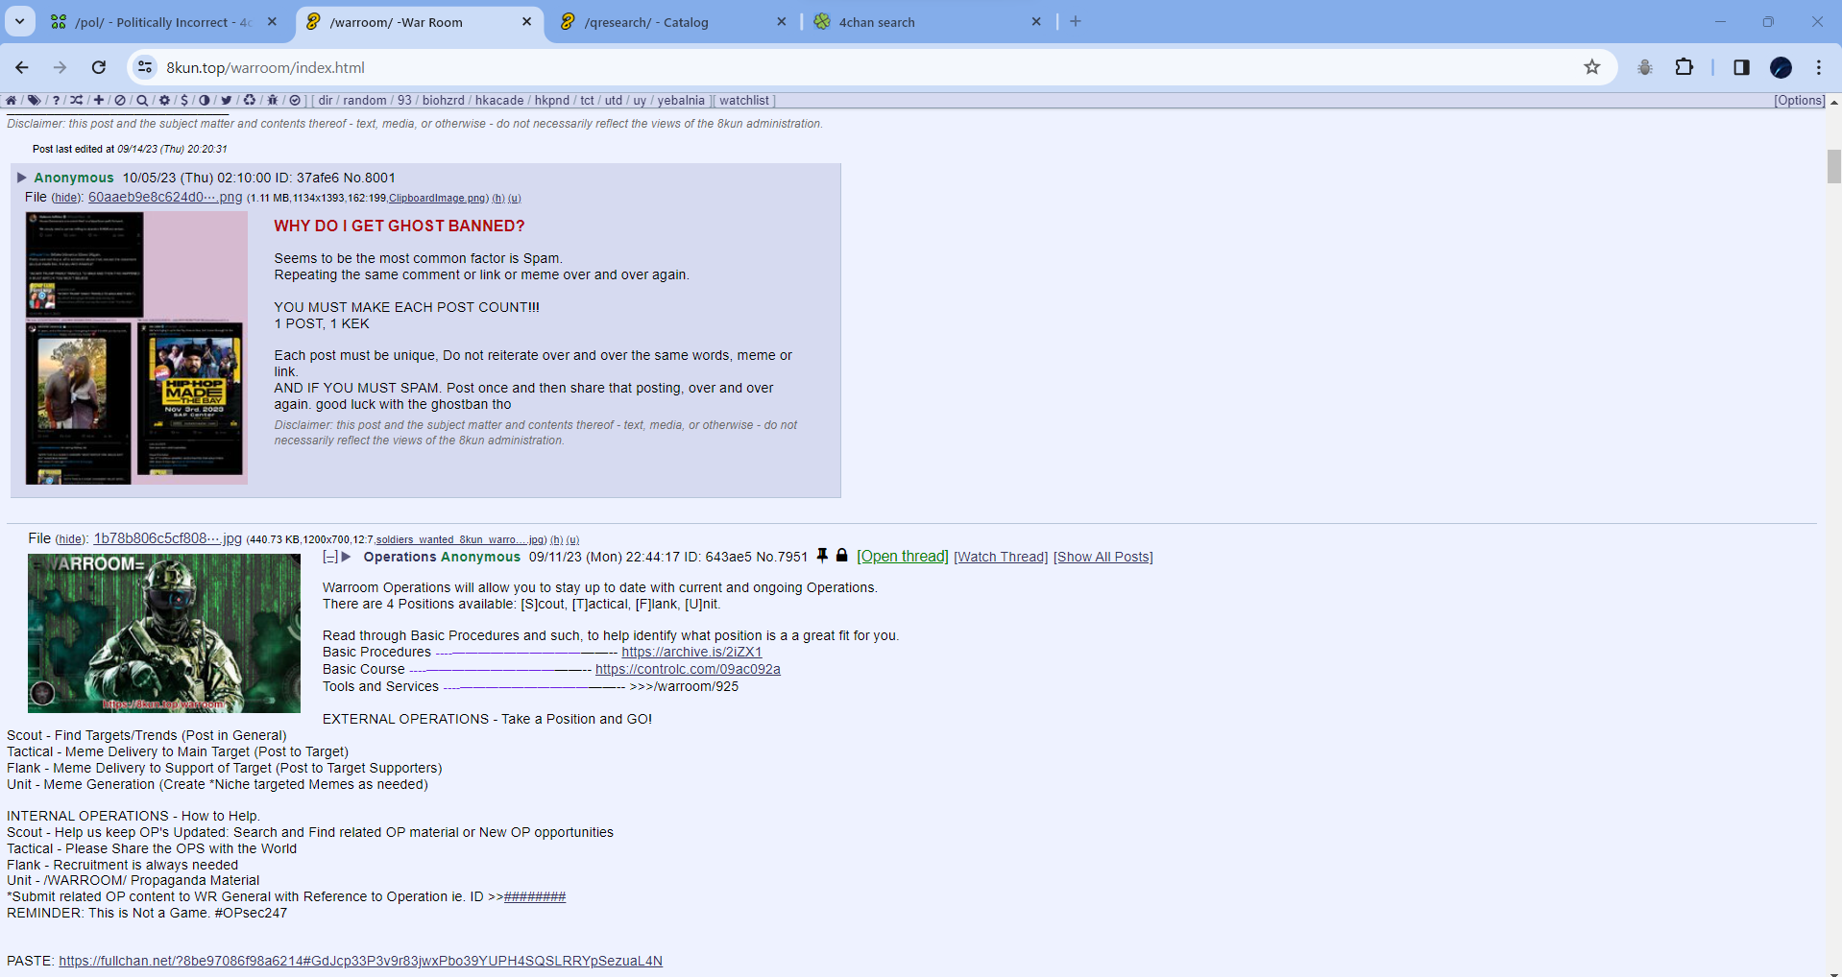
Images and texts to be extracted…

Slide 10
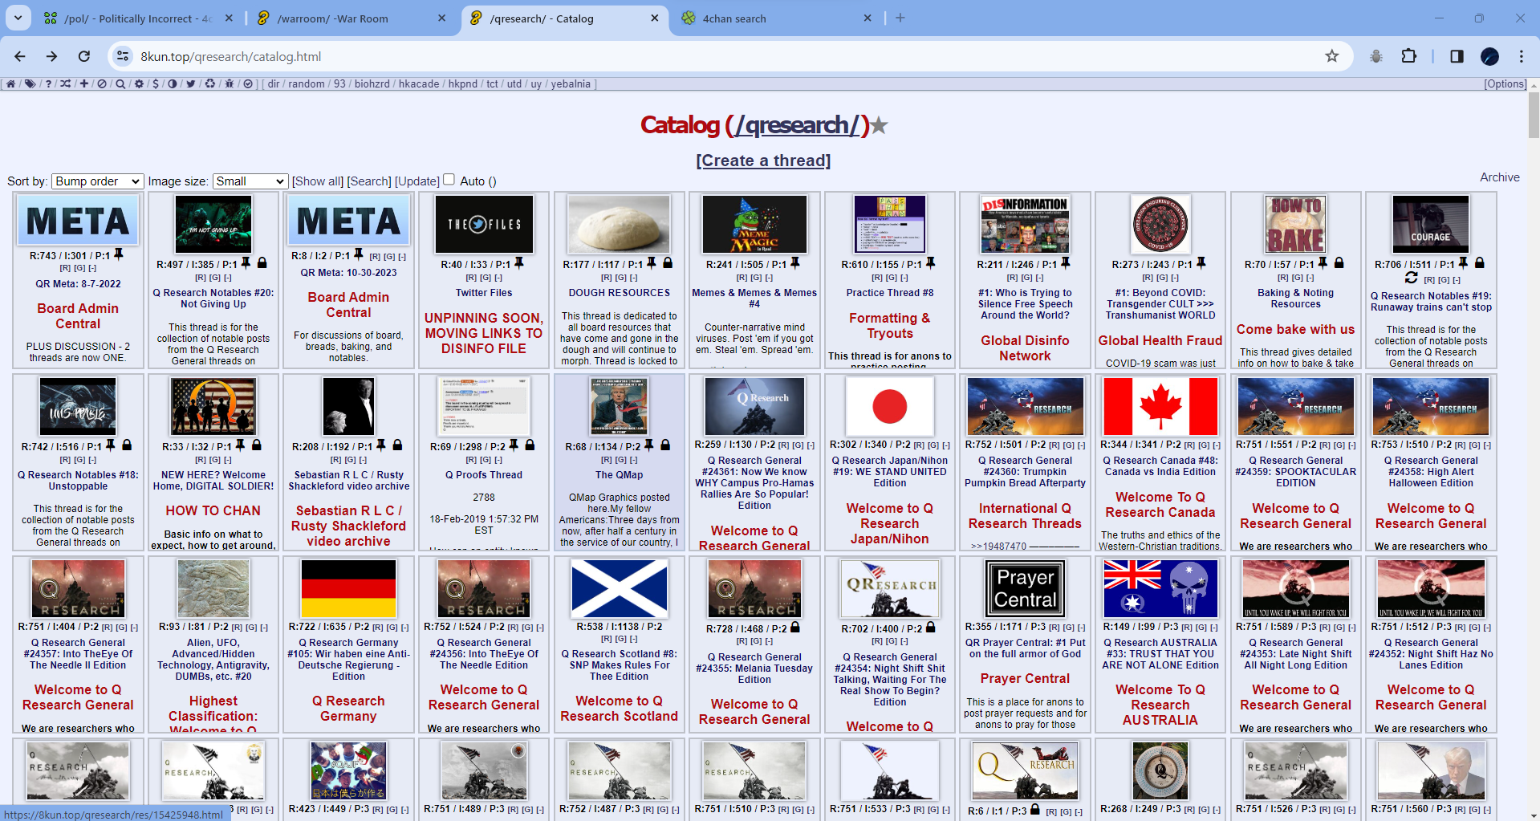
Images and texts to be extracted…

Slide 11
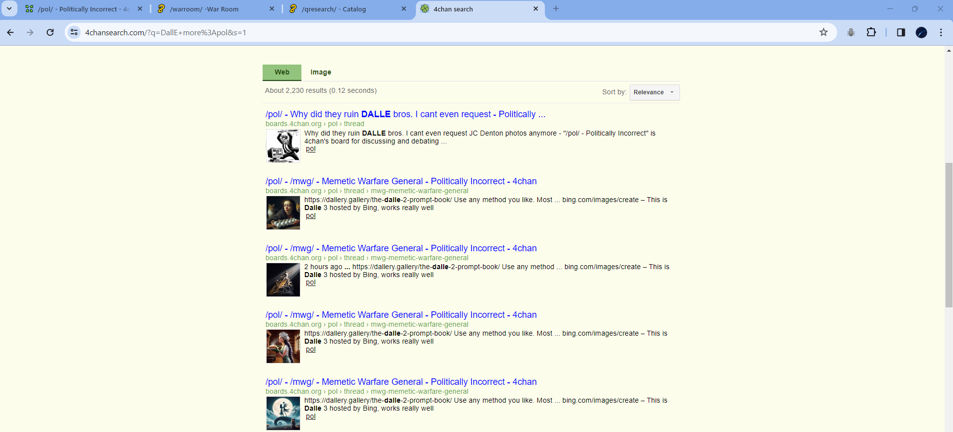
Images and texts to be extracted…

Slide 12
