Slide 1
DATABASE DEVELOPMENT WITH PL/SQL
Health Care
smart medicine inventory and demand optimization system
NAMES & ID
IHIRWE Benie 28806
LECTURER: Eric Maniraguha
GITHUB REPOSITORY
benie1234/ihirwe_28806_healthcare

Slide 2
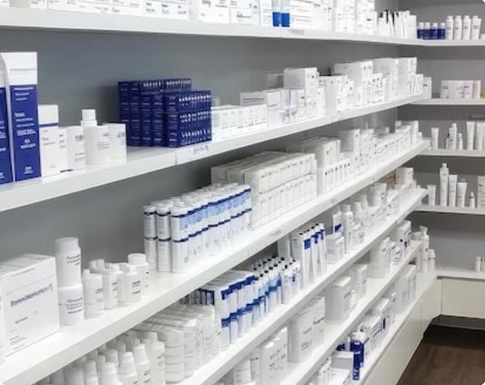
who is affected and why it matters
Who Is Affected
Patients, retail pharmacies, and clinical staff.
Core Operational Failures
Expired Sales: Unnoticed batch expiration dates.
Financial Waste: Spoiled medication write-offs.
Critical Stockouts: Inaccurate manual demand forecasting.

Slide 3
why I chose this project
1.Patient Safety First Zero
tolerance for expired drug dispensation.
2.Loss Prevention Eliminate preventable inventory shrinkage costs.
3. Database Enforcement
Strict business rules inside Oracle PL/SQL.

Slide 4
three specific objectives
1. EXPIRY BLOCKING
Block expired batch sales automatically.
2.EARLY ALERTS
Flag medications 30—90
days pre- expiry.
3. SMART REORDER
Forecast reorder points from sales velocity.

Slide 5
existing solutions and their gaps
Paper Logs & Basic POS
Spreadsheets: Rely on manual daily visual checks.
Generic POS: Track total stock without batch expiry.
Enterprise ERP: Too costly for local pharmacies.
Database-Level Enforcement
Hard Blocks: Triggers prevent expired checkout.
FEFO Logic: First-Expired-First-Out batch selection.
Full Audit Trail: Logs every blocked attempt.

Slide 6
dataset, link, size, a few sample records
5,000+
Transaction & Batch Records
CCO Public
Open
Educational License
kaggle.com/datasets/pharmacy inventory
Anonymized
• Zero Patient PII
5,000+ Transaction & Batch Records
Batch_lD | Medication_Name | Category | Stock_Qty | Expiry _ Date
B-1@42 | Name Amoxicillin 500 mg | Antibiotic | 240 units | 2027-08-15
B-1@89 | Paracetamol 500 mg | Analgesic | 18 units | 2026-12-10
B-@914 | Ibuprofen 400 mg | Anti-inflammatory | 45 units | 2026-10-01 (Blocked)

Slide 7
Proposed solution and innovation
• USER INTERFACE
Python Stream lit App
Live POS checkout calling PL/SQL procedures.
• BUSINESS LOGIC
Oracle 21c PL/SQL Engine
Triggers enforce expiry locks and stock rules.
SMART AUTOMATION
DBMS SCHEDULER Jobs
Nightly batch scans flagging near- expiry stock.

Slide 8
main tables and how they relate
Table Names | Primary / Foreign Keys | Core Purpose
SUPPLIERS | PK: Supplier_lD | Distributor contact and lead-time records
MEDICATIONS | PK: Medication_lD | Drug catalog, unit price, reorder threshold
SALE_ITEMS | PK: Medication _ lD, FK: Medication_ID, Supplier_lD | Batch quantity and exact expiration date
INVENTORY_BATCHES | PK: Sale _ ID | Timestamped customer checkout header
SALES_TRANSACTIONS | PK: Sale_ Item, FK:Sale _I D, Batch_lD | Line-item batch deduction per sale
AUDIT_LOG | PK: Log_lD | Denied expired sales and stock overrides

Slide 9
procedures, functions, cursors, triggers, packages, exceptions
Triggers: Block the sale of any expired drug batch on SALE_ITEMS insert.
Procedures: RECORD _ SALE validates stock and deducts batch quantities atomically.
Functions: GET _ REORDER _ STATUS computes 30-day velocity to flag low stock.
Cursors: Nightly cursor scans INVENTORY _ BATCHES for 30-day expiry warnings.
Packages: PHARMA_MGMT_PKG encapsulates all inventory and sales subprograms.
Exceptions: Custom EXPIRED_DRUG_ERR logs violations into AUDIT_LOG.

Slide 10
what I will demonstrate
Live Expiry Rejection
Trigger instantly blocks expired batch checkout.
2. Real-Time Streamlit POS
Interactive app executing Oracle procedures live.
3. Automated Reorder Flags
Dynamic low-stock alerts from sales demand.
4. Security Audit Trail
Complete log of denied transactions and overrides

Slide 11
Future improvements and limitations
LIMITATIONS
Single Branch: Built for one pharmacy location.
Historical Data: Uses static Kaggle records initially.
Manual Entry: No physical barcode scanner hardware.
IMPROVEMENTS
Barcode Integration: Instant GSI batch scanning.
Supplier APIs: Automated purchase order dispatch.
ML Forecasting: Seasonal disease outbreak modeling

Slide 12
REFERENCES
Sources & Documentation Kaggle. (2025). Pharmacy Sales and Inventory Tracking Dataset. https://www.kaggle.com
Kumar, A., & Sharma, R. (2023). Database design and expiry tracking in retail pharmacy automation.
Journal of Medical Systems, 14(2), 112—128.
National Institute of Statistics of Rwanda. (2024). Health facility supply chain report.
Kigali, Rwanda. Oracle Corporation. (2025). Oracle Database PL/SQL Language Reference (21c).
Oracle Docs.
World Health Organization. (2021). Ensuring safe stock management in primary health care facilities. WHO

