Slide 1

University Admissions outcomes after the implementation of the
Top 10% law in Texas
DATA 621 Spring 2023
Group 1: Ben Inbar, Cliff Lee, Daria Dubovskaia,
David Simbandumwe, Jeff Parks

Slide 2
Agenda
Abstract
Introduction
Literature Review
Methodology
Experimentation and Results
Conclusion
References

Slide 3
Abstract
Examined racial and ethnic changes in Texas A&M admissions after the 1996 Hopwood case
Analyzed the changes in admission criteria following the ban
Assessed the effectiveness of automatic admissions programs for the top 10% decile of HS graduates in maintaining minority admission rates
Determined changes in admissions criteria favored underrepresented minority applicants but failed to maintain the share of admitted black and Hispanic students
Alternative admissions procedures were not a reliable substitute for considering race and ethnicity

Slide 4

Introduction

Slide 5
Introduction
Gaps in education access - not all students have equal access to higher education, specifically along socio-economic and demographic lines
The debate - should we do anything about it, if so what should we do about it
Legal and academic landscape - two laws directly impacted admissions: 1. Hopwood v. Texas limited universities admission discretion; 2. Texas Legislature passed HB 588 better known as the Texas Top 10% Law (1997)
Admission changes - all Texas students who graduated in the top ten percent of their high school class were automatically admitted to all state-funded universities
Assessing the impacts - there are winners and losers in the current model and there are winners and losers associated with any changes

Slide 6

Literature review

Slide 7
Literature Review
Card & Krueger (2005): highly qualified minority students' application behavior remained unaffected by the bans, despite overall admissions rates for Black and Hispanic students decreasing.
Long (2004): predicted a decrease in score reports sent by minority students and an increase in non-minority reports to selective programs, indicating potential changes in acceptance expectations and minority enrollment.
Long & Tienda (2008): used actual admissions data and logistic regression models to simulate post-ban scenarios. They observed significant increases in admission rates for White and Asian students, along with steep decreases for Black and Hispanic students across all programs.
Several studies utilized SAT test score transmission data as a proxy to analyze the effects of affirmative action bans and Automatic Admissions Programs (AAPs).
University-specific efforts to identify proxy admissions criteria were discussed, aiming to address lost diversity without explicit reference to race or ethnicity.
Additional studies have explored unintended consequences, such as non-minority families strategically manipulating AAP-impacted school districts for a competitive advantage.
These findings highlight ongoing debates and tensions surrounding equitable access to educational and economic opportunities.

Slide 8

Methodology

Slide 9
Assessing the admission process: Adopting Long & Tienda's approach from "Winners and Losers: Changes in Texas University Admissions post-Hopwood" research paper.
1 | Access Data
2 | Prep Data
3 | Model Admissions
THEOP data files are available for download at: https://oprdata.princeton.edu
Preprocess application and transcript .dta files
as_factor() - convert haven labels into factors
Process NA levels
Texas A&M admissions baseline (<1998) and yearly (1998-2002)
glm() - probit model
cv.glmnet() - lasso shrinkage
Analysis of baseline and yearly model coefficients
4 | Forecast Admissions
5 | Class Composition
6 | Conclusions
Counterfactual admissions using baseline model
predict.glm()- glm admissions segments
predict() - glmnet admissions segments
Analyze class predicted admissions composition 1998 - 2002
Hypothetical admitted vs. actual admitted
Year over year forecasted admission highlight impacts of changing policies

Slide 10

Experimentation and results

Slide 11
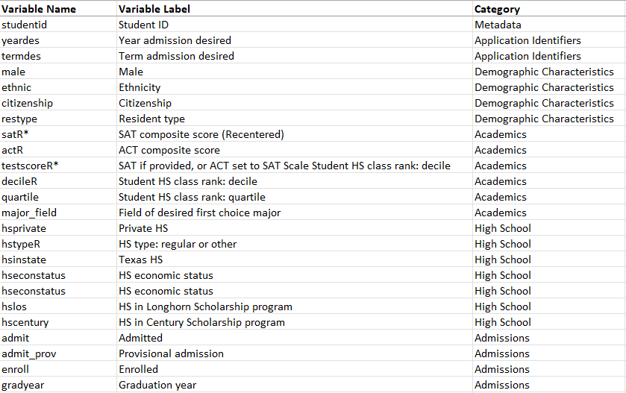
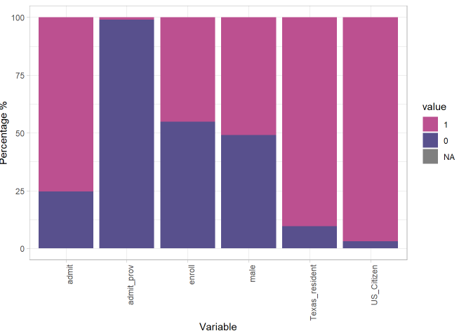
Data & Transformations
21 categorical variables, 3 numeric variables.
ACT, graduation year, participation in scholarship programs had over 50% missing data => Removed
76% of all applicants were admitted
Over 50% of the data to US citizens, Texas residents, and individuals identifying as White/non-Hispanic

Slide 12
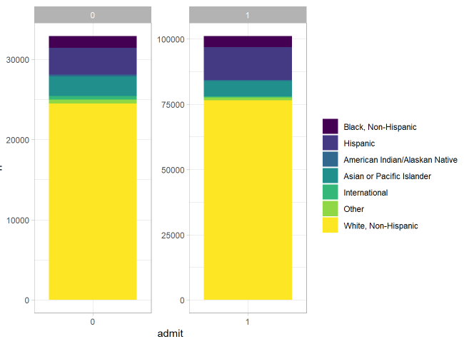
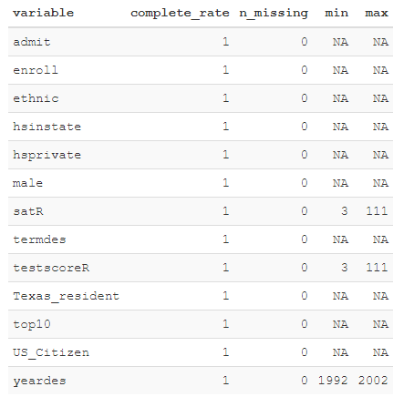
Data & Transformations
Final dataset: admission/enrollment status, starting semester, sex, ethnicity, citizenship/residency, SAT score, year of admission, high school type, Texas state high school indicator, top 10% decile
Admission distribution across ethnicities was approximately equal
Higher test scores => higher likelihood of admission
Selected variables into binary
Replaced missing values with "None."
Students with NA ethnicity to "White, Non-Hispanic"
New binary column indicating top 10% decile

Slide 13
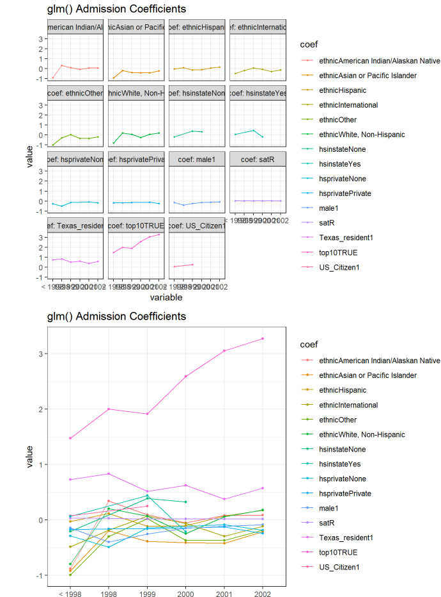
Models: GLM
Dataset from 1992 to Fall 1998, 69,019 observations of 13 variables
Logistic regression, stepwise selection, glm(family=binomial)
AIC=50444.85, residual deviance=50412, Accuracy=87.7%
Ethnicity: negative impact on university acceptance; Texas residency and inclusion in the top 10% decile: positive influence
Residual plots: under-fitting at lower predicted values but decent fit overall with normality of residuals
Over the years, Texas residency and being in the top 10% became more and more important

Slide 14
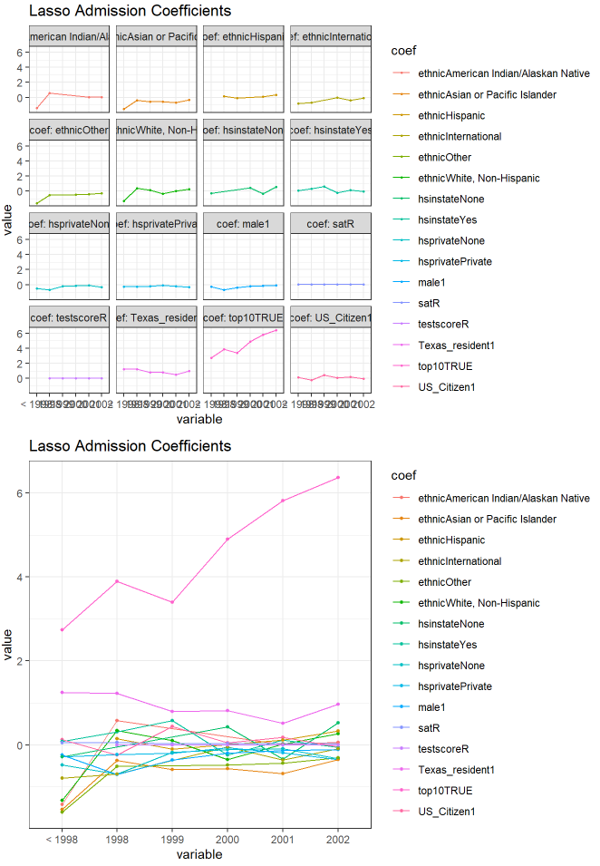
Models: Lasso regression
Dataset from 1992 to Fall 1998, 69,019 observations of 13 variables
AIC = -23258.91, accuracy = 87.8%
Over the years, being in the top 10% became increasingly important
Lasso model for further analysis due to superior AIC performance
US residency: coefficient for US citizenship is slightly negative
Ethnicity white/non-hispanic: from negative coefficient to positive in 2001
Ethnicity Hispanic: positive in 1998 and in 2001
Local advantage declining: coefficients for citizen, instate, Texas resident variables are on the decline
Top 10: growth from 3.4 to 6.4
No growth in coefficients to indicate a program fostering diversity (i.e ethnic, gender etc)

Slide 15
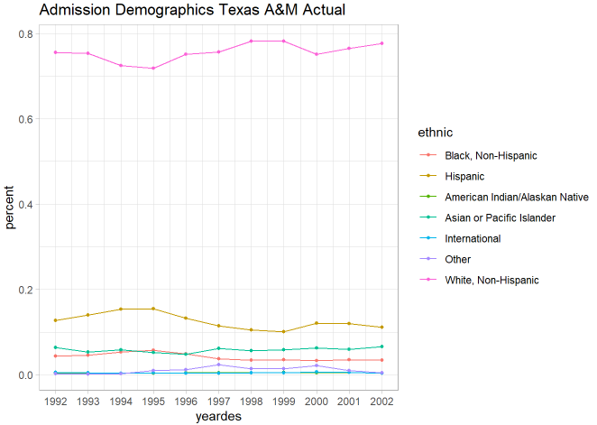
Predictions & Results
Outcomes:
pre-Fall 1998 data to examine the impact of factors on admission outcomes
Goal: Assess changes in the importance of applicant characteristics, particularly for underrepresented minority applicants, and determine the significance of ethnicity in admission decisions
Compared simulated class outcomes to actual data, considering factors such as the Hopwood decision and the top-10% policy
Most influential: top 10% status, Texas residency, downplaying the significance of ethnicity
Legal: the Hopwood case aligns with a slight increase in percentage ‘white, non-hispanic’ in the student population
Legislative: top 10 law does not appear to have improved the demographic diversity

Slide 16
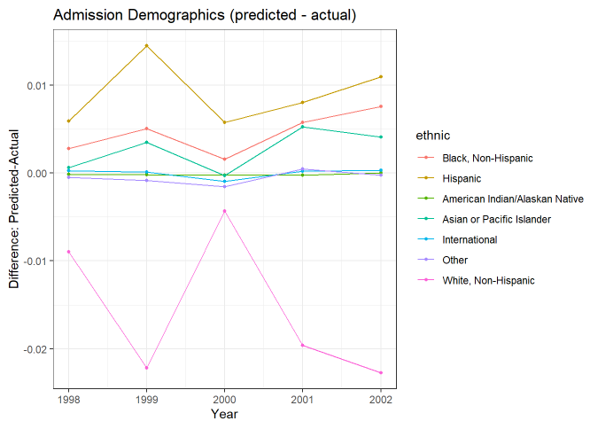
Predicted vs. Actual
Actual admission demographics differed from the predictions
Increased compared to the predictions: admission of the White ethnic group
Decreased: admission of the of Black, Hispanic, and Asian ethnic groups
Figure 10 and Table 11 illustrate disparities between model predictions (1998-2022 without a ban) and actual data.
Model: underestimated by 1% - 2% White/non-Hispanic students admitted after ban, overestimated 0.5% - 1.5% Hispanic and Black students
Actual: preference for minority before ban, Black and Hispanic applicants were less likely to be accepted compared to White applicants after ban.
The top 10% law did not lead to increased acceptance rates for minority

Slide 17
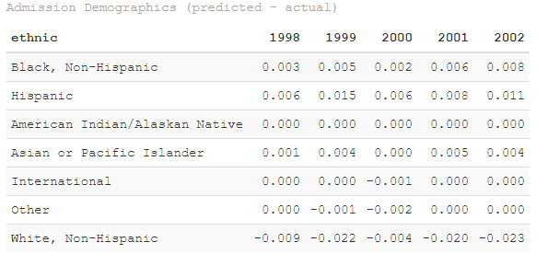
Conclusion
Our analysis questions the efficacy of the ‘top 10 law’. Post HB 588 Texas A&M has a less ethnically diverse population. Furthermore the model using pre-1998 coefficients predicted a more diverse student population than was actually observed between 1998 and 2002
Administrators are increasingly under pressure to build diverse cohorts with few tools available
The exploration of coefficients showed that the ‘top 10%’ law has increased in importance when modeling admission year over year but at the same time the student population is becoming less diverse
Concept of meritocracy and measurement of academic achievements will be essential for educators

Slide 18
References
Card, D., & Krueger, A. B. (2005). Would the Elimination of Affirmative Action Affect Highly Qualified Minority Applicants? Evidence from California and Texas. Industrial and Labor Relations Review, 58(3), 416–434. https://doi.org/10.1177/001979390505800306
Fiel, J. E. (2022). Opportunity Seeking Across Segregated Schools: Unintended Effects of Automatic Admission Policies on High School Segregation. Educational Evaluation and Policy Analysis, 44(3), 485–504. https://doi.org/10.3102/01623737221078286
Hinrichs, P. (2012). The Effects of Affirmative Action Bans on College Enrollment, Educational Attainment, and the Demographic Composition of Universities. The Review of Economics and Statistics, 94(3), 712–722. https://doi.org/10.1162/rest_a_00170
Long, M. C., & Tienda, M. (2010). Changes in Texas universities’ applicant pools after the Hopwood decision. Social Science Research, 39(1), 48–66. https://doi.org/10.1016/j.ssresearch.2009.06.004
Long, M. C. (2004). Race and College Admissions: An Alternative to Affirmative Action? The Review of Economics and Statistics, 86(4), 1020–1033. https://doi.org/10.1162/0034653043125211
Long, M. C., & Tienda, M. (2008). Winners and Losers: Changes in Texas University Admissions Post-Hopwood. Educational Evaluation and Policy Analysis, 30(3), 255–280. https://doi.org/10.3102/0162373708321384

