Slide 1
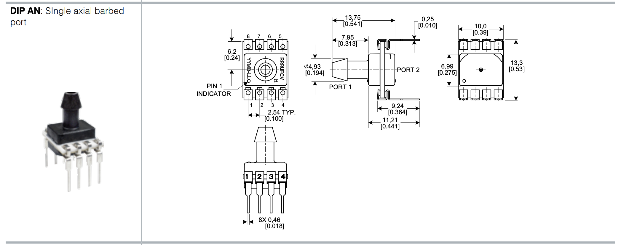
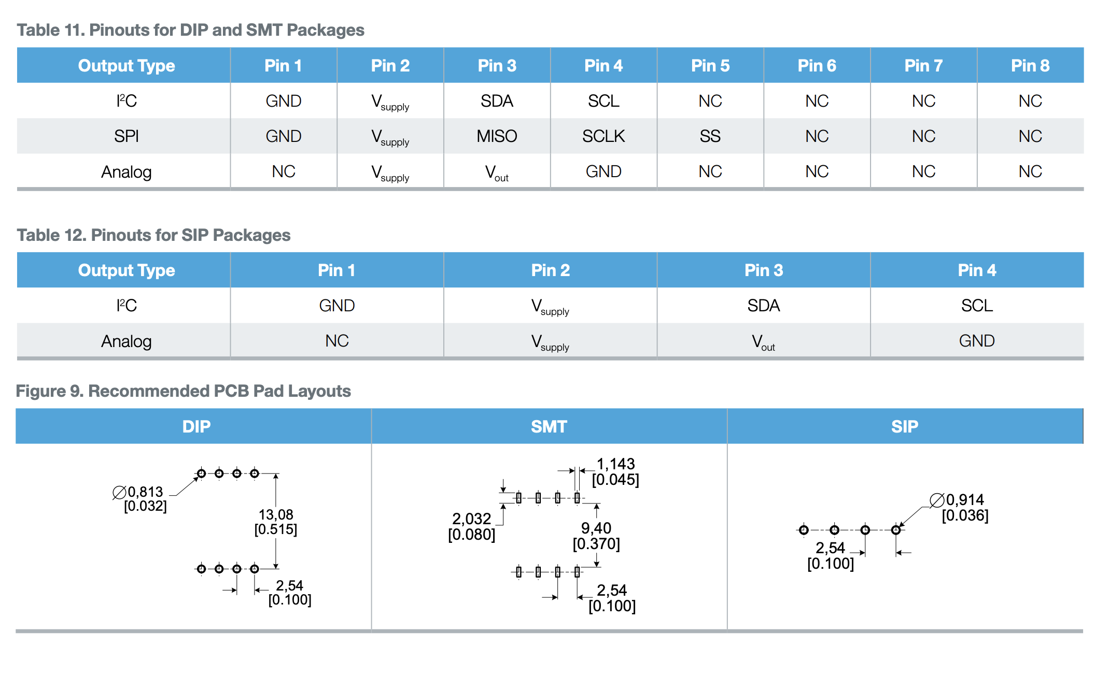
#define ADC_HONEYWELL 34 // Arduino analog pin
const float Null = 0.50; // Null VDC; datasheet Page 32
const float Sensitivity = 266.6; // Sensitivity mV/psi; datasheet Page 32
void setup() {
Serial.begin(9600);
}
void loop() {
Serial.print("P: ");
Serial.print(getPressure());
Serial.println("mbar g");
delay(5000);
}
float getPressure(void) {
float pressurePSI,pressureMBAR,pressureVDC;
int pressure;
pressure = analogRead(ADC_HONEYWELL);
pressureVDC = (float)pressure * 0.0048828125; // (5/1024 = 0.0048828125)
pressureVDC = pressureVDC - Null;
pressurePSI = pressureVDC / Sensitivity * 1000;
pressureMBAR = pressurePSI * 68.948;
return pressureMBAR;
}
https://www.mouser.com/ProductDetail/Honeywell/SSCDANV005PGAA5?qs=ZksK2nj1KWvnN3nIBw9%252BPQ%3D%3D
Liquid media on Port 1, diagnostics on
https://www.mouser.com/datasheet/2/187/honeywell_sensing_trustability_ssc_series_standard-1095240.pdf

