Slide 1
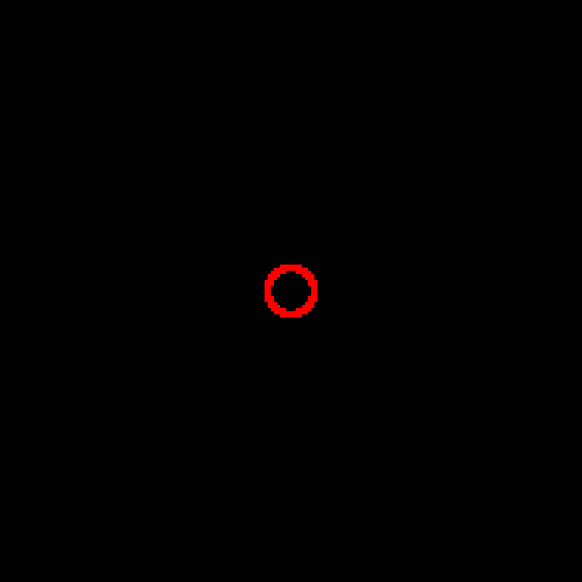

Illumination Aperture
Objective Aperture

Slide 2
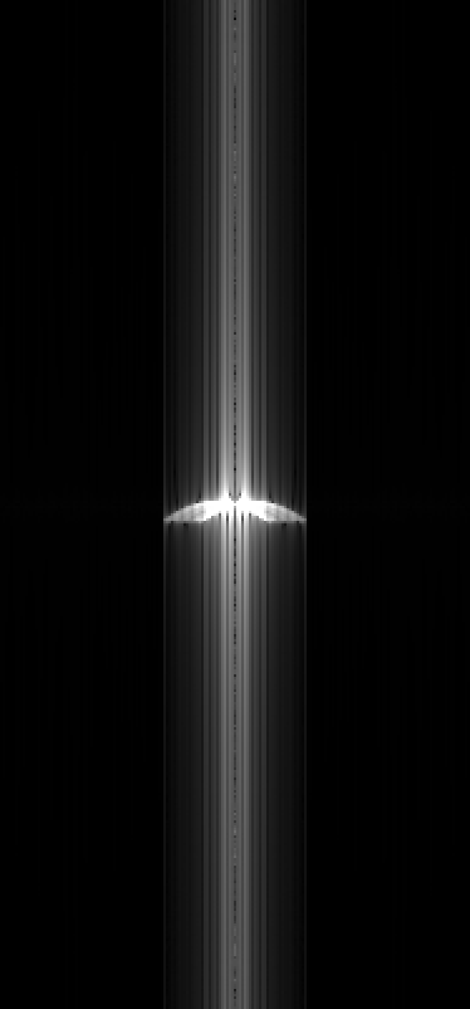
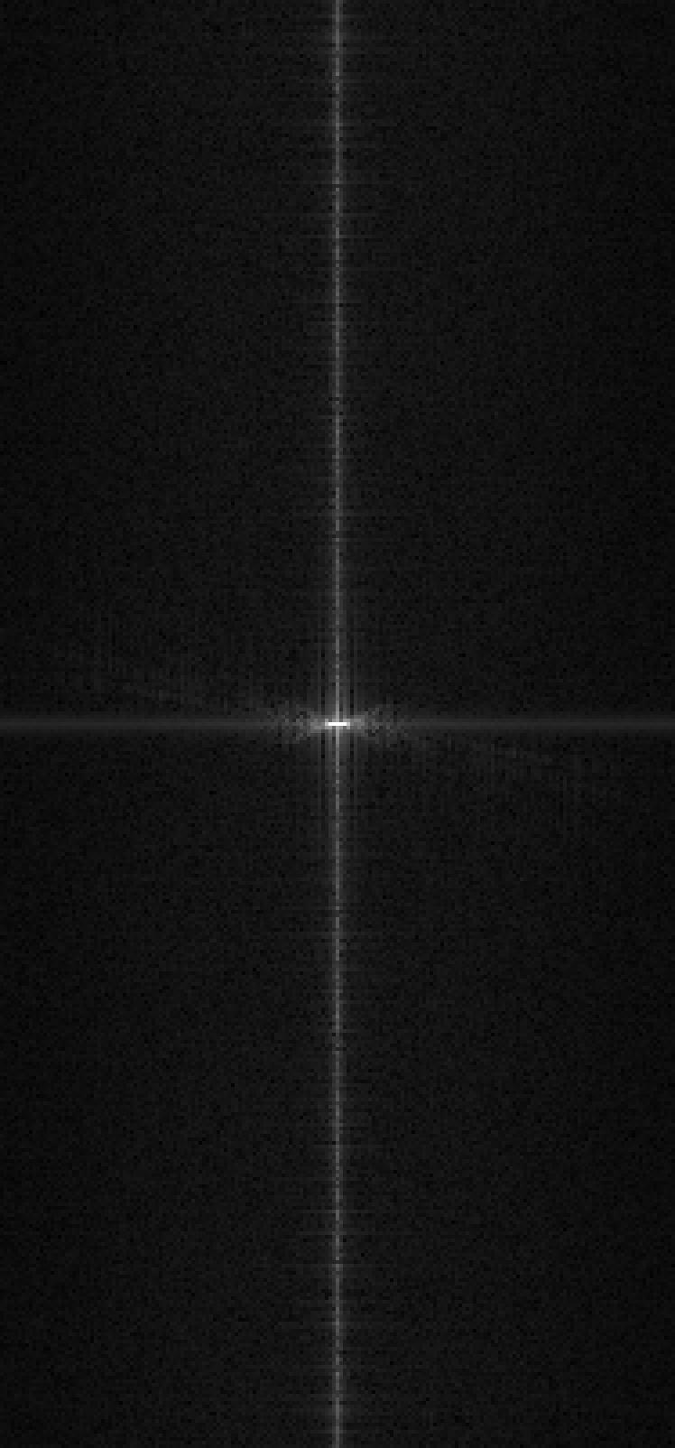
3D FFT of Amplitudes
Simulation
Measurement

Slide 3

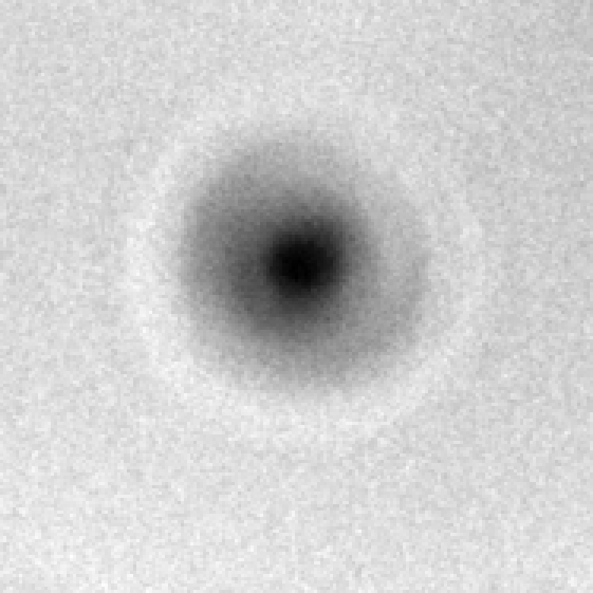
X/Y Plot of Center Slice
Simulation
Measurement

Slide 4

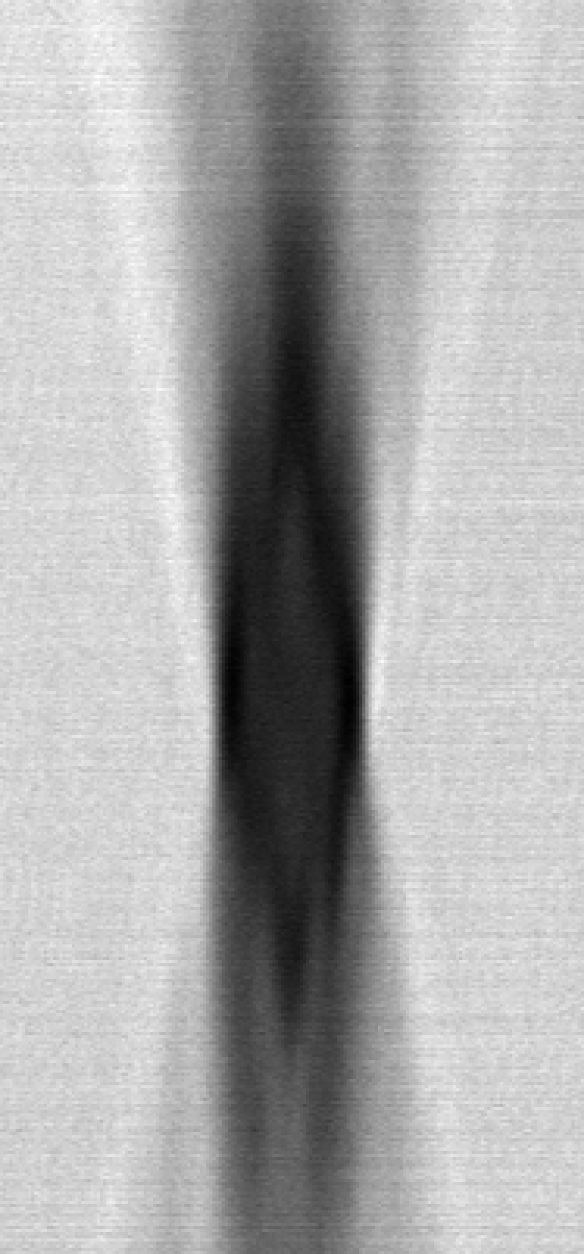
X/Z Plot of Center Slice
Simulation
Measurement

