Slide 1
Vehicle Recalls – Analysis Report
UTOR-VIRT-FIN-PT-11-2022-U-LOLC-MTTH
24th January 2023
Group 01
Abdullah Aldahhan
Beni Shankar De
Dileepa Dharmasiri
Noelia Nievas
Norman Valenzuela

Slide 2
Vehicle Recalls
This database records and stores details about recall campaigns, including the make and model of the recalled product, the issue that prompted the recall, the number of products affected, and the steps that need to be taken to address the issue.
The database is designed to be easily searchable so that consumers and industry professionals can quickly access information about the most relevant recalls. The database can be searched by product type, manufacturer, model year, and other criteria, which makes it easy to find information about specific recalls.
Transport Canada, as a regulatory body, uses this database to monitor the safety of vehicles and related products on Canadian roads. By tracking and publishing recall information, the database helps to ensure that consumers are aware of potential safety issues and that manufacturers are held accountable for addressing them.
The database also helps to promote transparency and accountability in the automotive industry, by making it easy for consumers to find information about recalls and the steps that manufacturers are taking to address them.
Overall, the Vehicle Recalls Database is an important tool for improving the safety of vehicles, tires, and child car seats on Canadian roads and protecting the consumer.
Analysis Report
How many vehicles of a specific make have been recalled in total?
What are the most recent vehicle recalls in Canada?
How many vehicles of a specific make and model have been recalled in the past year for vehicle models with more than 17 recall counts?
Is there a relationship between the vehicle recalls and the changes in temperature during the month?
What are the Tire makers with the most recent recalls?
How does the number of recalls compare for leading manufacturers?
How does the number of recalls for a specific make and model compared to other vehicles in the SUV category?

Slide 3
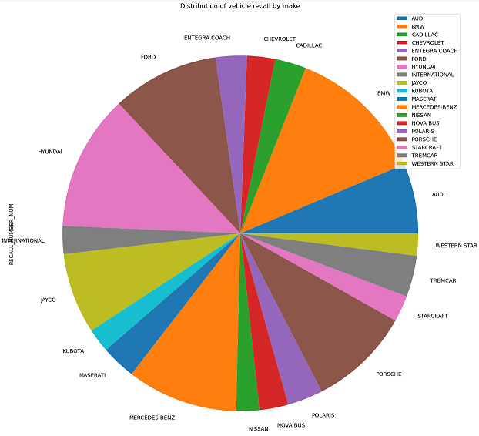
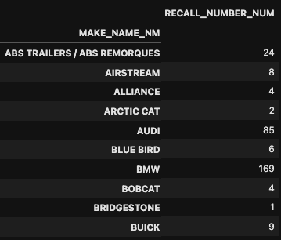
How many vehicles of a specific make have been recalled in total?
Vehicle recalls are an important aspect of ensuring the safety of vehicles on the road. Tracking and publishing recall information help to ensure that consumers are aware of potential safety issues and that manufacturers are held accountable for addressing them.
Distribution of vehicle recall by Make is illustrated in the following pie chart which shows BWM, Hyundai, Mercedes-Benz, Porsche, and Ford have a higher volume of recalls during this period of 2001 to 2022.

Slide 4
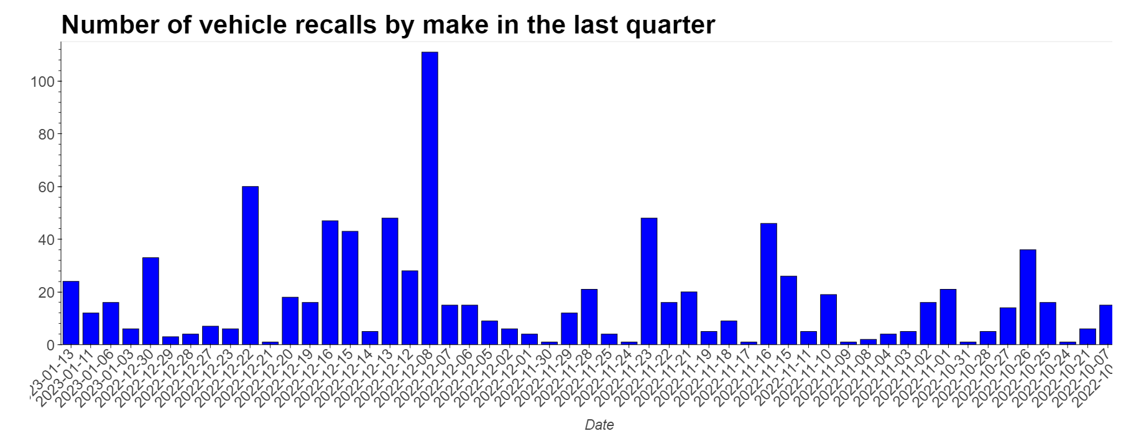
What are the most recent vehicle recalls in Canada?
As per the data extracted from the open Canada Government website, we can get a better picture as to what is the most recent vehicle recalls in Canada from the last quarter of 2022.
The reason recalls do happen can be for many different reasons, such as electrical, motor, airbag, tire issues, and much more.
As per the illustration, there has been more vehicle recalls in some specific makes over others.
On December 8th 2022, there have been more recalls that day specifically compared to the other days in the quarter. Although the names of the models are not illustrated, vehicles such as Audi and BMW are the most common vehicles to have been recalled in the last quarter of 2022.

Slide 5
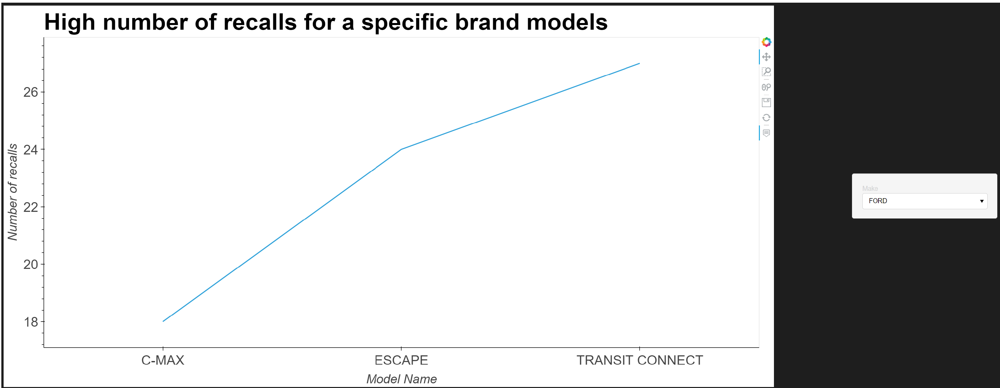
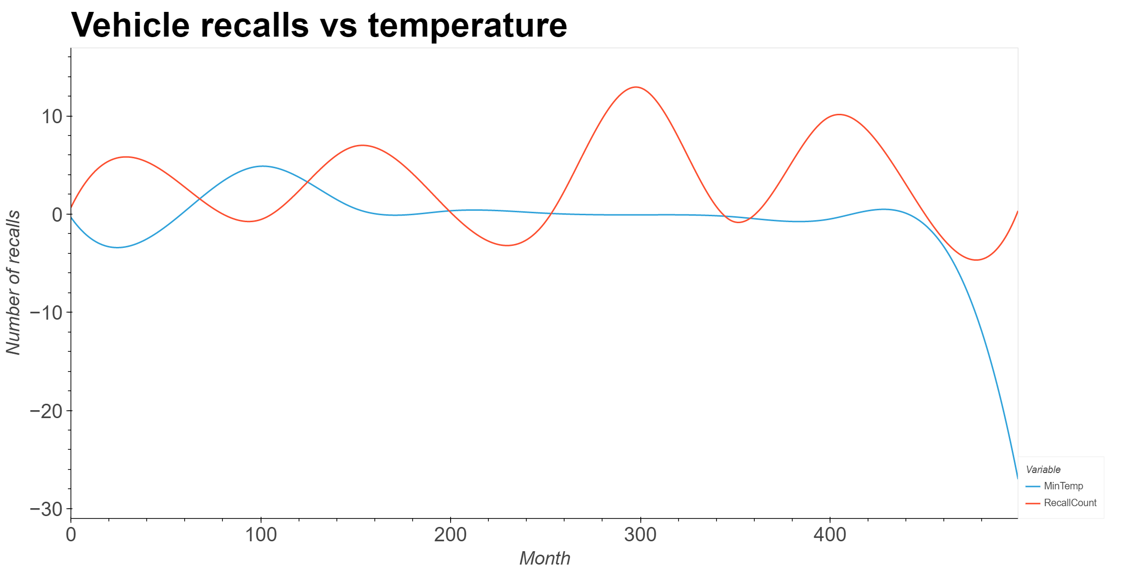
How many vehicles of a specific make and model have been recalled in the past year for vehicle models with more than 17 recall counts?
In the last year of 2022, the highest number of recalls made by FORD (as an example) is for the following models C-MAX, ESCAPE, and TRANSIT CONNECT
Illustration can be reviewed for various vehicle Make like FORD, HYUNDAI, PORSCHE, MERCEDES-BENZ, CAMPAGNA MOTORS, NOVA BUS, and BMW for the respective count of recalls per model made in the last year.
Is there a relationship between the vehicle recalls and the changes in temperature during the month?
According to the vehicle recalls vs temperature chart, there is no noticeable relationship between the temperature change of a month and the total number of recalls.

Slide 6
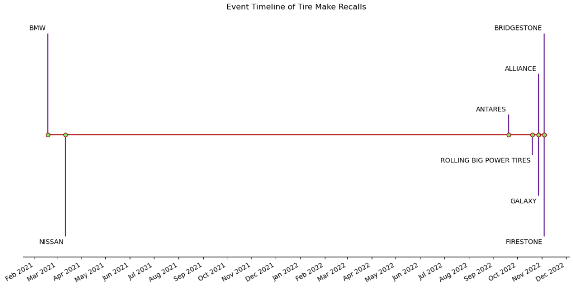
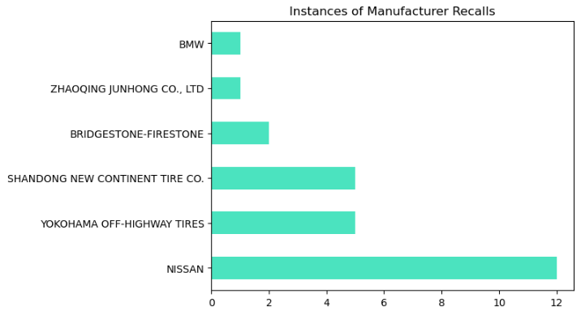
What are the Tire makers with the most recent recalls?
The following data analysis indicates that the brands recently recalled were:
Firestone and Bridgestone (4th November 2022)
Alliance and Galaxy (28th October 2022)
Rolling Big Power Tires (20th October 2022)
Antares (20th September 2022)
Nissan (12th March 2021)
BMW (18th February 2021)
Almost a year gap with the car companies Nissan and BMW recalling their vehicles around early 2021
Manufacturers often issue product recalls due to reported defects or safety concerns
Although it’s a car company, Nissan has reported a high frequency of recalls due to tire-related issues in comparison to dedicated tire manufacturing companies.

Slide 7
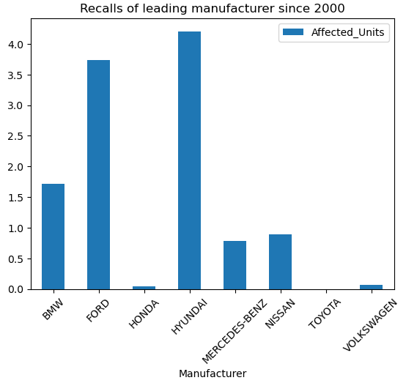
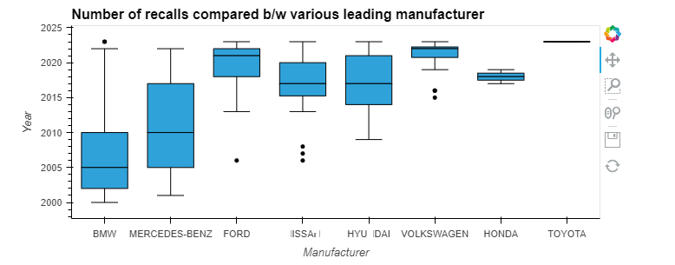
How does the number of recalls compare for leading manufacturers?
A comparative view of the total number of vehicle recalls in the last 21 years, per manufacturer is explained.
The risk of vehicle recall due to manufacturer fault by leading manufacturers is illustrated as follows.
The following plot explains that the distribution for BMW vehicle recall was high from 2002 till 2010, similarly the Mercedes-Benz recalls were high from 2005 till 2017.
To summarize, Toyota has the least recalls and Honda is the second best.

Slide 8
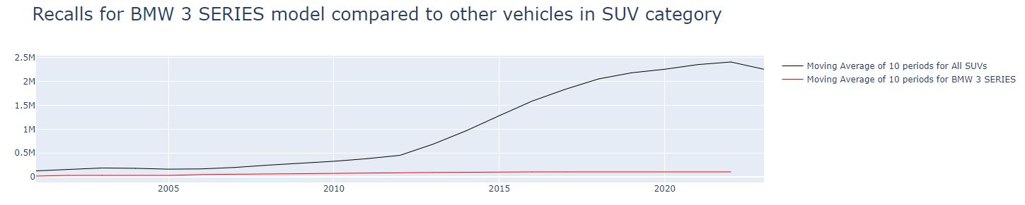
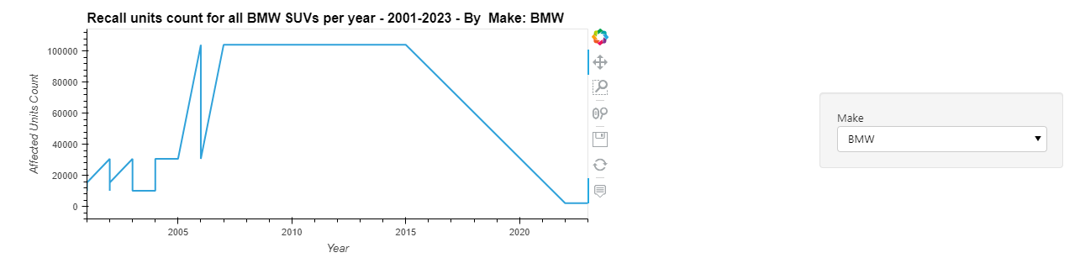
How does the number of recalls for a specific make and model compared to other vehicles in the SUV category?
The rolling average number of all the SUV recalls has gradually increased since 2010, except that there is a recent dip in 2022.
Here we are selecting a specific make and model e.g., BWM 3 SERIES SUV we have compared it to the other SUVs.
Similarly, BMW 3 SERIES SUV recalled units increased progressively in the same trend during this period of 2010 to 2022; although the number of recalls for total BWM SUVs in the market has declined since 2015.
The following plots illustrate the same.
Please note, this analysis gives the capability to analyze the performance any vehicle make and model, by keying in the values.

Slide 9
Q & A
Resources
In this case study, we have used data sources and a time frame of the analysis from 2001-2022 updated in the last 6 months.
https://open.canada.ca/data/en/dataset/1991fef6-9dfe-40e2-a0c6-19c60ddf4a02
https://www.weatherbit.io/api/climate-normals

Slide 10
Thank You

