Slide 1
MOVIE BUDDY
By: Group 2
Aakshay (AK) Gautam
Avneet Singh
Beni Shankar De
Juil Yoon
Tarun Midha
23-March-2023

Slide 2
Movie Recommendation and ROI Model Analysis
Our goal is to develop an AI tool that is a content-based filtering method for movie recommendations to suggest movies to users based on the movies' content and the users' preferences.
The system analyzes the content of the movies, such as their genre, different associated keywords, the mood of the users, and cult classics per genre, and uses this information to determine which films are similar to each other.
This tool provides recommendations that users predict future preferences by using their past experiences and preferences. These services use sophisticated systems to recommend the best items to their users to make their experiences great.
Prediction models for Budget vs Revenue based on the popularity of the movies are also defined.

Slide 3
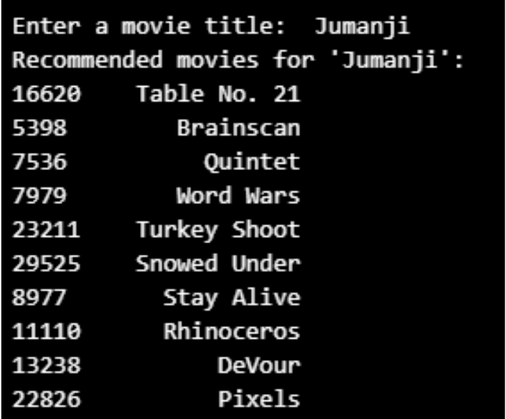
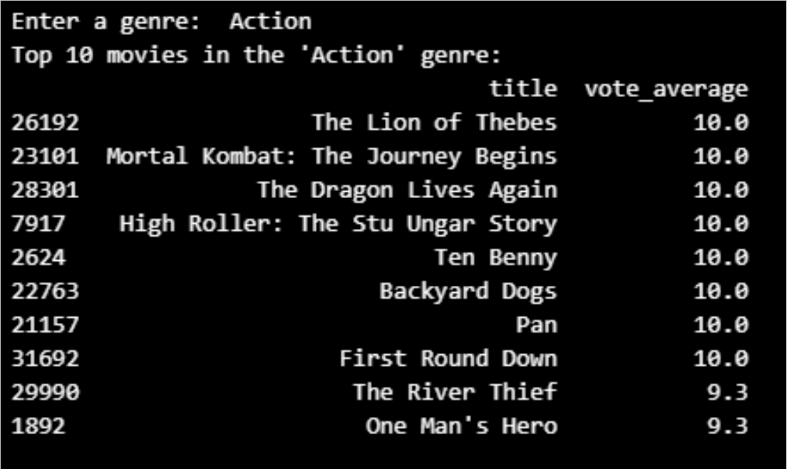
Content-Based Recommendation
Movie recommendations based upon Keywords:
The user gives a Movie Title as input and based on the keywords associated, the tool returns the top 10 movies.
Movie recommendations for the user based on different genres based upon votes:
If a user has watched and liked several action movies, the recommendation system might suggest other action movies that have similar content and order by maximum votes received.

Slide 4
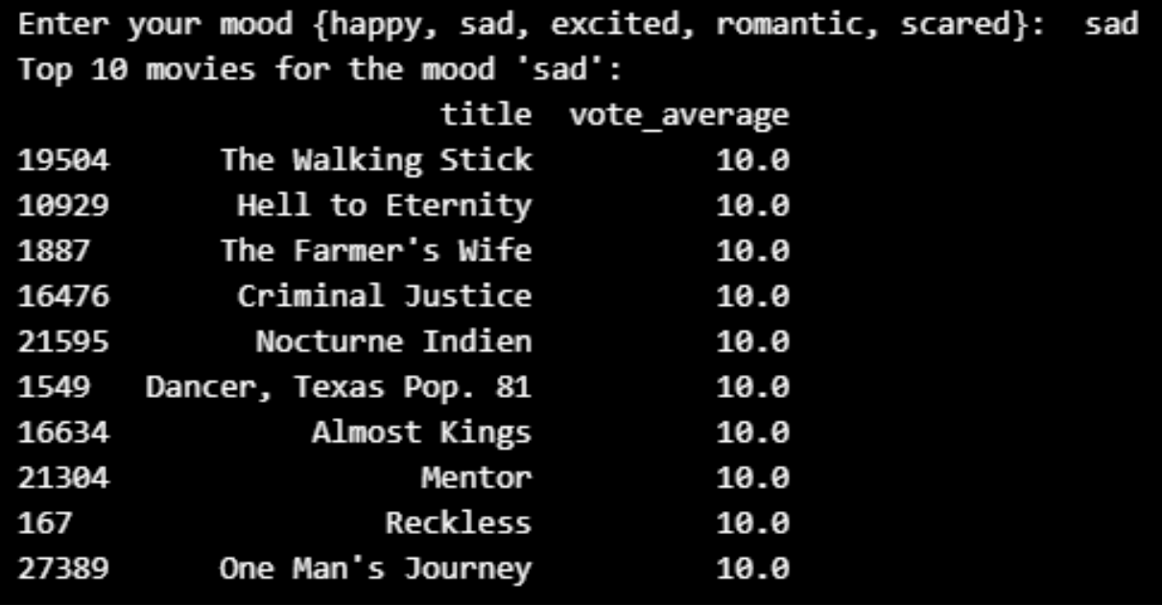
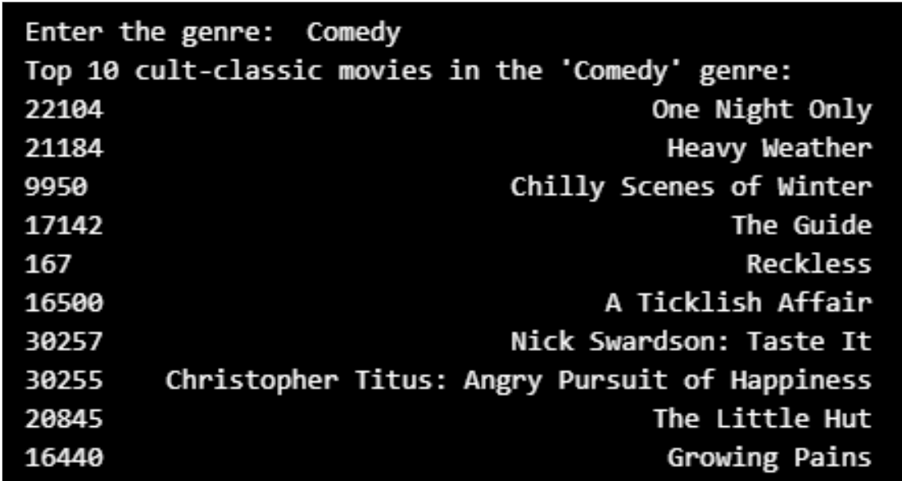
Content-Based Recommendation
Movie Recommendations for the user on the basis of the mood:
Assuming the mapping of a user's mood per genre, the Tool recommends the movie ordered by votes
Happy mood mapped to 'Comedy’
Sad mood mapped to 'Drama’
Excited mood mapped to 'Action’
Romantic mood mapped to 'Romance'
Scared mood mapped to 'Horror’
Recommendations for cult-classics (High Rating, Low Budget) based on different genres:
Assuming a movie of rating 7.5 and votes at least above 100 defined the cult-classics recommended movies on the genre provided by the user.

Slide 5
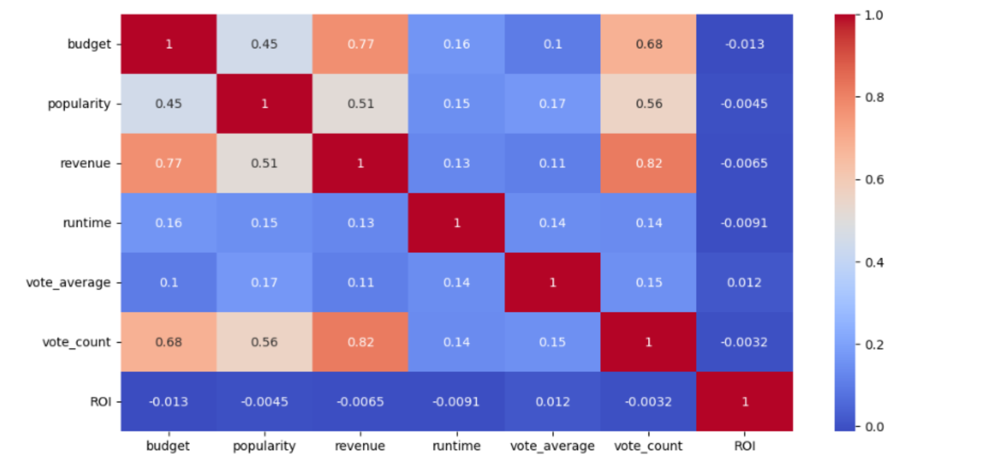
Analysis of various factors for ROI (Revenue vs Budget)
The above heat map shows the budget, revenue, and popularity of the movies are highly correlated.
Also, vote counts for high ratings are being gathered for high-budget movies.

Slide 6
Machine Learning: Prediction Models
The following prediction models are used in our analysis
1. AdaBoost Regressor
2. Gradient Boosting Regressor
The above models were used to define a better accuracy of revenue predicted for a movie of a certain budget compared to the true historical revenue.
AdaBoost is the first designed boosting algorithm with a particular loss function. On the other hand, Gradient Boosting is a generic algorithm that assists in searching the approximate solutions to the additive modeling problem. This makes Gradient Boosting more flexible than AdaBoost.

Slide 7
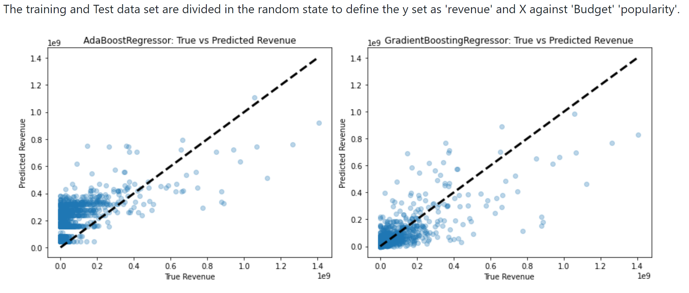
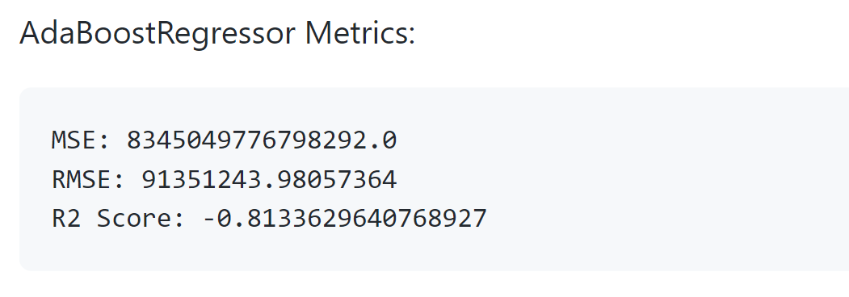
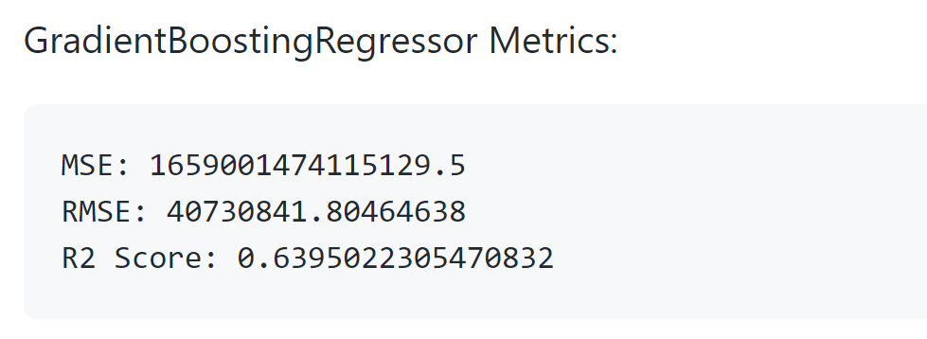
Machine Learning: Training and Test Data
The source data files contain metadata for 45,000 movies listed in the Full Movie Lens Dataset. The dataset consists of movies released on or before July 2017. Data points include plot keywords, budget, revenue, release dates, languages, production companies, countries, TMDB vote counts, and vote averages.
The source data set is a comma-separated value (CSV) file.
Cleaned up the columns not used in deriving recommendations and prediction analysis like id', 'original_title', 'production_companies', 'production_countries', 'status', 'tagline'. Also removed an NA and converted the date fields like Release Date to data time format.

Slide 8
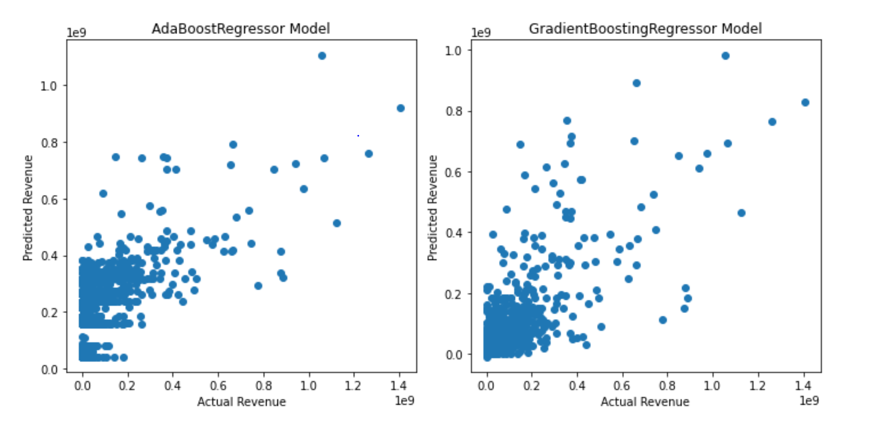
Machine Learning: Model Comparison
Based on the results, it can be observed that the Gradient Boosting Regressor model outperforms the AdaBoost Regressor model in terms of MSE, RMSE, and R2 Score.
The MSE and RMSE values for the Gradient Boosting Regressor model are significantly lower than the AdaBoost Regressor model, indicating that the Gradient Boosting Regressor model provides more accurate predictions.
The R2 Score for the Gradient Boosting Regressor model is also significantly higher than the AdaBoost Regressor model, indicating that the Gradient Boosting Regressor model explains more variance in the data.

Slide 9
Conclusion:
The tool provides recommendations for movies based on Keywords, genre, user's mood, and cult-classics per genre.
An analysis is performed for the ROI of budget vs revenue impact on the voting scores.
This tool also defines a prediction model to find what factors (budget and popularity vs revenue) correlate with the highest Return on Investment.
Next Steps:
Interface this tool in AWS for an interactive Chat Bot using Sage Maker, Lambda function, and Lex capabilities
Enhance the tool with a live data set of user history to provide recommendations using search history, keywords, and movie reviews.

Slide 10


