Slide 1
Data Analytics Internship
Level 3 (Advanced) — Task 1: Predictive Modeling (Classification)
BigML Telecom Churn Dataset | Python, pandas, scikit-learn, matplotlib
Codveda Technology Internship Programme

Slide 2
The Task
Build and evaluate a classification model to predict customer churn: preprocess the data, train multiple models, evaluate them, and tune hyperparameters with grid search.
1
2
3
Preprocess
Train & Compare
Tune & Evaluate
Encode categorical variables,
scale numeric features
Logistic Regression,
Decision Tree, Random Forest
GridSearchCV, then score
with accuracy, precision, recall, F1

Slide 3
Step 1 — Preprocessing
2,666
667
69
14.6%
Training Records
Testing Records
Features After Encoding
Churn Rate (Train)
Official 80/20 train/test split provided by the data source — used directly rather than re-splitting
Binary encoding for International plan / Voice mail plan (Yes/No → 1/0)
One-hot encoding for State (51 categories) and Area code, with drop_first=True to avoid collinearity
StandardScaler fit on training data only, then applied to test data — preventing data leakage

Slide 4
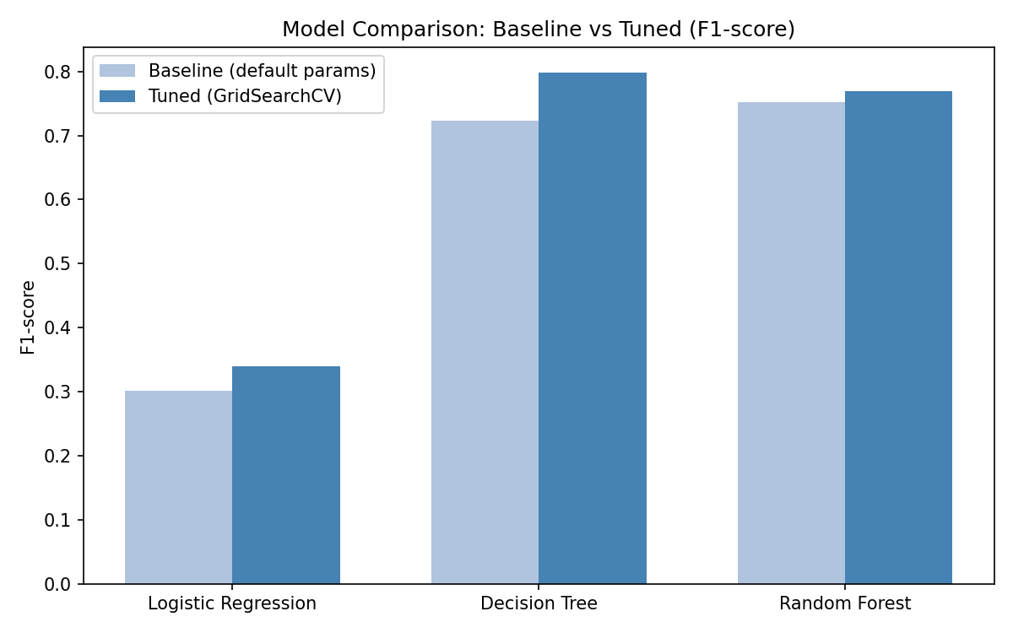
Step 2 — Model Comparison

Slide 5
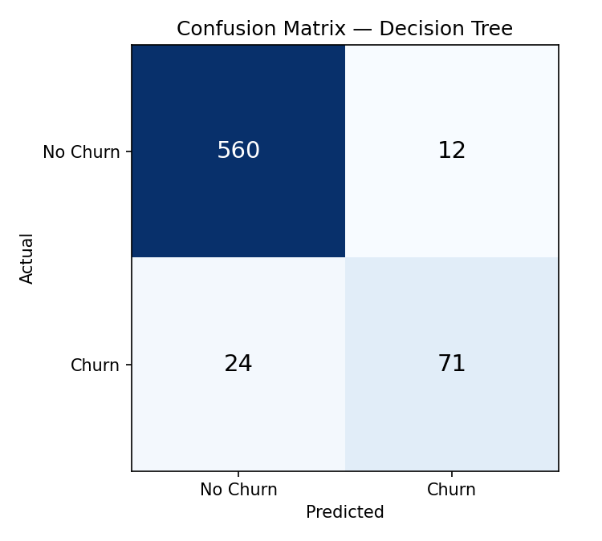
Step 3 — Best Model After Tuning
Decision Tree
94.6%
0.80
74.7%
Best Model
Accuracy
F1-score
Recall
Tuned with GridSearchCV (5-fold CV, F1 scoring)
Best params: max_depth=10, criterion='gini'
Tree-based models outperform Logistic Regression on this imbalanced dataset (14.6% churn)
560 true negatives, 71 true positives, only 12 false positives

Slide 6
Key Takeaway
Tree-based models (Decision Tree, Random Forest) handle this imbalanced churn dataset far better than Logistic Regression, which assumes a linear decision boundary too rigid for this problem.
Tools: Python | pandas | scikit-learn | matplotlib
Codveda Technology Internship — #CodvedaAchievements

