Slide 1
Customer Churn Analysis
ABC Communications Ltd — Business Findings & Retention Recommendations
AnalystLab Africa | Data Analytics Internship Programme | Week 1

Slide 2
Agenda
01
Business Context
Why churn matters for ABC Communications
02
Customer Base Snapshot
Who ABC's 7,043 customers are
03
Key Churn Drivers
Contract, tenure, service, payment method
04
Insights, Risks & Opportunities
What the data tells management
05
Recommendations
Five actions to reduce churn

Slide 3
Business Context
ABC Communications Ltd asked AnalystLab Africa to investigate why customers leave, and what can be done about it.
7,043
26.5%
21
Customers analysed
Overall churn rate
Attributes per customer
Churn — the loss of subscribers to cancellation or a competitor — is one of the most expensive problems in telecom: acquiring a replacement customer costs far more than retaining an existing one, and even small churn reductions meaningfully protect recurring revenue.

Slide 4
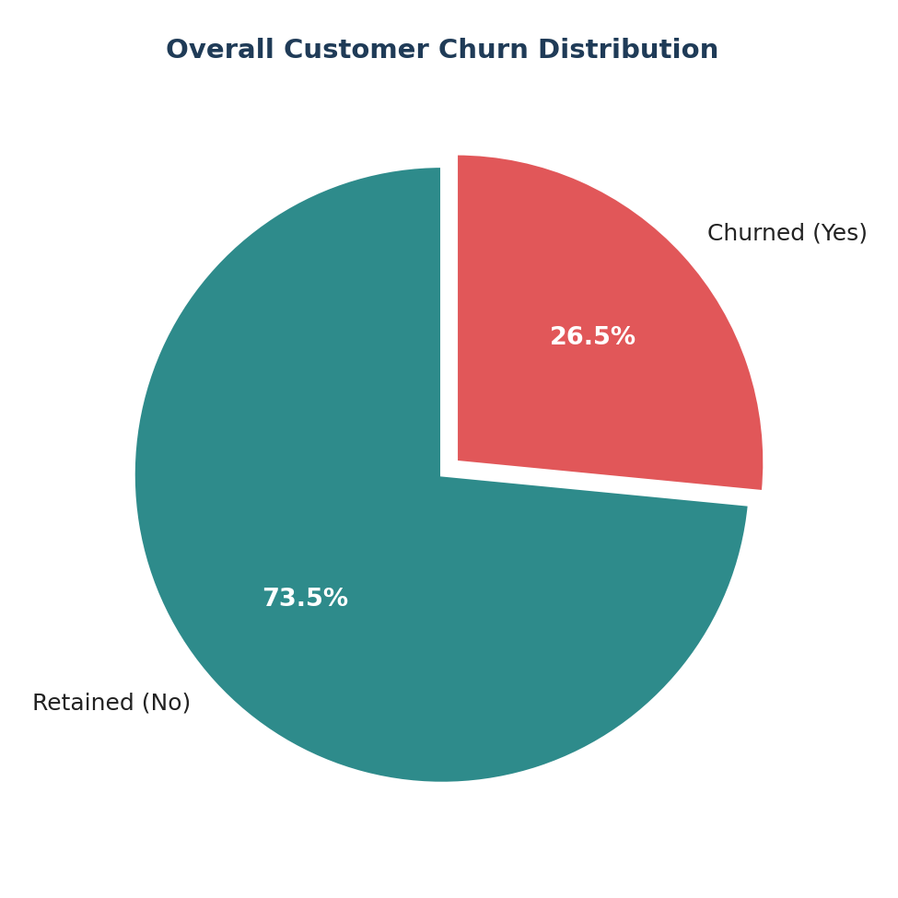
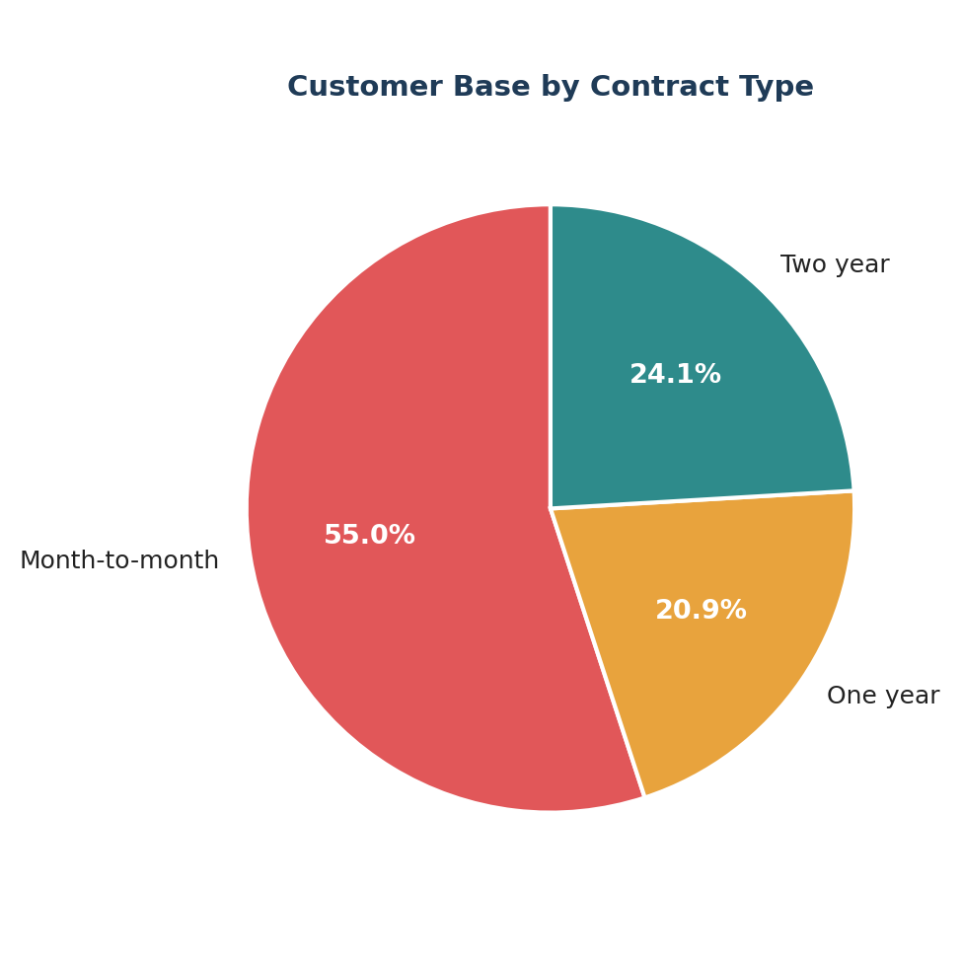
What Does the Customer Base Look Like?

Slide 5
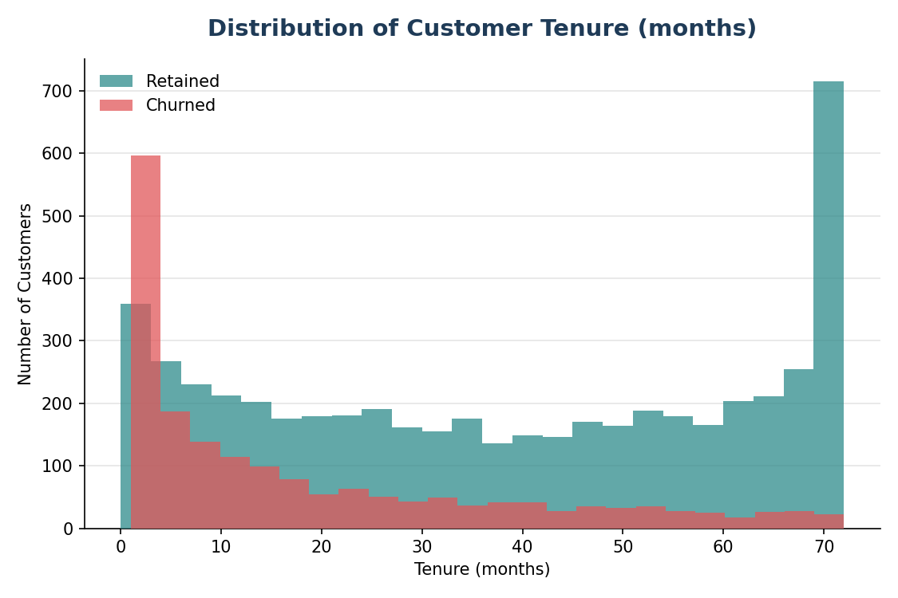
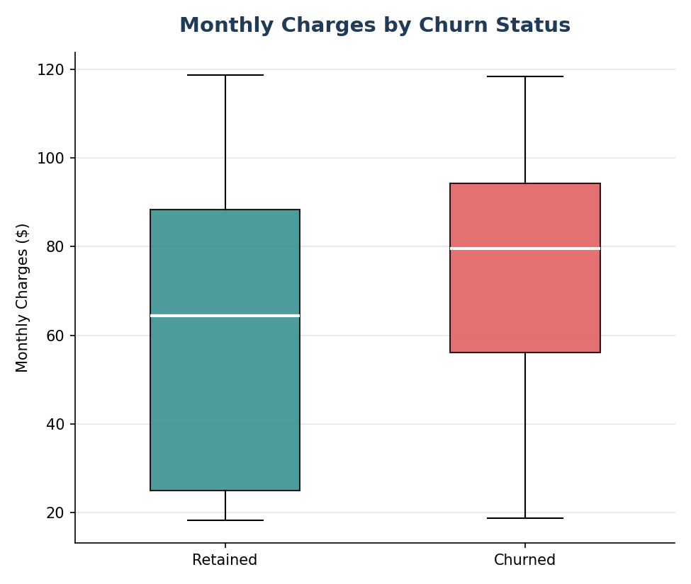
Tenure & Pricing Profile
Churned customers skew toward low tenure and higher monthly bills — ABC is losing newer, higher-value customers fastest.

Slide 6
Key Churn Drivers
What separates customers who stay from customers who leave

Slide 7
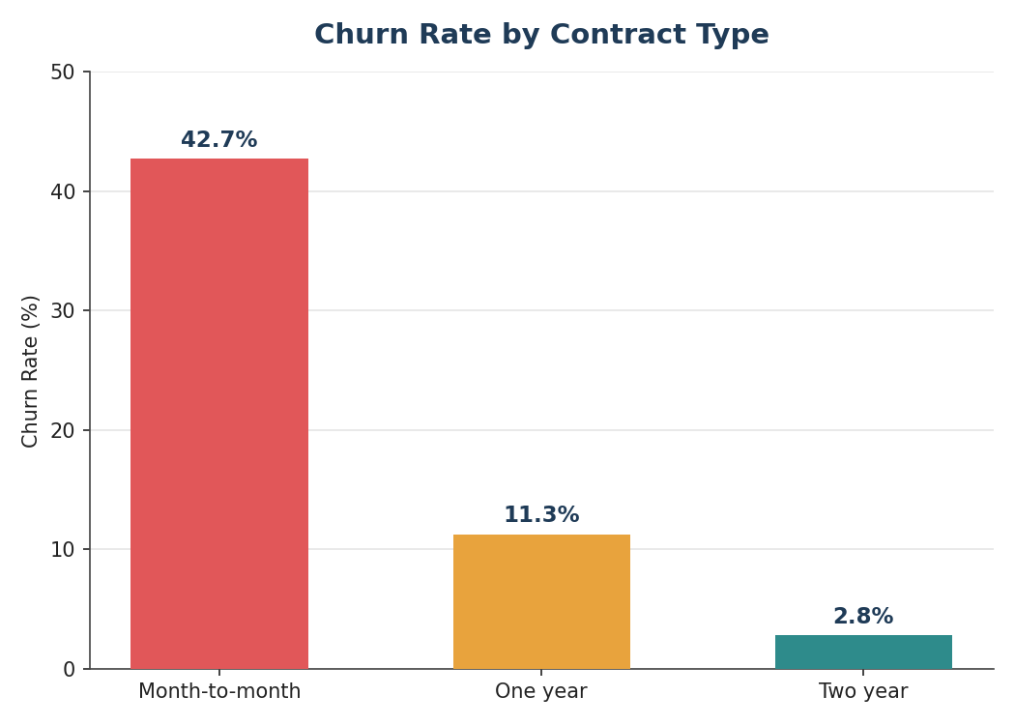
Contract Type Is the #1 Churn Driver
Month-to-month
42.7% churn
55% of customers
One-year contract
11.3% churn
21% of customers
Two-year contract
2.8% churn
24% of customers

Slide 8
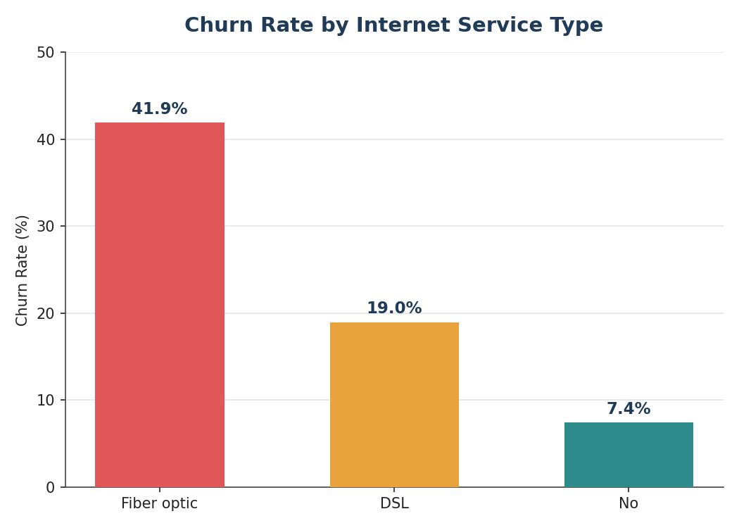
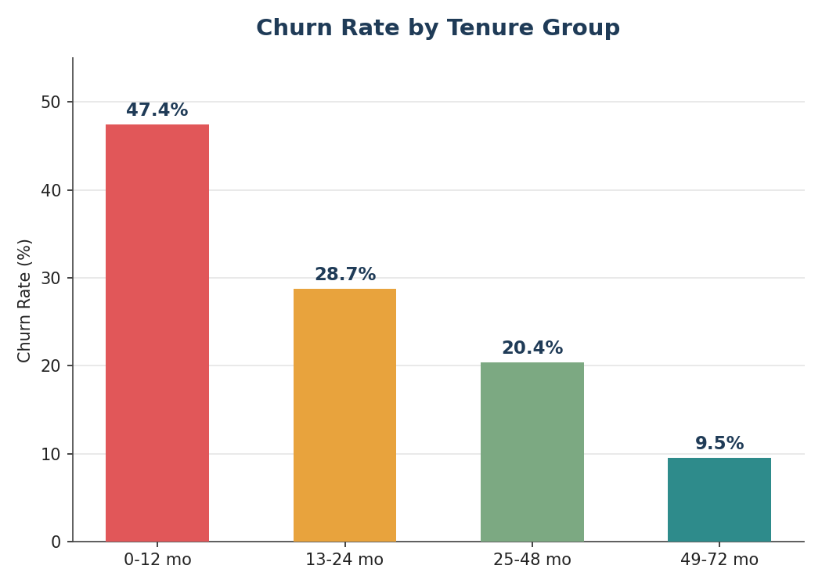
Product & Lifecycle Risk

Slide 9
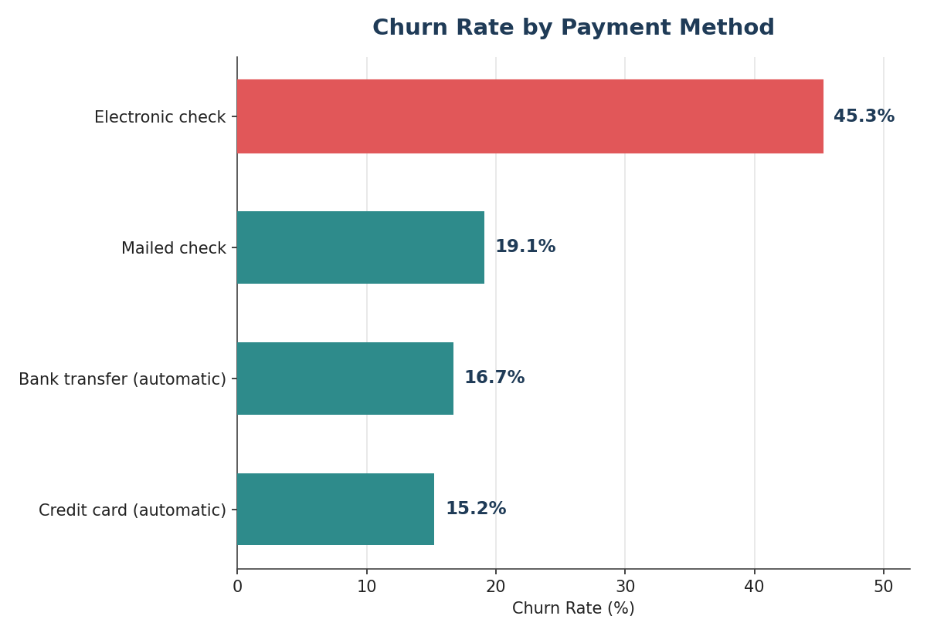
Payment Method & Add-On Services
Add-on services and churn (customers without the service):
Online Security
41.8%
Tech Support
41.6%
Online Backup
39.9%
Device Protection
39.1%
Electronic-check payers churn at 45.3% — roughly 3x automatic-payment customers.

Slide 10
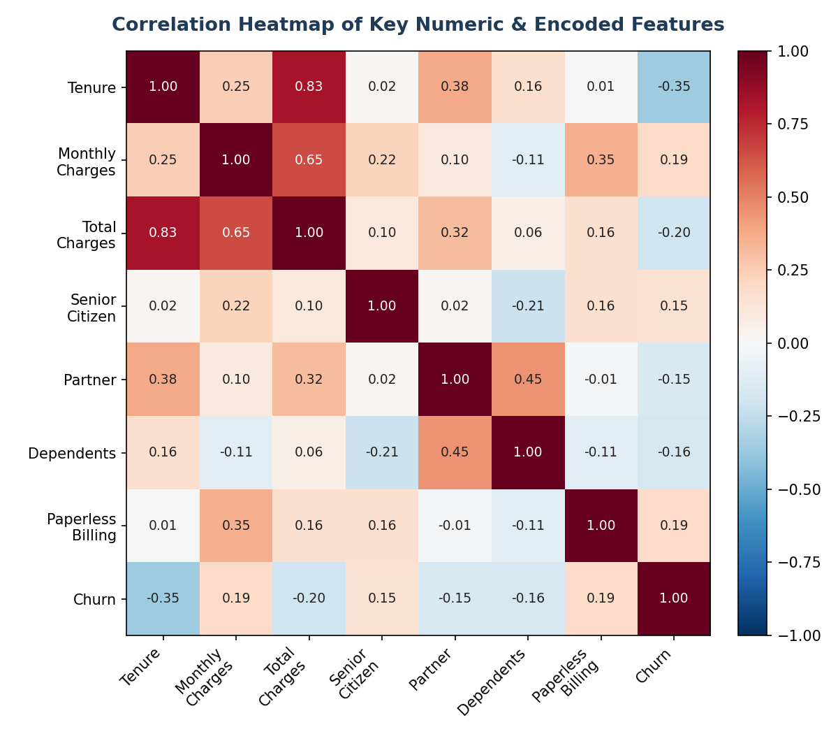
What Correlates With Churn?

Slide 11
Insights, Risks & Opportunities
Turning the data into a management view

Slide 12
Five Key Insights
1
Contract type is the dominant churn lever — month-to-month churns ~15x more than two-year contracts.
2
Churn is front-loaded: 47.4% of customers under 12 months tenure churn, vs. 9.5% past 49 months.
3
Fiber-optic, ABC's premium product, has the highest churn of any internet segment (41.9%).
4
Lack of protective add-ons (security, tech support) roughly triples churn risk.
5
Electronic check payers churn 3x more than automatic-payment customers, and overlap with price-sensitive segments.

Slide 13
Business Risks & Opportunities
Risks
Opportunities
• Losing higher-value customers: churners average $74.44/mo vs $61.27/mo for retained.
• Contract migration campaigns could cut churn dramatically given the 15x contract gap.
• Nearly half of first-year customers churn, undermining acquisition ROI.
• A first-90-days retention programme targets the single highest-churn window.
• Fiber dissatisfaction risks brand reputation in the premium segment.
• Bundling protective add-ons raises stickiness and average revenue per user.

Slide 14
Recommendations
Five actions for ABC's leadership team

Slide 15
Priority Actions
1
Contract-conversion incentive
Discount or free add-on for month-to-month customers who move to 1–2 year contracts.
2
First-90-days retention programme
Proactive onboarding, check-ins, and a month-12 loyalty milestone.
3
Investigate the fiber experience
Service-quality and pricing review — fiber churns 2x DSL.
4
Bundle protective add-ons
Include or discount Security/Tech Support for at-risk segments.
5
Migrate Electronic Check payers
Incentivise automatic payment methods, which correlate with far lower churn.

Slide 16
Questions?
Prepared by the AnalystLab Africa Data Analytics Internship team, for ABC Communications Ltd.

