Slide 1
Data Analytics Internship
Level 2 (Intermediate) — Task 1: Regression Analysis
Boston Housing Dataset | Python, pandas, scikit-learn, matplotlib
Codveda Technology Internship Programme

Slide 2
The Task
Build a simple linear regression model to predict one variable from another, evaluate its performance, and interpret the coefficients.
1
2
3
Split & Train
Interpret
Evaluate
Train/test split, fit a
LinearRegression model
Extract intercept and
coefficient, explain their meaning
R², MSE, RMSE on the
held-out test set

Slide 3
Step 1 — Data Split & Model Training
506
80/20
1
0
Total Records
Train/Test Split
Predictor Variable
Missing Values
The dataset was split into 80% training data (404 records) and 20% testing data (102 records), using random_state=42 for reproducibility. A LinearRegression model from scikit-learn was fit on RM (average number of rooms per dwelling) to predict MEDV (median home value, in $1000s).

Slide 4
Step 2 — Model Coefficients
MEDV = -36.25 + 9.35 × RM
Coefficient (9.35): each additional room is associated with an increase of ~$9,350 in predicted median house value.
Intercept (-36.25): the theoretical value when RM = 0 — not physically meaningful, just where the line crosses the y-axis.

Slide 5
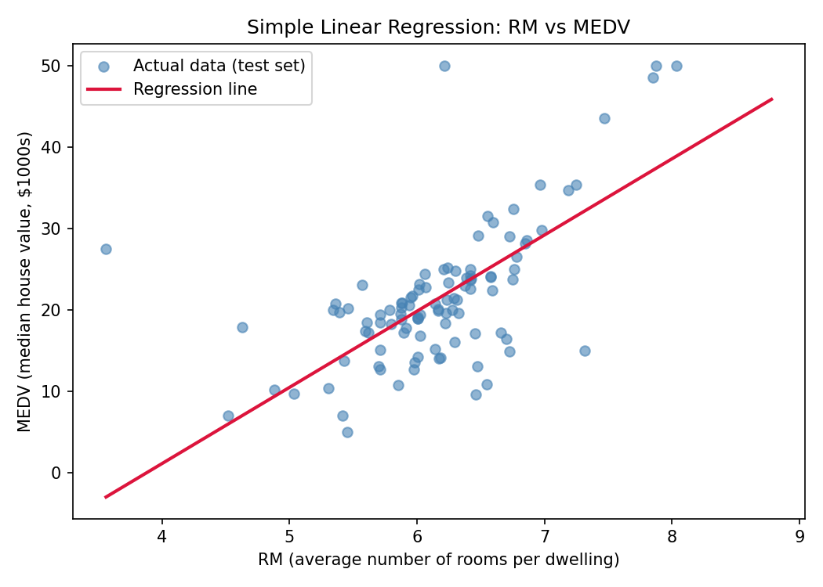
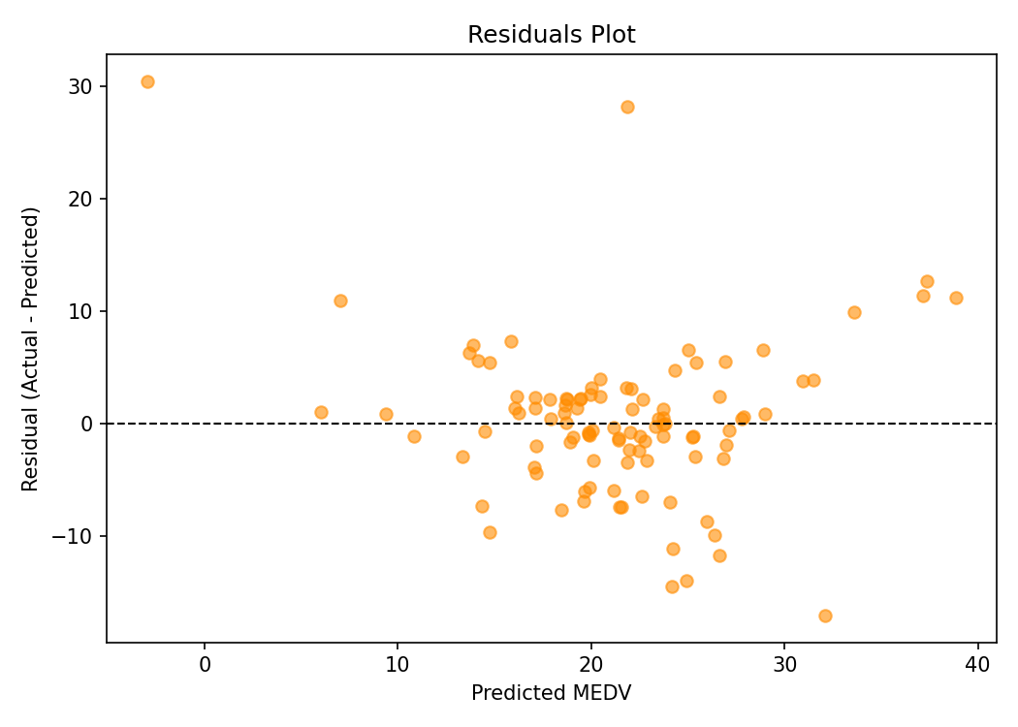
Step 3 — Model Evaluation
0.37
R² Score
46.14
MSE
6.79
RMSE ($1000s)
Regression line vs. actual data (left) | Residuals plot (right)
The model explains 37% of the variance in house prices using room count alone. On average, predictions deviate from actual prices by about $6,790 — a reasonable but limited fit, suggesting other features (crime rate, distance to employment, school quality) also matter.

Slide 6
Key Takeaway
Room count is a strong, intuitive predictor of house price — but explains only part of the picture. Combining it with other features would meaningfully improve predictive accuracy.
Tools: Python | pandas | scikit-learn | matplotlib
Codveda Technology Internship — #CodvedaAchievements

Slide 7
Data Analytics Internship
Level 2 (Intermediate) — Task 2: Time Series Analysis
Stock Prices Dataset (AAPL) | Python, pandas, statsmodels, matplotlib
Codveda Technology Internship Programme

Slide 8
The Task
Analyze a time-series dataset to detect trends and seasonality: plot the raw series, decompose it into trend, seasonality and residuals, then apply moving average smoothing.
1
2
3
Plot & Inspect
Decompose
Smooth
Visualize the raw closing
price and identify patterns
Split into trend, seasonal
and residual components
Apply 30-day and 90-day
moving averages

Slide 9
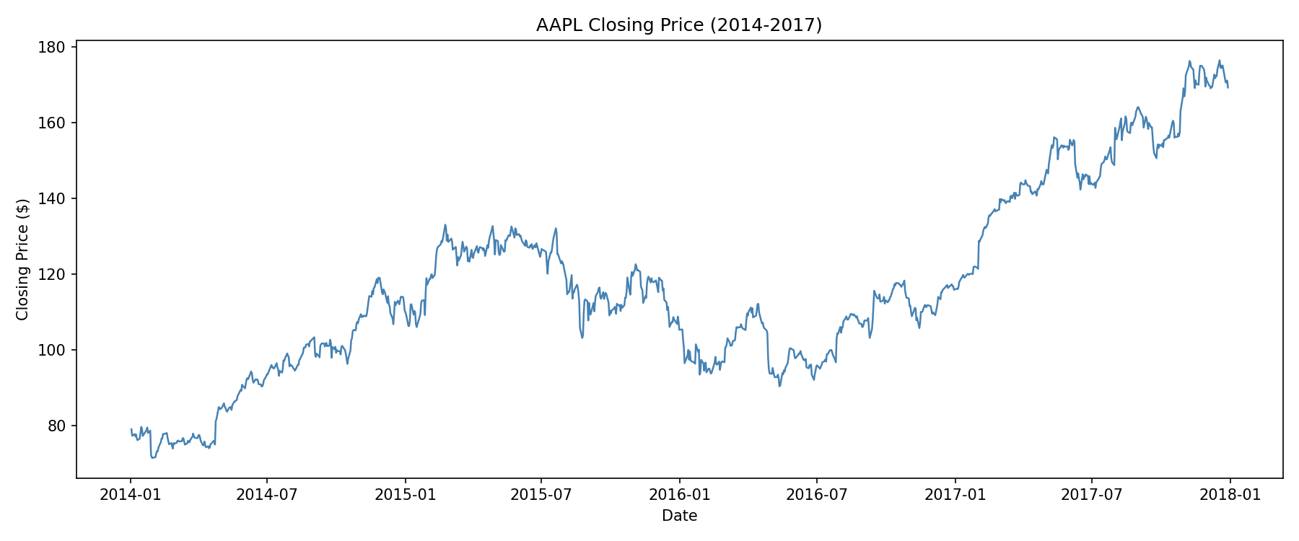
Step 1 — Raw Time Series
505
1,007
2014-17
0
Companies in Dataset
Trading Days (AAPL)
Period Covered
Missing Close Values

Slide 10
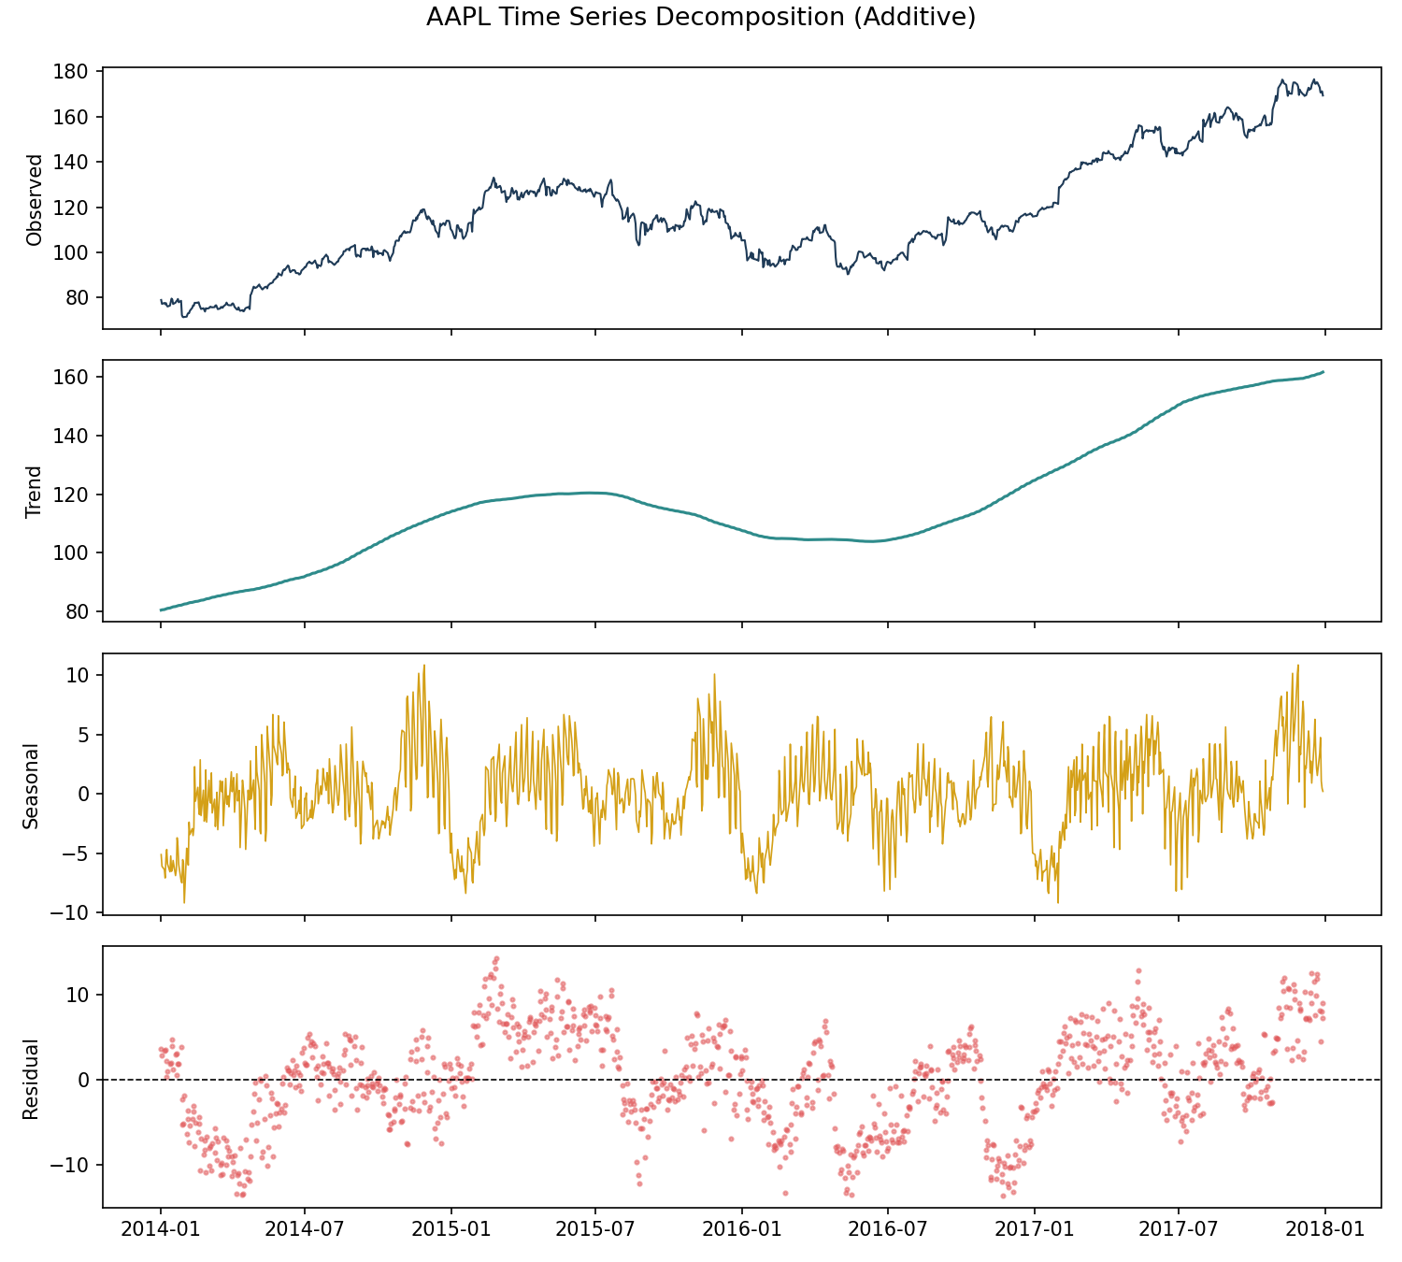
Step 2 — Trend, Seasonality & Residuals
Additive Decomposition
Period: 252 trading days (~1 year)
Trend captures the long-term direction
Seasonal component is small relative to price — stocks behave closer to a random walk than a seasonal process
Residuals capture day-to-day market noise

Slide 11
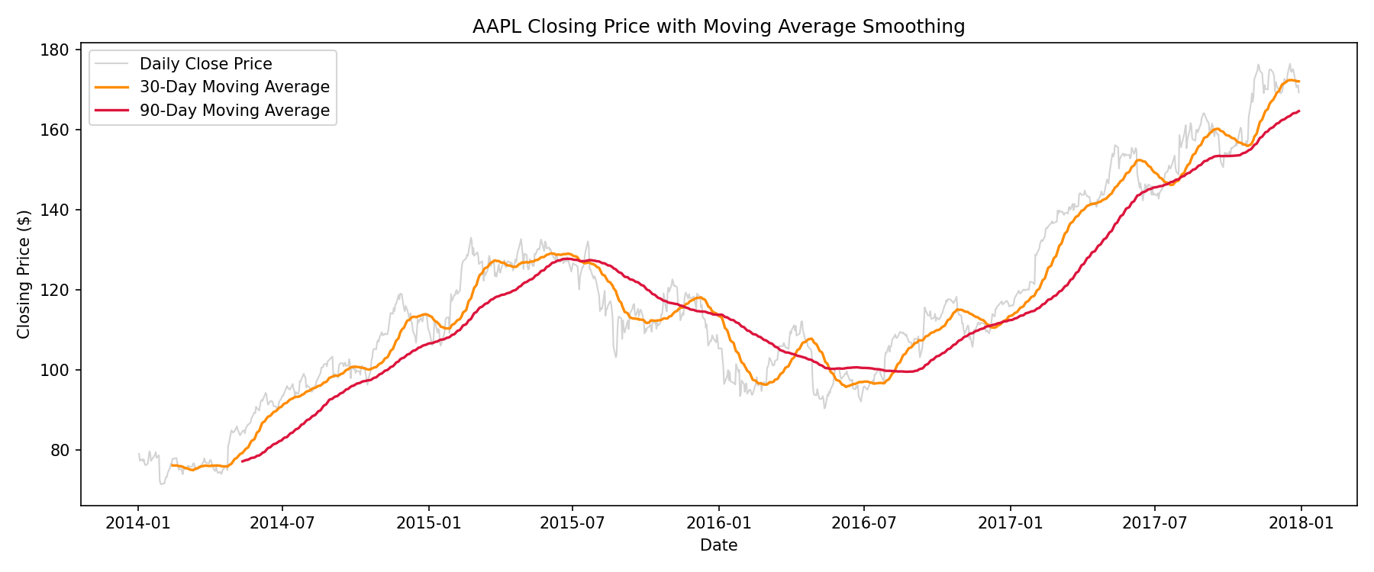
Step 3 — Moving Average Smoothing
The 30-day moving average smooths short-term noise while tracking medium-term swings; the 90-day moving average is smoother still, filtering out most daily volatility to reveal the underlying trend.

Slide 12
Key Takeaway
AAPL shows a clear long-term uptrend across 2014-2017, with two notable corrections in 2015 and 2016. Decomposition confirms the seasonal signal is minor — most of the movement is trend plus daily noise.
Tools: Python | pandas | statsmodels | matplotlib
Codveda Technology Internship — #CodvedaAchievements

