Slide 1



Market Analysis
Benita Voran, Data Analyst GameCo

Slide 2
determine the marketing budget for 2017 by region GameCo’s current understanding of the market is that the sales have not changed in various geographic regions throughout the years.
Objective:

Slide 3
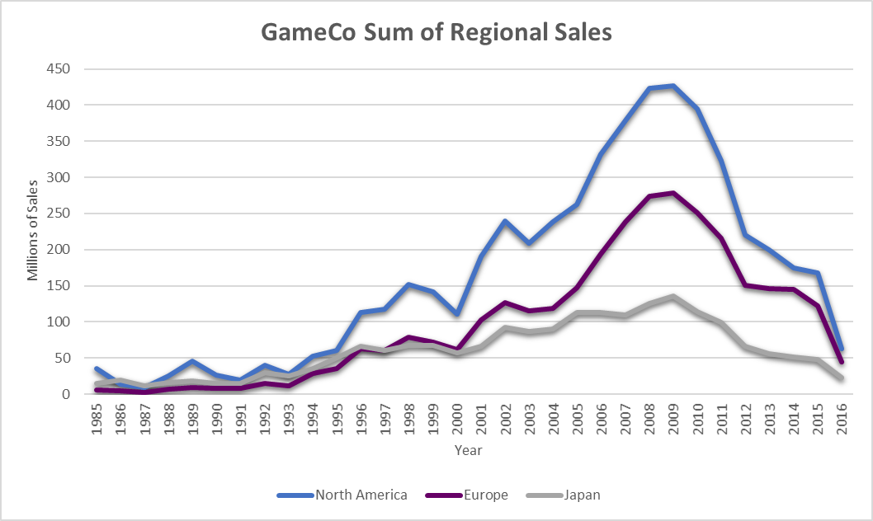
sum of sales per region:
Sales in all the geographic locations have fluctuated throughout the years
They peaked around 2008
Based on this initial data:
North America has the highest sum of sales, followed by Europe, and then Japan

Slide 4
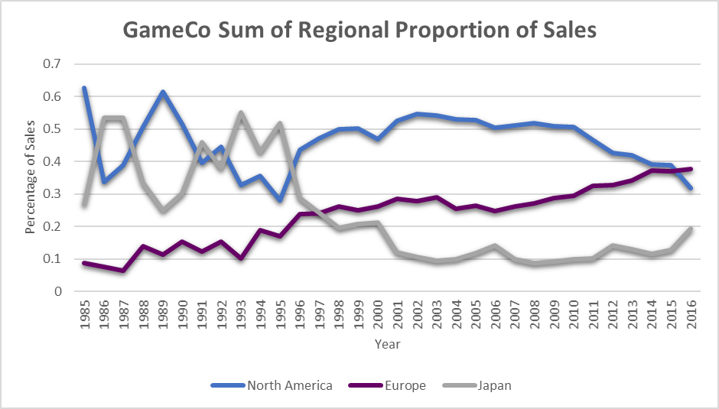
proportion of sales:
North America initially seemed to have the highest sum of sales
After looking into the data further, you can see that Europe surpasses North America in the proportion of sales in 2016
This slide provides a deeper insight into where to distribute the budget for 2017

Slide 5
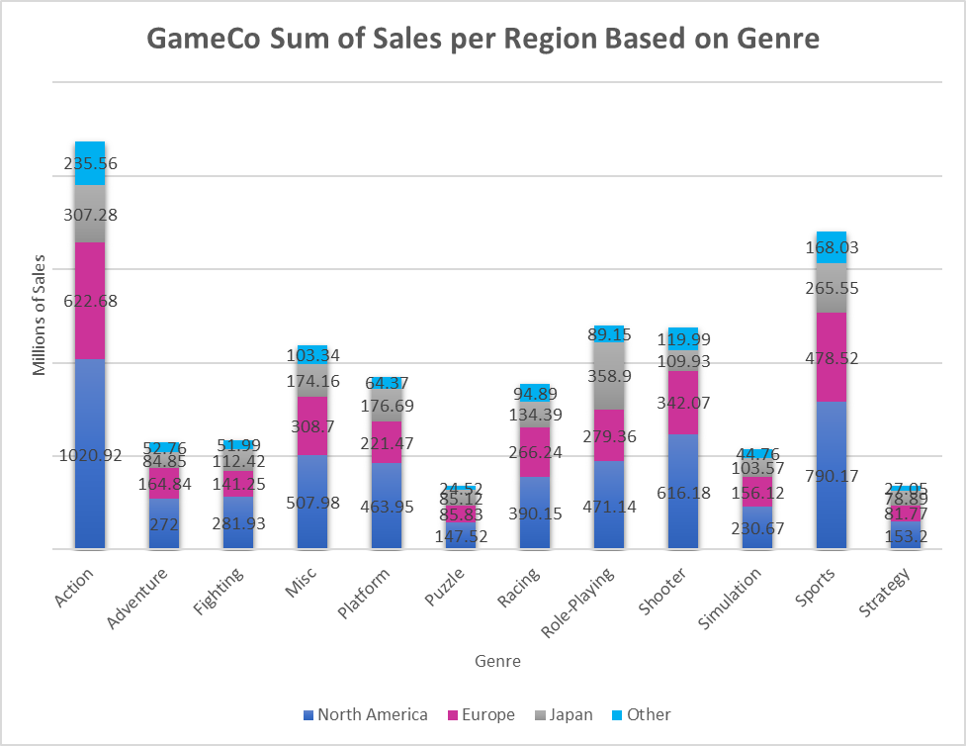
genre popularity by geographic region:
Europe:
Most popular: Action and Sports
Least popular: Puzzle and Strategy
Japan:
Most popular: Role Playing and Action
Least popular: Puzzle and Strategy
North America:
Most popular: Action and Sports
Least Popular: Puzzle and Strategy
Action is performing the best across most of the regions
Strategy and Puzzle games are the lowest selling genres across all regions

Slide 6
Conclusion and recommendations:
Based on the data, GameCo’s assumption that the sales in the geographic regions have remained the same throughout the years was not accurate
I would recommend we split the budget:
North America: 38%
Europe: 40%
Japan: 22%
North America has had the highest sales of video games over the years, but all the regions have a similar sales pattern
Europe surpasses North America in 2016 in the of proportion of sales
My recommendations take the historical data into consideration as well as the data from 2016.
Because historically North America has done so well with sales, I bumped up the percentage of the budget for North America and slightly reduced the budget for Europe.
I kept Europe’s budget slightly higher than North America, because based on the data, the trend seems to be steadily increasing in recent years, whereas North America’s sales are declining slightly, even though they remain high.

Slide 7
Additional information:
My additional recommendations for GameCo’s 2017 marketing strategy:
The genre that seems to being doing the best in sales overall is the Action genre, followed by Sports
The genre that seems to being doing the worst in sales overall is the Strategy genre followed by Puzzles
Look at the sales of each genre per geographic region and see which ones are the highest and which are the lowest.
To determine why that might be, we could investigate the pop culture of those geographic regions. Things to look at to gain insight into the pop culture could be movies, TV shows, music, podcasts, and social media.
Examining these attributes further may provide insight into why certain genres are performing better than others.
GameCo could work on a marketing strategy to incorporate the things that are popular and work on developing advertising on popular media sources and targeting them to appeal most to people in that region.

Slide 8

Thank you for your attention!
Questions?

