Slide 1
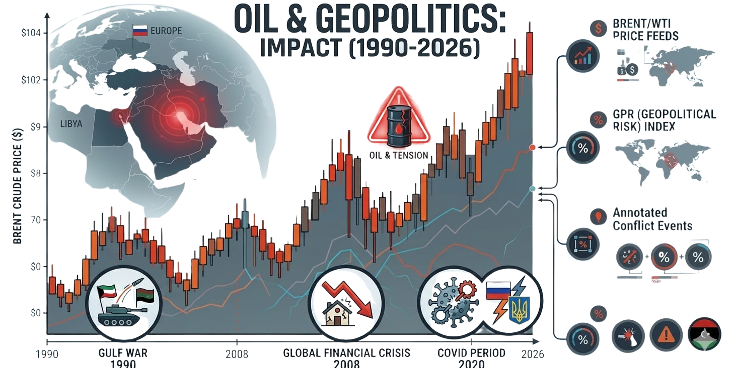
ECONOMETRIC ANALYSIS

Slide 2



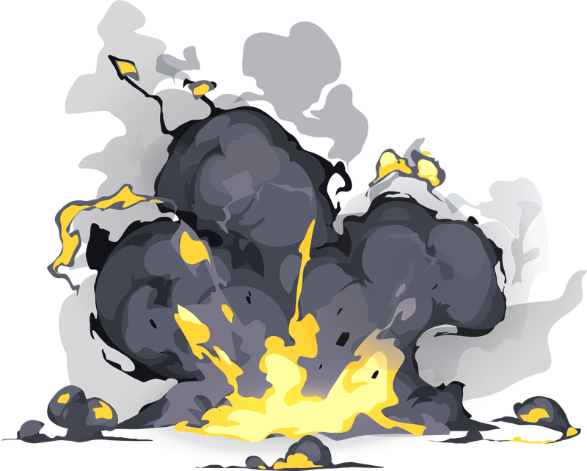


EVENT TIMELINE
1990 - 1991
2007 - 2008
2019 - 2021
Ongoing
Ongoing
Global financial Crisis
Covid 19
Russia - Ukriane War
Iran - Israel USA WAR
Gulf War
1
Our entrepreneurial story begins with a creative idea from three tech entrepreneurs.
2
Stage where we focus on a process of analysis, study of the market and the target audience.
3
Team building and training phase, brainstorming, company objectives, and roadmap.
4
Launch of the first local technology project dedicated to universities and educational centers.
5
Development of a digital solution focused on enhancing creativity in children.

Slide 3


ECONOMETRIC WORKFLOW
Data Preparation
Descriptive Statistics
Correlation Analysis
Stationarity
Test
Structural Break Test
Handle missing values
Create log returns
Create event dummies
Pearson correlation
matrix of all variables
ADF
Phillips-Perron
KPSS
Bai–Perron
(multiple breakpoints)
Time series plots
ARCH Effect
Test
Autocorrelation Test
Heteroskedasticity Test
Multicollinearity Test
OLS Regression
For volatility clustering
ARCH LM test
Durbin–Watson (DW)
Breusch–Godfrey test
(BG)
White test
Breusch–Pagan test
Use robust std. errors
VIF
(Variance Inflation Factor)
Model Comparision GJR-GARCH & EGARCH
GARCH(1,1) Residual Diagnostics
VAR Model (Dynamic Interaction)
Impulse Response Function (IRF)
GARCH Model
Model time-varying volatility
GARCH(1,1) with Ljung
Box
GARCH(1,1) with Ljung
Box
Joint modeling of variables
Shock analysis in GPR & Oil prices

Slide 4
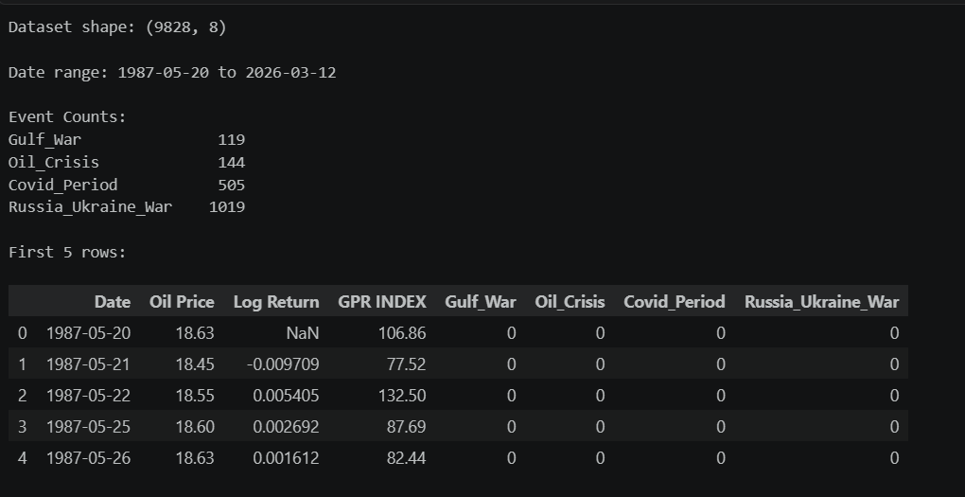
DATA INFO & EVENT DUMMIES

Slide 5
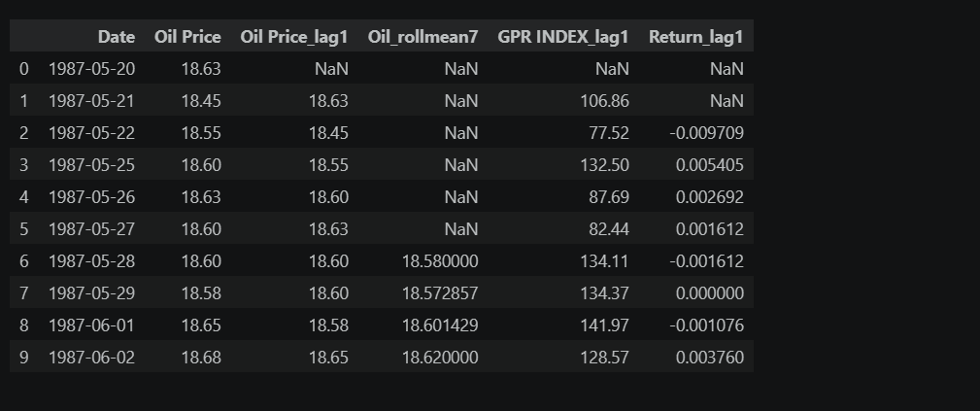
FEATURE ENGINEERING

Slide 6
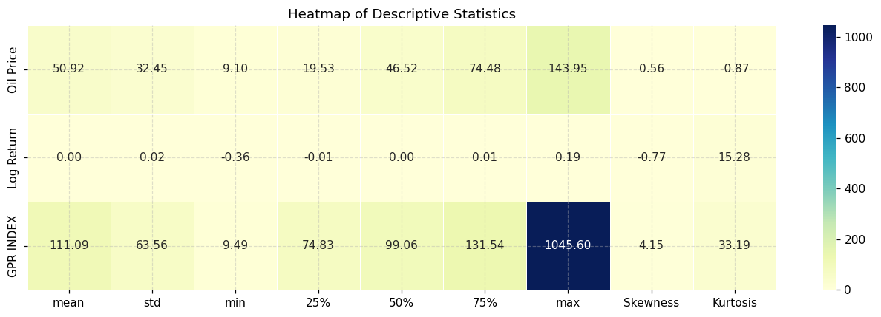
DESCRIPTIVE STATISTICS

Slide 7
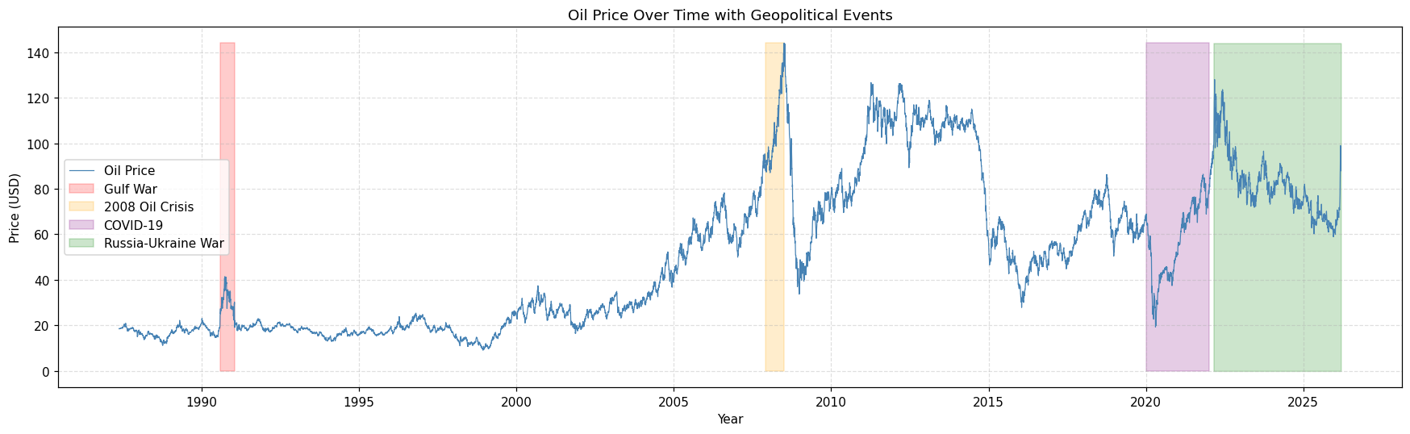
OIL PRICE OVER TIME WITH GEOPOLITICAL EVENTS

Slide 8
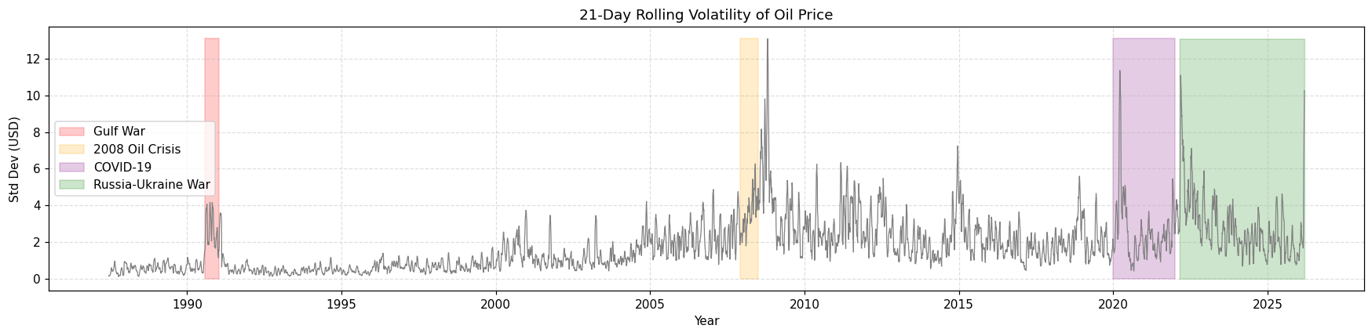
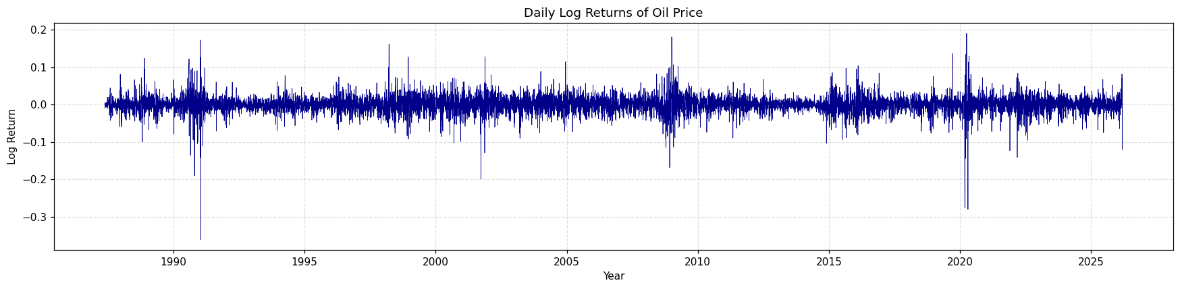
ROLLING VOLATILITY & LOG RETURNS TREND

Slide 9
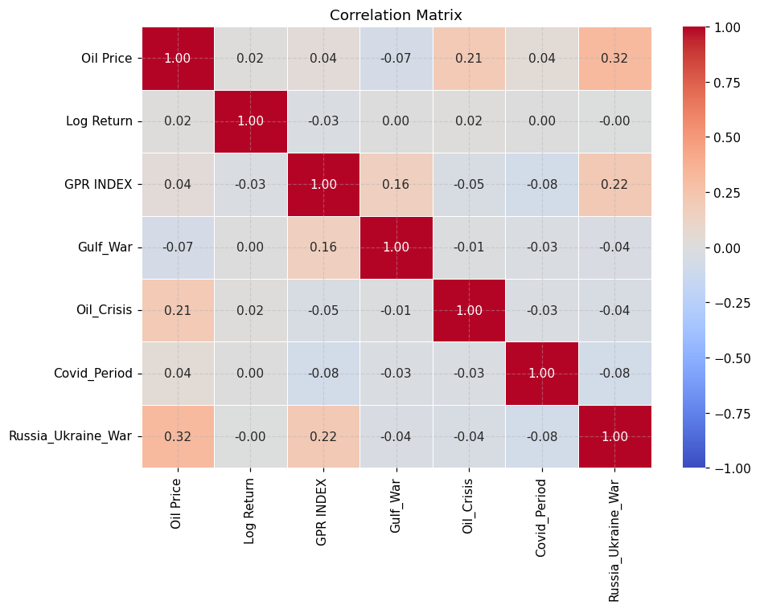

Slide 10
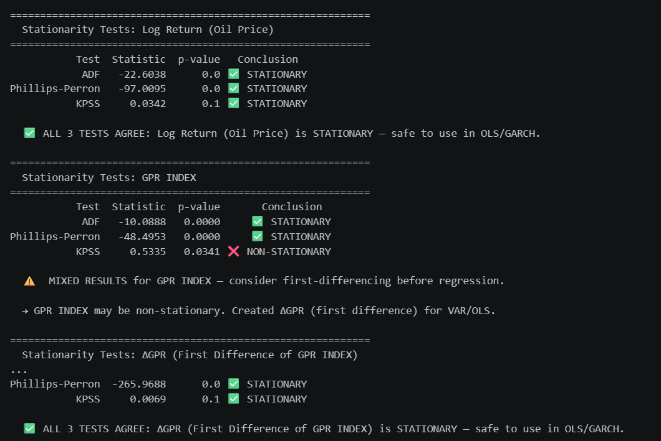
STATIONARITY TESTS

Slide 11
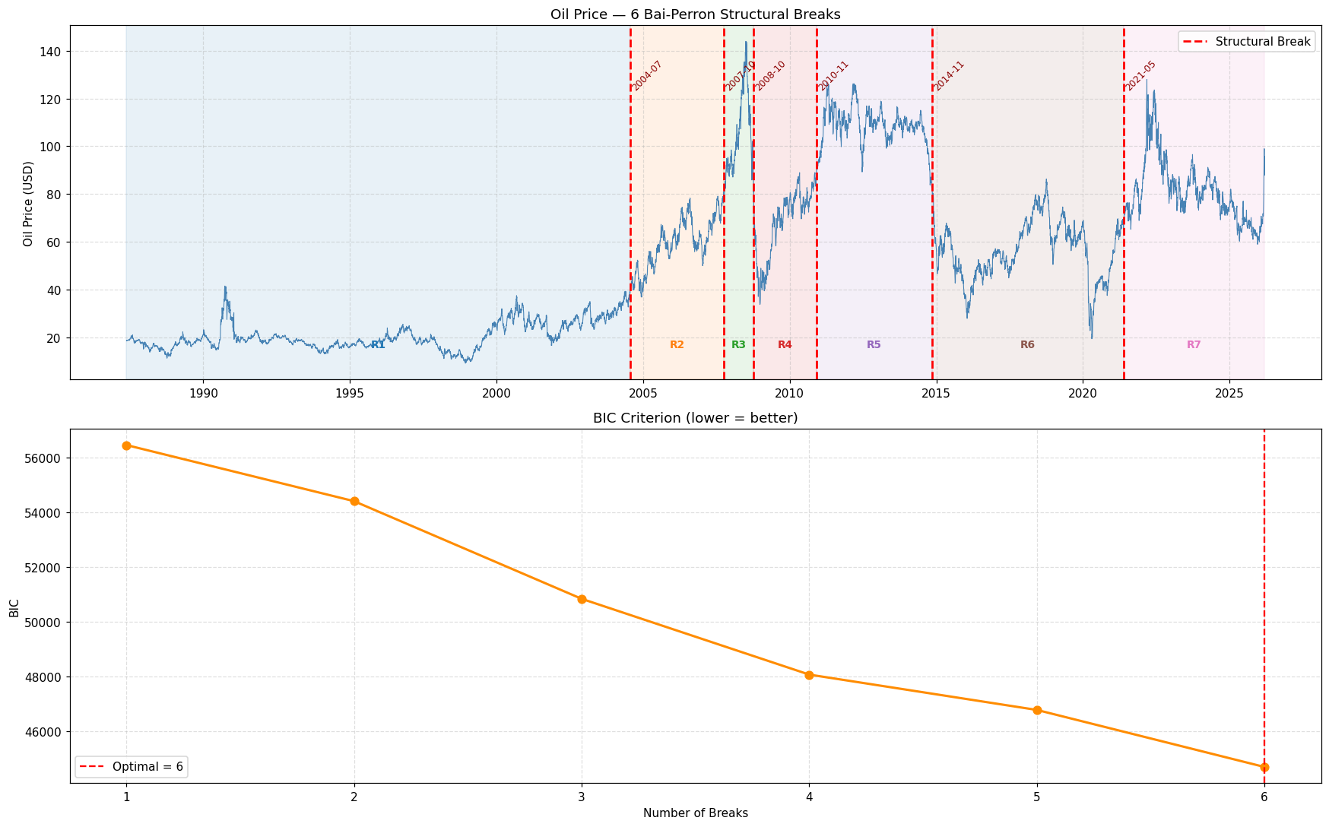
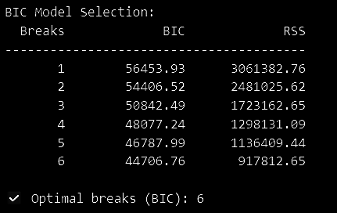
BAI-PERRON MULTIPLE STRUCTURAL BREAK TEST

Slide 12
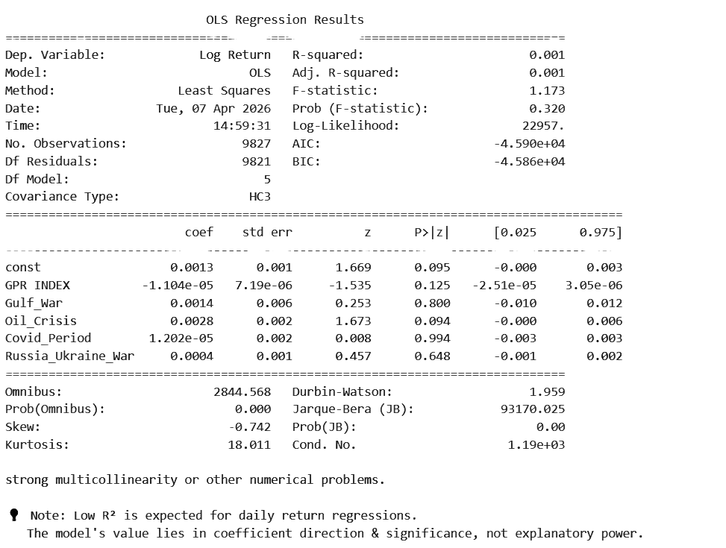
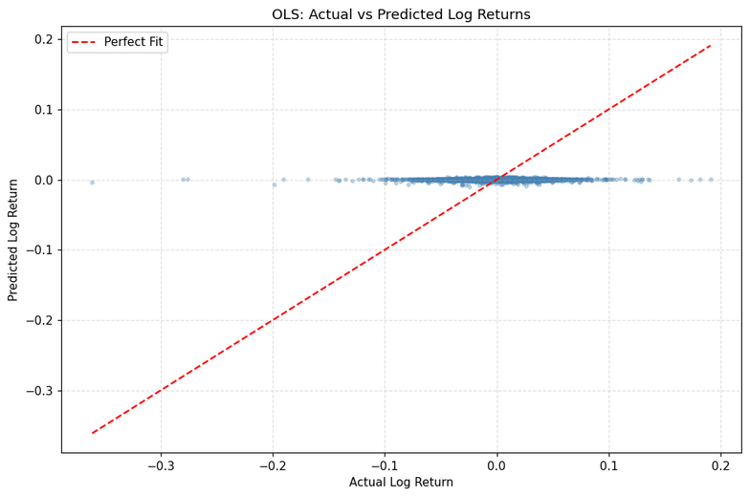
OLS REGRESSION

Slide 13
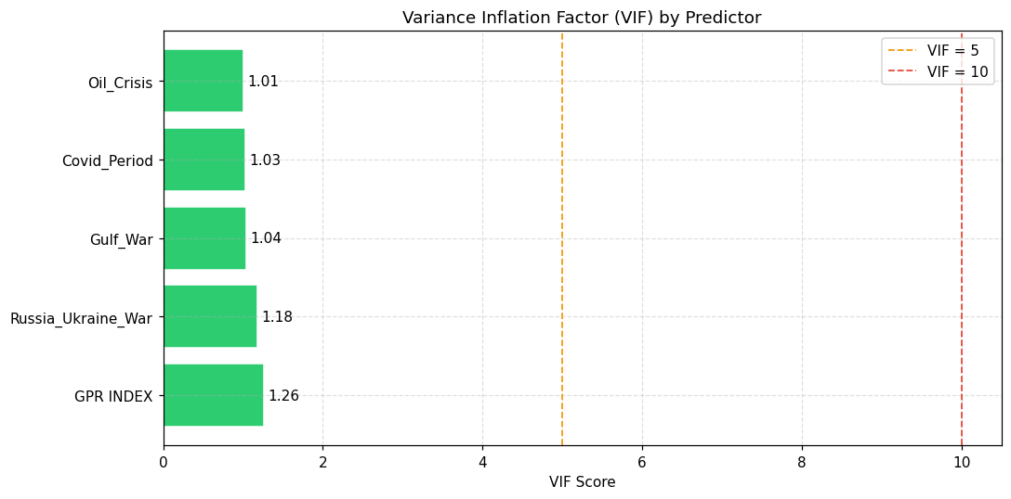
MULTICOLLINEARITY TEST (VIF)

Slide 14
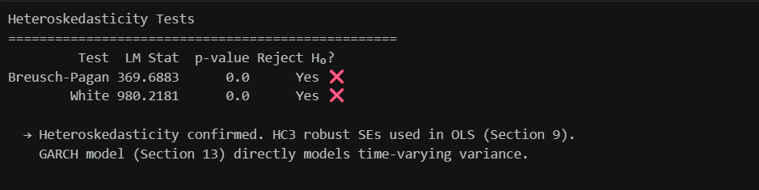
HETEROSKEDASTICITY TEST

Slide 15
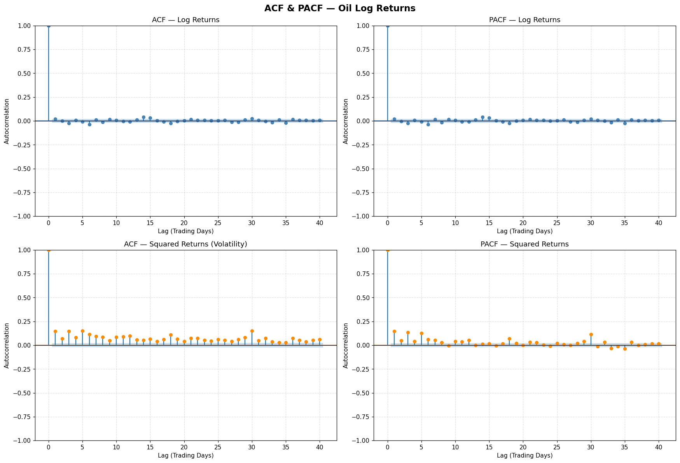
ACF & PACF
LOG RETURNS & SQUARE RETURNS

Slide 16
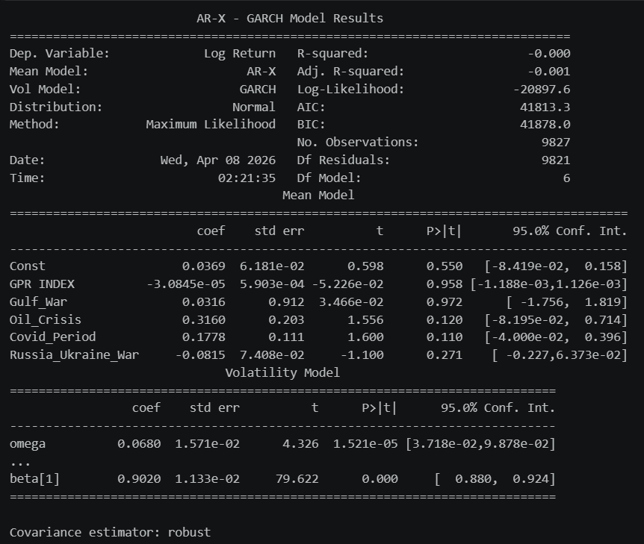
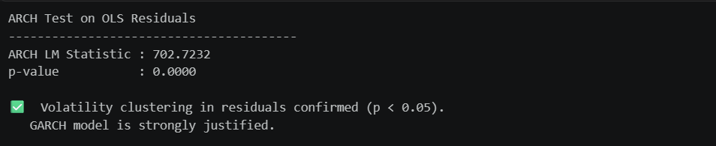
ARCH & GARCH RESULTS

Slide 17
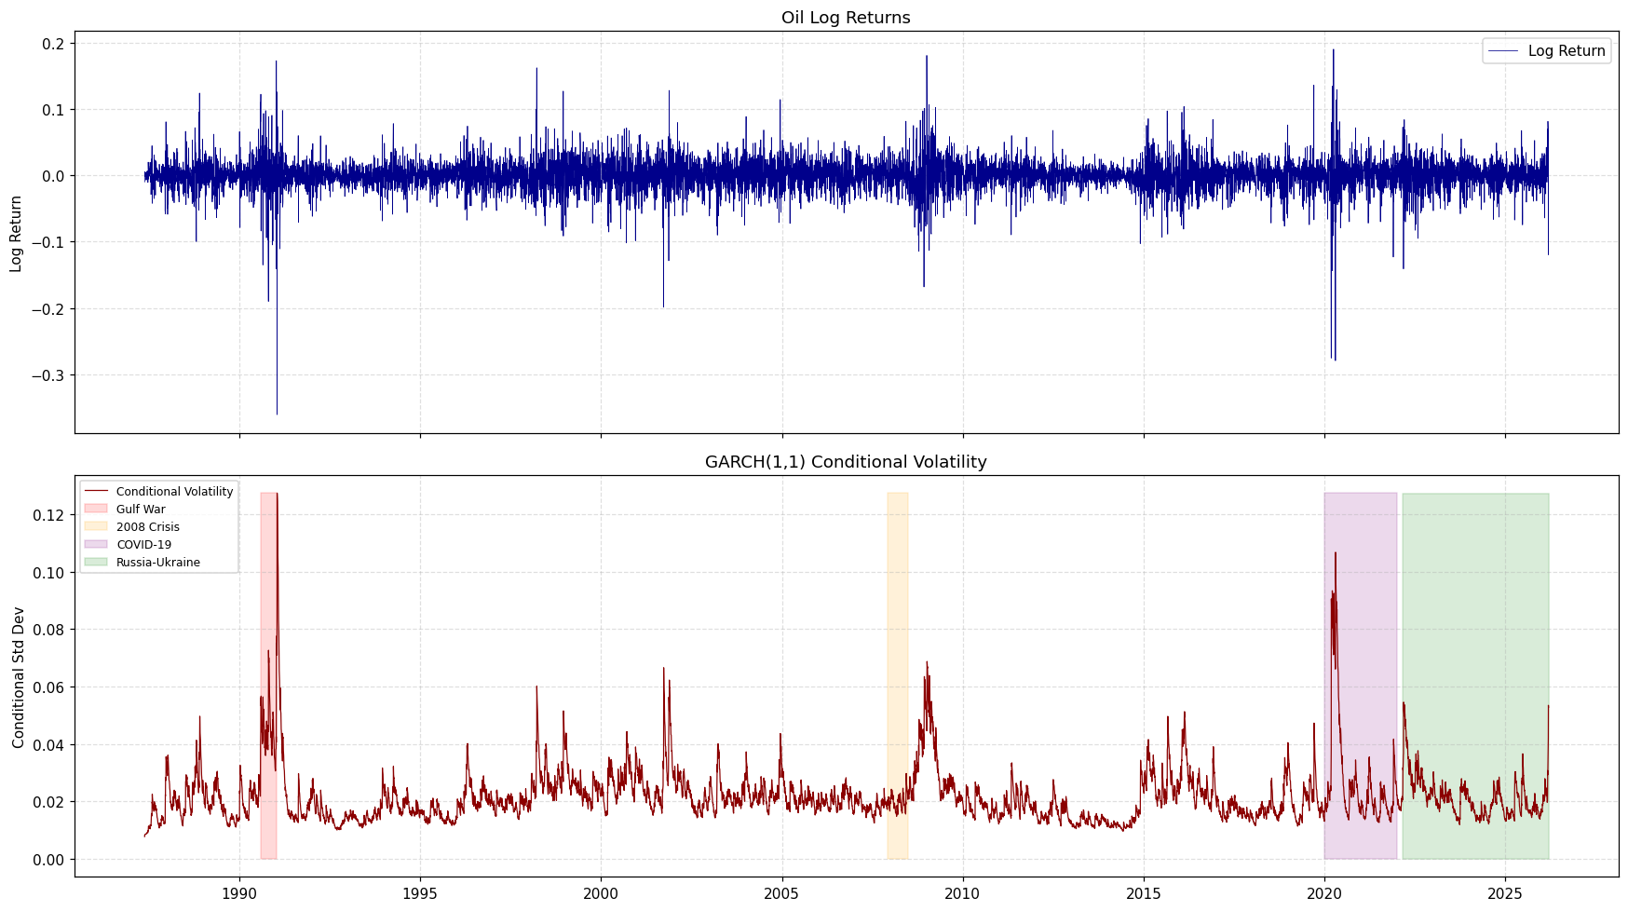

Slide 18
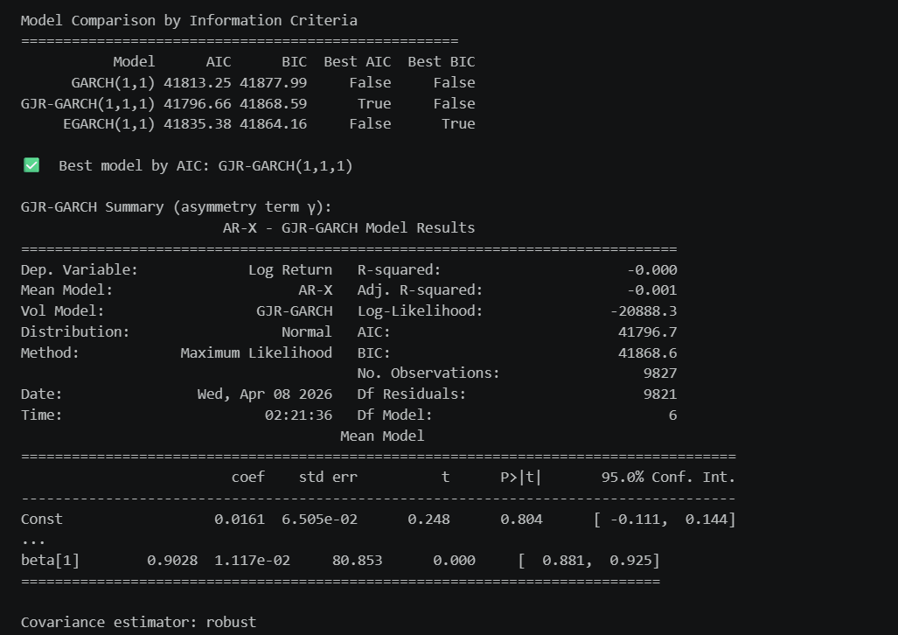
GARCH VS GJR-GARCH VS EGARCH COMPARISON

Slide 19
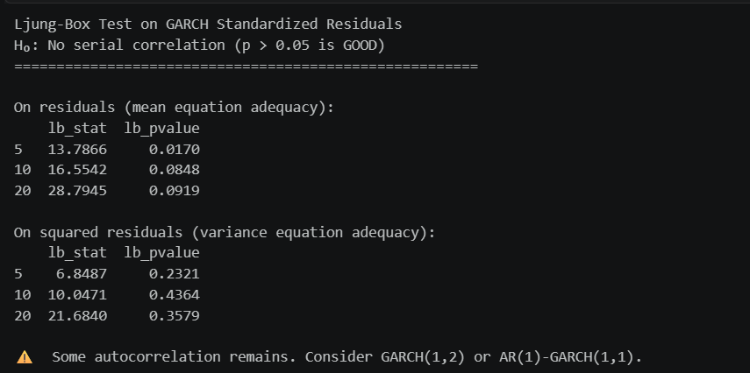
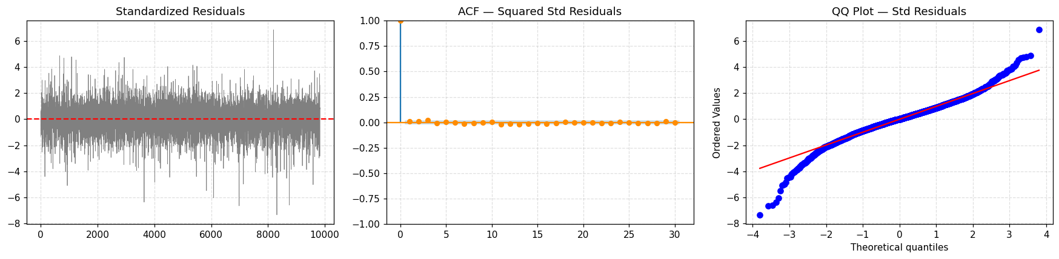
GARCH(1,1) RESIDUAL DIAGNOSTICS

Slide 20
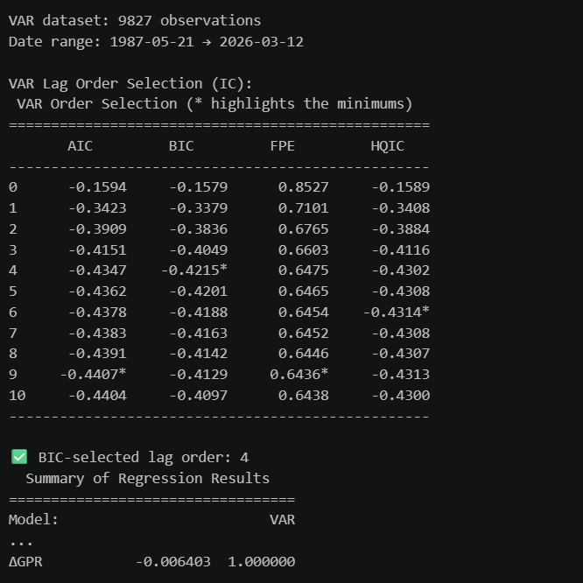
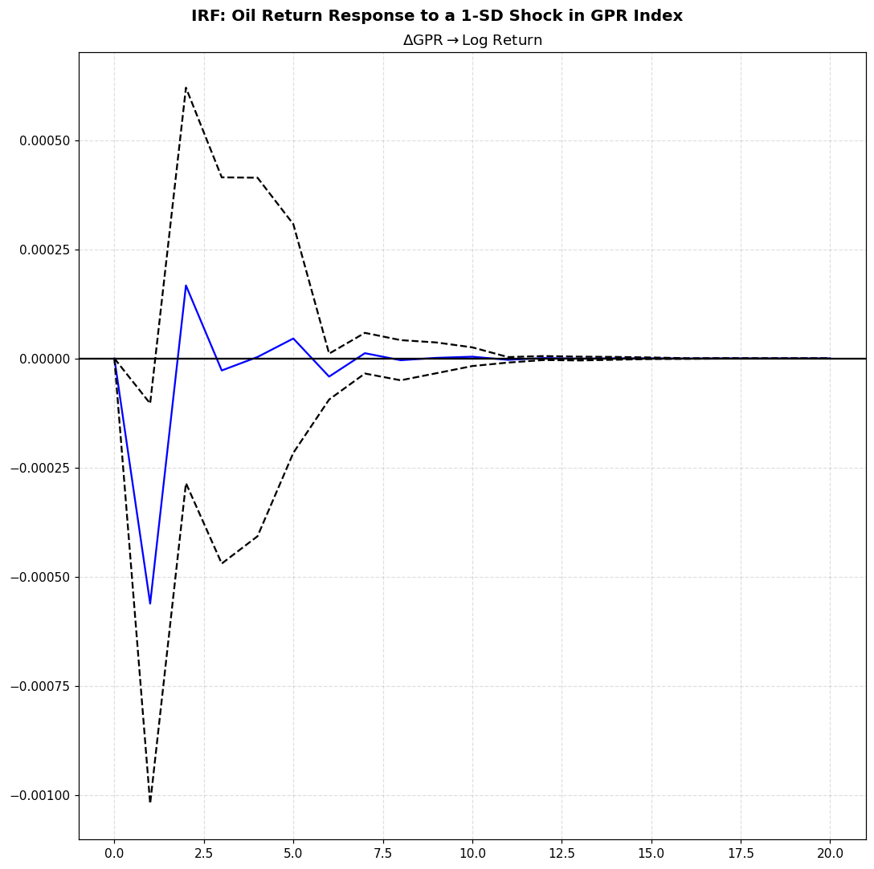
VAR MODEL + IRF

