Slide 1

Analyzing Used Car Listings on eBay Kleinanzeigen
This presentation will explore a dataset of used car listings from eBay Kleinanzeigen, a classifieds section of the German eBay website. We will analyze the data to gain insights into the used car market in Germany.
SB
by Siya Beniwal

Slide 2
Data Overview
Data Source
Data Dictionary
The dataset was originally scraped and uploaded to Kaggle. We are working with a sample of 50,000 data points prepared by Dataquest.
The dataset includes 20 columns, such as dateCrawled, name, seller, offerType, price, abtest, vehicleType, yearOfRegistration, gearbox, powerPS, model, odometer, monthOfRegistration, fuelType, brand, notRepairedDamage, dateCreated, nrOfPictures, postalCode, and lastSeen.

Slide 3
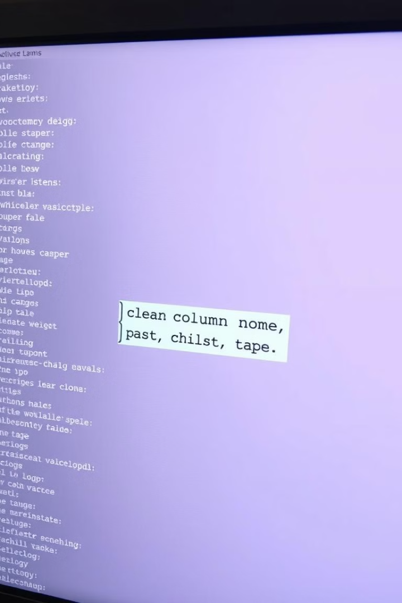
Data Cleaning
1
Column Names
2
Dropping Unnecessary Columns
We will change the column names from camelcase to snakecase and update some wordings for clarity.
We will drop columns like num_photos, seller, and offer_type, as they contain mostly one value.
3
Cleaning Numeric Columns
We will clean and convert the price and odometer columns, which are numeric values stored as text.

Slide 4
Exploring Odometer and Price
Odometer
Price
The odometer values are rounded, suggesting pre-set options. There are more high mileage vehicles than low mileage vehicles.
Prices seem rounded, with a wide range of values. There are 1,421 cars listed with $0 price, and a few listings with very high values.

Slide 5

Cleaning Price Data
We will remove listings with prices above $350,000, as they seem unrealistic. We will also keep listings with $1 price, as they could be legitimate opening bids on an auction site.

Slide 6

Exploring Date Columns
date_crawled
ad_created
The site was crawled daily over a one month period in March and April 2016.
Most ad created dates fall within 1-2 months of the listing date, but a few are quite old.
1
2
3
last_seen
The crawler recorded the date it last saw any listing, allowing us to determine when a listing was removed.

Slide 7
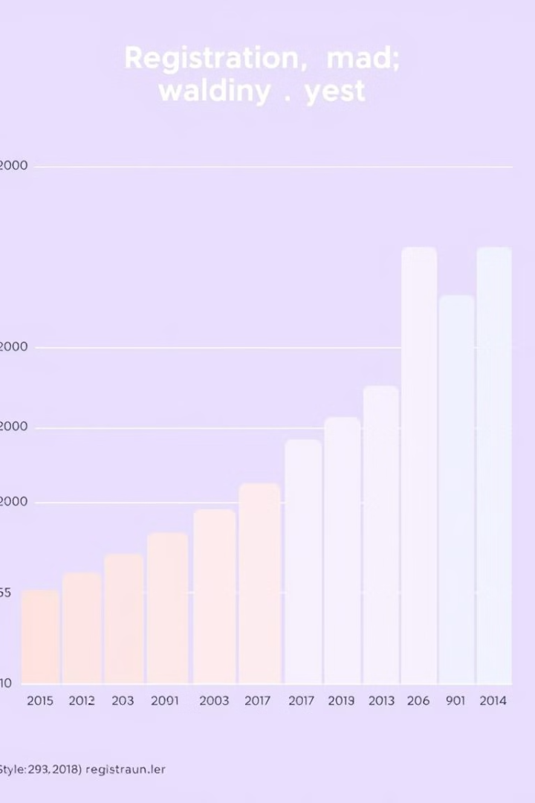
Dealing with Incorrect Registration Year Data
The yearOfRegistration column contains some odd values, including years before cars were invented and years in the future. We will remove listings with registration years above 2016, as a car cannot be registered after it was last seen.

Slide 8



Exploring Price by Brand
Volkswagen
1
Most popular brand, with approximately double the cars for sale of the next two brands combined.
Audi, BMW, Mercedes Benz
2
More expensive brands.
Ford, Opel
3
Less expensive brands.

Slide 9
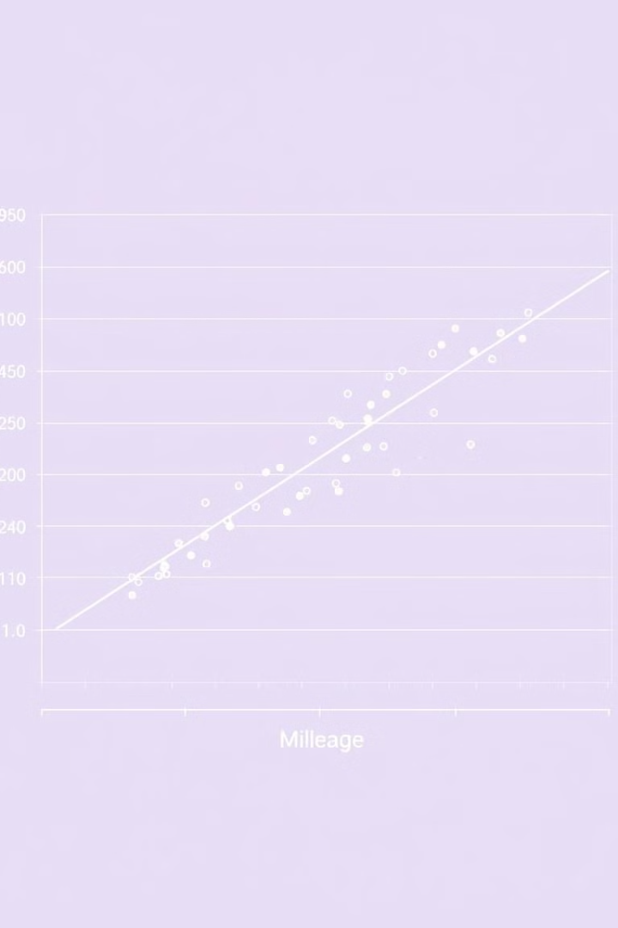
Exploring Mileage
The range of car mileages does not vary as much as the prices do by brand. There is a slight trend to the more expensive vehicles having higher mileage, with the less expensive vehicles having lower mileage.

Slide 10
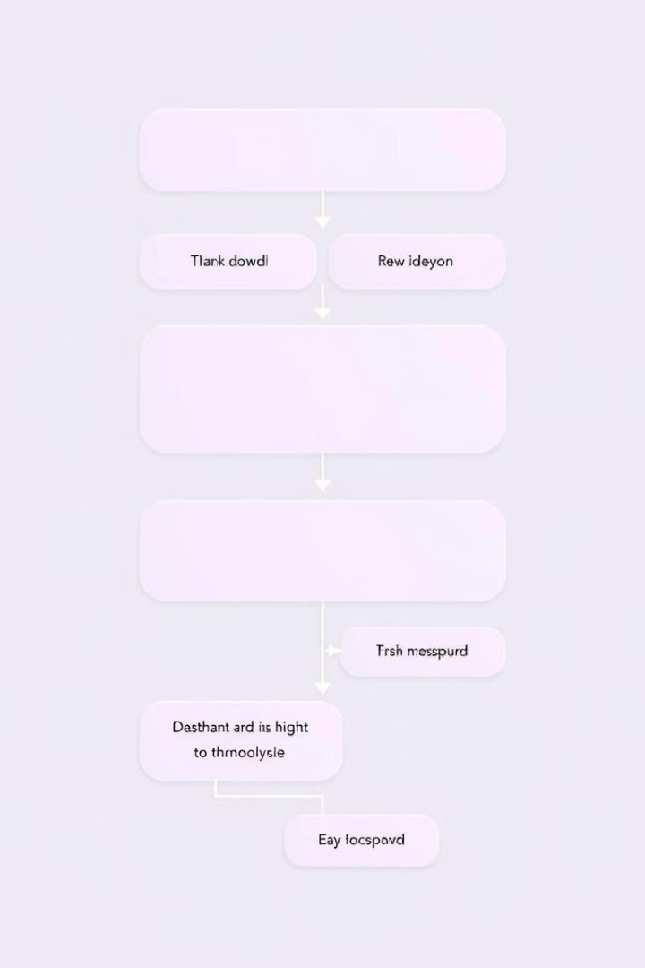
Next Steps
Further Data Cleaning
Feature Engineering
We will create new features from existing data, such as age of the car and price per kilometer.
We will continue to clean the data, addressing any remaining inconsistencies or errors.
Model Building
We will build predictive models to analyze the relationship between car features and price.

Slide 11
Conclusion
Price Trends
Popular Models
Regional Variations
Used car prices have been steadily increasing in recent years. This trend is likely driven by factors such as supply chain disruptions and rising demand.
Certain models are more popular than others, with some experiencing higher demand than others. The data can be used to identify the most sought-after cars and their pricing trends.
There are significant regional variations in car prices. Understanding these variations can be helpful for identifying potential opportunities or challenges.

Slide 12
Thank You
Do you have any Questions?

