Slide 1
Process Analyst Internship Recap – Summer 2023
Ben Jupina
University of Pittsburgh class of ‘25
Computer Science Major
Civil Engineering Minor

Slide 2
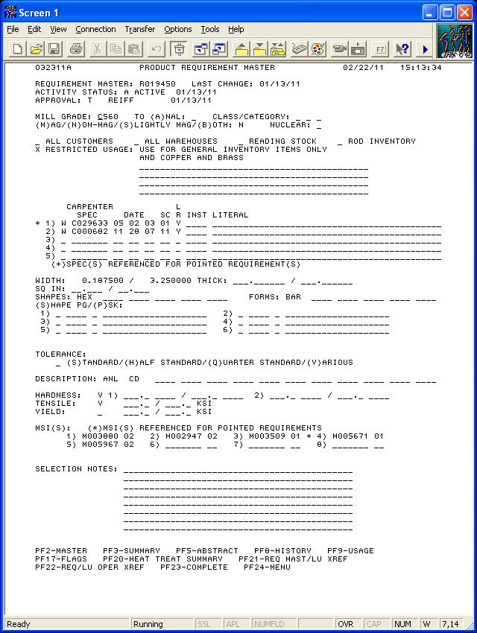
What is the Process Analyst Department?
Process Planning Department
Turns a Purchase Order (P.O.) Into a sequence of mill steps (Lineup)
Review requirements from purchase order
Continues to work with order while in production
Orders are stored in a backlog until completion
Analysis of the backlog is important for the dept. to run smoothly

Slide 3
Projects
Standard Operating Procedures
Review & upkeep of existing SOPs
Creation of new SOPs
Data automation using ThoughtSpot
Learning how to use a new software
Automating backlog analysis

Slide 4
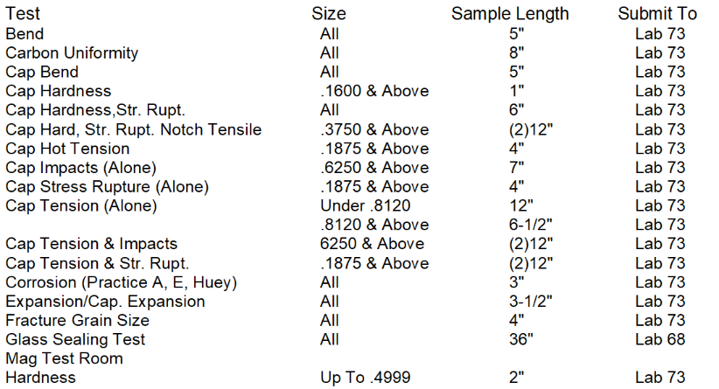
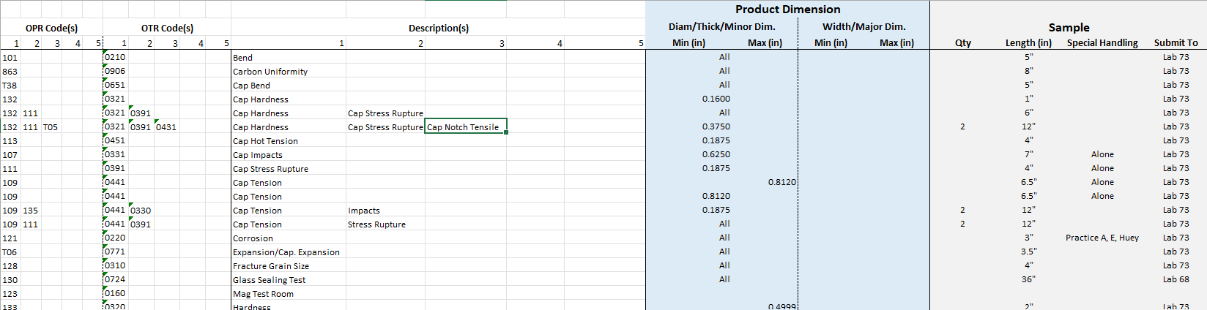
SOP Migration – Review & Upkeep
SOPs are currently stored in Lotus Notes, but are being moved to Cornerstone
Remove content that is no longer relevant; add content for new technologies (SAP, TIQ, etc.)
Reformat documents for future ease of use
Create new SOP document for migration to Cornerstone

Slide 5
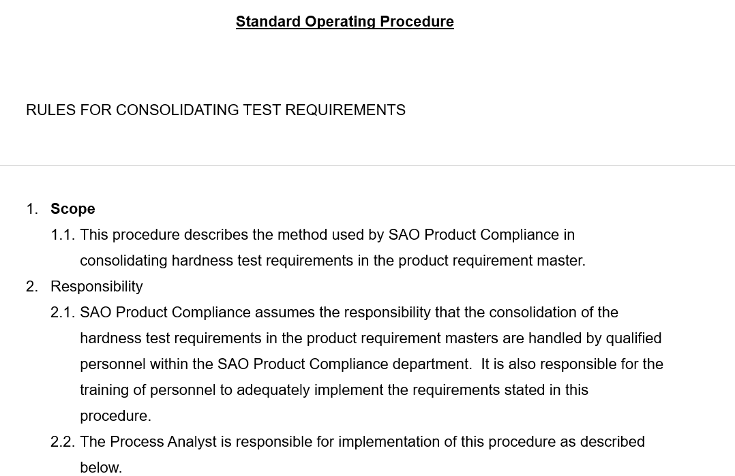
SOP Migration – Creation
Worked with current PAs to begin a new, extensive testing SOP in both Latrobe & Reading
Used existing documents & presentations to create a draft
Reviewed draft with current PAs
Created with the intent to add more in the future; living document

Slide 6
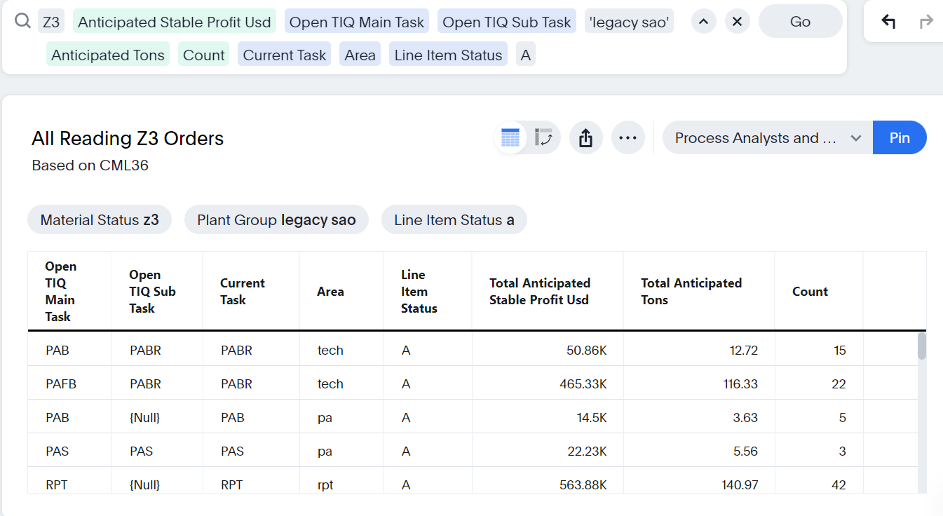
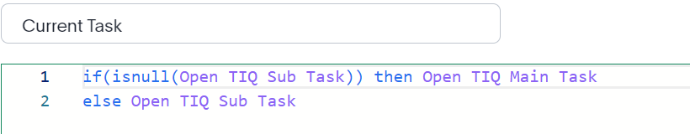
ThoughtSpot
Data analysis software
Created charts and tables that analyze the backlog for types of orders in backlogs, and who it is assigned to
Charts are currently made by hand in Excel, but are now automated using ThoughtSpot
Use simple query statements to organize data

Slide 7
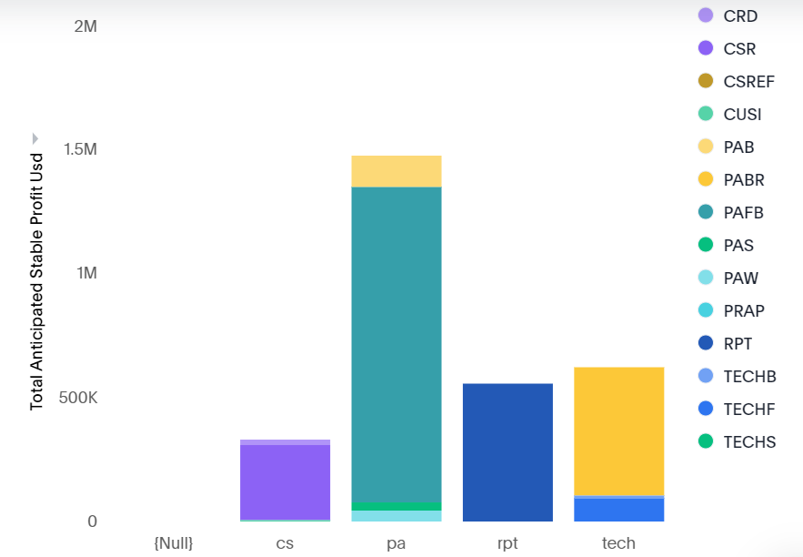
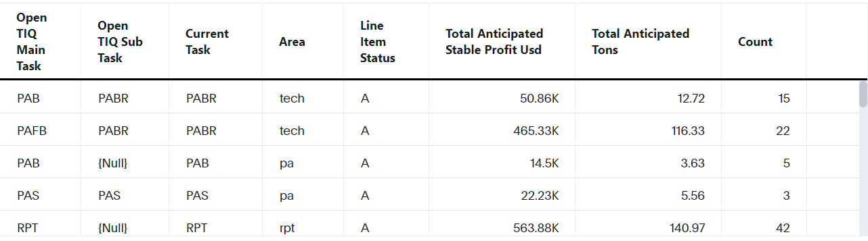
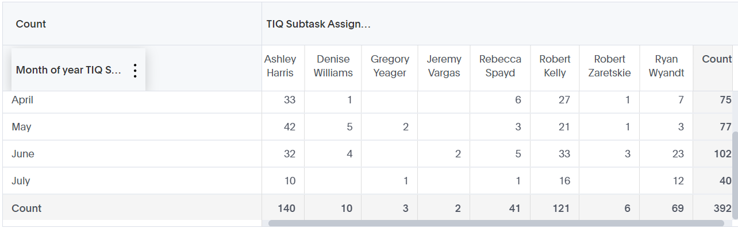
ThoughtSpot Examples

Slide 8
Overview
Main Challenges
ThoughtSpot is a very new software and has little documentation.
Fun challenge to learn.
Process Analysts must know the ins and outs of metallurgy, manufacturing, and how Carpenter operates.
Main Takeaways
Communication is the biggest key to success.
I now have experience using actual databases to create useful analysis.
Soft skills are equally as important as technical skills.

Slide 9
Questions?
benj210003@gmail.com
484-379-7566
Benjamin Jupina | LinkedIn

