Slide 1
Natural Feature Tracking for Augmented Reality
Benjamin Flueck & Hongyi Liu

Slide 2
Index
Introduction
Method Overview
Feature Detection
KLT Tracker
Homography
Results & Short Demo

Slide 3

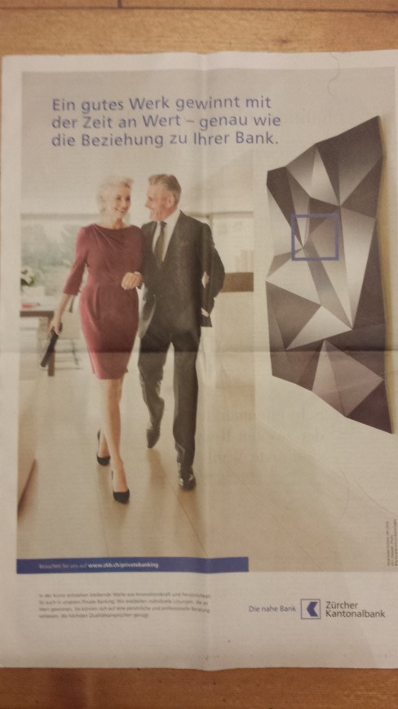
Introduction
Goal: Augmented Reality Application without markers or predefined patterns.

Slide 4
Method Overview
New Frame
Initialization:
Capture image of desired object
Extract initial features from this image
Feature Detection
KLT Tracker
Feature Extraction
Feature Matching
Initial Features
Homography Estimation
Visualization

Slide 5
Method Overview
New Frame
Tracking:
Two complementary approaches:
Full fledged feature detection & extraction
KLT tracker
Feature Detection
KLT Tracker
Feature Extraction
Feature Matching
Initial Features
Homography Estimation
Visualization

Slide 6
Method Overview
New Frame
Augmented Reality
Calculate a homography between the initial image and subsequent camera frames
Use this homography for the visualization
Here: overlay the original image onto its current positon
Feature Detection
KLT Tracker
Feature Extraction
Feature Matching
Initial Features
Homography Estimation
Visualization

Slide 7
Feature Detection
ORB feature detector
250 features per frame
FLANN matcher
Detect+extract+matching=126ms

Slide 8
KLT Tracker
Tracks image patches between frames
Needs initial set of points
Good for small changes
Suffers from drift in zooming and rotational motions
~80 ms processing time
Dependant on number of features
Needs to be balanced with accuracy

Slide 9

Homography
Map two sets of point in different planes.
Based on OpenCV function findHomography()

Slide 10

Results
Simple augmented reality app
Overlay initial image on current frame
~10 fps when tracking works

Slide 11
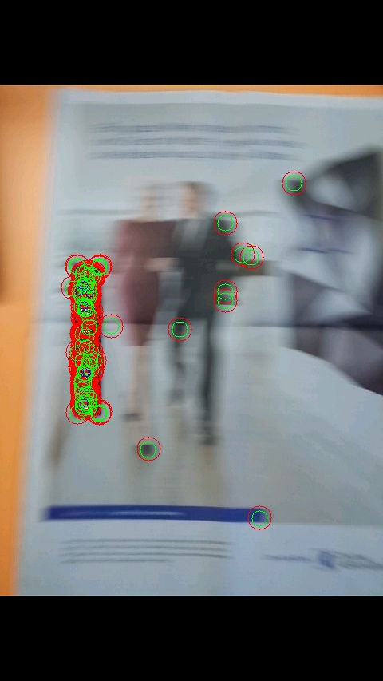
Results – Failure Cases
Blurred frames
Scaling
Target is too large/small in current frame

Slide 12
Demo

Slide 13
Questions and the End

