Slide 1

Real-World .NET in the Enterprise
What Changes When Your Codebase
Has 10 Years of History
Ben Hooper · Clear Measure
TechBash · 2026
01

Slide 2

The architecture diagram we all drew.
Controller
Service
Repository
SQL Server
Clean layers. Dependencies point one way. Every class has one reason to change and a test that proves it.
It is in every conference talk, every project template, every sample repo on GitHub.
It is also not the codebase most of us will open on Monday.
02

Slide 3
Same diagram. Year ten.
the controller calls the procedure directly (2013: "it was faster")
Controller
Service
Repository
SQL Server
+ the business logic
Common (everything)
Portal and/or magic tool no one talks about
edits production data by hand
Nobody did anything wrong.
Every shortcut had a deadline behind it and a reason in a commit message nobody reads.
It just accreted.
03

Slide 4
Nobody wrote a legacy system.
individually reasonable
collectively a legacy system
2011
2013
2014
2016
2017
2019
2023
2026
one project,
.NET 3.5
"Common"
is born
rules move into
procs "for speed"
weekend rule,
hard-coded
port to 4.8,
no tests added
"temporary"
30-day month
port to .NET,
AppSettings shim
you arrive
So the question is not "how do we rewrite it?"
It is: how do we make change safe again, one piece at a time, while the business keeps billing customers on it every night? Every technique in the rest of this talk works without stopping the world.
04

Slide 5
Five patterns. You will find all of them in week one.
PATTERN
WHAT IT LOOKS LIKE
DEMO
1
The gravity-well hub
Common / Business / Utils, referenced by most projects. Every change ripples.
demo 1
2
Logic in stored procedures
IF and CASE on money, data types that round, called from three places.
demo 3
3
The god class
700-5,700 lines, 30+ constructor parameters, "DO NOT REFACTOR".
demo 2
4
No seams
DateTime.Now, Db.Open(), AppSettings.Get(...), .Instance, new BillingManager().
demo 2
5
Compile-time forks
#if PARALLEL, #if LEGACY_TAX: two programs in one tree, one of them tested.
demo 1
None of these are bugs. All of them are reasons nobody is allowed to touch the code.
05

Slide 6
DI does not fix a god class. It makes it legible.
public AccountAdjustmentOrchestrator(
IAppSettings appSettings,
IBlobService blobService,
IRepository<Invoice> invoices,
IRepository<LedgerEntry> ledger,
ILockService locks,
IInvoiceService invoiceService,
Lazy<IPaymentStrategyFactory> strategies,
IAllocationService allocation,
ICurrencyService currency,
// ... 24 more ...
ILogger logger) : base(...)
The container can build it
It resolves in four milliseconds. No human can hold it in their head.
Constructor parameter count is a free metric
Past about seven, the class is several classes sharing a name.
Split by verb, not by layer
Group the parameters by the public methods that use them. Each cluster is a class trying to get out.
The container moved the coupling from "new" to the constructor. That is progress: now you can see it.
06

Slide 7
Legacy code is not old code.
It is code nobody is allowed to change.
Rewrites fail for a boring reason: the old system keeps changing while you rebuild it, and the new one has to match behavior nobody wrote down. So the goal is not a new codebase. It is getting back the ability to change this one, safely, a piece at a time, while it keeps running.
Everything after this is one of three moves: map it, seam it, strangle it. Plus the fourth one nobody talks about: leave it alone.
07

Slide 8
Map it in days, not a quarter.
1
What depends on what, and what is the blast radius?
files you have
ProjectReference in every .csproj · transitive dependents
2
What is too big to hold in your head?
files you have
lines · public methods · constructor parameters
3
How much of the logic is not in C# at all?
files you have
procedures with IF / CASE / WHILE · who calls them
4
Where does change actually happen?
history you have
git log, last 12 months · churn x size
5
What does nobody know?
ask people
incidents · roadmap · usage · what people are scared of
The first four take an afternoon. The fifth takes a week of conversations, and it is the part that decides everything else.
08

Slide 9
Hotspots: where change meets complexity.
START HERE
SEAM FIRST
# churn, last 12 months (PowerShell)
git log --since="12 months ago" `
--format="" --name-only |
Where-Object { $_ } |
Group-Object |
Sort-Object Count -Descending |
Select-Object -First 20 Count, Name
Changes every sprint, small, often already has seams. Cheap, visible wins.
The hotspot. Do not rewrite it. Cut one seam at the edge, pin it, move a method at a time.
MeterReadImporter 38 commits
BillingManager 61 commits, 700 ln
change frequency ↑
IGNORE
LEAVE ALONE
Small and stable. Not your problem this year.
Ugly and stable. Put a fence around it and spend the money elsewhere.
Multiply by lines of code. The top ten files are where your first month goes. Adam Tornhill calls this "your code as a crime scene"; it is the best cheap signal there is.
ReportGenerator 2 commits, 800 ln
size / complexity →
09

Slide 10
LIVE DEMO 1
Map the project
PS> .\demo.ps1 demo1
PS> .\demo.ps1 demo1-real
10

Slide 11
A seam: change behavior without editing that place.
SEAM
WHAT IT REPLACES
COST
Constructor parameter
the default choice
one new overload; old one chains to production
"To me, legacy code is simply code without tests."
TimeProvider
the clock
in the BCL since .NET 8; FakeTimeProvider for tests
Plain values / IOptions<T>
configuration
read once at the edge, pass the value in
Michael Feathers
Working Effectively with Legacy Code, 2004
Func<T> / a delegate
a single call
the smallest seam there is
Still the best book on this subject. Every technique in the next ten minutes has a chapter in it.
Extract and Override
virtual method + test subclass
when you cannot touch the constructor yet
#if / preprocessor
the seam you already have
and the one to remove first
11

Slide 12
Parameterize Constructor: zero call sites change.
BEFORE: THE ONLY WAY IN IS A DATABASE
AFTER: A SECOND DOOR FOR TESTS
public BillingManager()
{
_db = Db.Open();
}
public decimal CalculateLateFee(int id)
{
var account = AccountRepository
.GetAccount(_db, id);
DateTime today = DateTime.Now.Date;
...
public BillingManager()
: this(new SqlBillingData(), TimeProvider.System)
{
_db = Db.Open();
}
public BillingManager(IBillingData data,
TimeProvider clock)
{ _data = data; _clock = clock; }
var account = _data.GetAccount(id);
DateTime today = _clock.GetLocalNow()
.DateTime.Date;
14 lines added, 3 changed. 16 places construct BillingManager with "new"; none of them change. The first test becomes possible.
12

Slide 13
Characterization tests: pin what it does.
Record
Replay
Compare
Decide
Where cases come from
What they assert
What they are for
A production snapshot, request logs, shadow traffic, or a spreadsheet Billing Ops already keeps. 240 real inputs beat 20 invented ones.
The recorded output, to the cent, including the parts that look like bugs. Especially those.
Making the next change safe. When real unit tests exist for the behavior, delete them without ceremony.
A characterization test has no opinion about what is right. That is the feature.
13

Slide 14
LIVE DEMO 2
The seam
PS> .\demo.ps1 demo2
PS> .\demo.ps1 demo2-break
14

Slide 15
Introducing DI into code that never had it.
1
Default constructor chains to production
Poor man's DI. Zero callers change. Tests use the other constructor.
2
Wrap the statics, do not rewrite them
TimeProvider.System, SqlBillingData over Db.Open(). Adapters around what exists.
3
One composition root, at the edge
Program.cs, Startup, Global.asax. The one place that is allowed to say "new".
4
Move "new" out one class at a time
In hotspot order, not alphabetical order, and never as its own project.
5
Container last
Once most classes take their dependencies, registering them is the easy part.
Service locator is not DI. It is a global variable with a nicer name, and it hides the thirty-four parameters instead of showing them.
15

Slide 16
The Strangler Fig: one door, then move the room.
Web
usp_ProrateFinalBill
legacy
FinalBillRouter
(the door)
Batch
Fixer
FinalBillCalculator
modern
1 Door
2 Shadow
3 Shift
4 Remove
every caller goes through the router; it only calls legacy
both run, legacy answers, every difference recorded and explained
1% → 5% → 25% → 100%, sticky per account, gated on shadow
delete the old path. The only step that lowers cost.
16

Slide 17
Pick your door.
WHAT YOU ARE STRANGLING
THE DOOR
IN .NET
HTTP endpoints / pages
a reverse proxy in front of both apps
YARP + System.Web adapters (Microsoft's incremental ASP.NET → ASP.NET Core path)
A class or method
an interface and a router class
Branch by Abstraction; a feature flag picks the implementation
A stored procedure
one repository method every caller uses
shadow compare against recorded results, then route
A batch job or consumer
a switch in the scheduler or the queue binding
run both; only one is allowed to write
A shared internal API
the compiler
[Obsolete] with a date: warnings now, errors later
The door is the whole trick. Once every caller goes through one place, replacing what is behind it is a routing decision, not a project.
17

Slide 18
Business logic in stored procedures.
dbo.usp_ProrateFinalBill (called from 3 projects, changed 19 times this year)
DECLARE @Days INT = DATEDIFF(DAY, @CycleStart, @MoveOut) + 1;
DECLARE @DailyCharge DECIMAL(10,2) = @MonthlyCharge / 30;
DECLARE @BaseCharge DECIMAL(10,2) = @DailyCharge * @Days;
DECLARE @UsageCharge DECIMAL(10,2) = @UsageKwh * @RatePerKwh;
DECLARE @Total DECIMAL(10,2) = @BaseCharge + @UsageCharge
- @DepositHeld - @Credits;
IF (@Total > 0 AND @Total < 1.00)
OR (@Total < 0 AND @Total > -1.00)
SET @Total = 0;
DECIMAL(10,2) rounds, per day
A data type is a business rule. Nobody will ever find it with grep.
/ 30, every month
The "temporary" 2019 change. February is billed as if it had 30 days.
The $1.00 write-off, both ways
2013. Refunds under a dollar quietly disappear.
legacy map counted 3 decisions in this procedure. Shadow traffic found two more, and neither one is an IF statement.
18

Slide 19
Shadow: run both, answer with the old one.
modern/Tallgrass.FinalBill/FinalBillRouter.cs
var legacyResult = legacy.Calculate(request);
if (route.Mode == RouteMode.Legacy) return legacyResult;
try
{
var modernResult = modern.Calculate(request);
if (modernResult.Total != legacyResult.Total)
onDifference(request, legacyResult, modernResult);
}
catch (Exception)
{
// shadow must never break production
}
return legacyResult;
Sticky routing
Hash the account id into a bucket 0-99. A customer never flips between engines mid-lifecycle.
Attribute every difference
To a named legacy behavior, or it is "unexplained". Unexplained is the only word that matters.
Gate the dial
The percentage cannot go up while anything is unexplained. Make the tool refuse, not the reviewer.
19

Slide 20
LIVE DEMO 3
Strangle the stored procedure
PS> .\demo.ps1 demo3
PS> .\demo.ps1 demo3-compat
20

Slide 21
Every quirk is a decision. None of them are bugs.
modern/final-bill.policy.json
{
// Decided with Billing Ops and Regulatory.
// Changing these is a tariff change,
// not a side effect of a rewrite.
"rounding": "PerDay",
"monthBasis": "Thirty",
"smallBalanceWriteOffUnder": 1.00,
"decision": "BILL-2291: keep legacy proration;
revisit with the 2027 rate case"
}
The modern code was right
It did what the tariff says. It would also have changed 926 of 1,000 final bills, and nobody would have known why.
Compatibility is a feature
Keep each quirk behind a named option. Turn it off later, on purpose, with an announcement and a date.
A rewrite is not allowed to make a business decision silently.
21

Slide 22
When to modernize, and when to leave it alone.
MODERNIZE
STRANGLE
KEEP GOING
High change, real incidents, on the roadmap.
Logic you must replace, called from many places.
Changes a lot and already has seams.
You will be in there anyway. Seam, pin, move.
Door, shadow, shift, remove.
This is what good looks like. Normal investment.
CONTAIN
LEAVE ALONE
RETIRE
The hubs. Blast radius of most of the estate.
Stable, correct, and ugly.
Unused, or a symptom of bugs elsewhere.
No new dependencies. Move things out, never in.
Fence it with a ratchet. Spend the money elsewhere.
Delete it, or make it unnecessary.
Inputs: change, pain, coupling, and use. Not on the list: how ugly it is.
22

Slide 23
Ratchets: the legacy does not get to grow.
WHAT THE COMPILER CAN SEE
WHAT IT CANNOT: COUNT IT, COMMIT THE BASELINE
// On the API you are retiring:
[Obsolete("Use IBillingData. Removal: 2027-Q1")]
public static SqlDb Open() { ... }
<!-- Directory.Build.props -->
<!-- visible, counted, not yet fatal -->
<TreatWarningsAsErrors>true</TreatWarningsAsErrors>
<WarningsNotAsErrors>CS0618</WarningsNotAsErrors>
legacy ratchet
rule baseline now
ambient-time 124 125 [FAIL]
ambient-config 109 110 [FAIL]
newed-service 20 21 [FAIL]
DelinquencyAgingReport.cs:15
var billing = new BillingManager();
You will not remove 124 DateTime.Now calls this quarter. You can make sure there is never a 125th.
23

Slide 24
LIVE DEMO 4
Triage and the ratchet
PS> .\demo.ps1 demo4
PS> .\demo.ps1 demo4-fix
24

Slide 25
Five things I would tell myself on day one.
1
The target framework upgrade is plumbing
Tools can retarget every project in a weekend. None of them will cut a seam or shrink a hub.
2
Get one characterization test green in week one
Credibility with the business comes from "we can prove it did not change", not from diagrams.
3
Put a door in front, and give the dial an owner
Before you write a line of the replacement. Without both, the new side stalls at one commit.
4
Ratchet before you refactor
Otherwise you are bailing out a boat that is still taking on water.
5
Write down what you are leaving alone, and why
Otherwise the next team "fixes" the most stable code you have.
25

Slide 26
The adoption ladder. Every rung pays first.
1
Map + signals
2
Ratchet baseline
week 1 · an afternoon of tooling, a week of conversations
week 1 · stops the bleeding
3
First seam
4
Characterization suite
week 2 · one constructor, the hottest method
week 2 · recorded from production
5
One door
6
Shadow
week 3 · in front of one proc or endpoint
month 2 · every difference attributed
7
Shift 5% → 100%
8
Delete the old path
month 3 · gated on the shadow verdict
quarter · the only rung that lowers cost
Notice what is not on the ladder: a rewrite, a new framework, or a migration project with its own budget code.
26

Slide 27
You do not modernize a codebase.
You modernize your ability to change it.
Map it before you touch it.
Seam it before you change it.
Put a door in front before you replace it.
And leave the rest alone: on purpose, in writing, behind a ratchet.
27

Slide 28
Take it home.
The demo repository
Working Effectively with Legacy Code
Michael Feathers · seams, characterization tests
github.com/benjamhooper/dotnet-legacy-demo
StranglerFigApplication
git clone <repo>
.\demo.ps1 verify
.\demo.ps1 demo1
Martin Fowler, martinfowler.com · the pattern and its history
Your Code as a Crime Scene
Adam Tornhill · hotspots from version control
Everything runs offline: no database, no cloud account, no NuGet feed. The .NET 10 SDK is the entire list of requirements. Point legacy map at your own estate/ folder on Monday.
Incremental ASP.NET to ASP.NET Core migration
Microsoft Learn · YARP + System.Web adapters
28

Slide 29

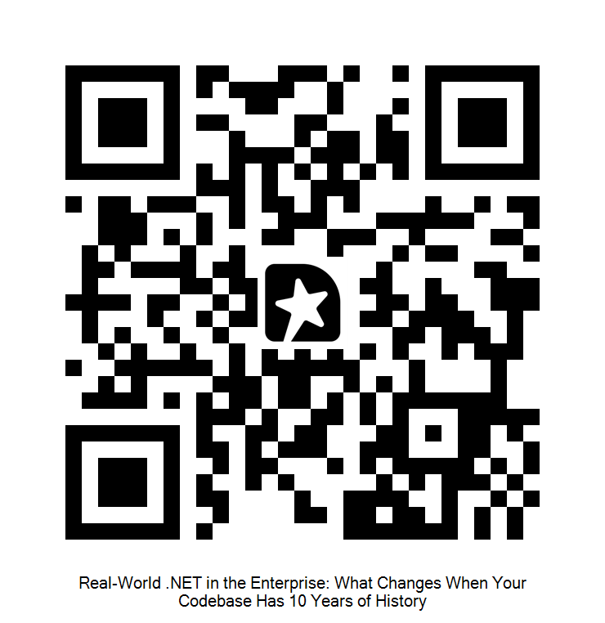
Questions
LET'S TALK
SESSION FEEDBACK
Ben Hooper
Clear Measure
ben.hooper@clear-measure.com
github.com/benjamhooper/dotnet-legacy-demo
Scan to give session feedback
29

